Slide 1
Syphilis by Stage
Total Syphilis
Primary & Secondary Syphilis
Early Syphilis
Congenital Syphilis
(Revised 02/2023)

Slide 2
Total Syphilis
(Revised 02/2023)

Slide 3
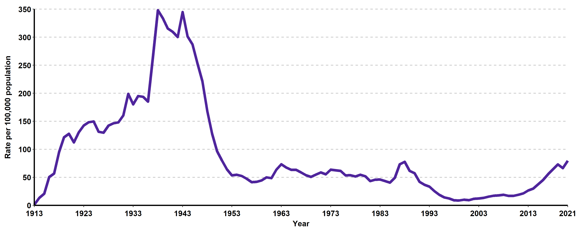
Total Syphilis (all stages), California Incidence Rates, 1913–2021

Slide 4
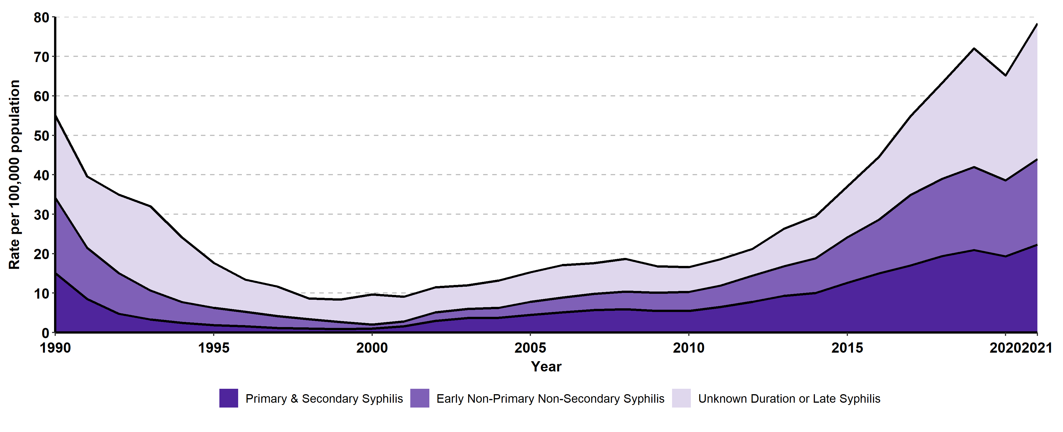
Syphilis Incidence Rates by Stage, California, 2012–2021

Slide 5
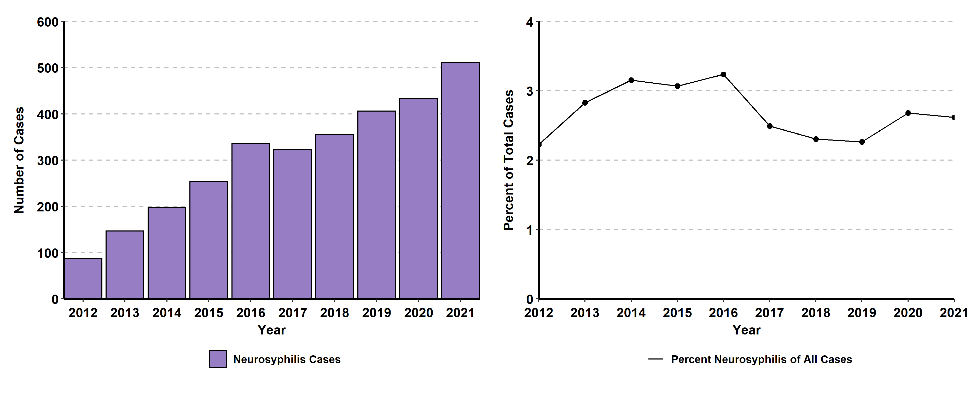
Neurosyphilis Case Count and Percent of All Syphilis Cases,
California Project Area‡, 2012–2021
‡California Project Area (CPA) excludes Los Angeles and San Francisco local health jurisdictions.

Slide 6
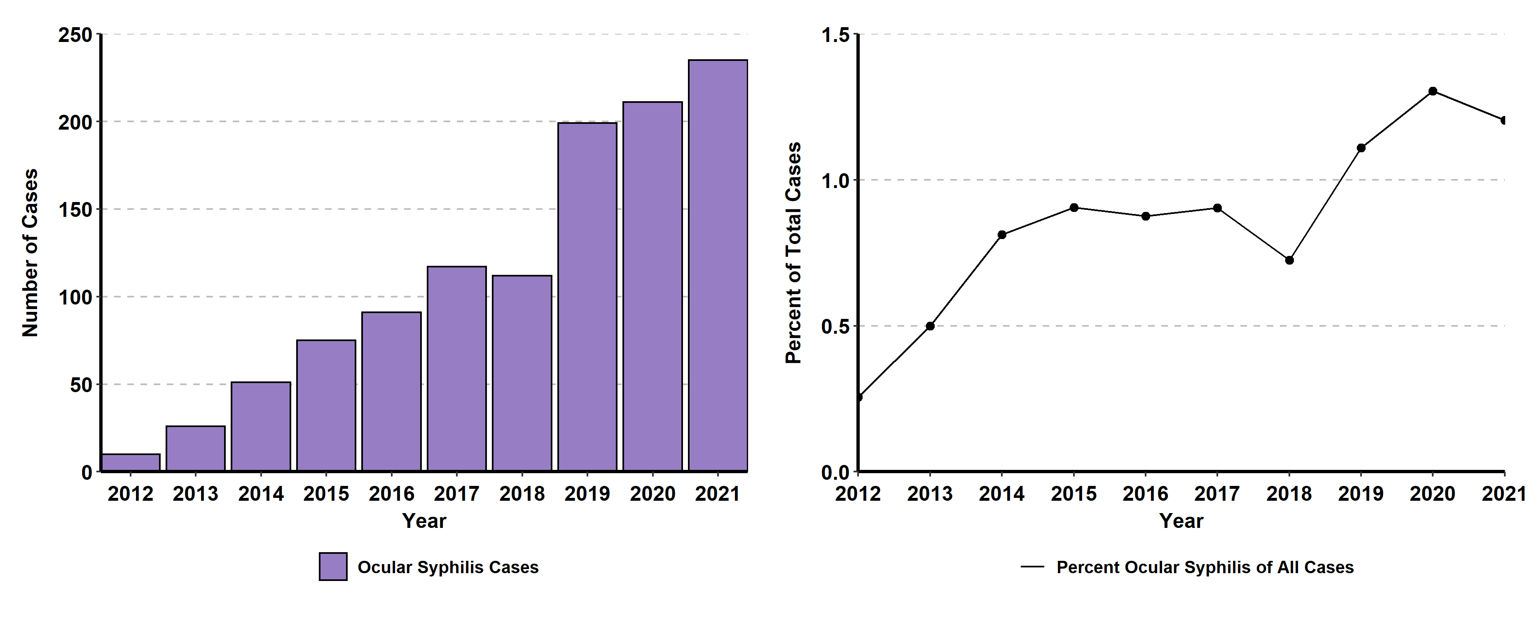
Ocular Syphilis Case Count and Percent of All Syphilis Cases,
California Project Area‡, 2012–2021
California Project Area (CPA) excludes Los Angeles and San Francisco local health jurisdictions.
Trends in ocular syphilis should be interpreted with caution due to inconsistent data collection of eye-related symptoms over time and data systems.

Slide 7
Primary & Secondary Syphilis
(Revised 02/2023)

Slide 8
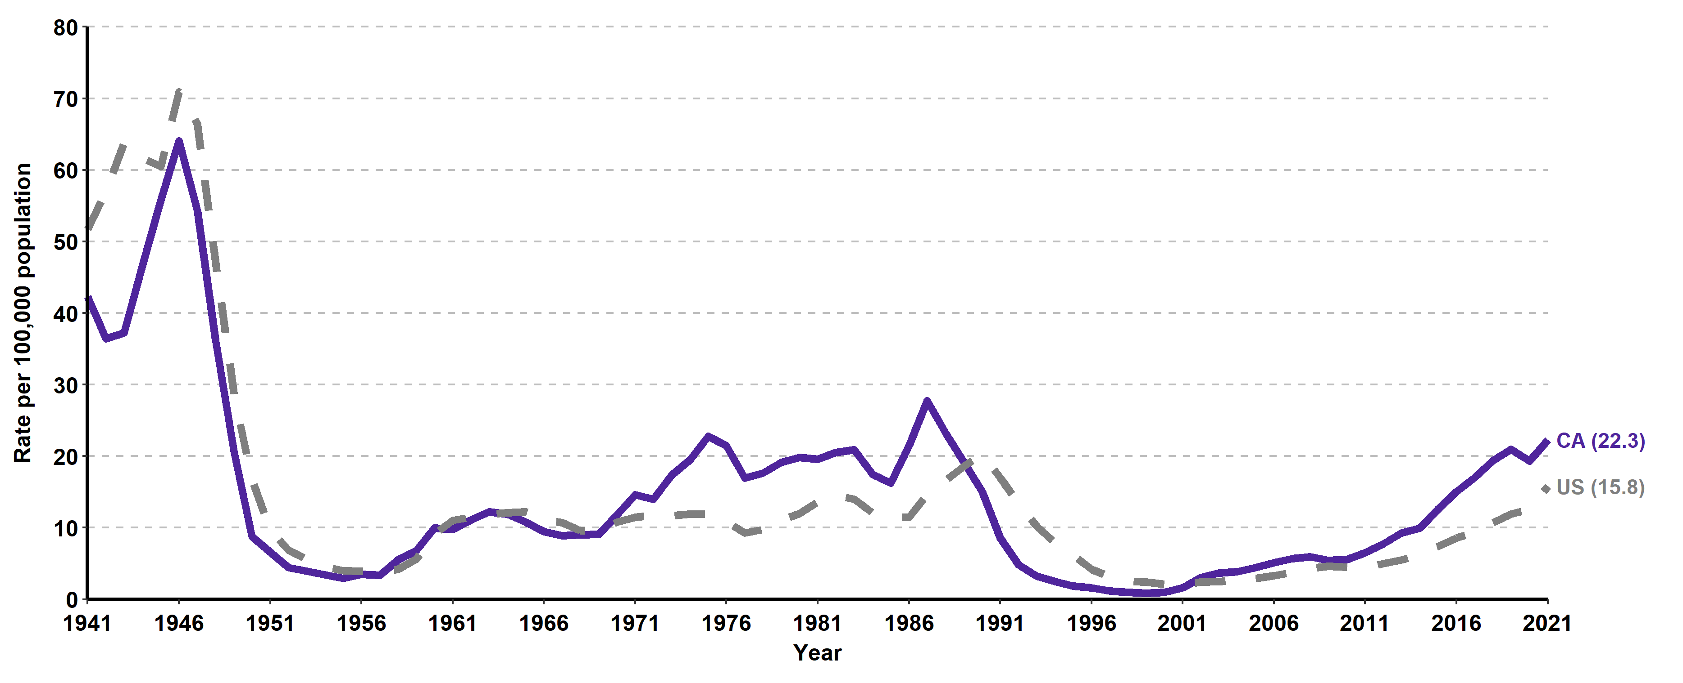
Primary & Secondary Syphilis, California versus United States
Incidence Rates, 1941–2021

Slide 9
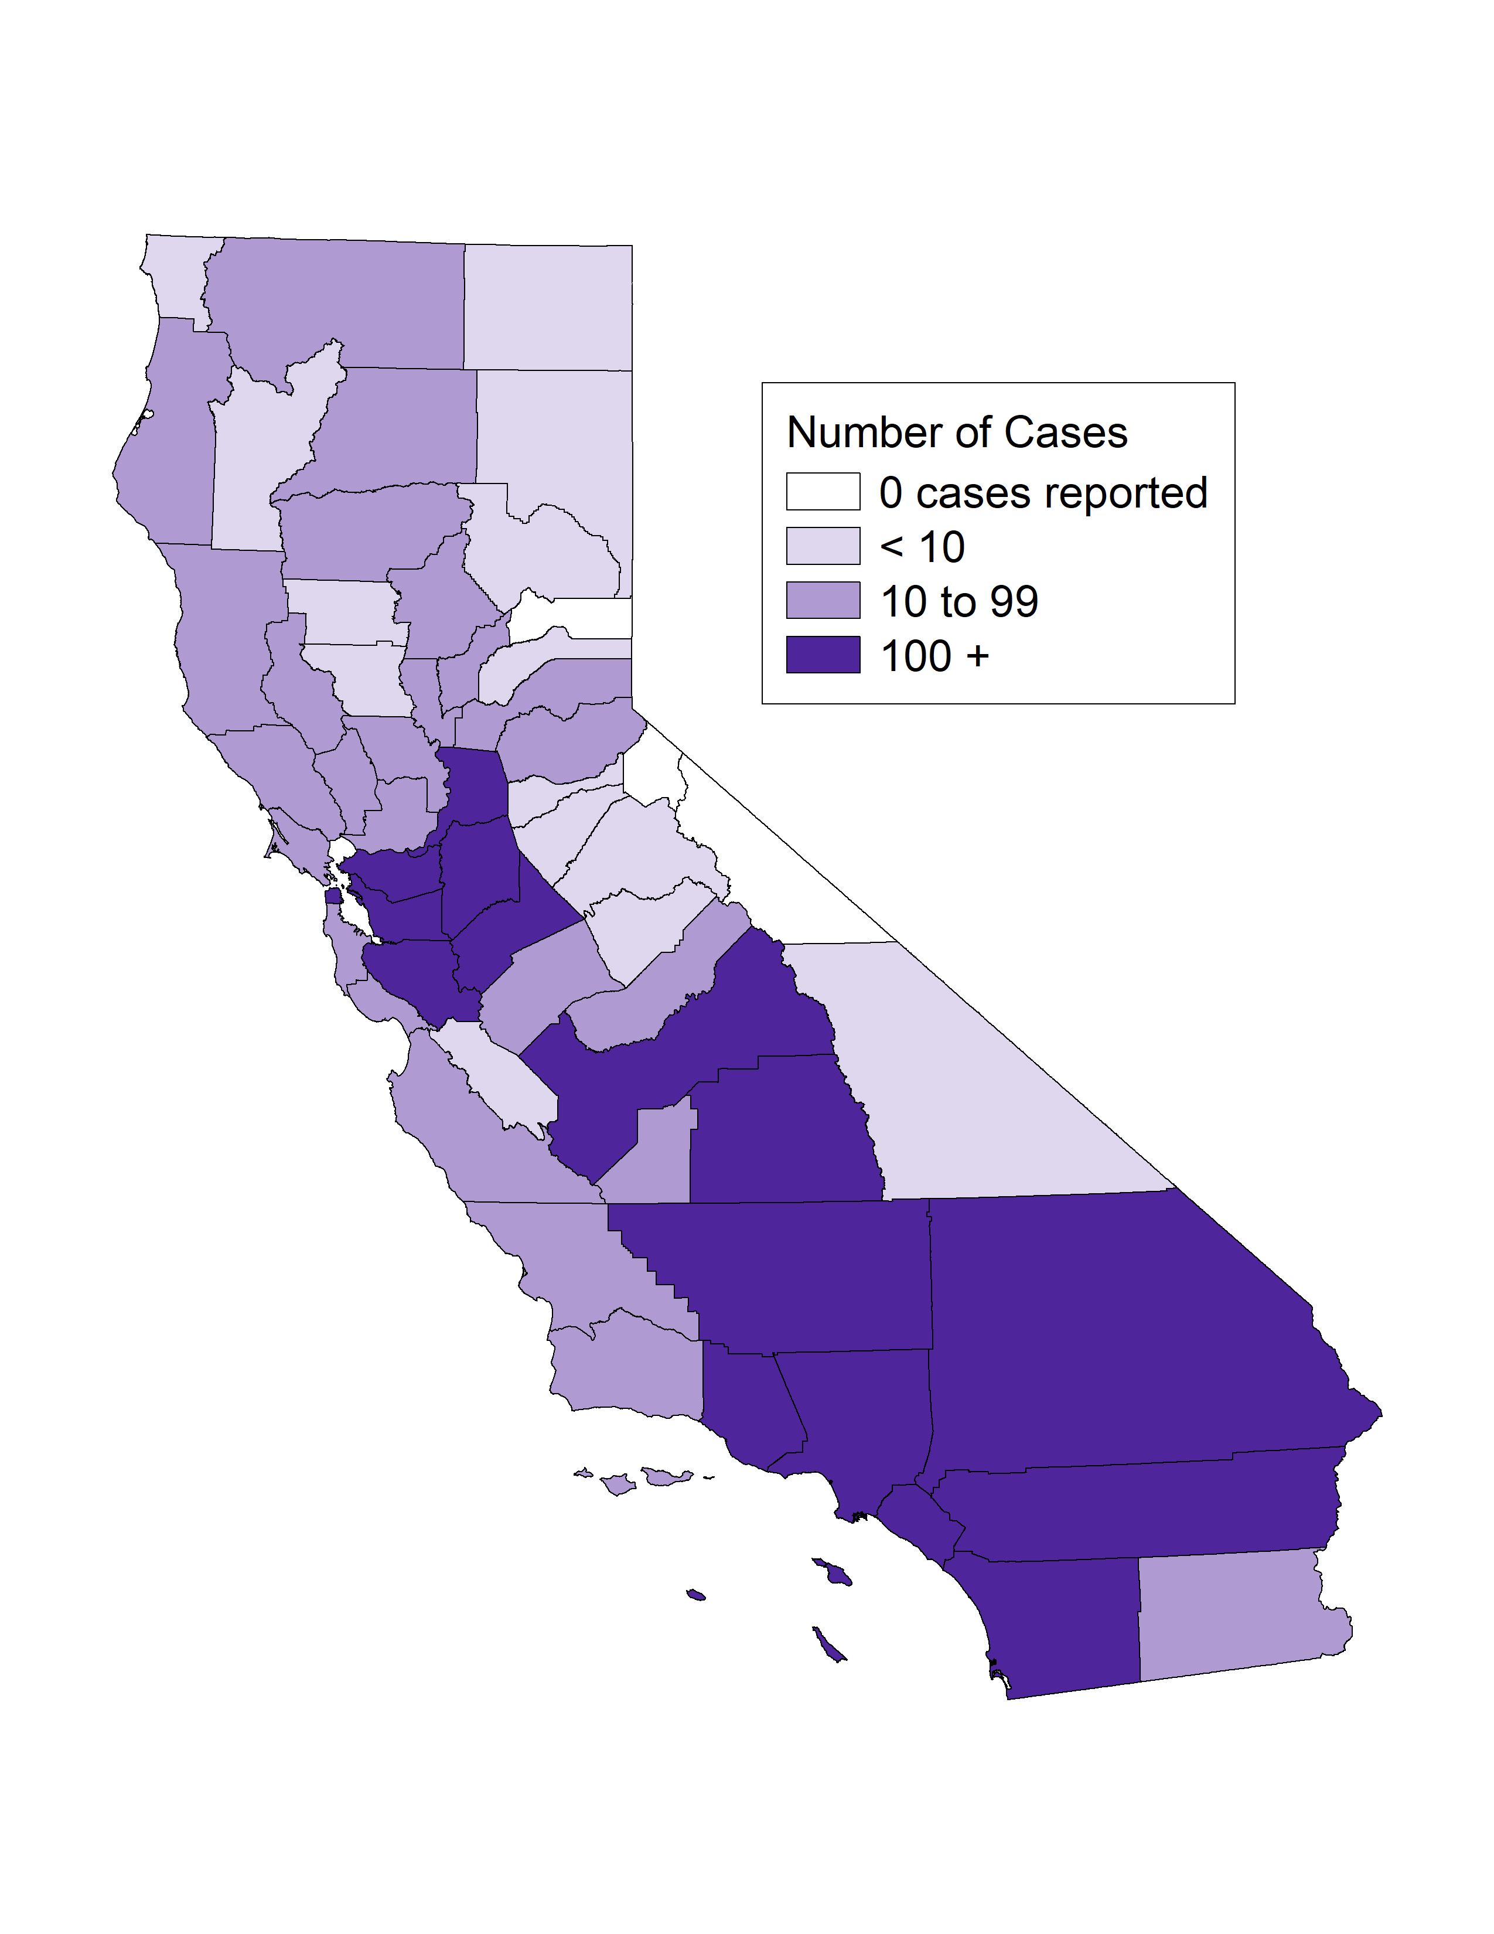
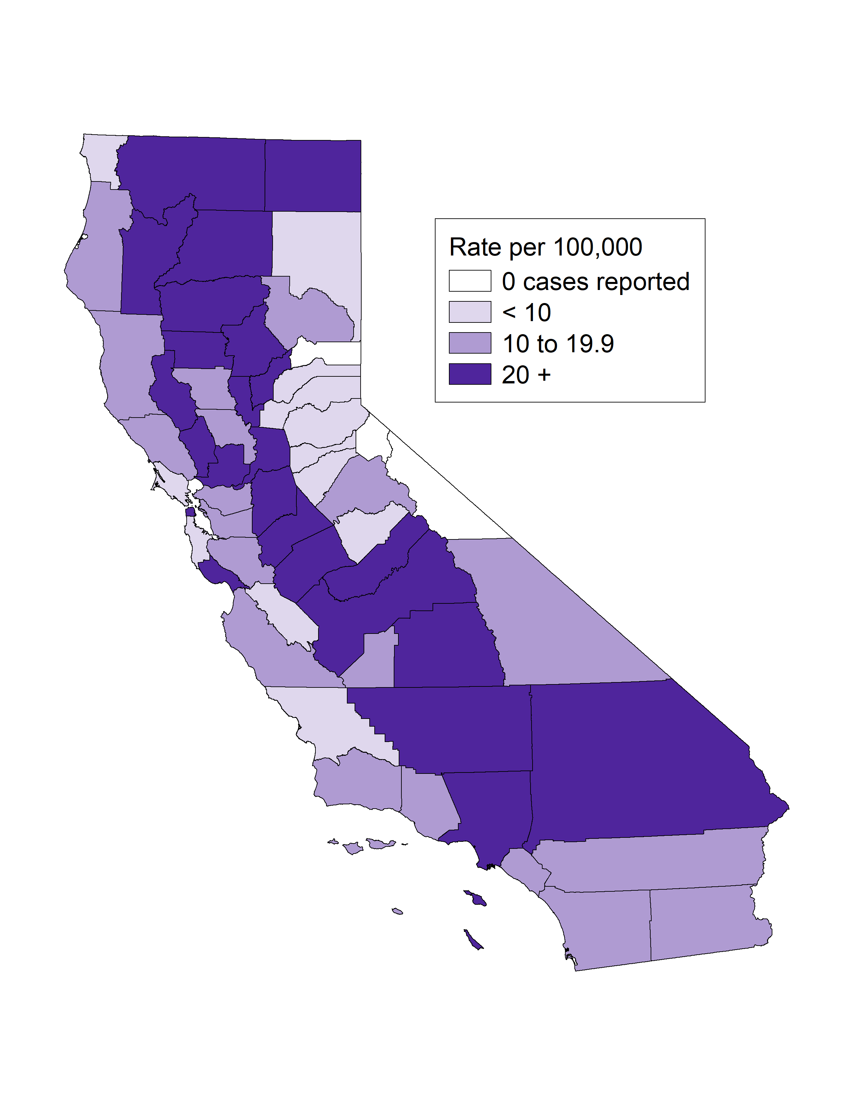
Primary & Secondary Syphilis, Case Counts and Incidence Rates by
County, California, 2021
P&S Syphilis Cases
P&S Syphilis Rates
* P&S syphilis includes primary and secondary syphilis.

Slide 10
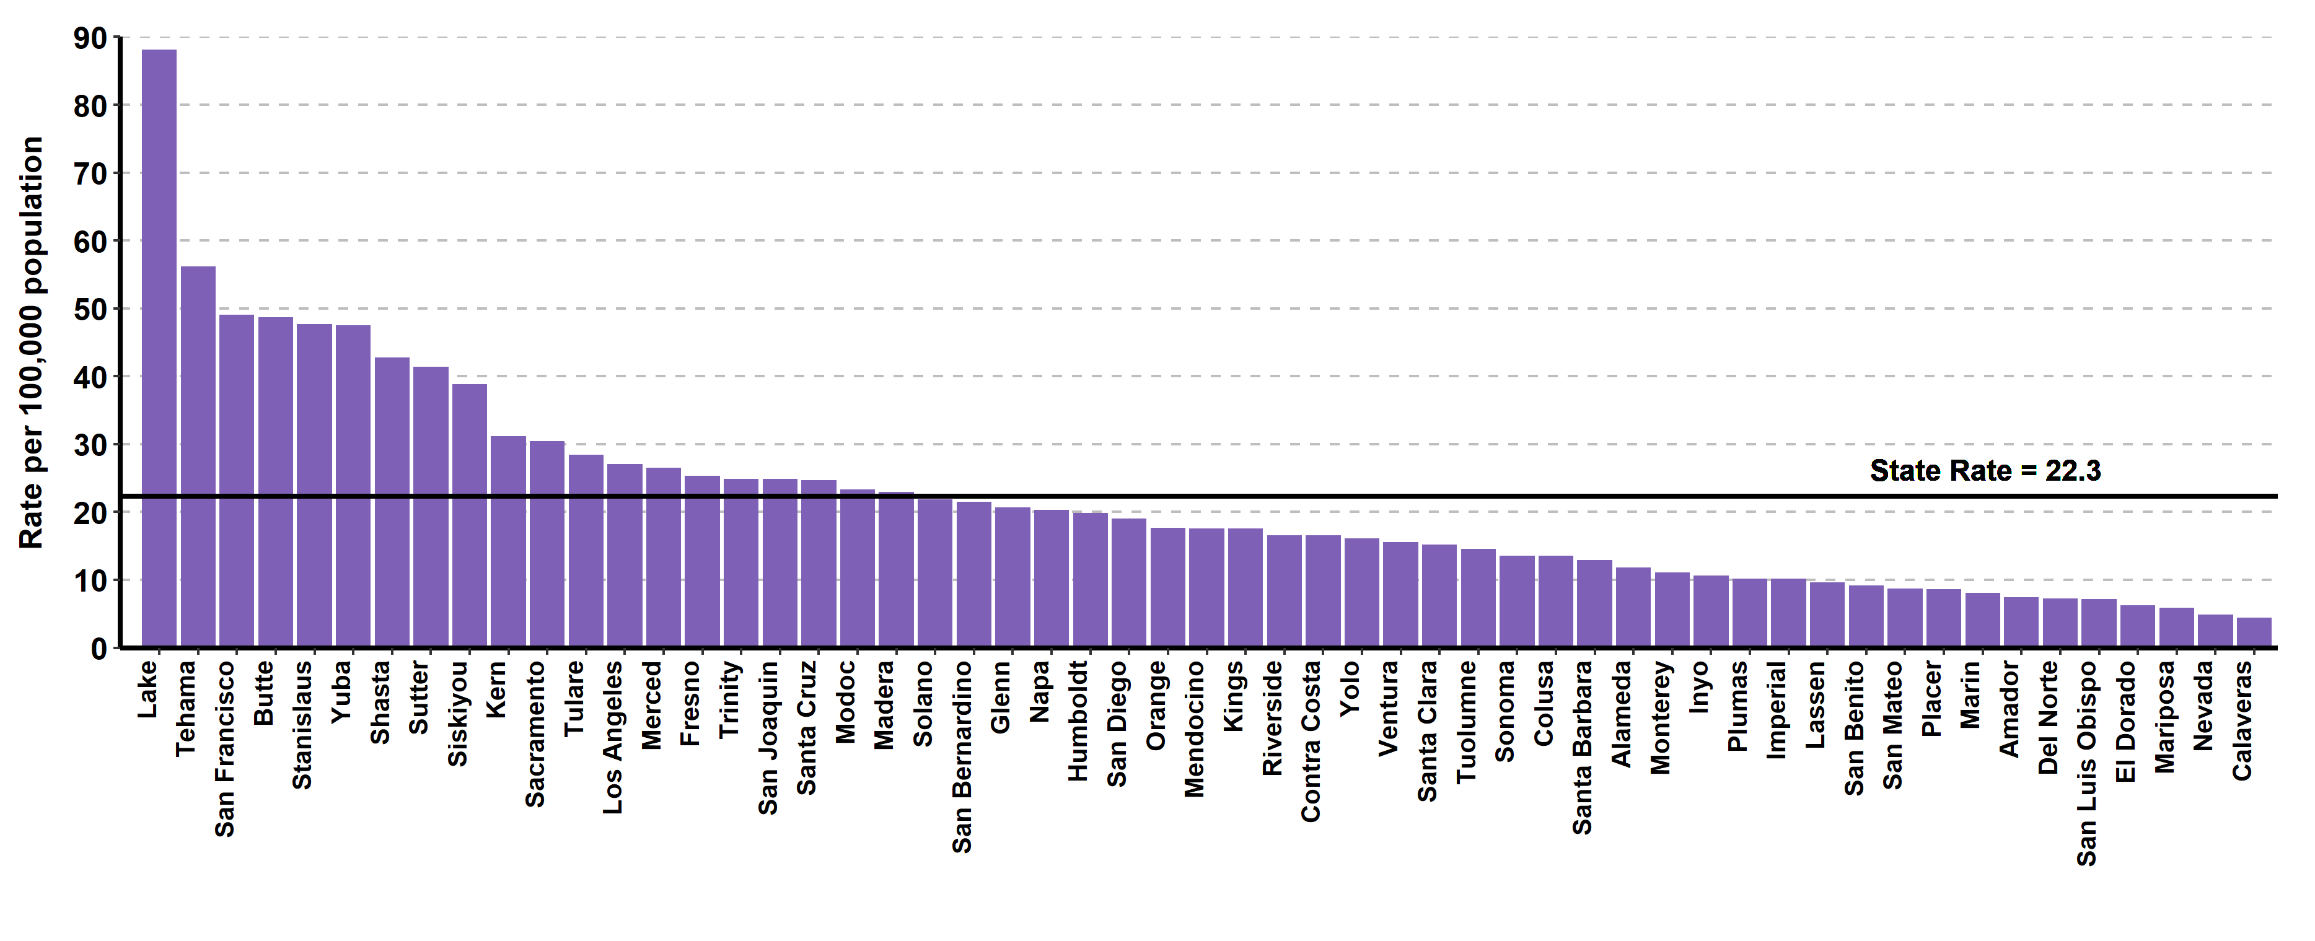
Primary & Secondary Syphilis, Ranked Incidence Rates by County,
California, 2021
This figure excludes counties with zero cases (3 counties had zero cases in 2021)

Slide 11
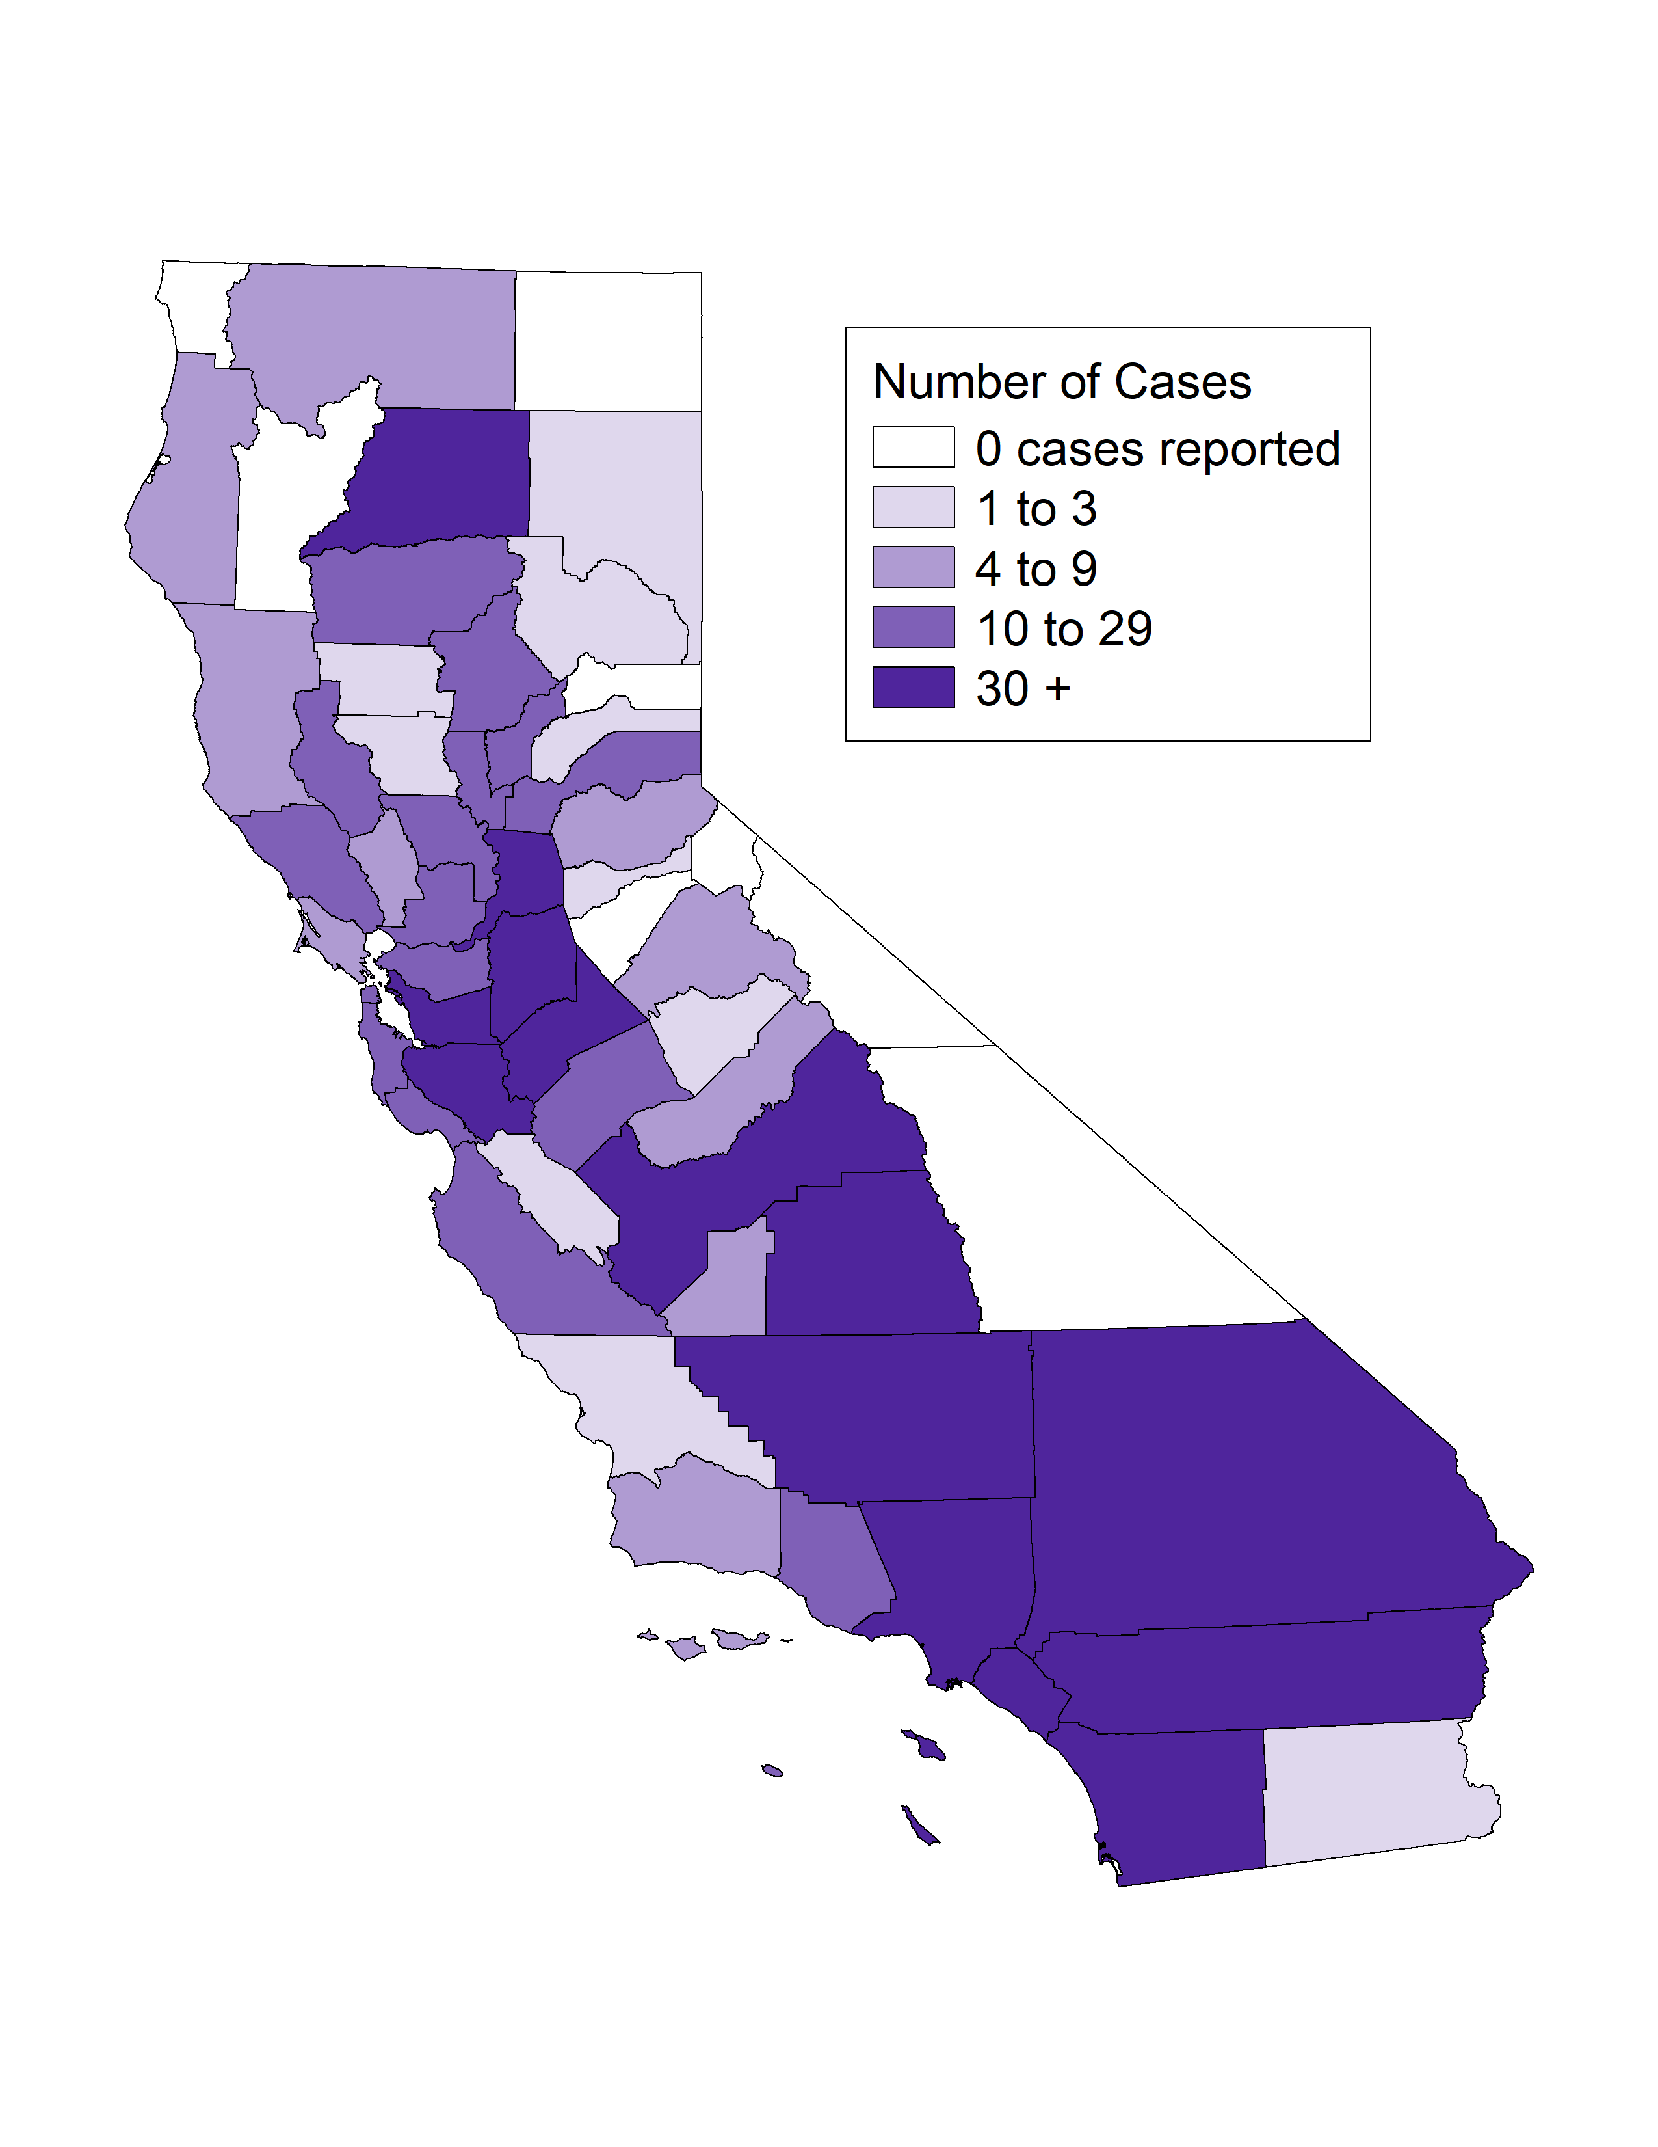
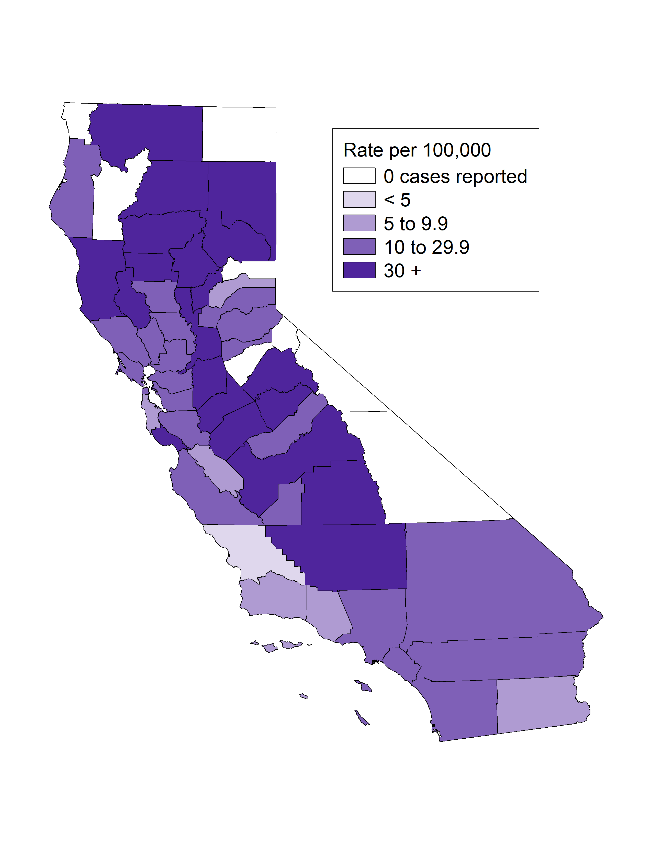
Primary & Secondary Syphilis among Females Ages 15-44,
Case Counts and Incidence Rates by County, California, 2021
P&S Syphilis Female Age 15-44 Cases
P&S Syphilis Female Age 15-44 Rates
* P&S syphilis includes primary and secondary syphilis.

Slide 12
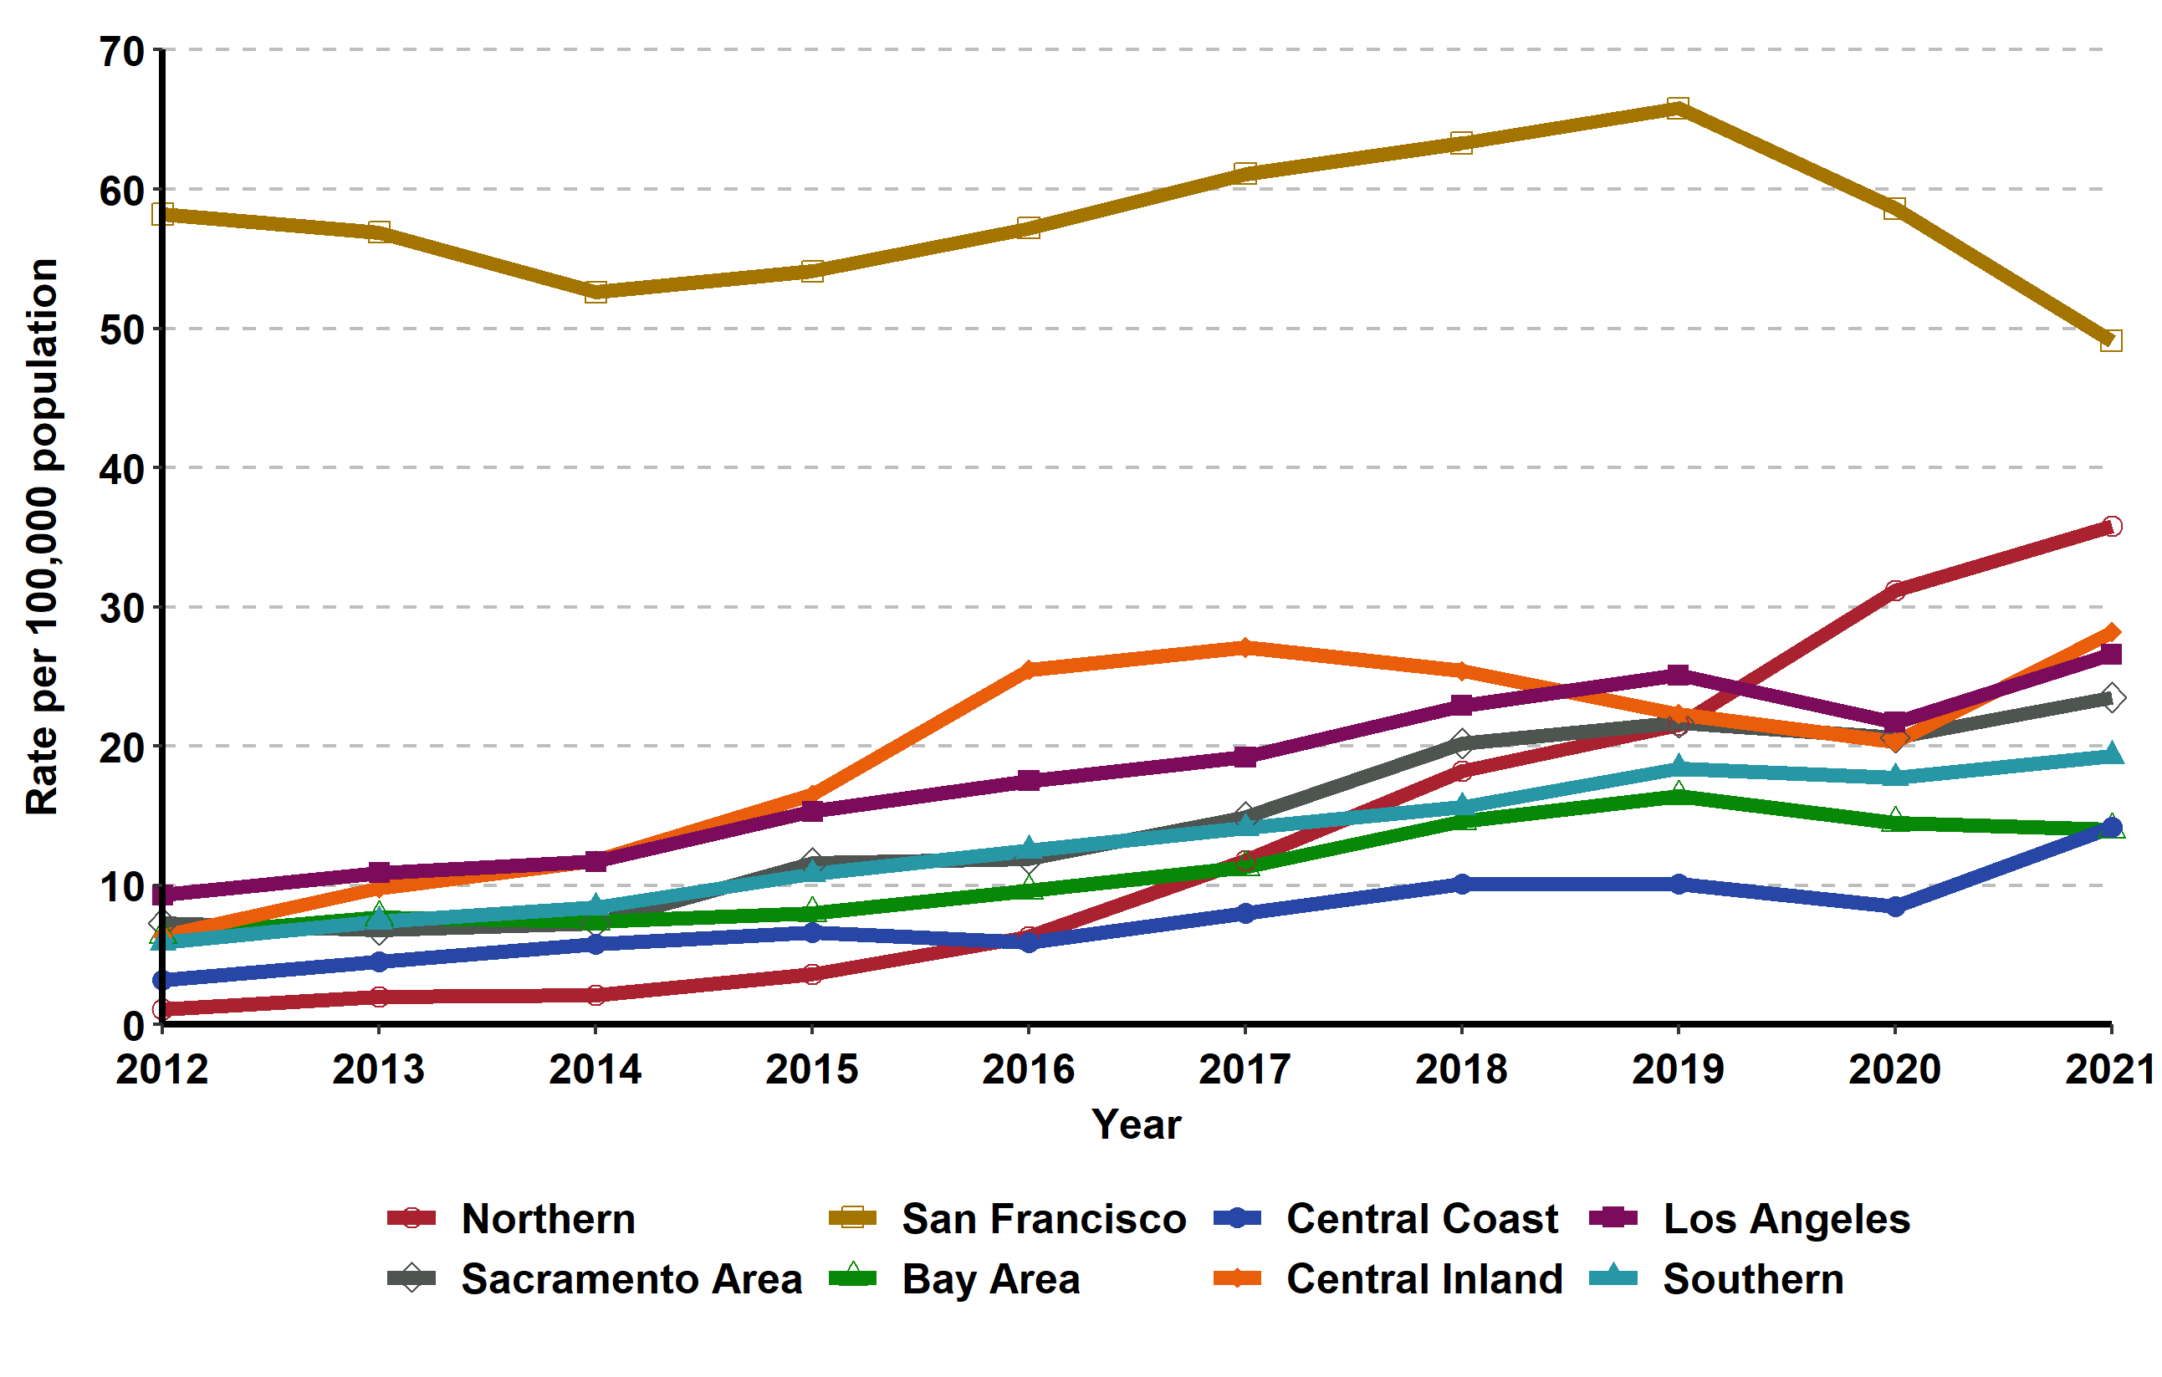
Primary & Secondary Syphilis, Incidence Rates by Region,
California, 2012–2021

Slide 13
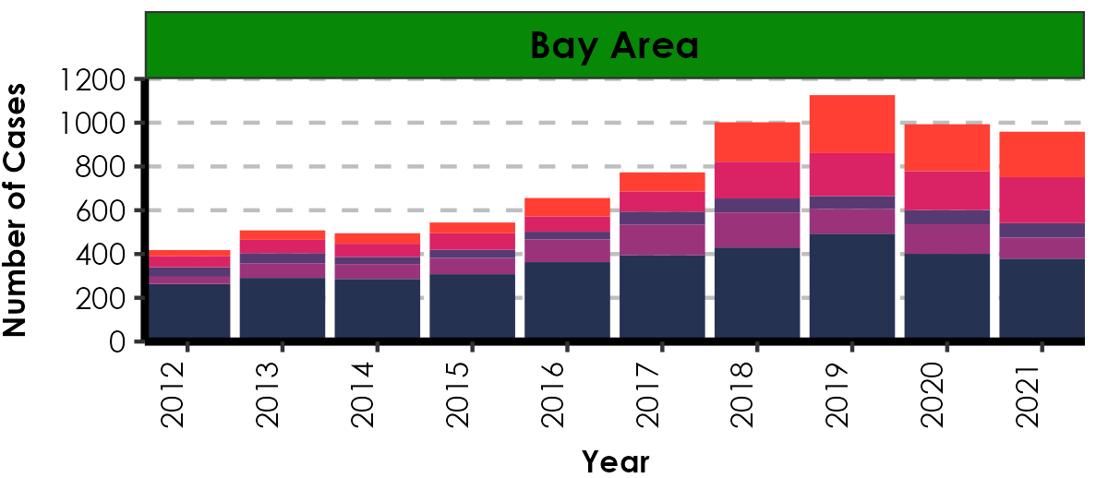
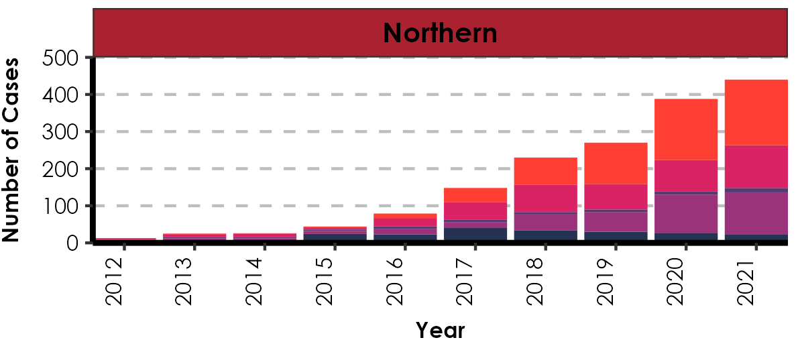
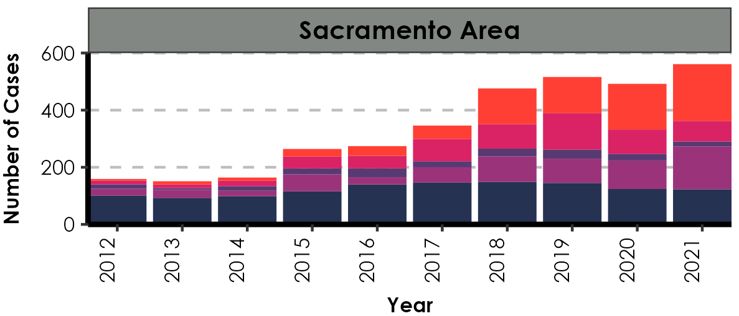
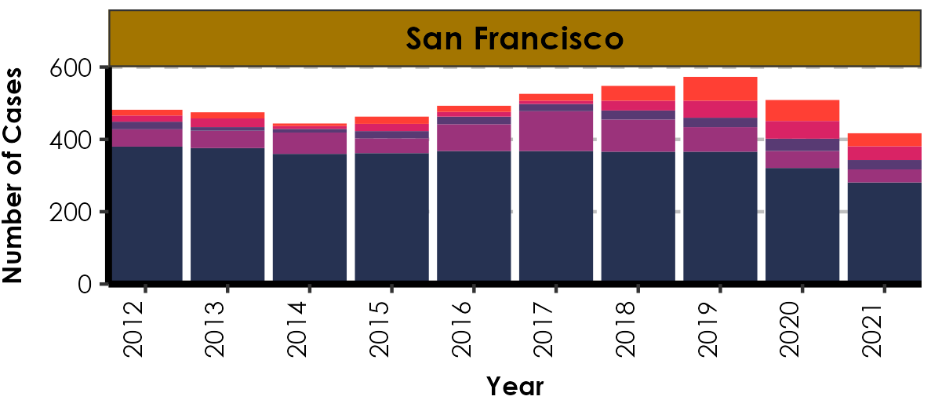
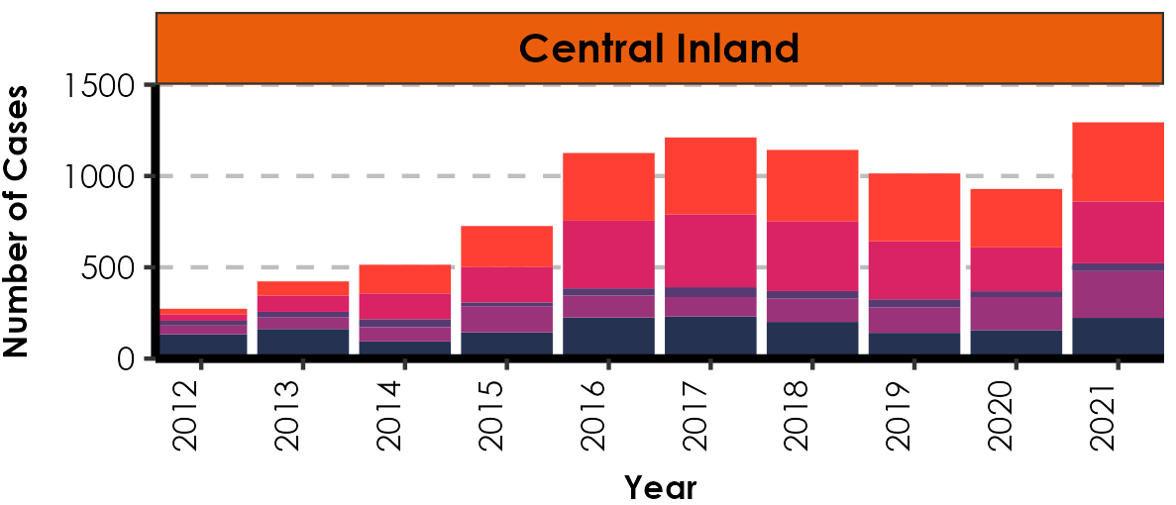
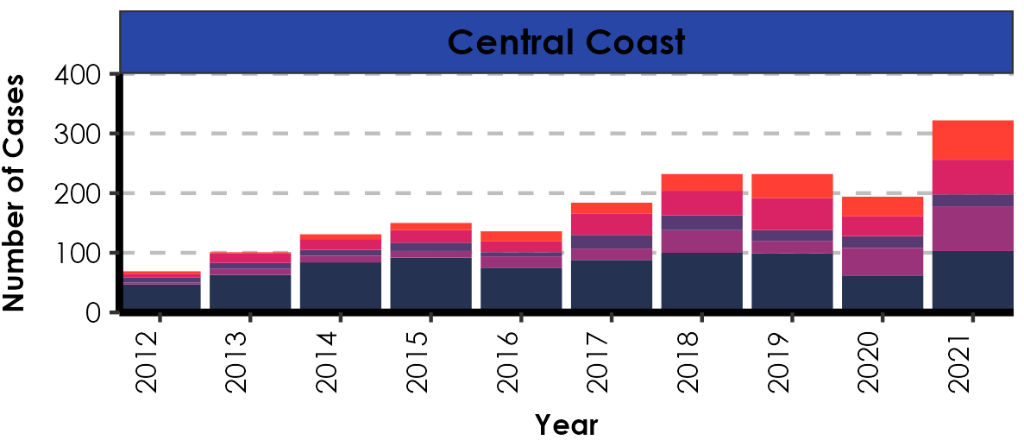
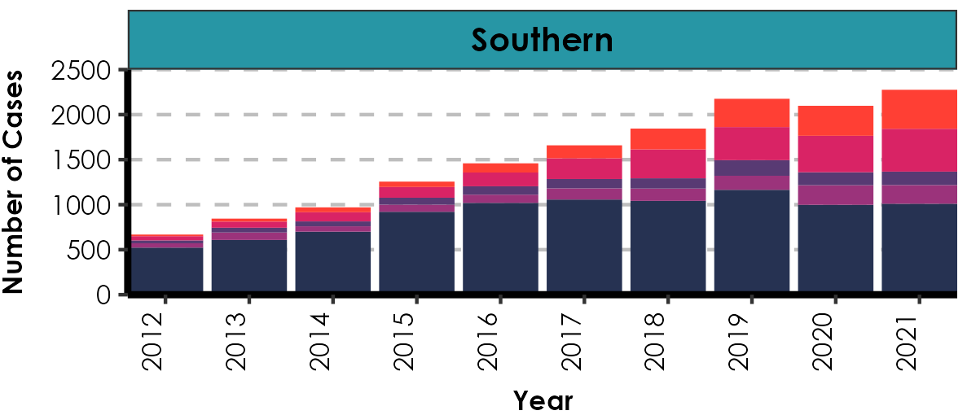
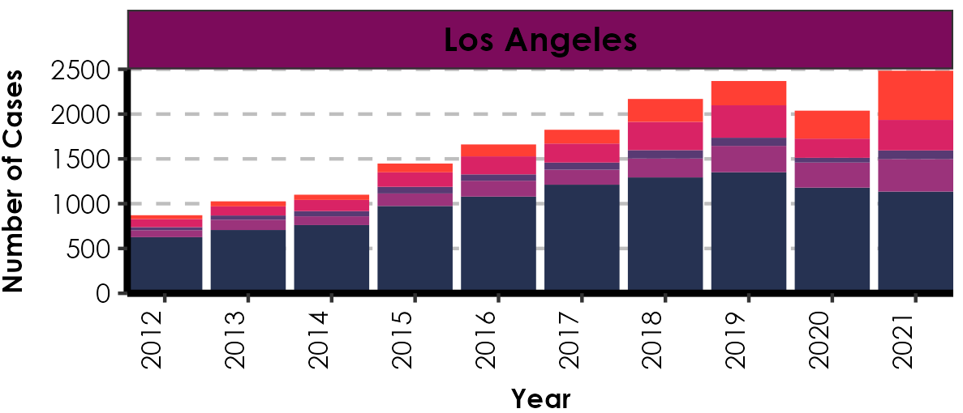
Number of Primary & Secondary Syphilis Cases by Region, Gender, Gender of Sex Partners, and Year, California, 2012–2021
MSM includes Men who had sex with Men only. MSMW includes Men who had sex with both Men and Women. MSU includes Men with unknown gender of sex partners. MSW includes Men who had sex with Women only

Slide 14
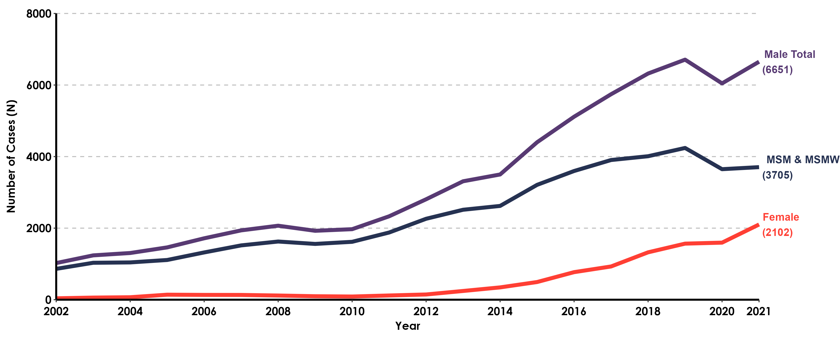
Primary & Secondary Syphilis, Case Counts by Gender or by Gender and Gender of Sex Partners, California, 2002-2021
MSM includes Men who had sex with Men only.
MSMW includes Men who had sex with both Men and Women.

Slide 15
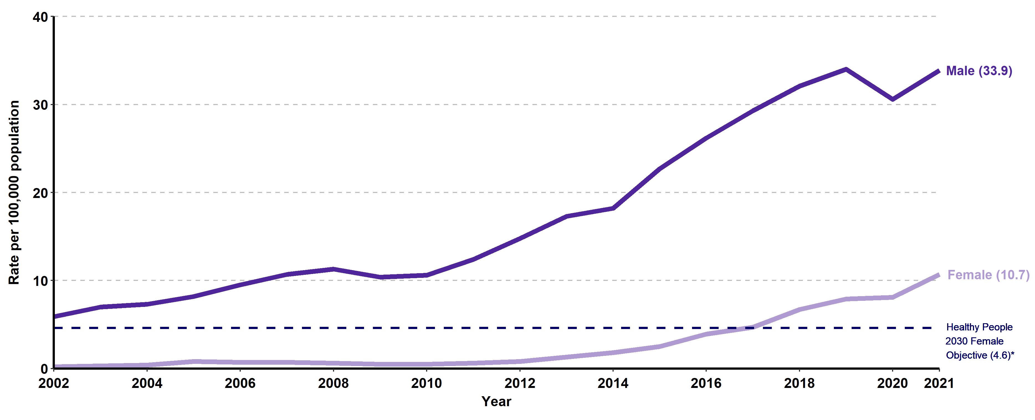
Primary & Secondary Syphilis, Incidence Rates by Gender,
California, 2002–2021
*Healthy People 2030 does not have a primary & secondary syphilis target for men.

Slide 16
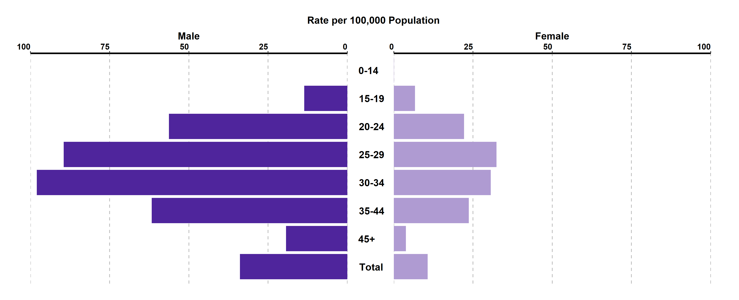
Primary & Secondary Syphilis, Incidence Rates by Age Group (in years) and Gender, California, 2021
Age was “Not Specified” for 0.05% of female cases and 0% of male cases in 2021.

Slide 17
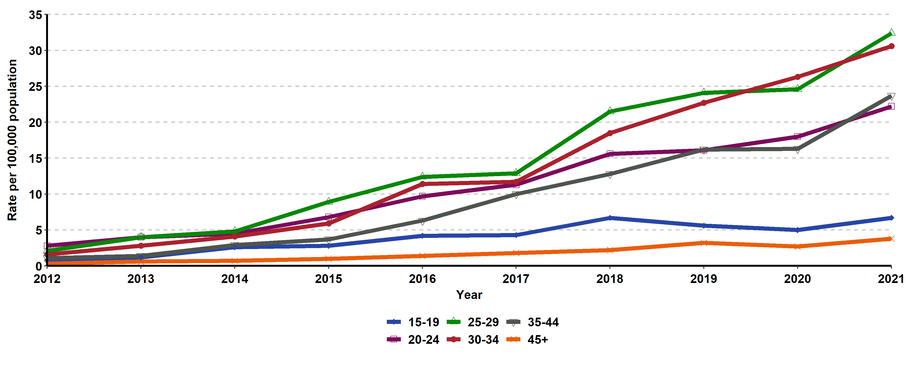
Primary & Secondary Syphilis, Incidence Rates for Females by Age
Group (in years), California, 2012–2021
Age “Not Specified” ranged from 0% to 0.13% of cases for females in any given year.

Slide 18
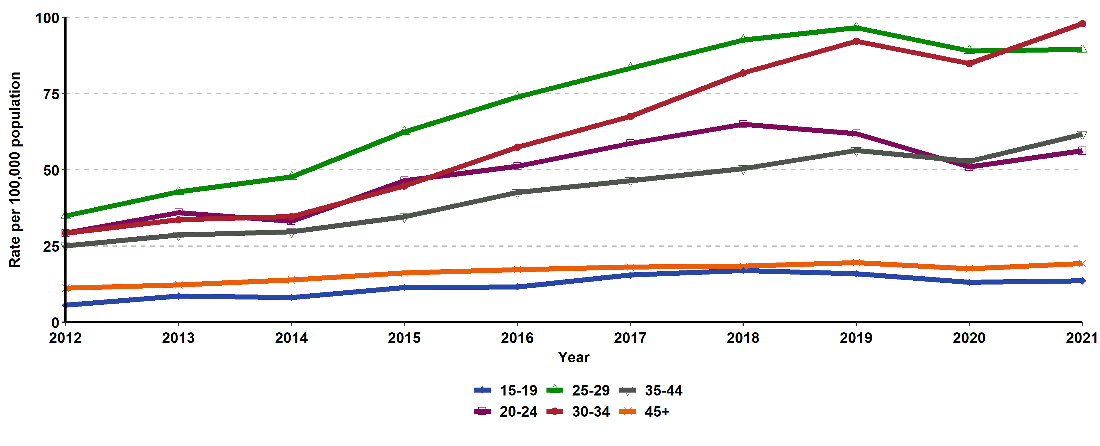
Primary & Secondary Syphilis, Incidence Rates for Males by Age
Group (in years), California, 2012–2021
Age “Not Specified” ranged from 0% to 0.06% of cases for males in any given year.

Slide 19
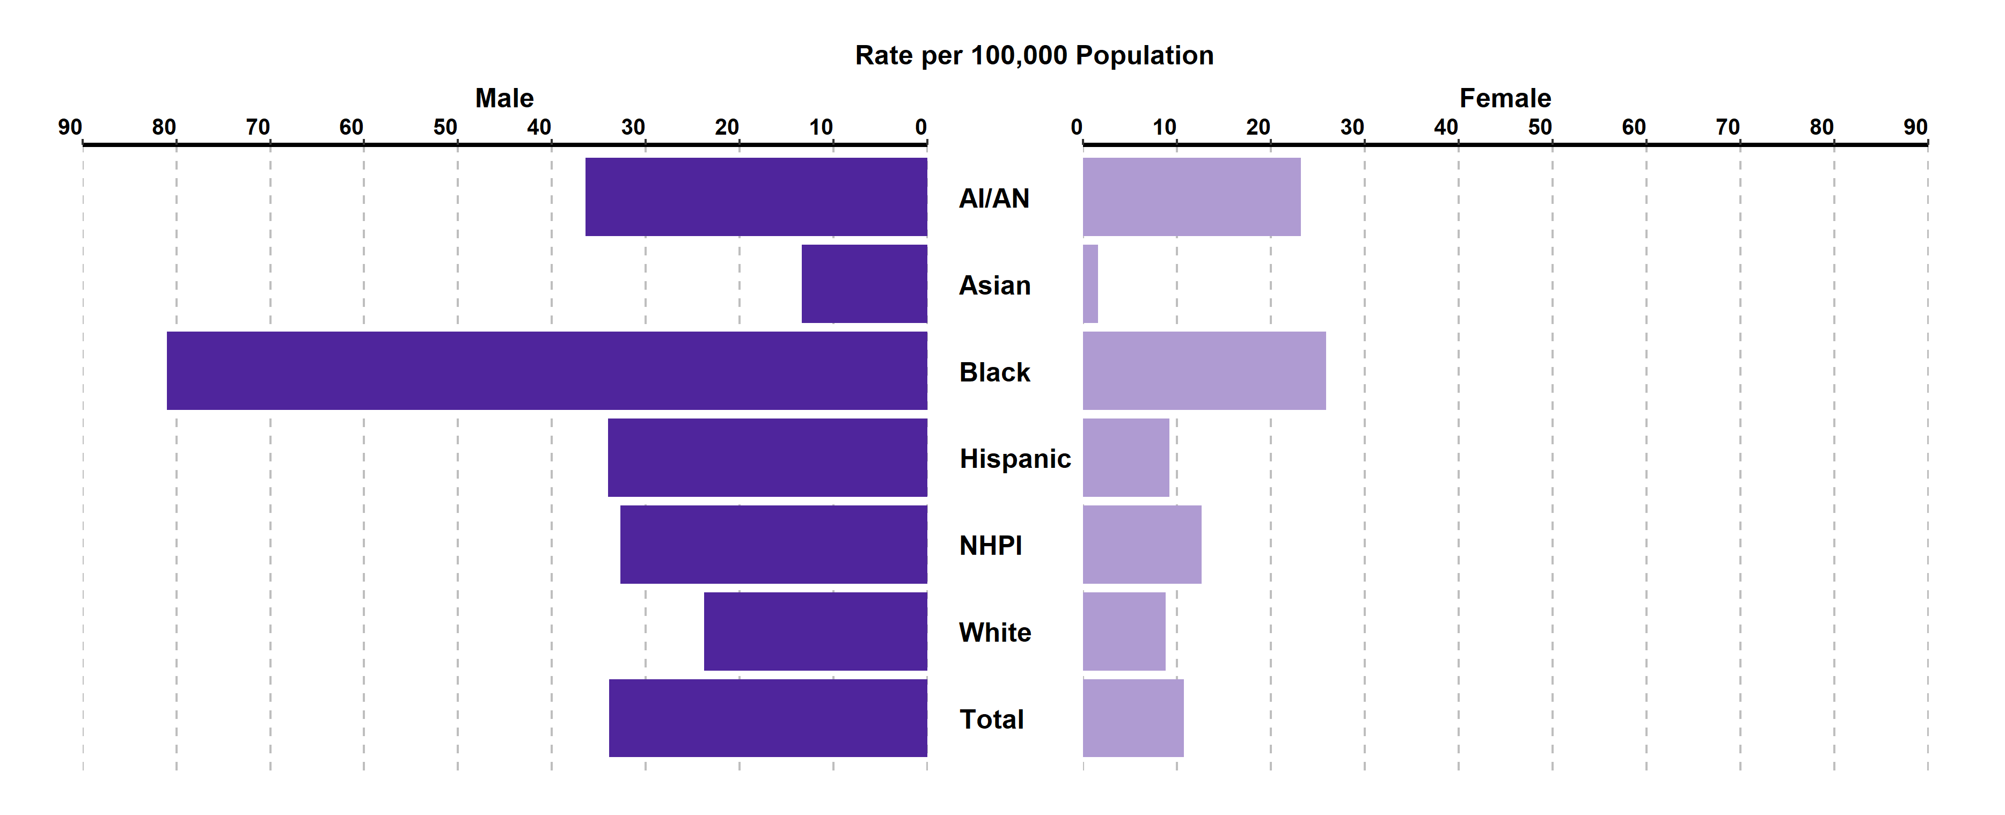
Primary & Secondary Syphilis, Incidence Rates by Race/Ethnicity and
Gender, California, 2021
AI/AN = American Indian/Alaska Native; NHPI = Native Hawaiian/Other Pacific Islander.
Race/Ethnicity was “Not Specified” for 15.41% of female cases and 9.98% of male cases in 2021.

Slide 20
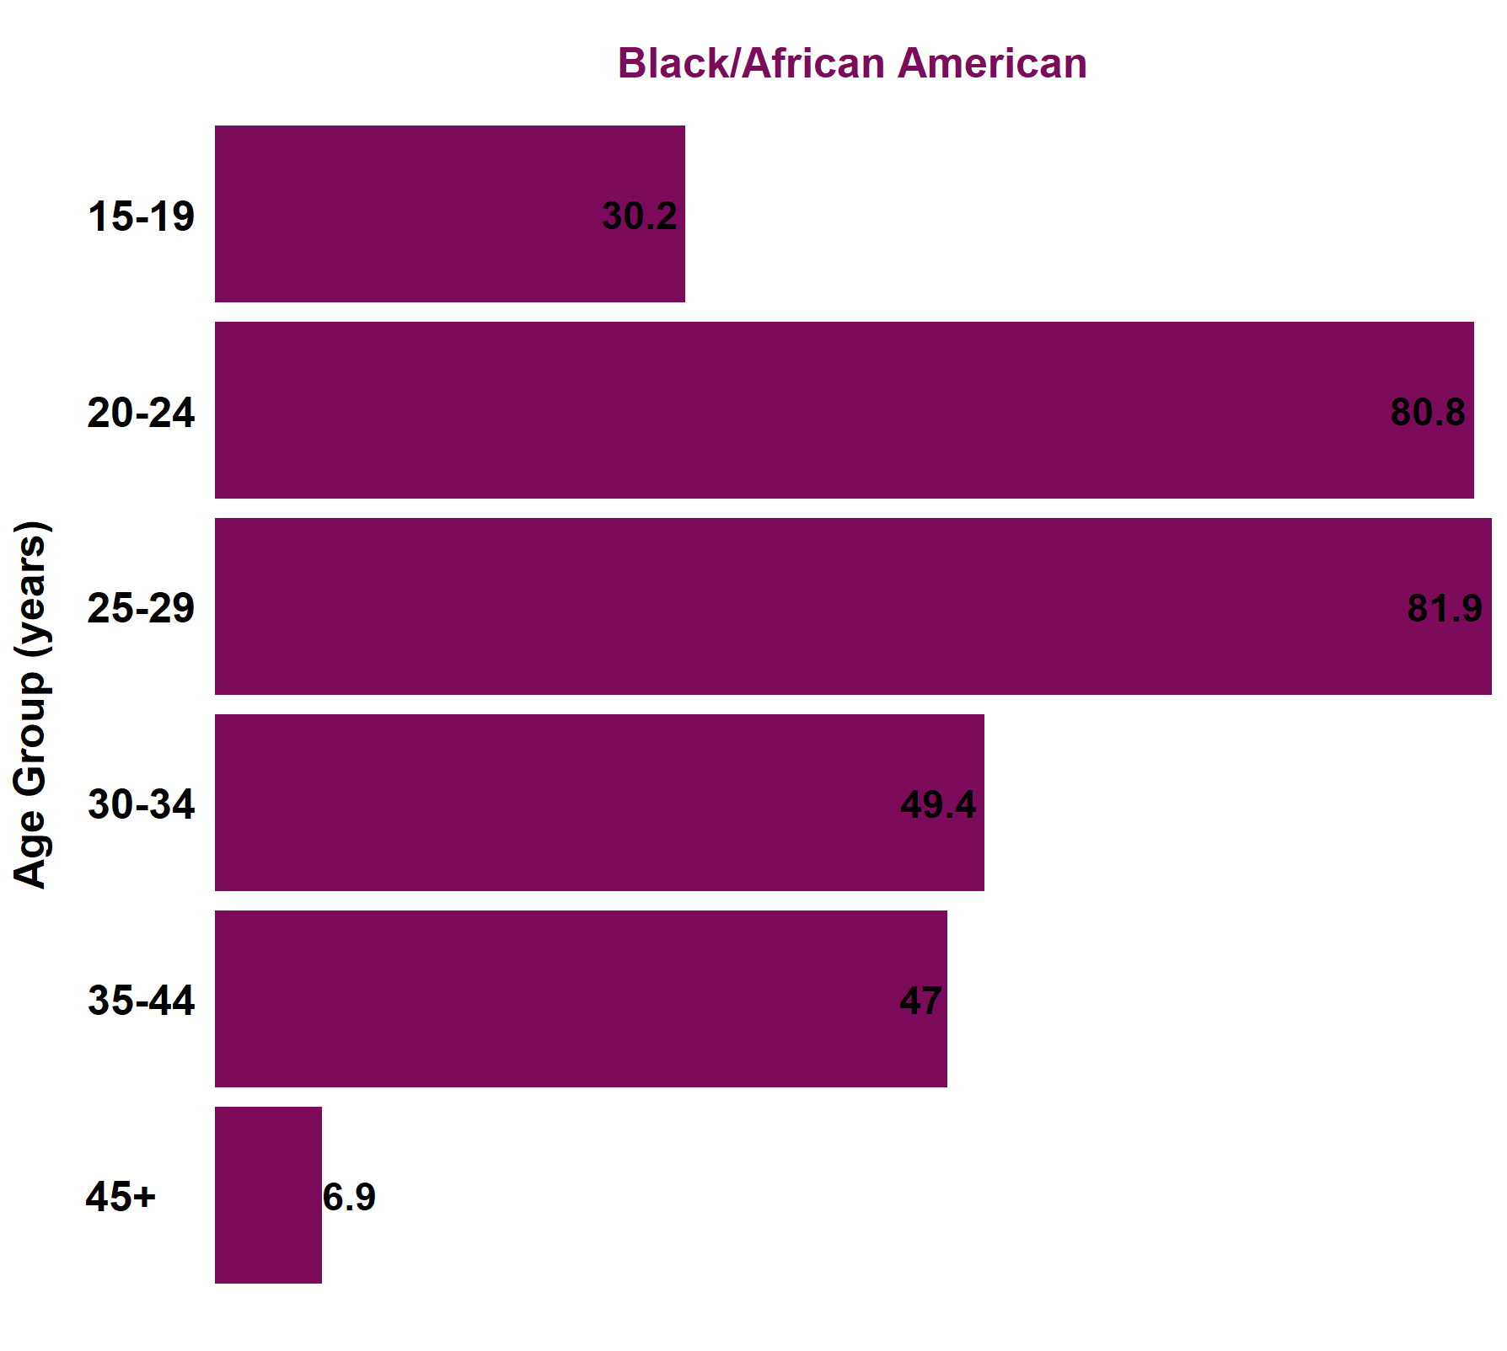
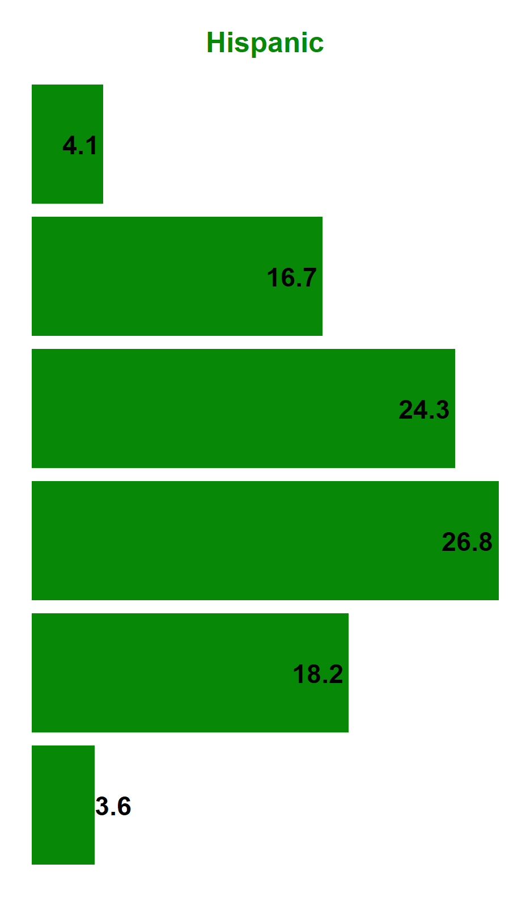
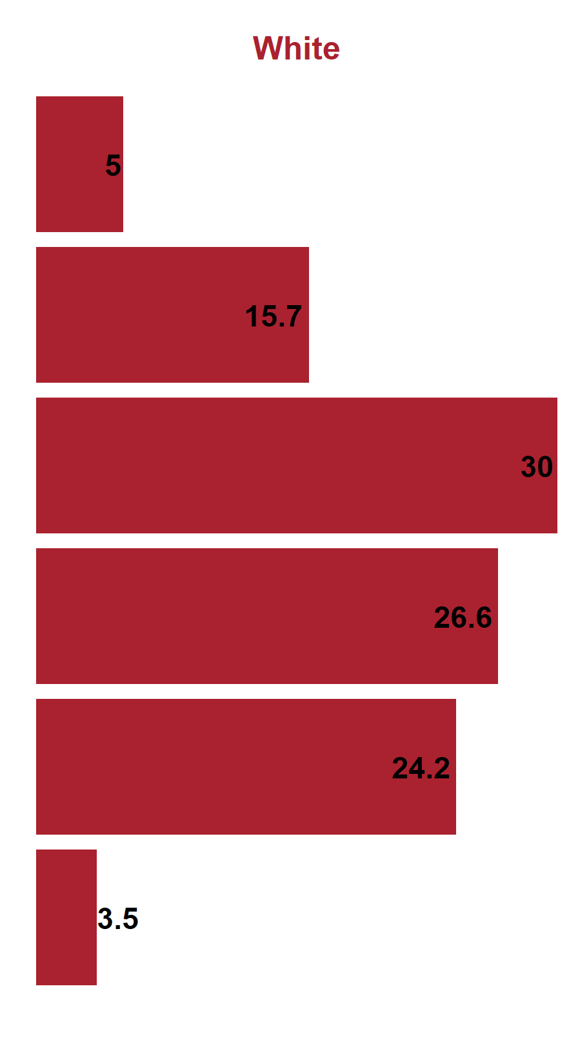
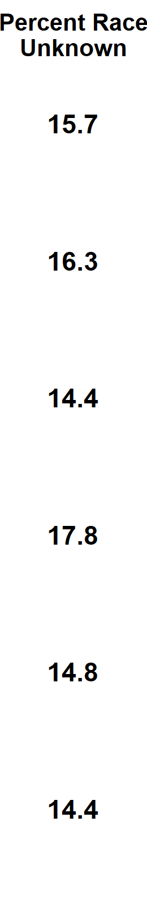
Primary & Secondary Syphilis, Female Incidence Rates by Race/Ethnicity and Age Group (in years), California, 2021
American Indian/Alaska Native and Native Hawaiian/Other Pacific Islander and race-specific data for ages 0-14 were suppressed as per agency Data De-Identification Guidelines (DDG).

Slide 21
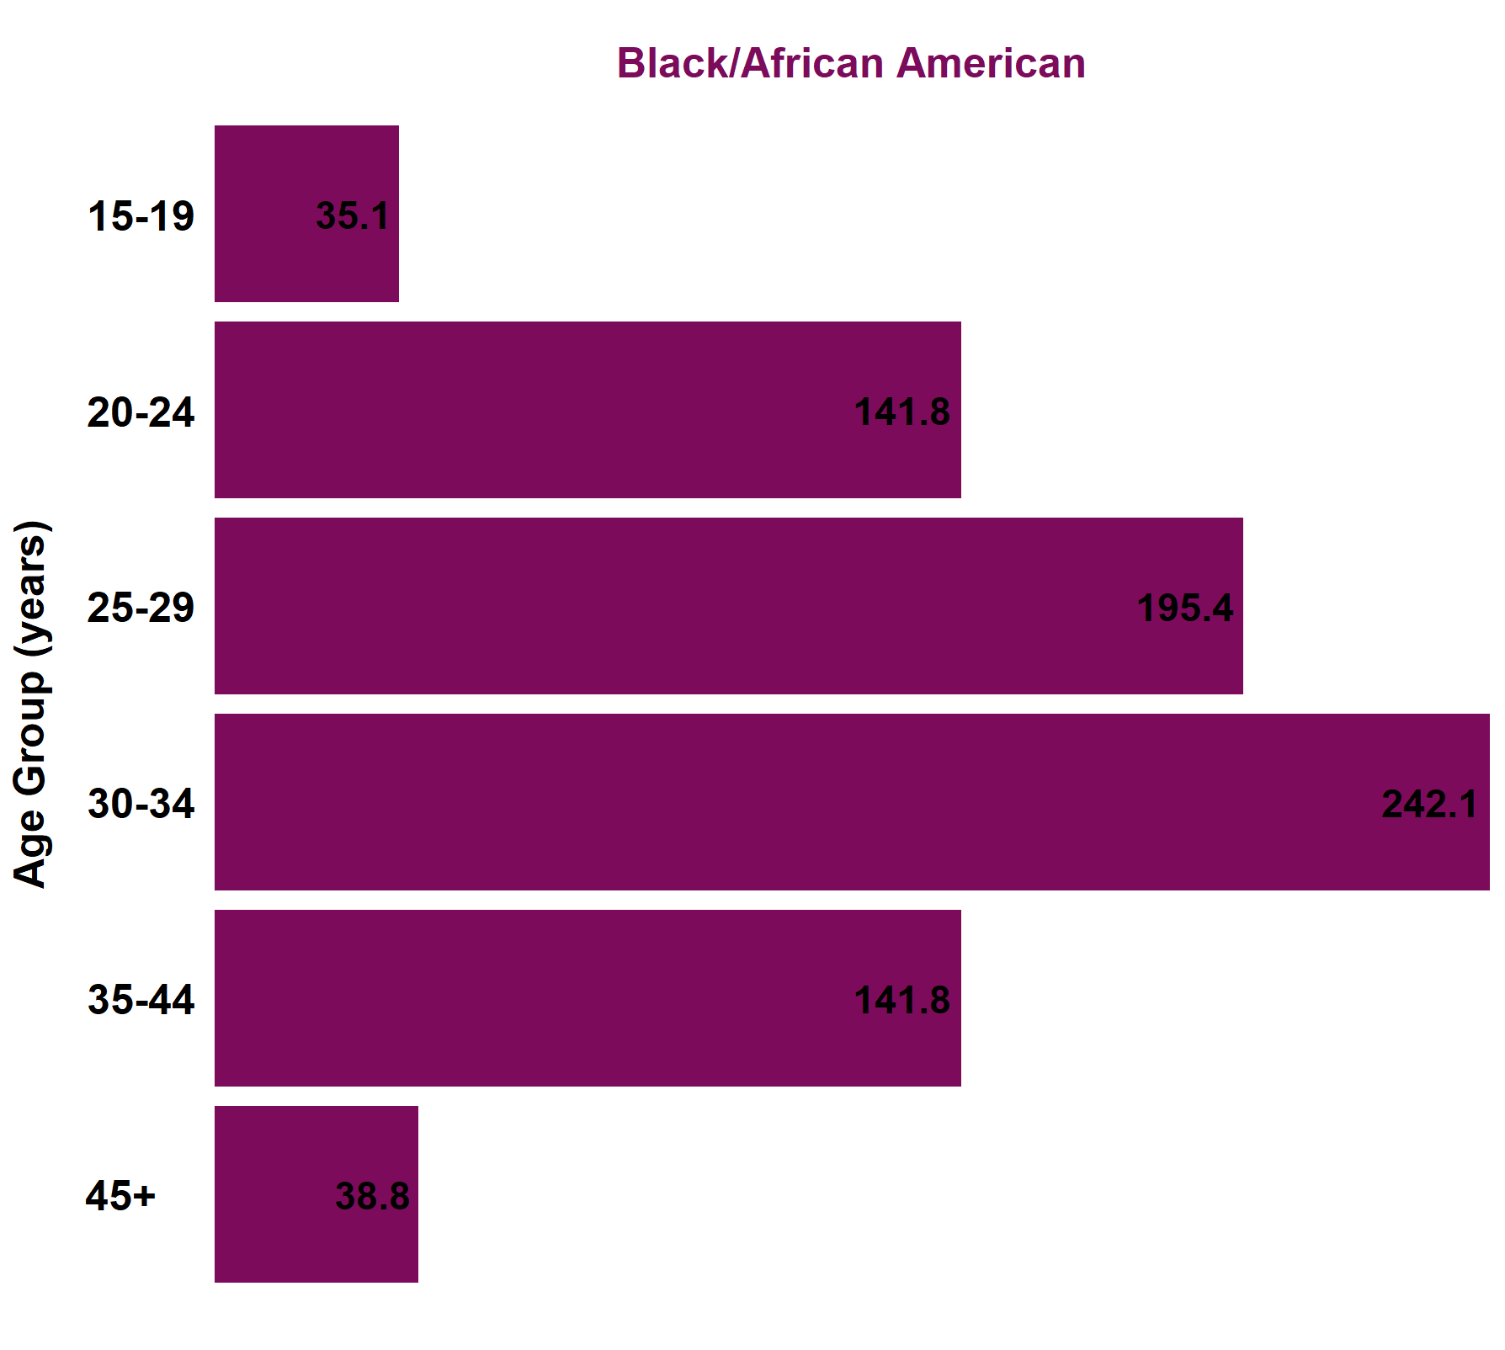
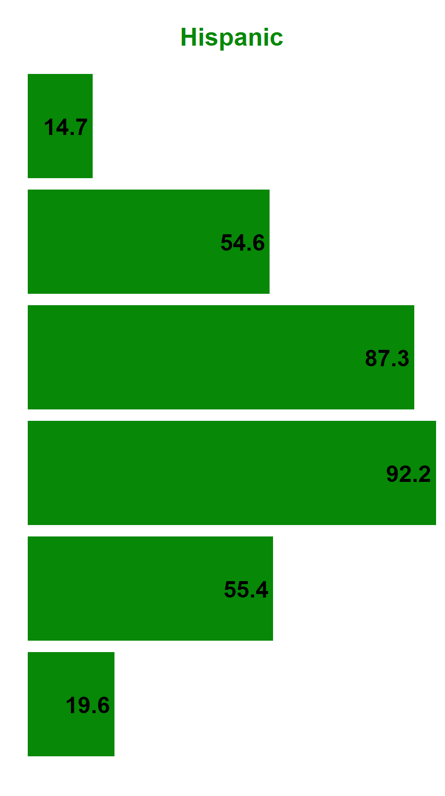
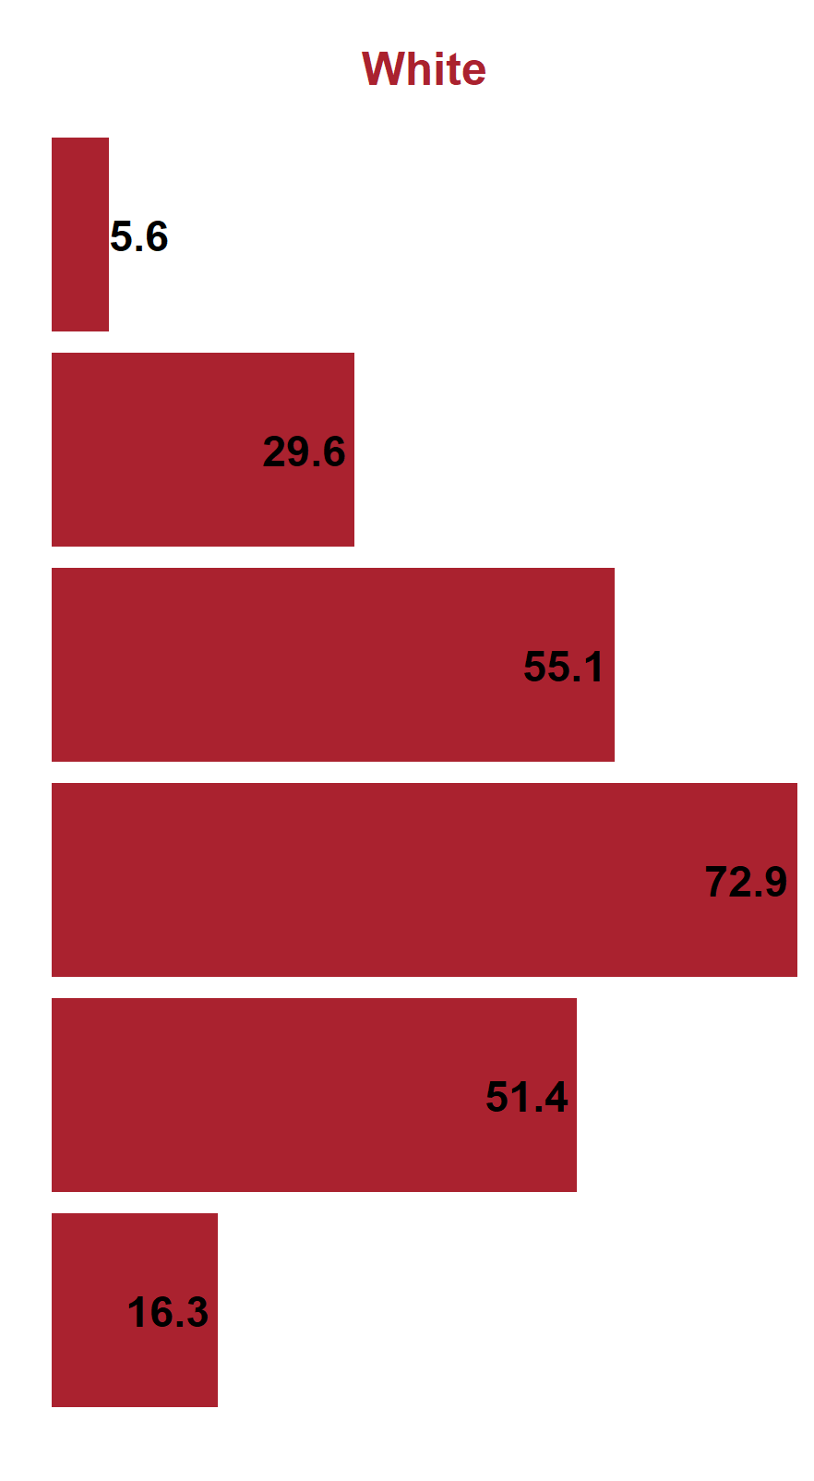
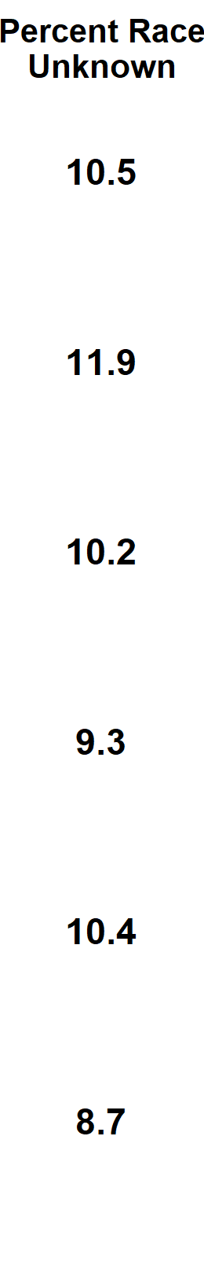
Primary & Secondary Syphilis, Male Incidence Rates by Race/Ethnicity and Age Group (in years), California, 2021
American Indian/Alaska Native and Native Hawaiian/Other Pacific Islander and race-specific data for ages 0-14 were suppressed as per agency Data De-Identification Guidelines (DDG).

Slide 22
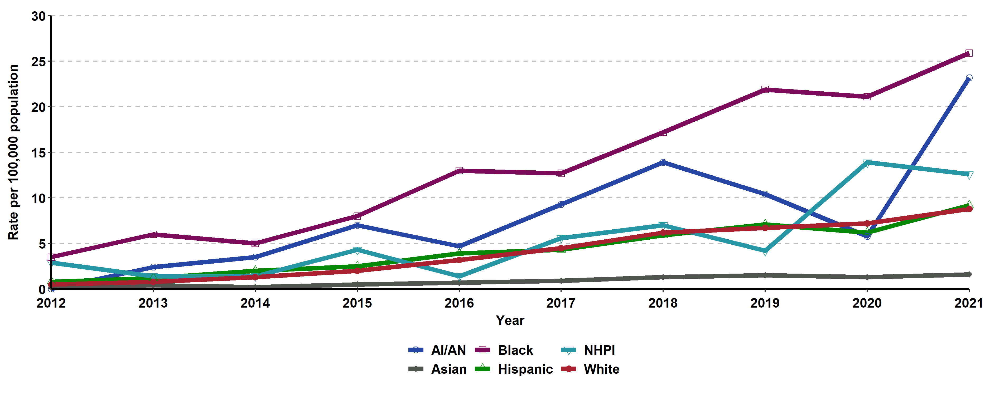
Primary & Secondary Syphilis, Incidence Rates for Females by
Race/Ethnicity, California, 2012–2021
AI/AN = American Indian/Alaska Native; NHPI = Native Hawaiian/Other Pacific Islander.
Race/ethnicity “Not Specified” ranged from 3.42% to 15.41% of cases for females in any given year.

Slide 23
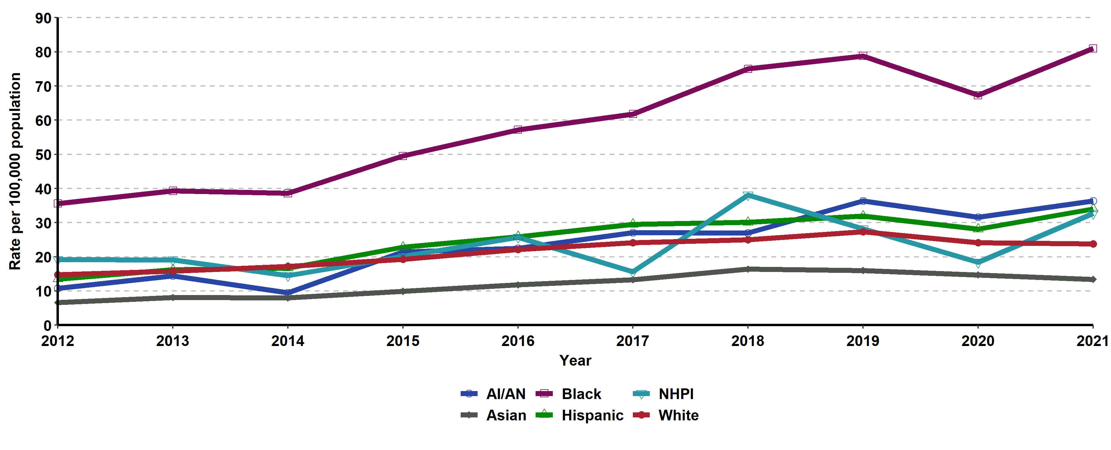
Primary & Secondary Syphilis, Incidence Rates for Males by
Race/Ethnicity, California, 2012–2021
AI/AN = American Indian/Alaska Native; NHPI = Native Hawaiian/Other Pacific Islander.
Race/ethnicity “Not Specified” ranged from 3.24% to 10.95% of cases for males in any given year.

Slide 24
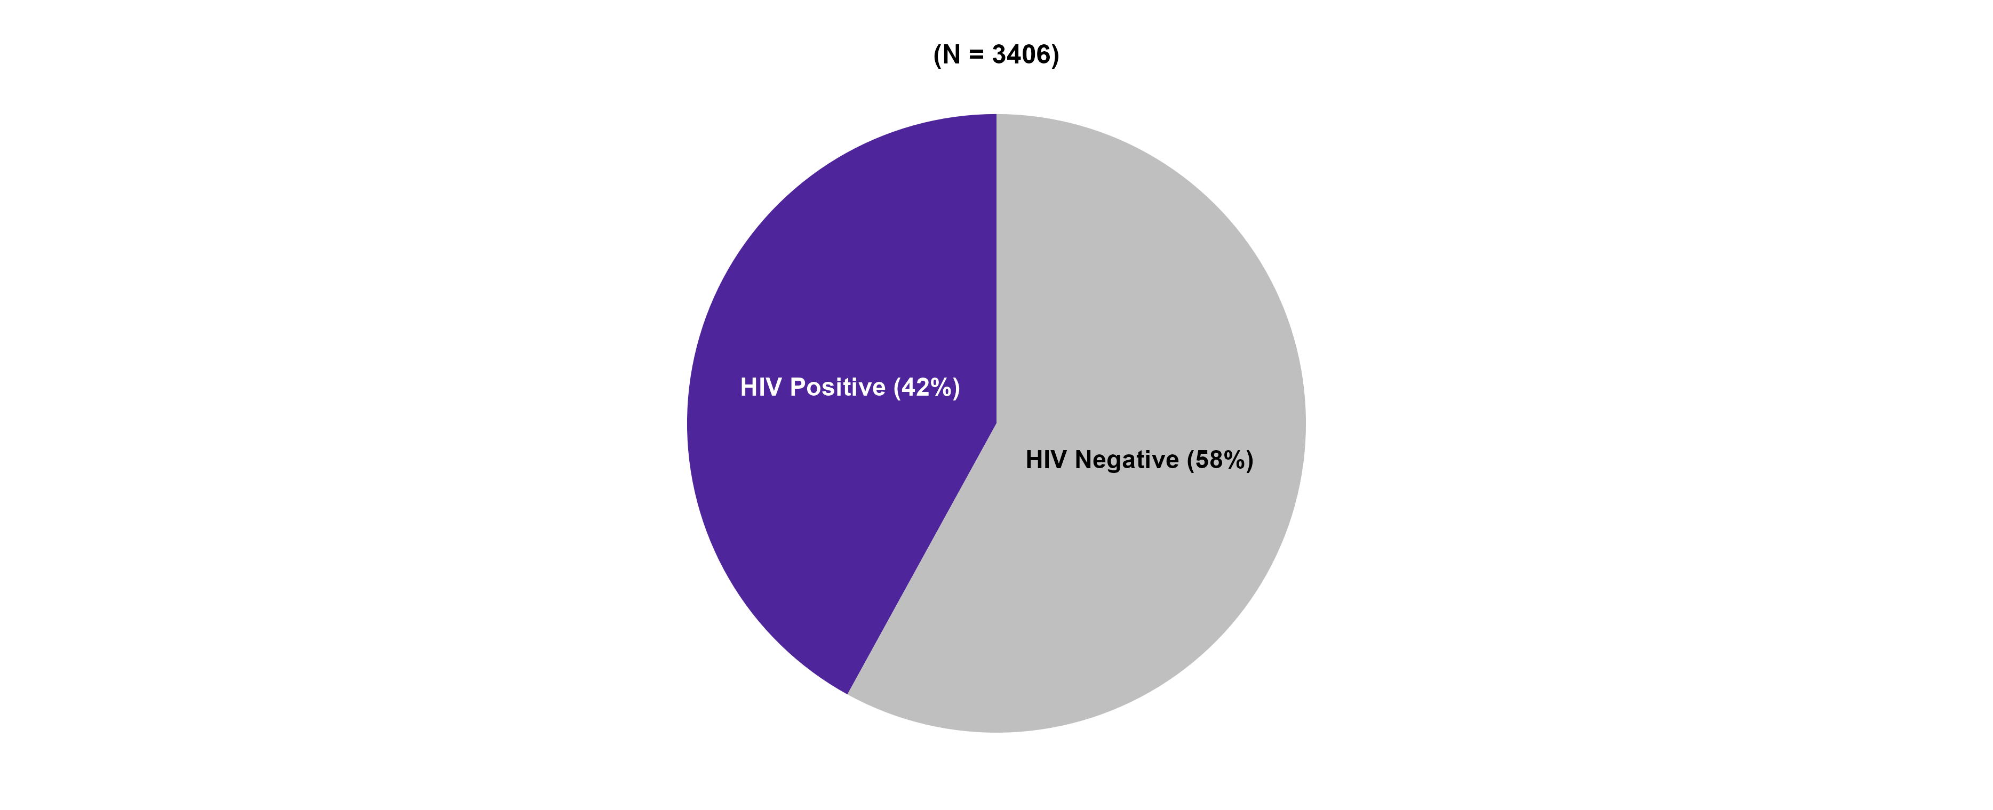
HIV Status among Primary & Secondary Syphilis Men Who Had Sex with Men* Cases, California, 2021
MSM includes Men who had sex with Men only.
N does not include HIV status unknown or refused to state: 299 cases in 2021

Slide 25
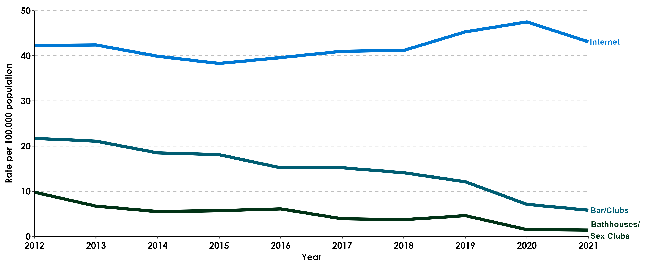
Percent of Interviewed Primary & Secondary Syphilis Men Who Had Sex with Men Cases Who Reported Meeting Sex Partners at Specified Venues, California, 2012–2021
MSM includes Men who had sex with Men only.

Slide 26
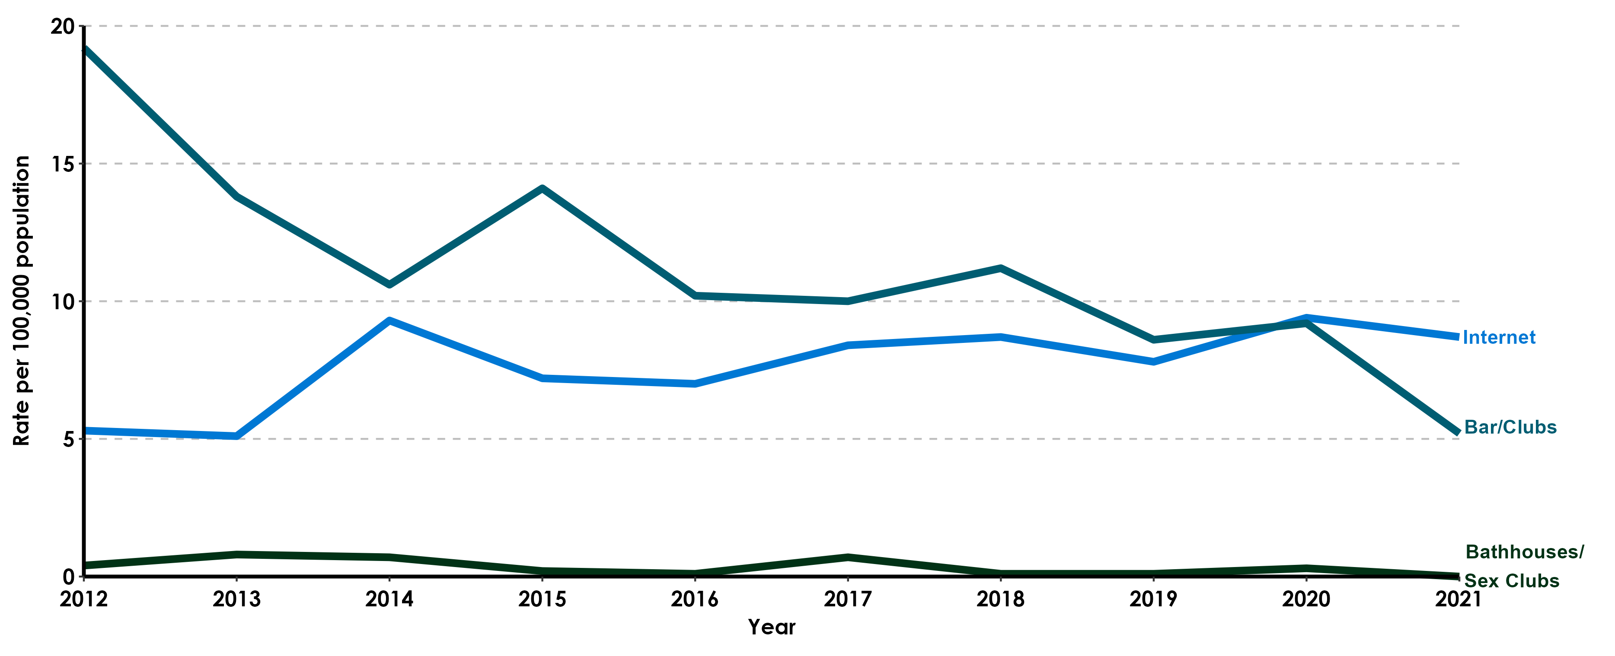
Percent of Interviewed Primary & Secondary Syphilis Men Who Had Sex with Women Cases Who Reported Meeting Sex Partners at Specified Venues, California, 2012–2021

Slide 27
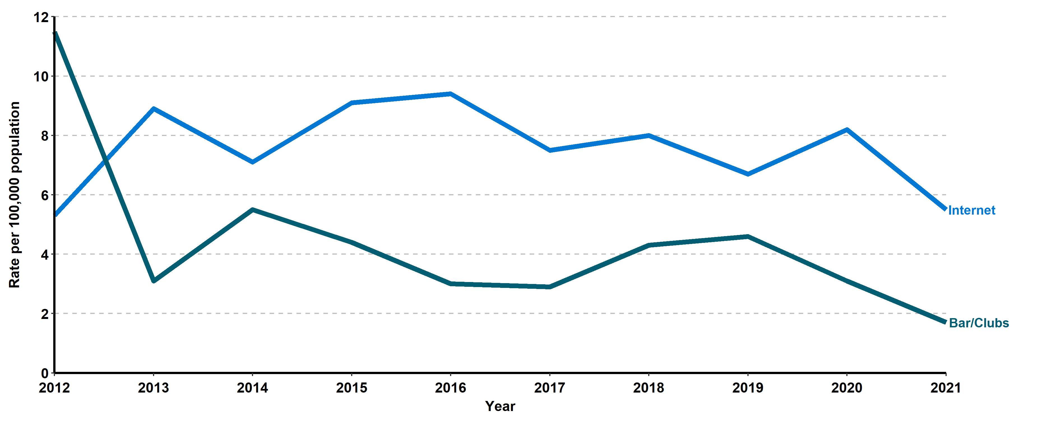
Percent of Interviewed Primary & Secondary Syphilis Female Cases Who Reported Meeting Sex Partners at Specified Venues, California, 2012–2021
Bathhouses/Sex Clubs have been excluded as each year were 0% of cases.

Slide 28
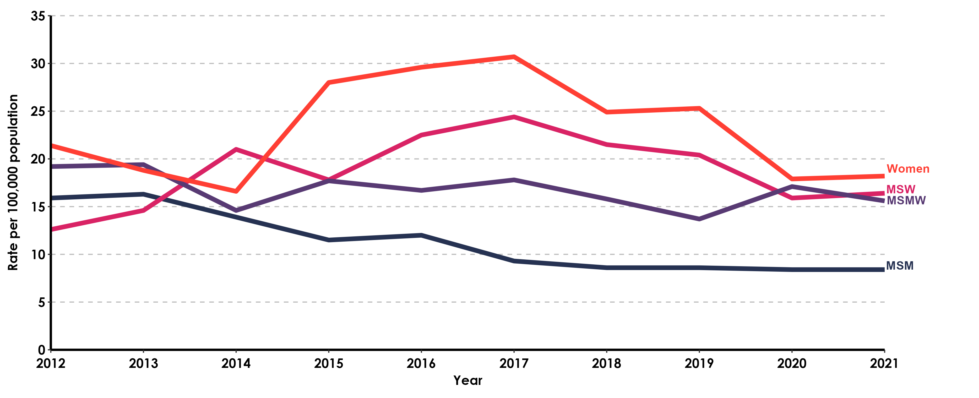
Percent of Interviewed Primary & Secondary Syphilis Cases Who Reported Methamphetamine Use, by Gender and Gender of Sex Partners, California, 2012-2021
MSM includes Men who report only Men as the gender of their sex partners;
MSMW includes Men who report both Men and Women as the gender of their sex partners;
MSW includes Men who report only Women as the gender of their sex partners;

Slide 29
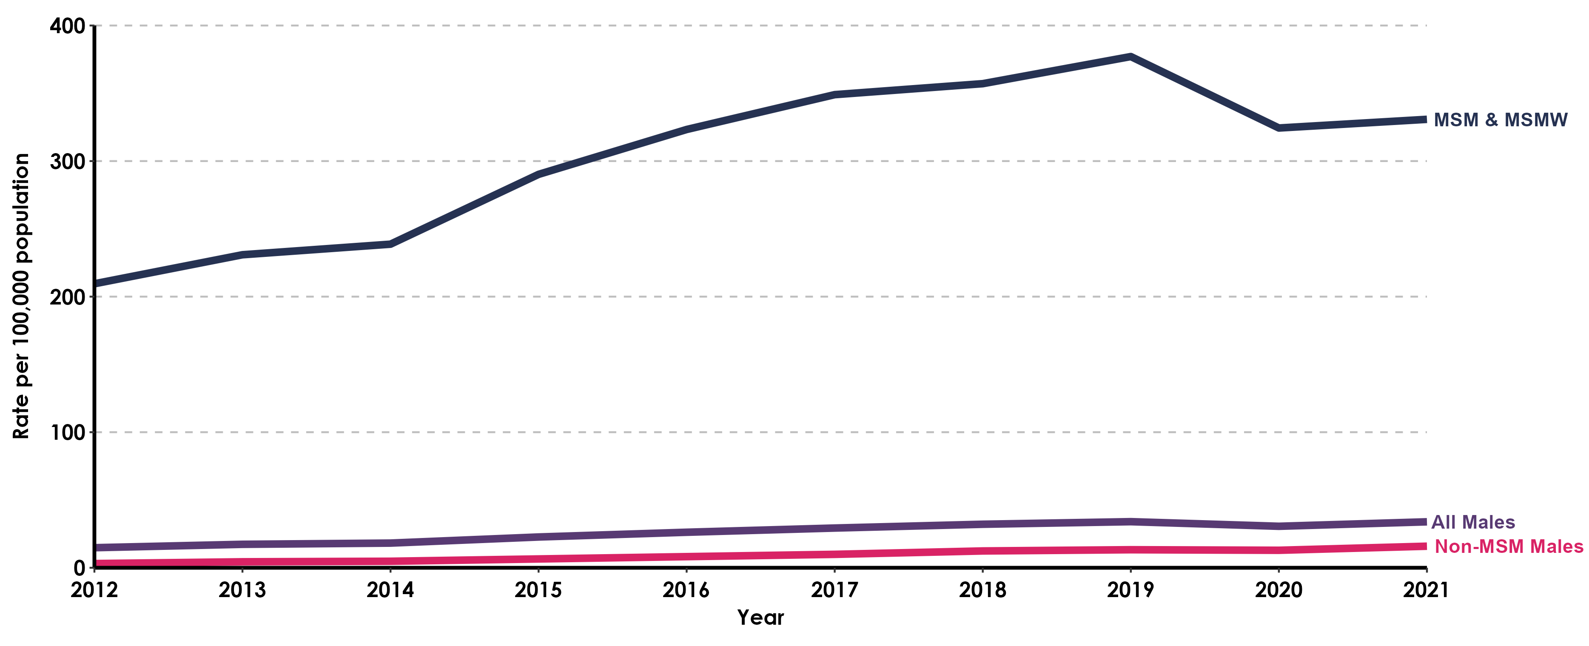
Primary & Secondary Syphilis, Incidence Rates for Males by Gender of Sex Partners, California, 2012-2021
MSM includes Men who had sex with Men only. MSMW includes Men who had sex with both Men and Women.
Estimates for MSM population were calculated from the American Community Survey (ACS) data (2009-2013) and estimated to be 5.7% of the Male population in California.
Grey et al. Estimating the Population Sizes of Men Who Have Sex With Men in US States and Counties Using Data From the American Community Survey. 2016. JMIR Public Health Surveillance. https://publichealth.jmir.org/2016/1/e14/

Slide 30
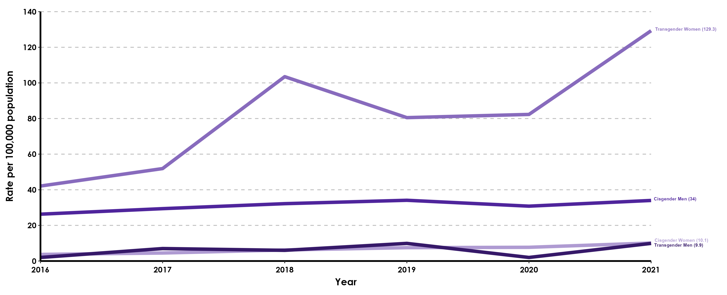
Primary & Secondary Syphilis Incidence Rates by Gender Identity, California, 2016-2021
Transgender population estimates were calculated using Herman, J.L., Flores, A.R., O’Neill, K.K. (2022). How Many Adults and Youth Identify as Transgender in the United States? The Williams Institute, UCLA School of Law

Slide 31
Early Syphilis
(Revised 02/2023)

Slide 32
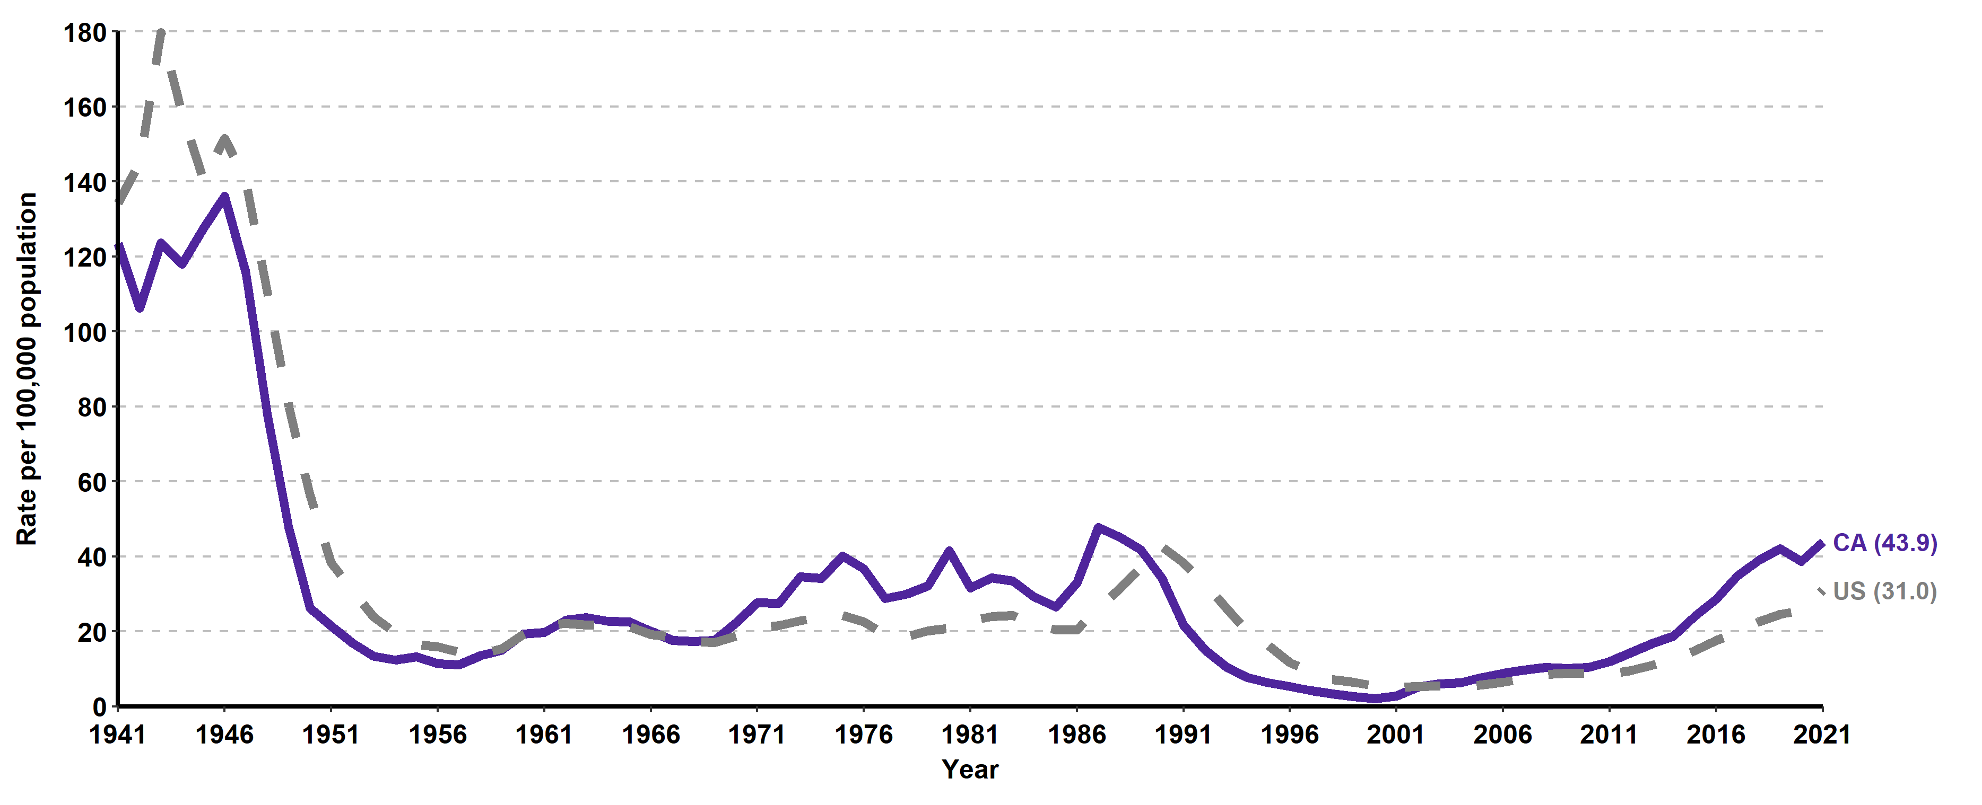
Early Syphilis*, California versus United States
Incidence Rates, 1941–2021
* Early syphilis includes primary, secondary, and early non-primary non-secondary syphilis.

Slide 33

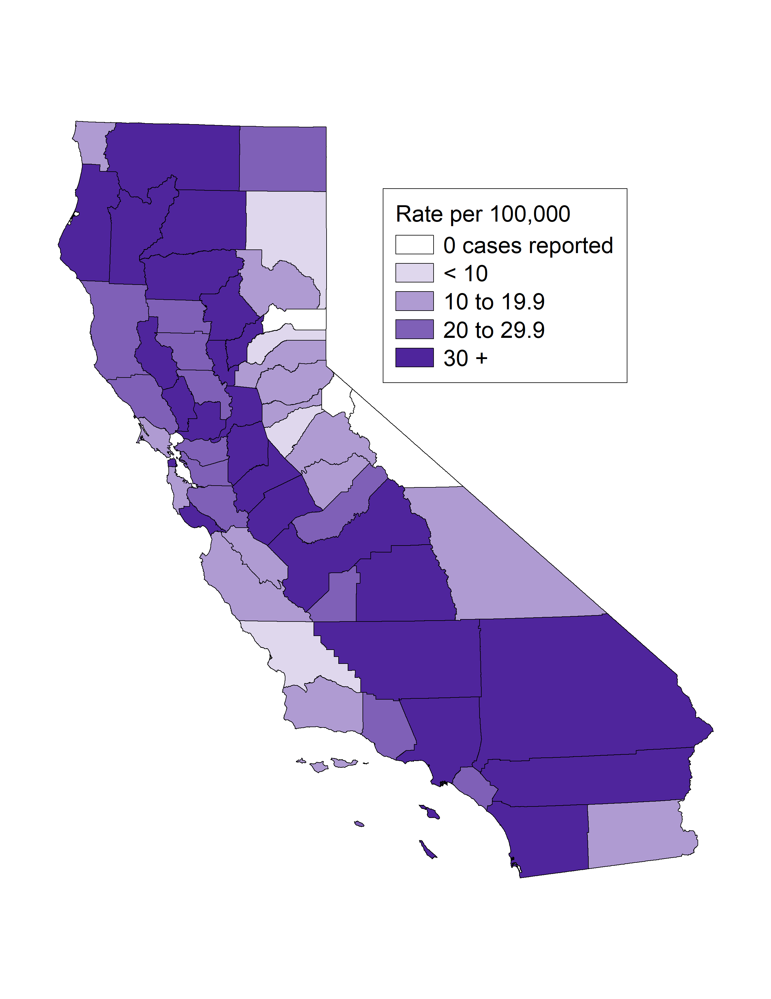
Early Syphilis*, Case Counts and Incidence Rates by
County, California, 2021
Early Syphilis Cases
Early Syphilis Rates
* Early syphilis includes primary, secondary, and early non-primary non-secondary syphilis.

Slide 34
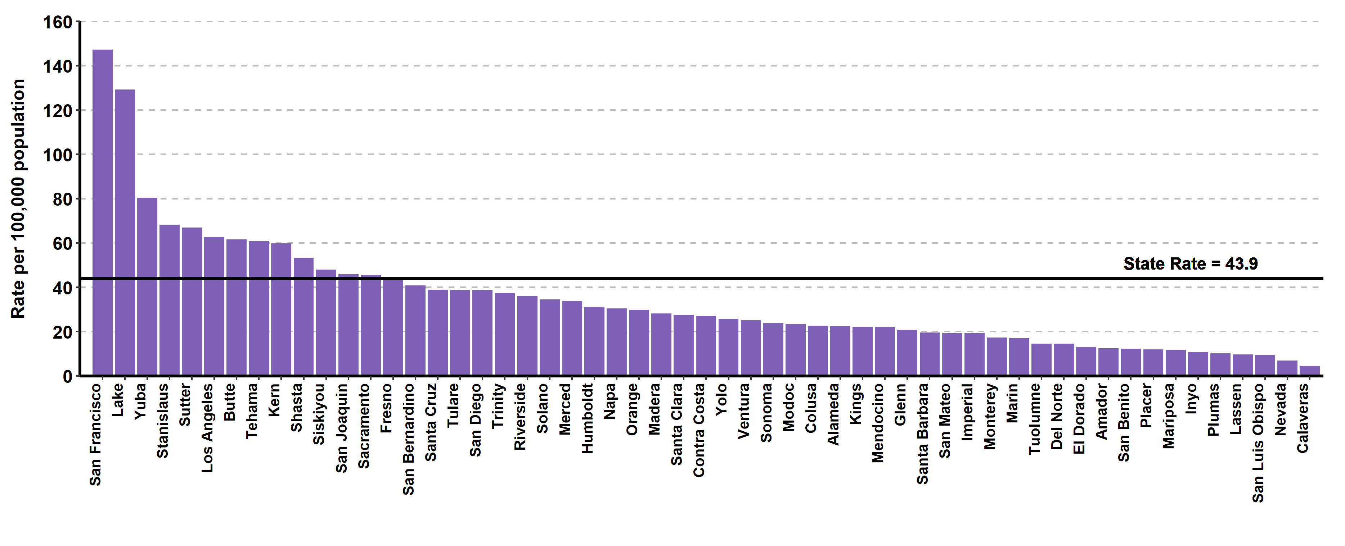
Early Syphilis*, Ranked Incidence Rates by County, California, 2021
* Early syphilis includes primary, secondary, and early non-primary non-secondary syphilis.
This figure excludes counties with zero cases (3 counties had zero cases in 2021)

Slide 35
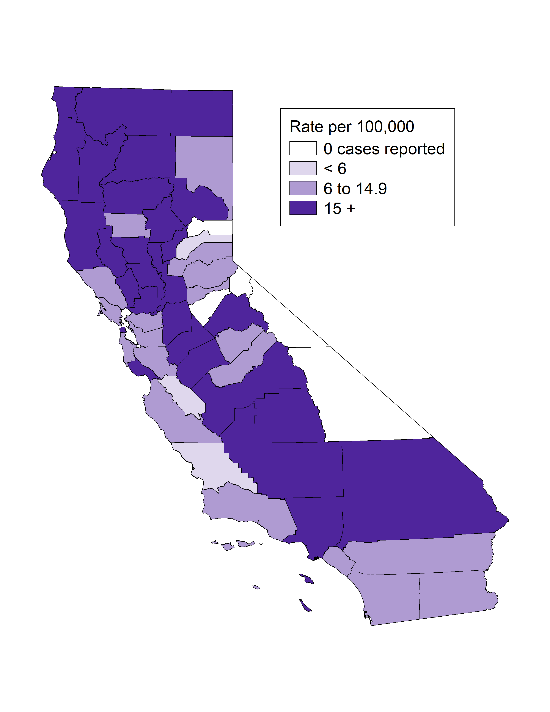
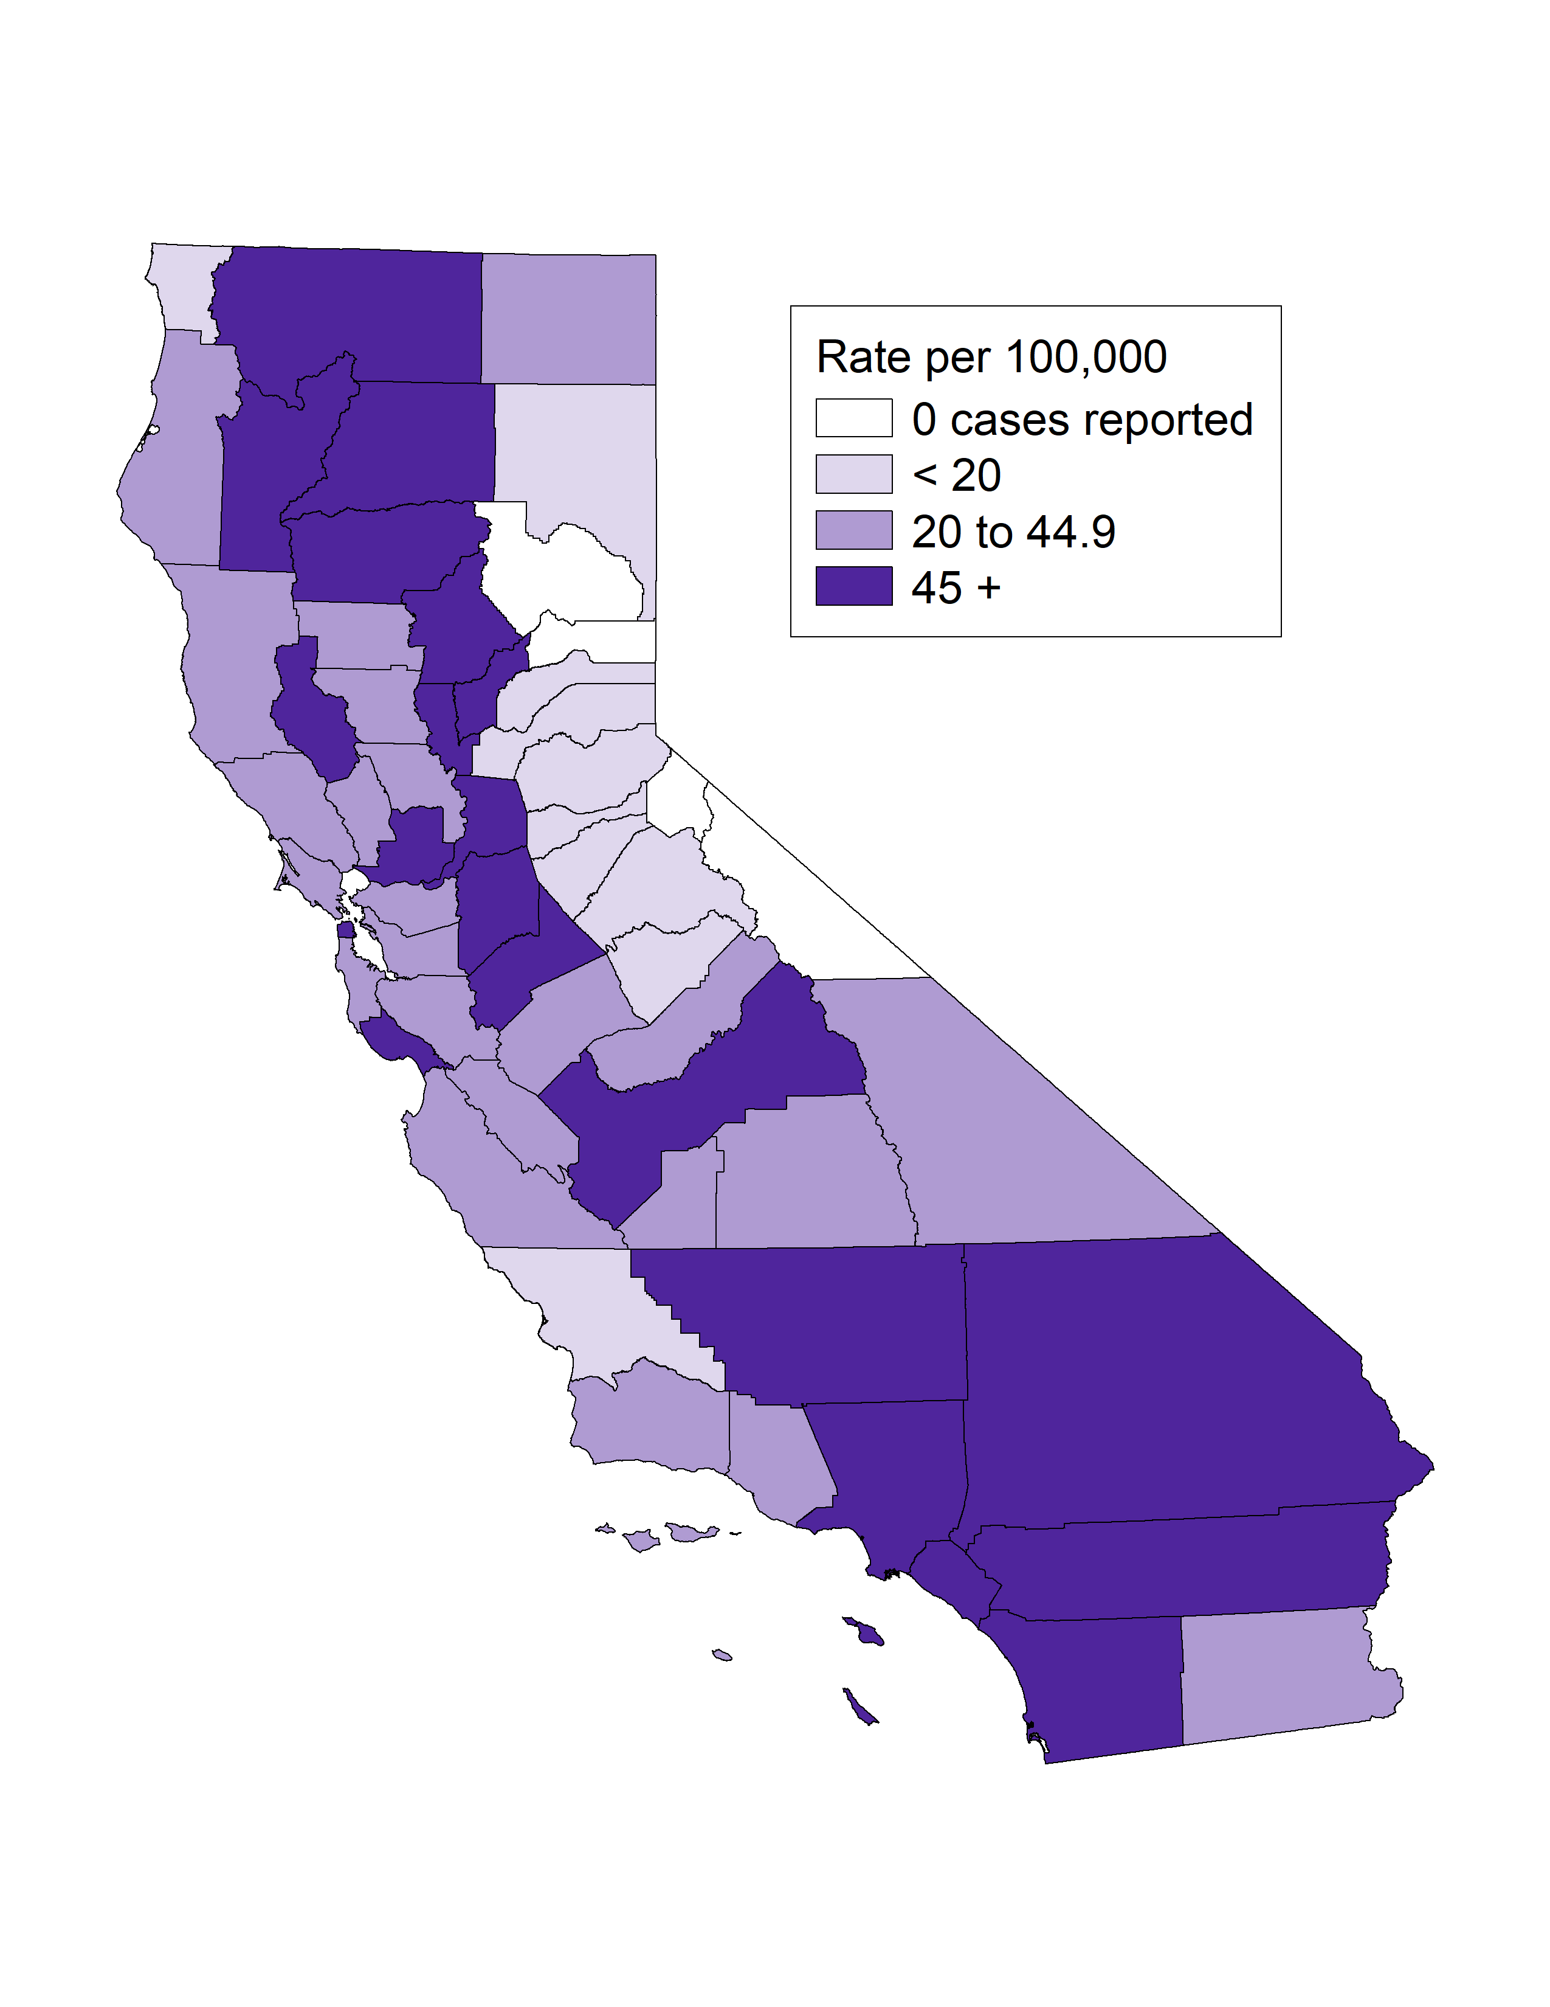
Early Syphilis*, Incidence Rates by County and Gender,
California, 2021
Early Syphilis Female Rates
Early Syphilis Male Rates
* Early syphilis includes primary, secondary, and early non-primary non-secondary syphilis.
Different scales are displayed for female versus male rate ranges.

Slide 36
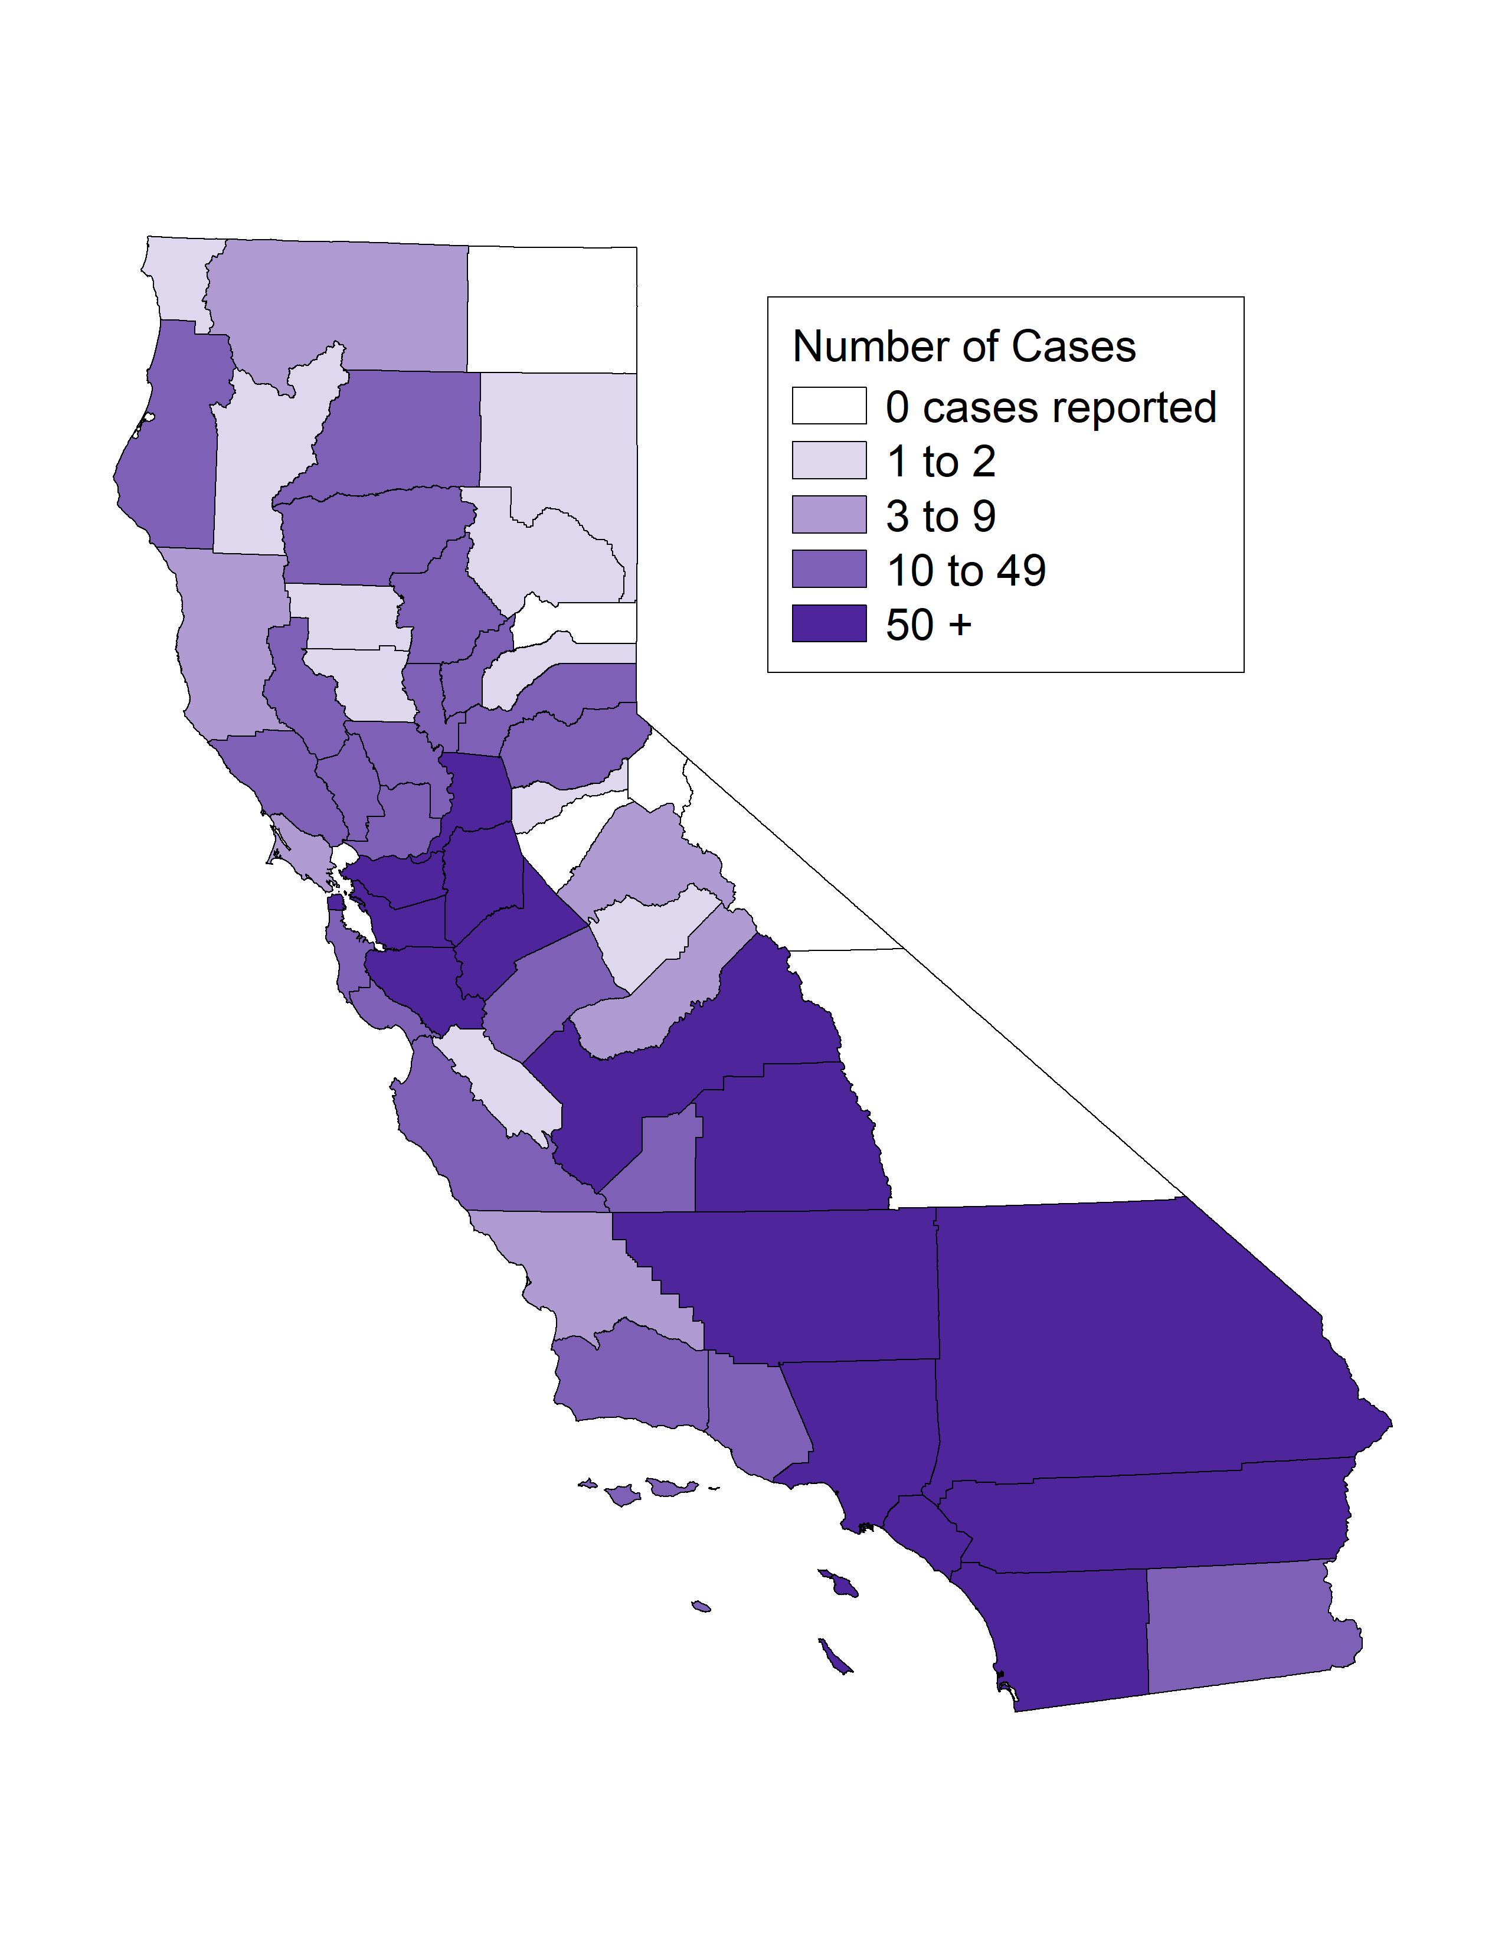
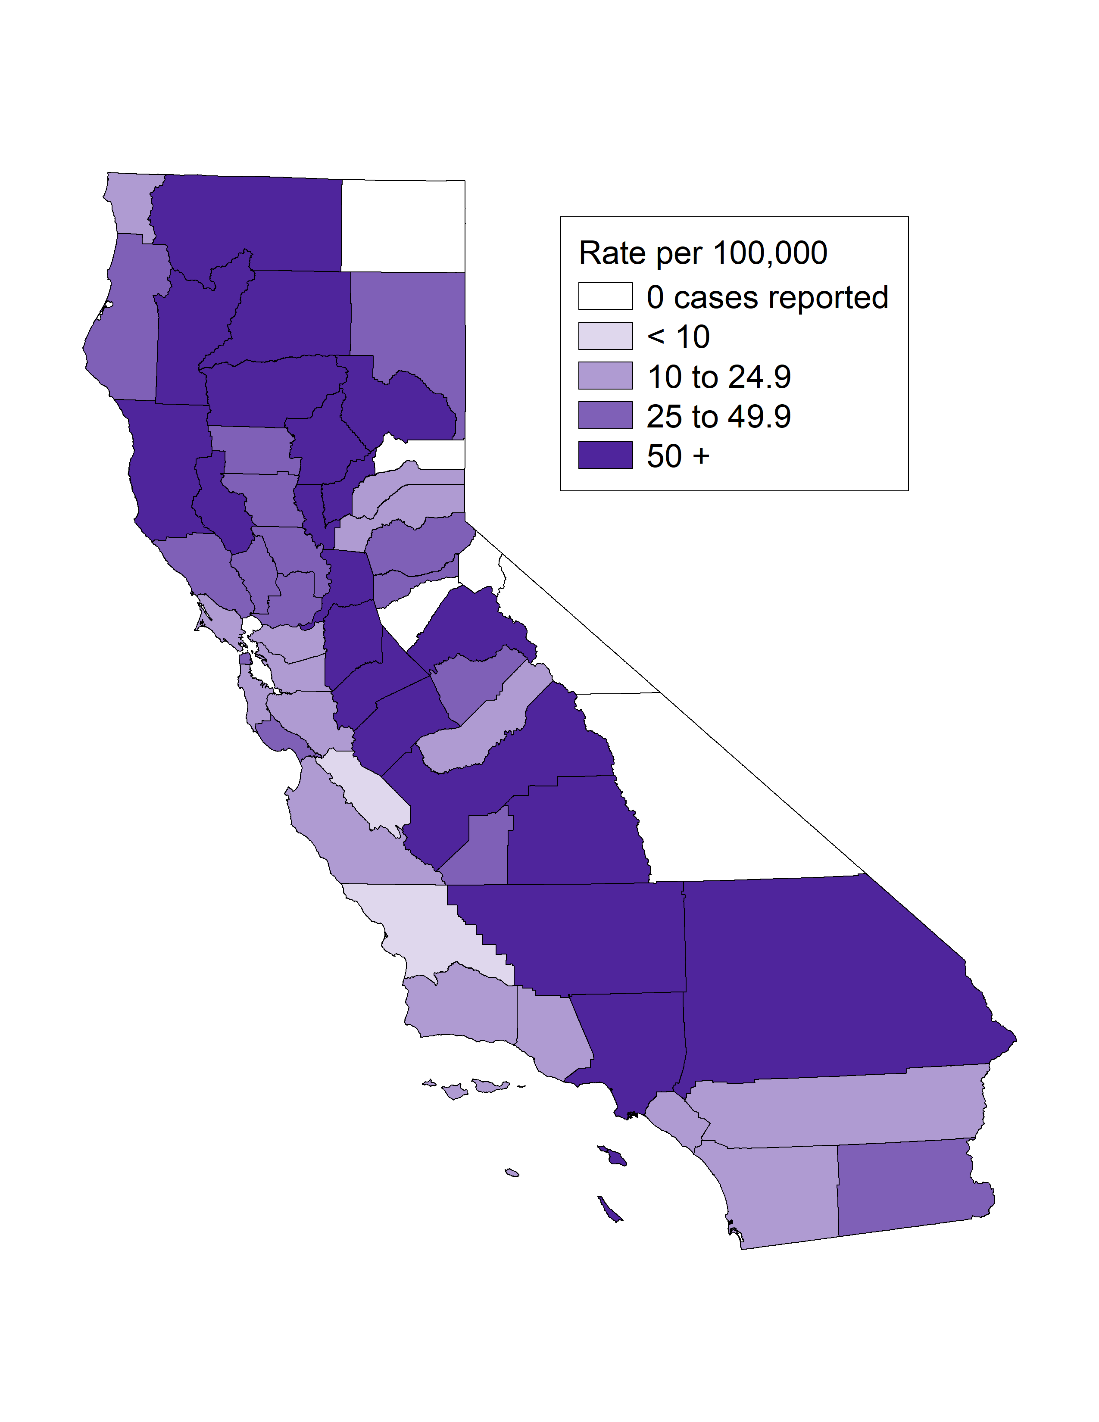
Early Syphilis* among Females Ages 15-44, Case Counts and Incidence Rates by County, California, 2021
Early Syphilis Female Ages 15-44 Cases
Early Syphilis Female Ages 15-44 Rates
* Early syphilis includes primary, secondary, and early non-primary non-secondary syphilis.

Slide 37
Early Syphilis*, Incidence Rates by Region, California, 2012–2021
* Early syphilis includes primary, secondary, and early non-primary non-secondary syphilis.

Slide 38
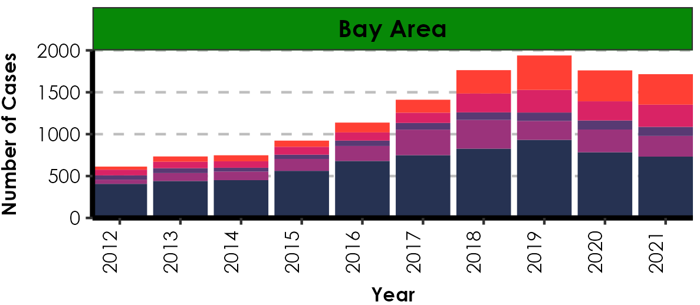







Number of Early Syphilis* Cases by Region, Gender, Gender of Sex Partners, and Year, California, 2012–2021
MSM includes Men who had sex with Men only. MSMW includes Men who had sex with both Men and Women. MSU includes Men with unknown gender of sex partners. MSW includes Men who had sex with Women only
* Early syphilis includes primary, secondary, and early non-primary non-secondary syphilis.

Slide 39

Early Syphilis*, Case Counts by Gender, California, 2002-2021
* Early syphilis includes primary, secondary, and early non-primary non-secondary syphilis.

Slide 40

Early Syphilis*, Male Case Counts by Gender of Sex Partners, California, 2002-2021
* Early syphilis includes primary, secondary, and early non-primary non-secondary syphilis.
MSM includes Men who had sex with Men only. MSMW includes Men who had sex with both Men and Women.
MSU includes Men with unknown gender of sex partners. MSW includes Men who had sex with Women only

Slide 41

Early Syphilis*, Cases by Gender and Gender of Sex Partners, California, 2021
* Early syphilis includes primary, secondary, and early non-primary non-secondary syphilis.
MSM includes Men who had sex with Men only. MSMW includes Men who had sex with both Men and Women.
MSU includes Men with unknown gender of sex partners. MSW includes Men who had sex with Women only

Slide 42

Early Syphilis*, Incidence Rates by and Gender, California, 2002-2021
* Early syphilis includes primary, secondary, and early non-primary non-secondary syphilis.
Age was “Not Specified” for 0.05% of female cases and 0% of male cases in 2021.

Slide 43

Early Syphilis*, Incidence Rates by Age Group (in years) and Gender, California, 2021
* Early syphilis includes primary, secondary, and early non-primary non-secondary syphilis.
Age was “Not Specified” for 0.05% of female cases and 0% of male cases in 2021.

Slide 44

Early Syphilis*, Incidence Rates for Females by Age Group (in years), California, 2012–2021
* Early syphilis includes primary, secondary, and early non-primary non-secondary syphilis.
Age “Not Specified” ranged from 0% to 0.07% of cases for females in any given year.

Slide 45

Early Syphilis*, Incidence Rates for Males by Age Group (in years),
California, 2012–2021
* Early syphilis includes primary, secondary, and early non-primary non-secondary syphilis.
Age “Not Specified” ranged from 0% to 0.06% of cases for males in any given year.

Slide 46

Early Syphilis*, Incidence Rates by Race/Ethnicity and Gender,
California, 2021
AI/AN = American Indian/Alaska Native; NHPI = Native Hawaiian/Other Pacific Islander.
* Early syphilis includes primary, secondary, and early non-primary non-secondary syphilis.
Race/Ethnicity was “Not Specified” for 14.17% of female cases and 8.64% of male cases in 2021.

Slide 47




Early Syphilis*, Female Incidence Rates by Race/Ethnicity and Age Group (in years), California, 2021
* Early syphilis includes primary, secondary, and early non-primary non-secondary syphilis.
American Indian/Alaska Native and Native Hawaiian/Other Pacific Islander and race-specific data for ages 0-14 were suppressed as per agency Data De-Identification Guidelines (DDG).

Slide 48




Early Syphilis*, Male Incidence Rates by Race/Ethnicity and Age Group (in years), California, 2021
* Early syphilis includes primary, secondary, and early non-primary non-secondary syphilis.
American Indian/Alaska Native and Native Hawaiian/Other Pacific Islander and race-specific data for ages 0-14 were suppressed as per agency Data De-Identification Guidelines (DDG).

Slide 49

Early Syphilis*, Incidence Rates for Females by Race/Ethnicity,
California, 2012–2021
* Early syphilis includes primary, secondary, and early non-primary non-secondary syphilis.
AI/AN = American Indian/Alaska Native; NHPI = Native Hawaiian/Other Pacific Islander.
Race/ethnicity “Not Specified” ranged from 2.88% to 14.17% of cases for females in any given year.

Slide 50

Early Syphilis*, Incidence Rates for Males by Race/Ethnicity,
California, 2012–2021
* Early syphilis includes primary, secondary, and early non-primary non-secondary syphilis.
AI/AN = American Indian/Alaska Native; NHPI = Native Hawaiian/Other Pacific Islander.
Race/ethnicity “Not Specified” ranged from 3.24% to 10.95% of cases for males in any given year.

Slide 51

HIV Status among Early Syphilis* Men Who Had Sex with Men Cases, California, 2021
* Early syphilis includes primary, secondary, and early non-primary non-secondary syphilis.
MSM includes Men who had sex with Men only.
N does not include HIV status unknown or refused to state: 641 cases in 2021.

Slide 52

HIV PrEP Use among Early Syphilis* HIV Negative Men Who Had Sex with Men Cases, California Project Area‡, 2021
* Early syphilis includes primary, secondary, and early non-primary non-secondary syphilis.
‡California Project Area (CPA) excludes Los Angeles and San Francisco local health jurisdictions.
MSM includes Men who had sex with Men only.
PrEP=Pre-exposure prophylaxis. N does not include PrEP status unknown or refused to state: 268 cases in 2021.

Slide 53

Early Syphilis*, Incidence Rates by Sex, Gender of Sex Partners, and HIV Status, California, 2021
* Early syphilis includes primary, secondary, and early non-primary non-secondary syphilis.
MSM includes Men who had sex with Men and Men who had sex with both Men and Women.

Slide 54

Percent of Interviewed Early Syphilis* Men Who Had Sex with Men Cases Who Reported Meeting Sex Partners at Specified Venues, California, 2012–2021
* Early syphilis includes primary, secondary, and early non-primary non-secondary syphilis.
MSM includes Men who had sex with Men only.

Slide 55

Percent of Interviewed Early Syphilis* Men Who Had Sex with Women Cases Who Reported Meeting Sex Partners at Specified Venues, California, 2012–2021
* Early syphilis includes primary, secondary, and early non-primary non-secondary syphilis.

Slide 56

Percent of Interviewed Early Syphilis* Female Cases Who Reported Meeting Sex Partners at Specified Venues, California, 2012–2021
* Early syphilis includes primary, secondary, and early non-primary non-secondary syphilis.
Bathhouses/Sex Clubs have been excluded as each year was under 1% of cases.

Slide 57

Percent of Interviewed Early Syphilis* Syphilis Cases Who Reported Methamphetamine Use, by Gender and Gender of Sex Partners, California, 2012-2021
* Early syphilis includes primary, secondary, and early non-primary non-secondary syphilis.
MSM includes Men who had sex with Men only. MSMW includes Men who had sex with both Men and Women. MSW includes Men who had sex with Women only.

Slide 58

Early Syphilis*, Incidence Rates for Males by Gender of Sex Partners, California, 2012-2021
* Early syphilis includes primary, secondary, and early non-primary non-secondary syphilis.
MSM includes Men who had sex with Men only. MSMW includes Men who had sex with both Men and Women.
Estimates for MSM population were calcuated from the American Community Survey (ACS) data (2009-2013) and estimated to be 5.7% of the Male population in California.
Grey et al. Estimating the Population Sizes of Men Who Have Sex With Men in US States and Counties Using Data From the American Community Survey. 2016. JMIR Public Health Surveillance. https://publichealth.jmir.org/2016/1/e14/

Slide 59

Early Syphilis* Incidence Rates by Gender Identity, California, 2016-2021
* Early syphilis includes primary, secondary, and early non-primary non-secondary syphilis.
Transgender population estimates were calculated using Herman, J.L., Flores, A.R., O’Neill, K.K. (2022). How Many Adults and Youth Identify as Transgender in the United States? The Williams Institute, UCLA School of Law

Slide 60
Congenital Syphilis
(Revised 02/2023)

Slide 61

Congenital Syphilis (all stages), California Incidence Rates, 1941–2021

Slide 62

Congenital Syphilis, California versus United States
Incidence Rates, 1963–2021
The Modified Kaufman Criteria were used through 1989. The CDC Case Definition (MMWR 1989; 48: 828) was used effective January 1, 1990. California data prior to 1985 include all cases of congenital syphilis, regardless of age.

Slide 63


Congenital Syphilis, Case Counts and Incidence Rates by County,
California, 2021
Congenital Syphilis Cases
Congenital Syphilis Rates

Slide 64

Congenital Syphilis, Ranked Incidence Rates by County,
California, 2021
This figure excludes counties with zero cases (24 counties had zero cases in 2021)

Slide 65

Congenital Syphilis, Cases by Vital Status and Presence of
Signs/Symptoms, California, 2012-2021
Alive, no signs of CS includes cases that were alive but were missing documentation of signs/symptoms.
Of the 528 total CS cases in 2021, 424 were alive with no signs, 53 were alive with signs of CS, 49 were stillbirths or neonatal deaths.

Slide 66

Congenital Syphilis Stillbirths or Neonatal Deaths, California, 2012-2021

Slide 67

Congenital Syphilis, Stillbirth versus Live Birth Case Counts, California, 1990-2021

Slide 68

Congenital Syphilis versus Female Primary & Secondary Syphilis Incidence Rates, California, 1990-2021
P&S rates include Primary and Secondary Syphilis Rates

Slide 69
Early Syphilis* Incidence Rates among Women Age (15-44) & Congenital Syphilis Incidence Rates, by County, California, 2021
Early Syphilis Female Ages 15-44 Rates
Congenital Syphilis Rates
* Early syphilis includes primary, secondary, and early non-primary non-secondary syphilis.

Slide 70

Congenital Syphilis Cases and Early Syphilis* Incidence Rates among Females Ages 15-44, California, 2012-2021
* Early syphilis includes primary, secondary, and early non-primary non-secondary syphilis.

Slide 71

Congenital Syphilis Cases and Syphilis (all stages*) Incidence Rates among Females Ages 15-44, California, 2012-2021
* Includes primary, secondary, early non-primary non-secondary, and unknown duration or late syphilis.

Slide 72

Congenital Syphilis Cases and Female Early Syphilis* Cases by Pregnancy Status, California, 2012-2021
* Early syphilis includes primary, secondary, and early non-primary non-secondary syphilis.

Slide 73

Congenital Syphilis Cases and Female Syphilis (all stages*) Cases by Pregnancy Status, California, 2012-2021
* Includes primary, secondary, early non-primary non-secondary, and unknown duration or late syphilis.

Slide 74

Congenital Syphilis Cases and Females Ages 15-44 Early Syphilis* Cases by Pregnancy Status, California, 2012-2021
* Early syphilis includes primary, secondary, and early non-primary non-secondary syphilis.

Slide 75

Congenital Syphilis Cases and Females Ages 15-44 Syphilis (all stages*) Cases by Pregnancy Status, California, 2012-2021
* Includes primary, secondary, early non-primary non-secondary, and unknown duration or late syphilis.

Slide 76

Female Early Syphilis* and Congenital Syphilis Cases, California, 2012–2021
* Early syphilis includes primary, secondary, and early non-primary non-secondary syphilis.

Slide 77

Female Syphilis (all stages*) and Congenital Syphilis Cases, California, 2012–2021
* Includes primary, secondary, early non-primary non-secondary, and unknown duration or late syphilis.

Slide 78

Congenital Syphilis, Incidence Rates for Females by Race/Ethnicity,
California, 2012–2021
Data were excluded for American Indian/Alaska Native and Native Hawaiian/Other Pacific Islander due to small number of cases causing unstable rates.

Slide 79

Congenital Syphilis, Incidence Rates by Race/Ethnicity, California, 2021
Data were excluded for American Indian/Alaska Native and Native Hawaiian/Other Pacific Islander due to small number of cases causing unstable rates.

Slide 80

Risk Factors Reported by Mothers of CS Infants, California Project Area (CPA), 2021
These data do not include Los Angeles or San Francisco local health jurisdictions.
*Prenatal care information was collected from CS cases in the CPA (N=405).
Additional risk information were collected through CS quality assurance review of case interview records (N=175 interviewed/405 (43.2) total CS cases in CPA).

