Slide 1
Gonorrhea
(Revised 02/2023)

Slide 2
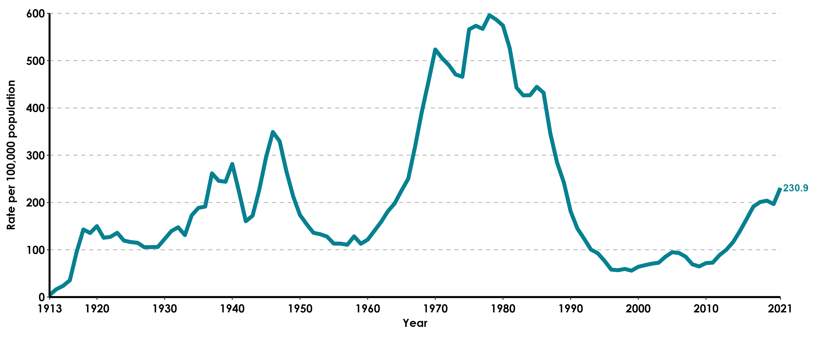
Gonorrhea, California Incidence Rates, 1913–2021

Slide 3
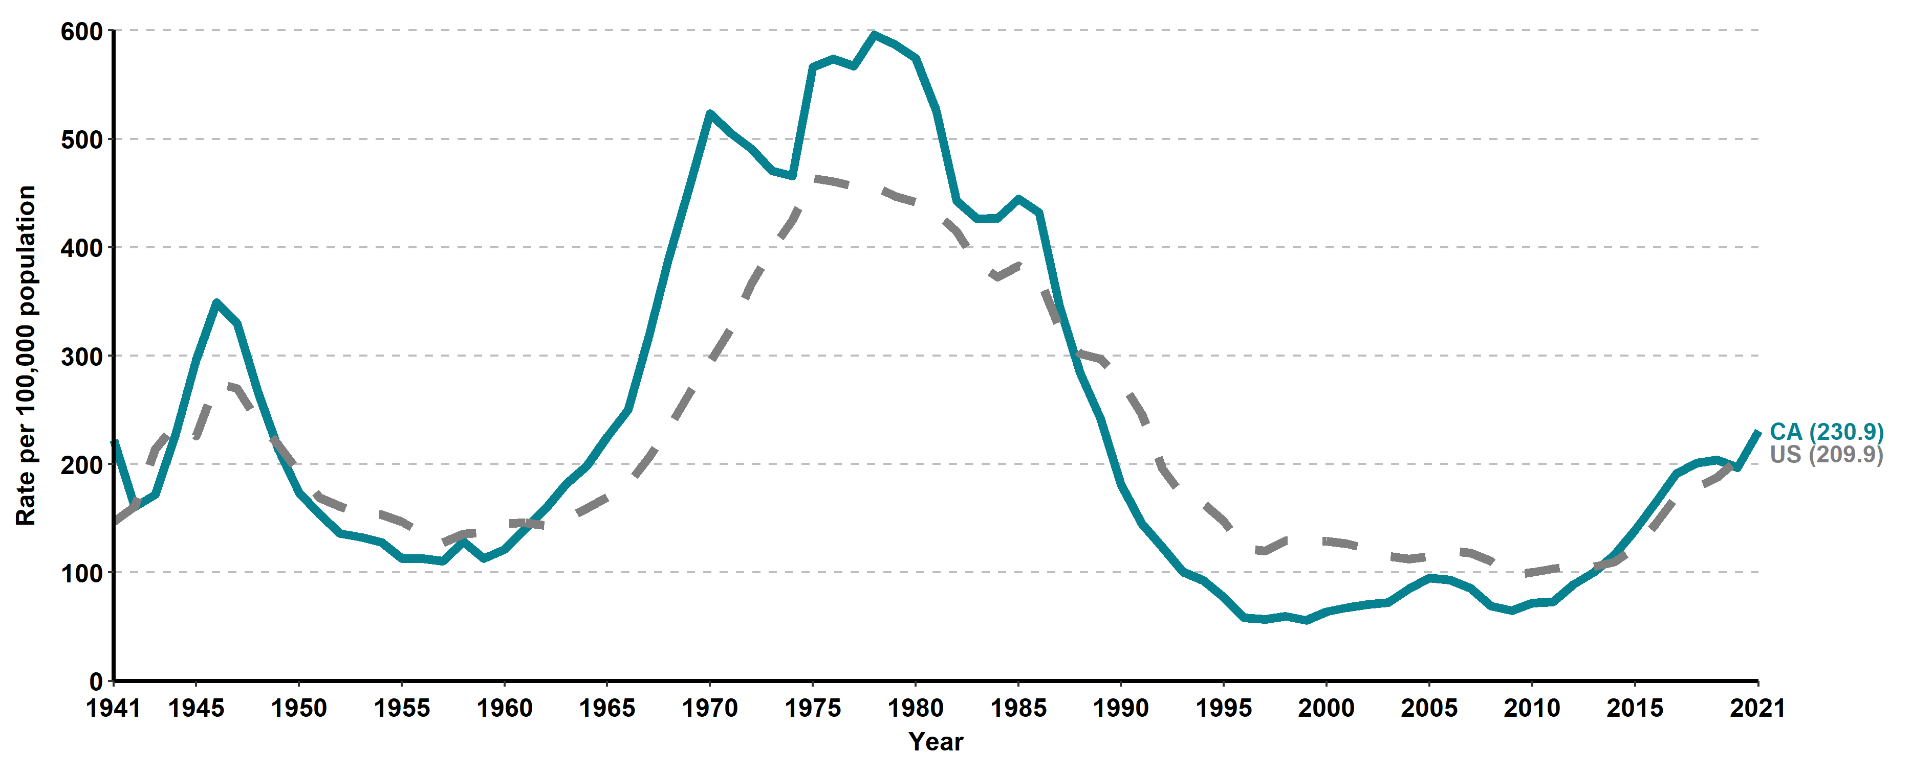
Gonorrhea, California versus United States
Incidence Rates, 1941–2021

Slide 4
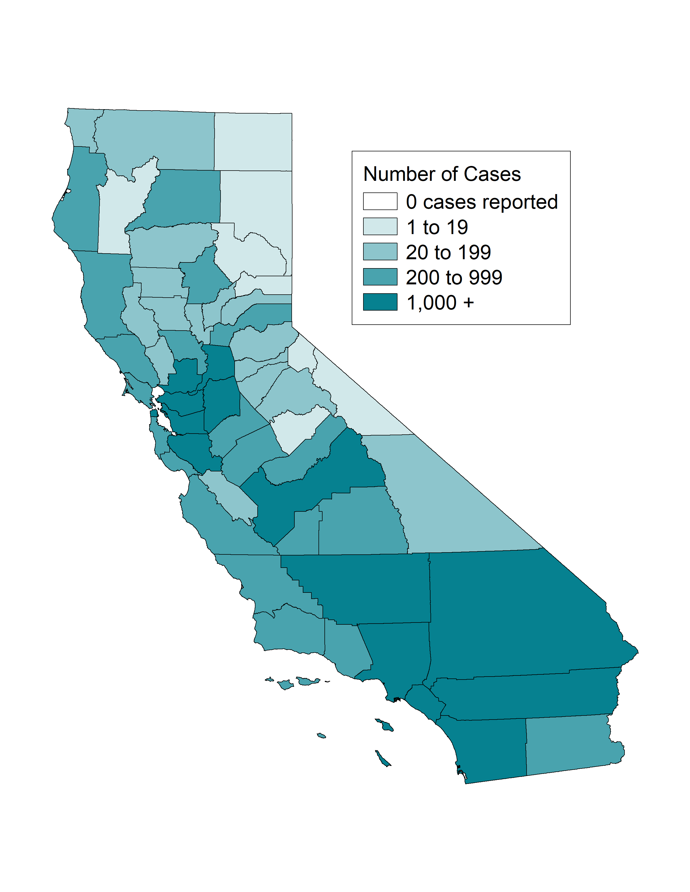
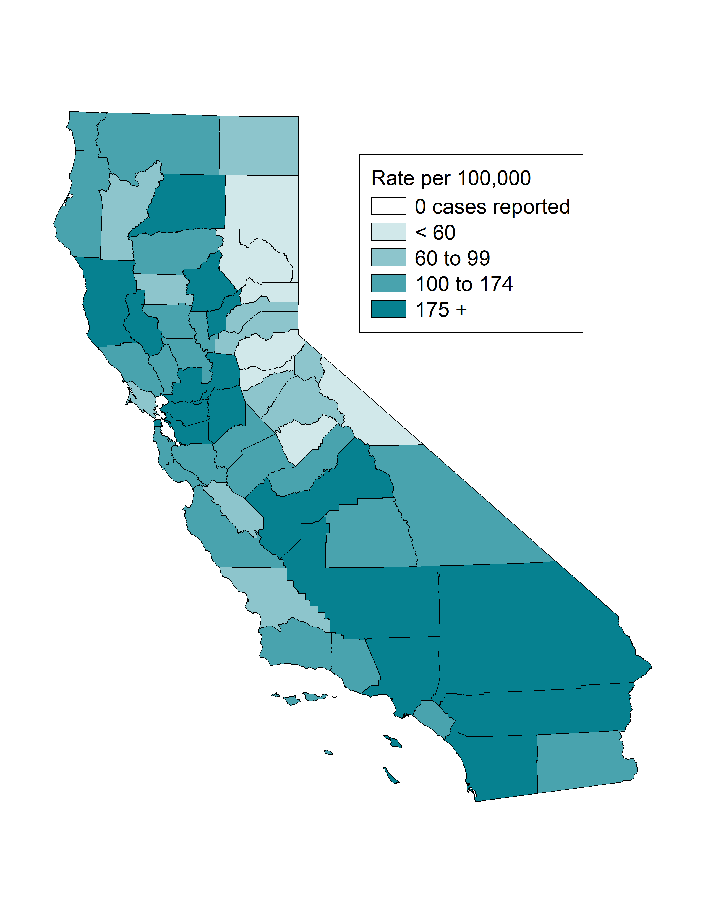
Gonorrhea, Case Counts and Incidence Rates by County, California, 2021
Gonorrhea Cases
Gonorrhea Rates

Slide 5
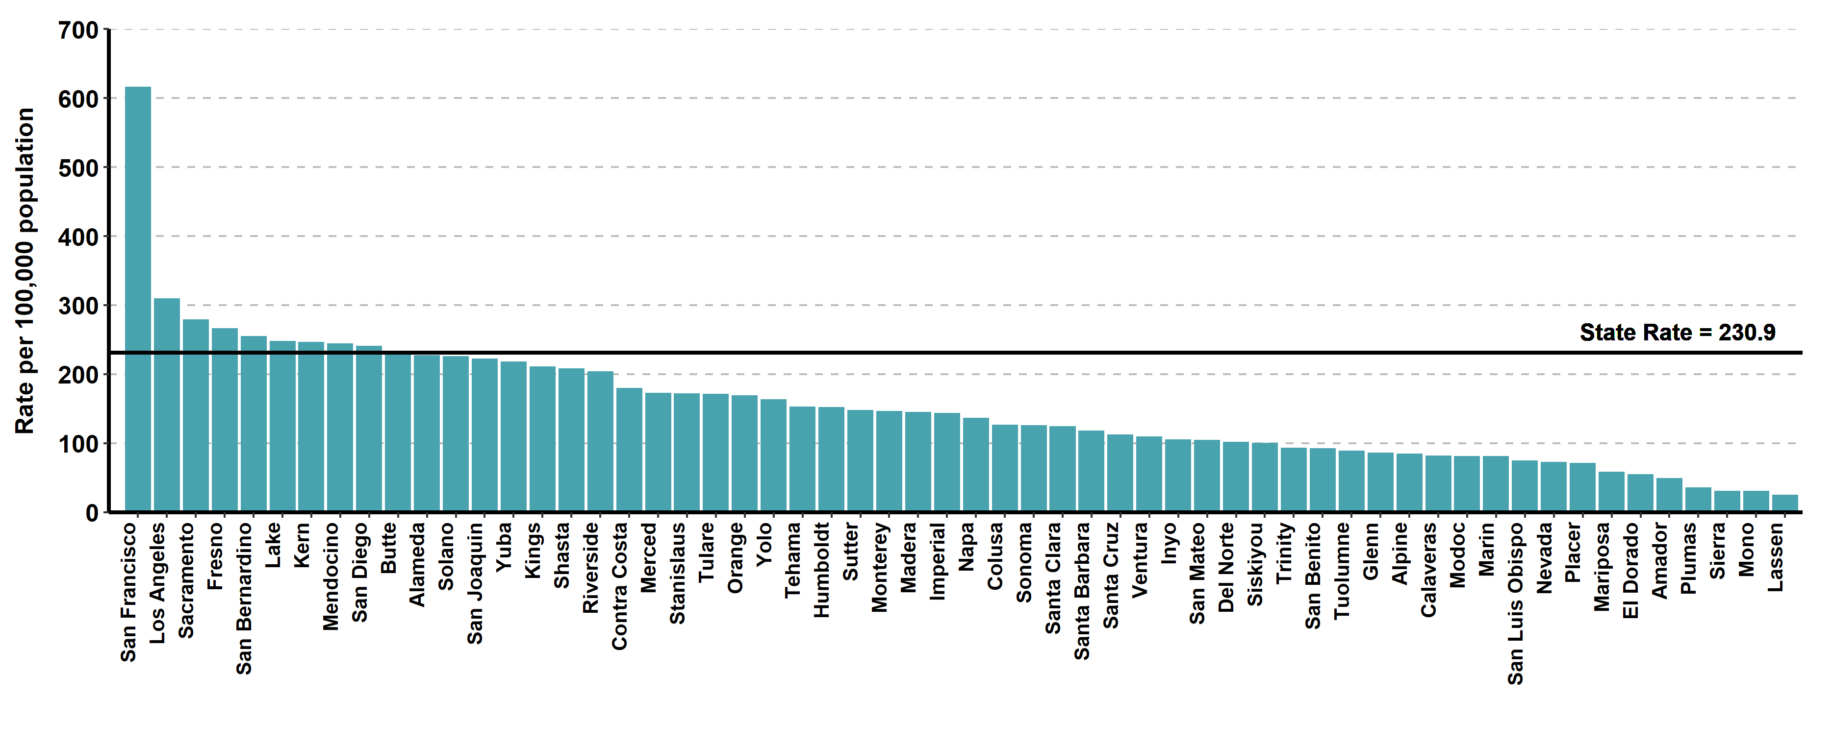
Gonorrhea, Ranked Incidence Rates by County, California, 2021
This figure excludes counties with zero cases (0 counties had zero cases in 2021)

Slide 6
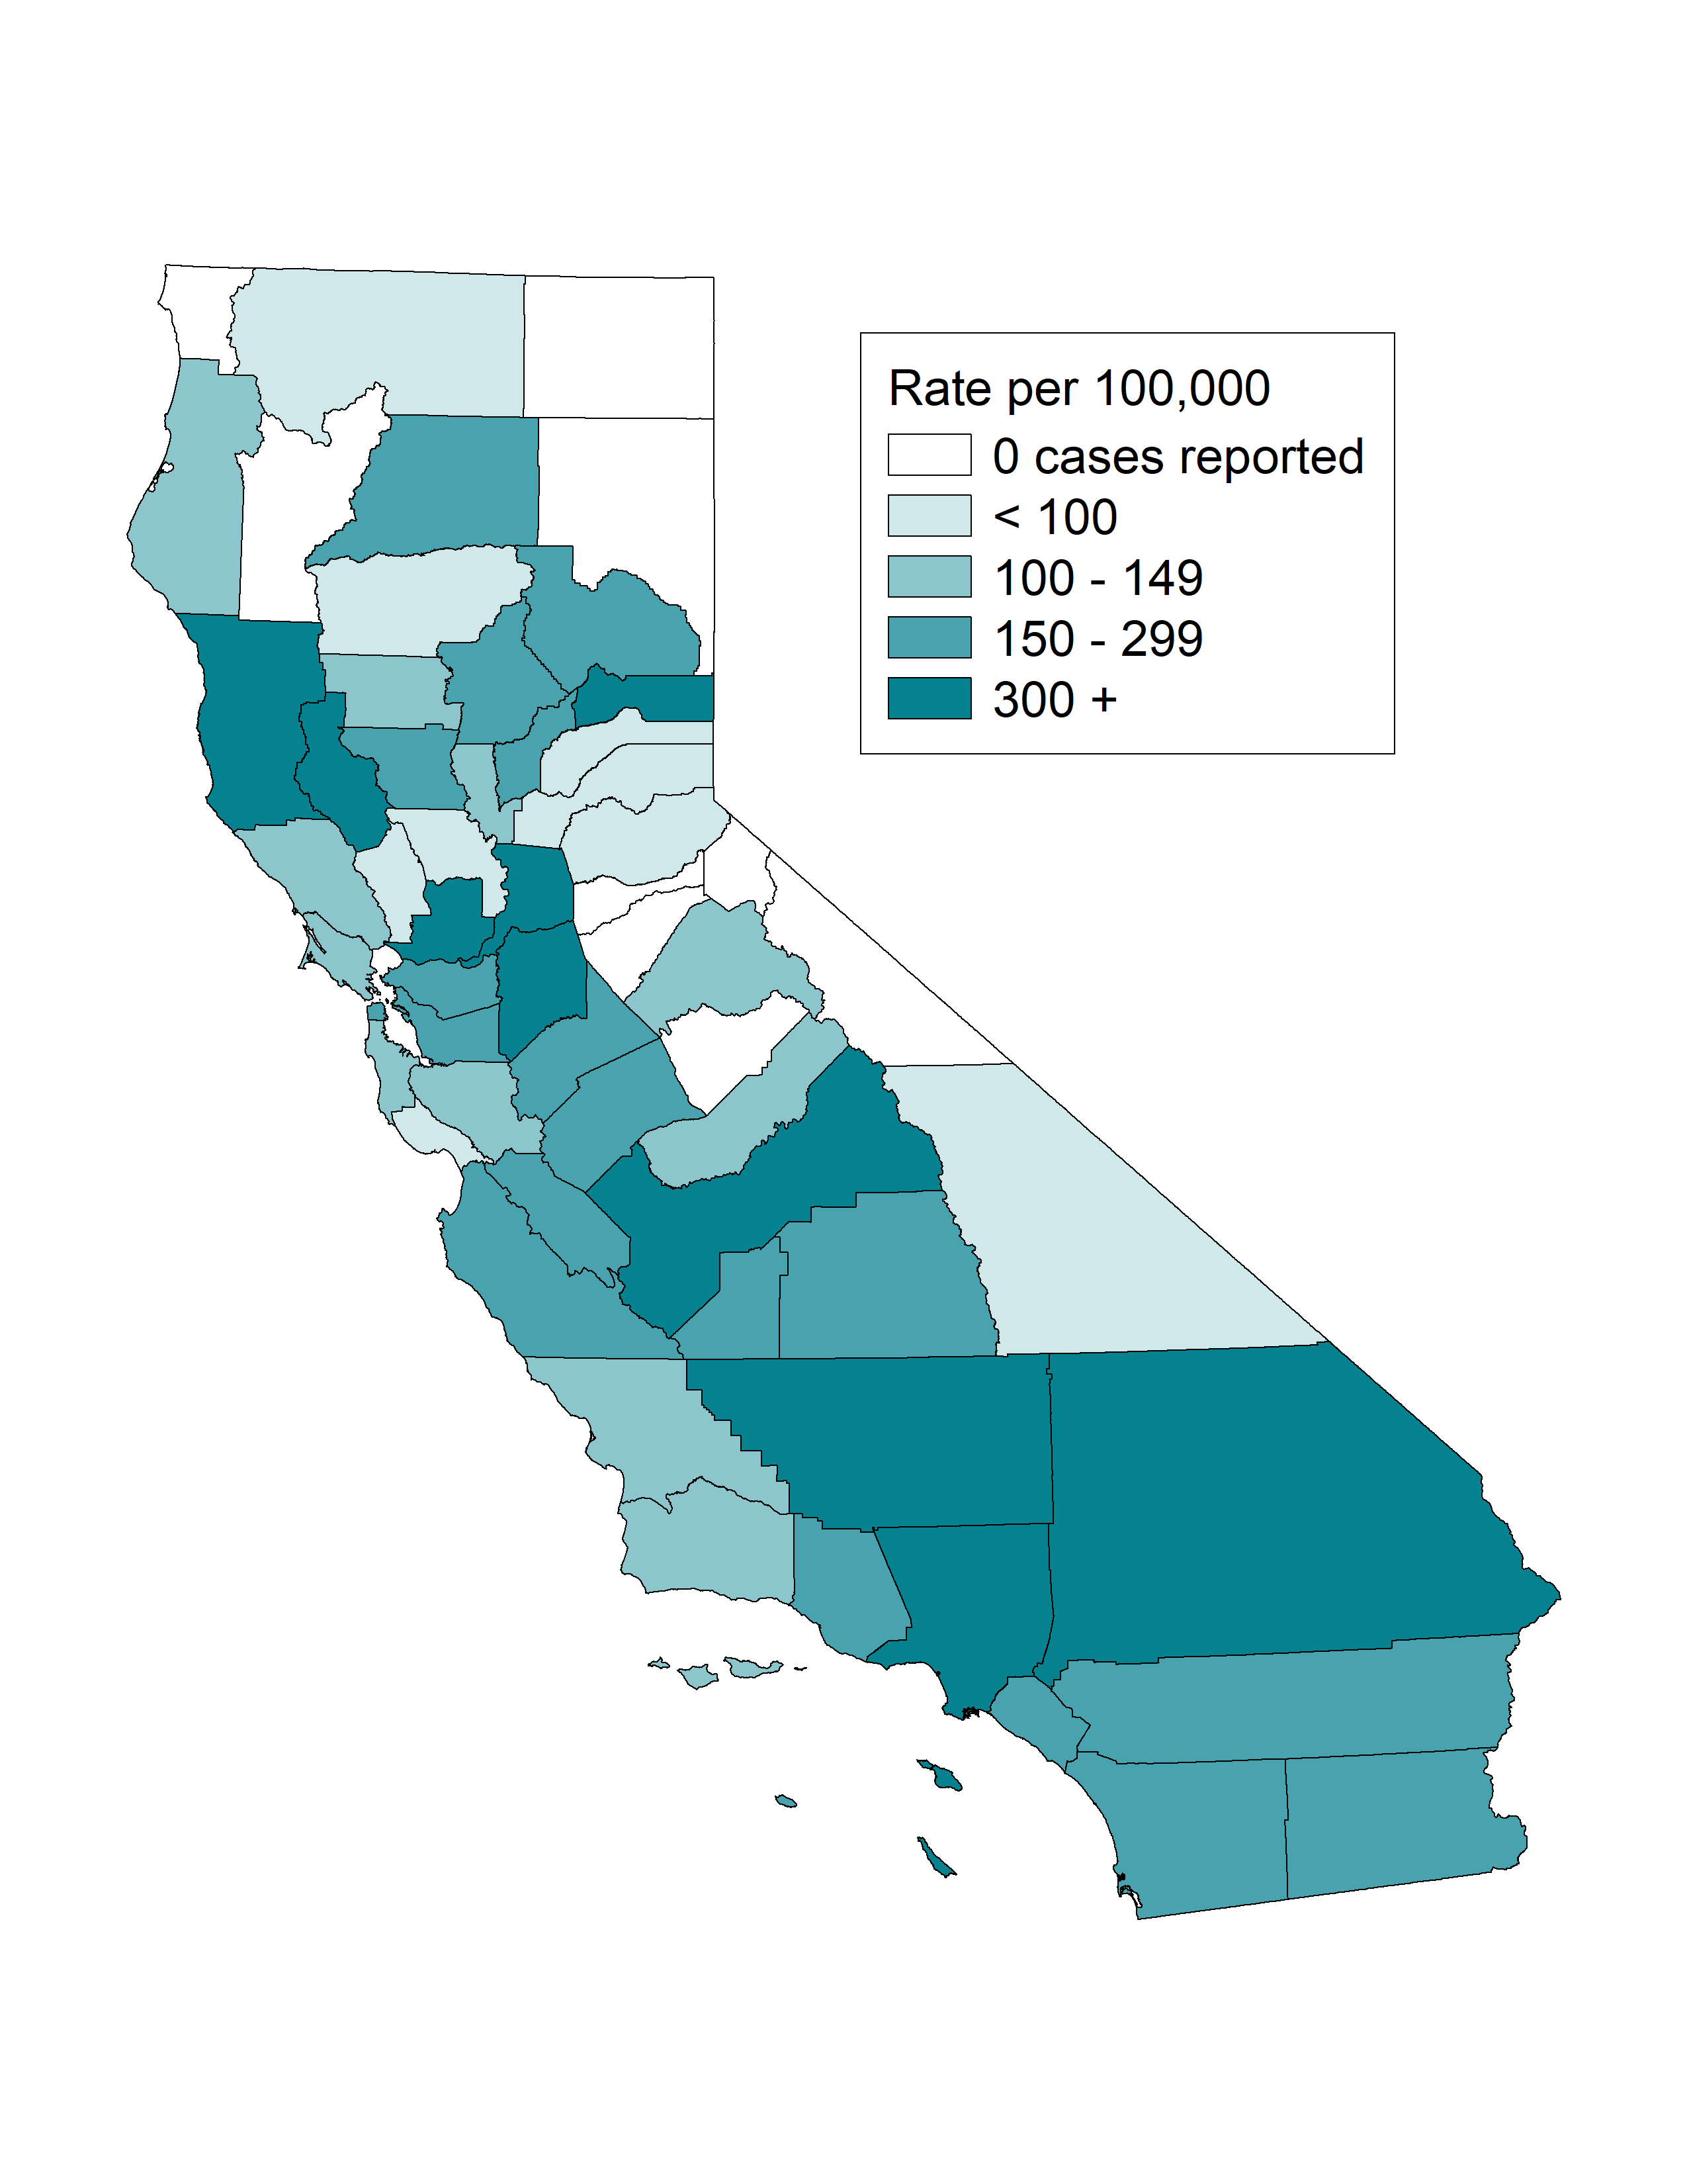
Gonorrhea among Youth Ages 15-19, Incidence Rates by County, California, 2021

Slide 7
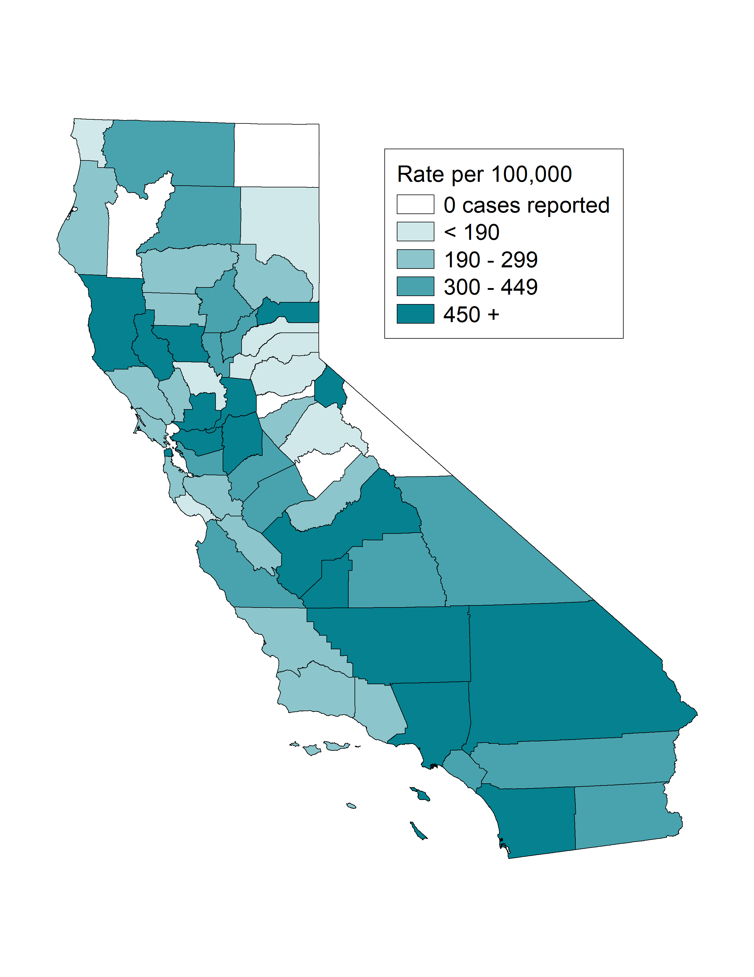
Gonorrhea among Females Ages 15-24, Incidence Rates by County, California, 2021

Slide 8
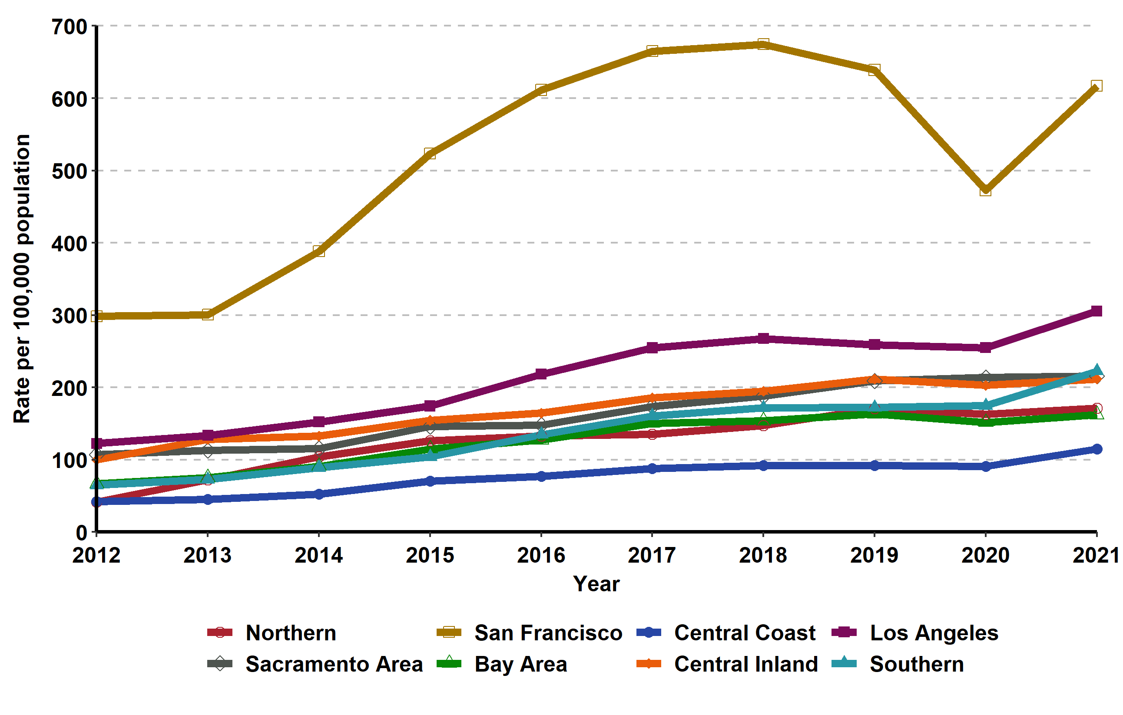
Gonorrhea, Incidence Rates by Region, California, 2012–2021

Slide 9
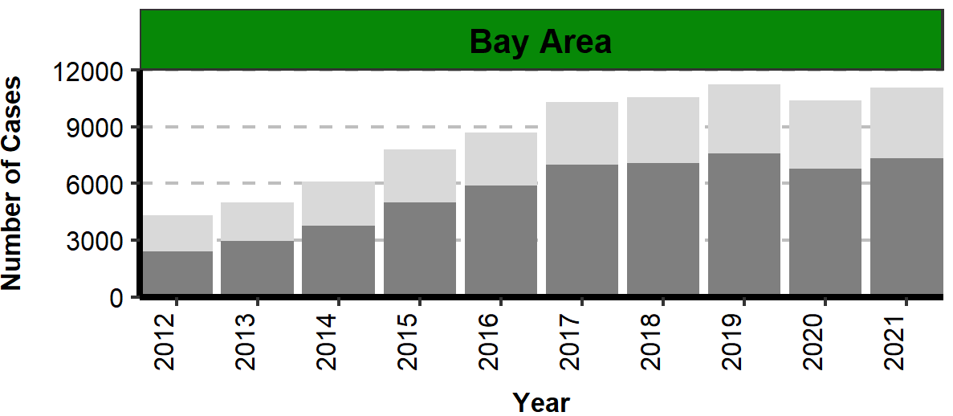
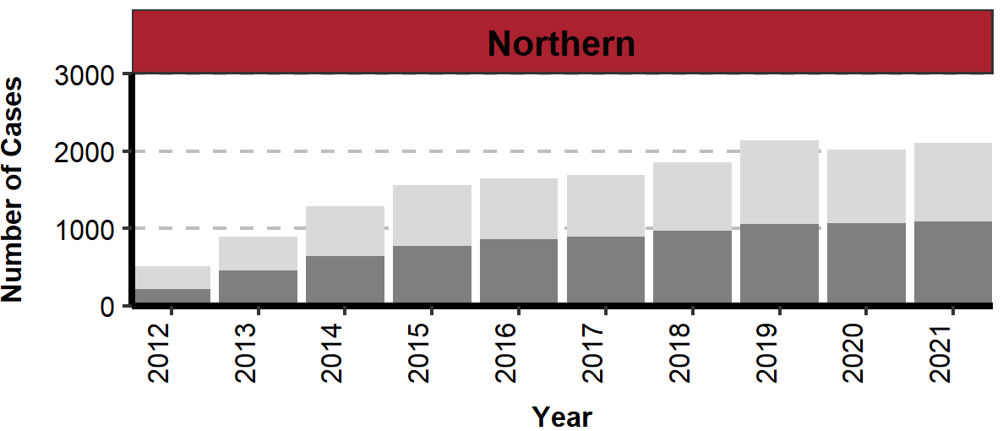
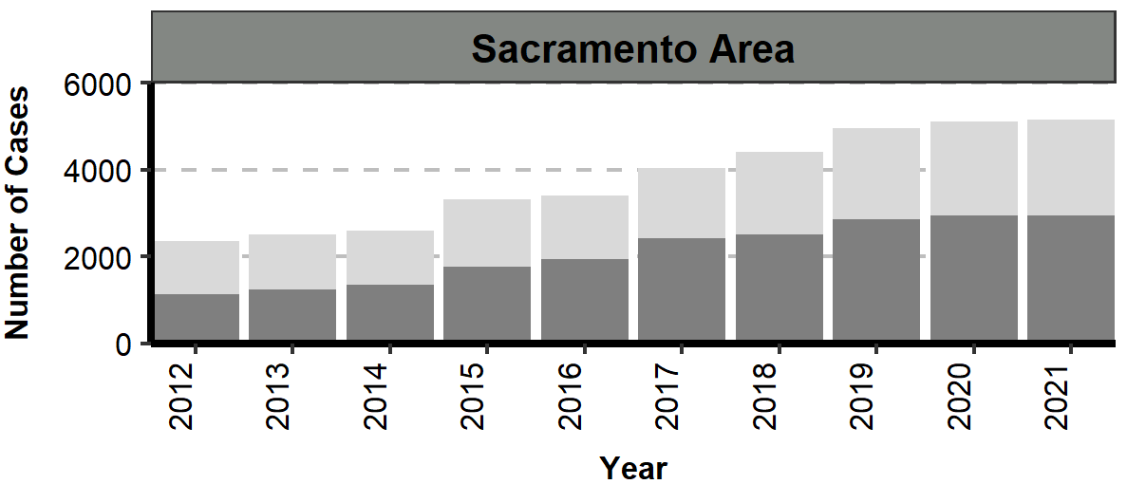
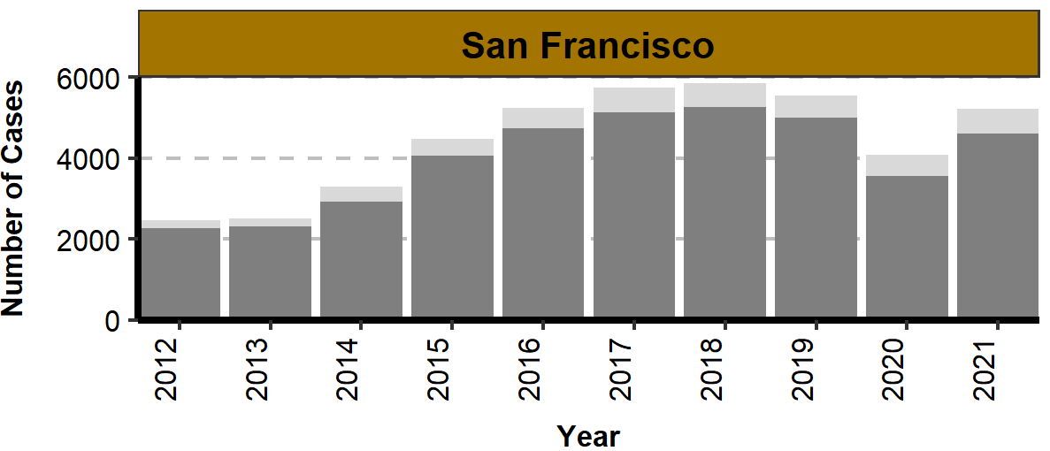
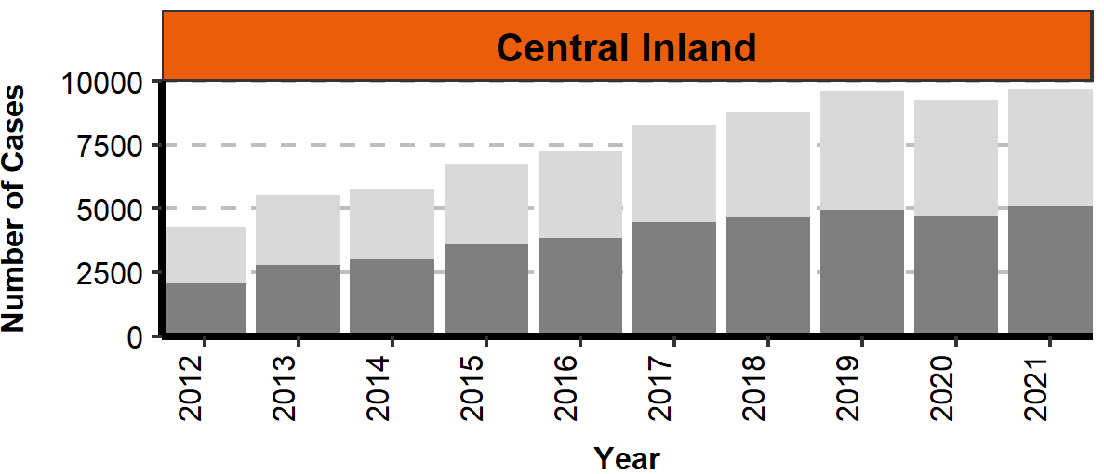
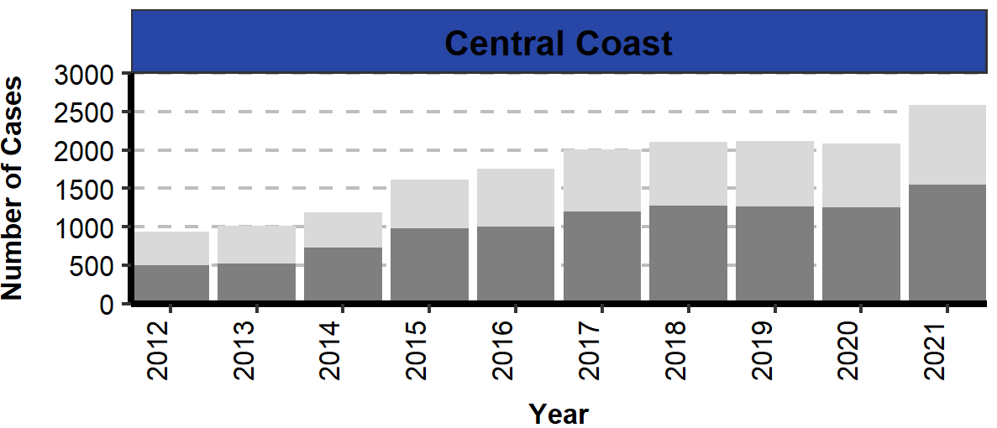
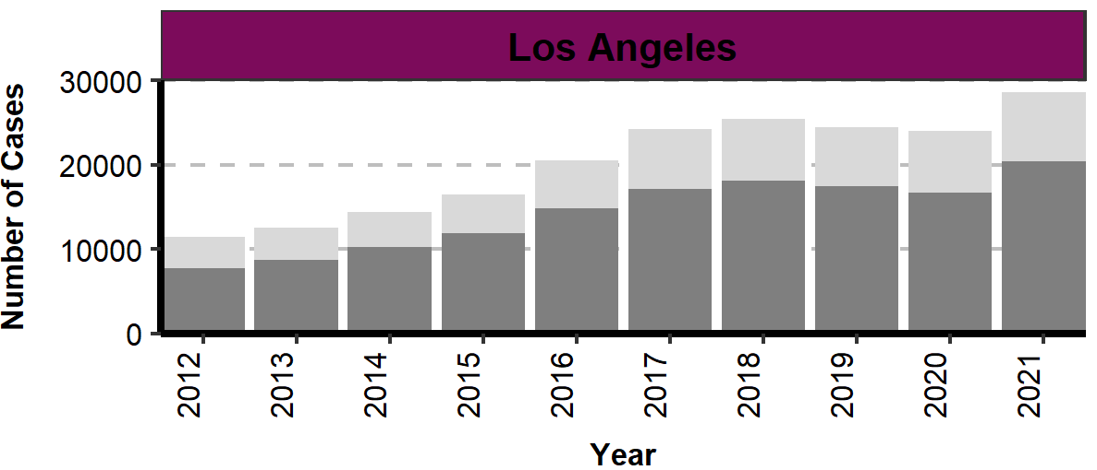
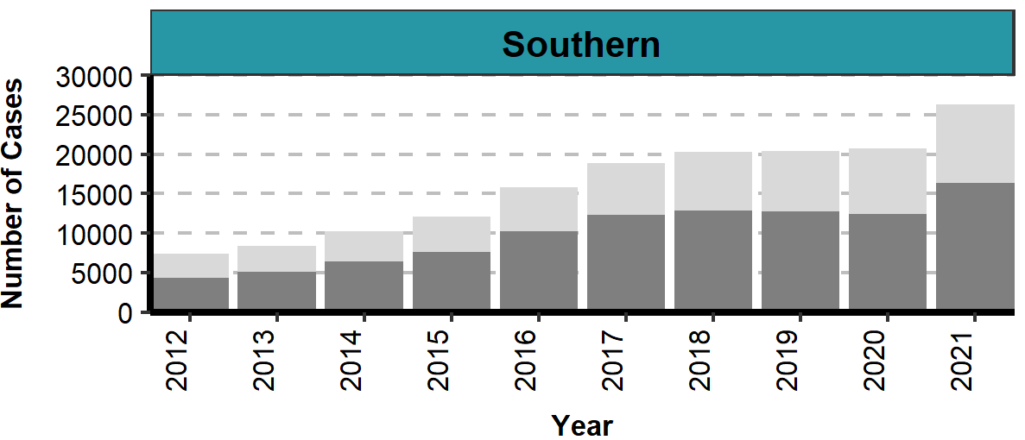
Number of Gonorrhea Cases by Region, Gender, and Year
California, 2012–2021

Slide 10
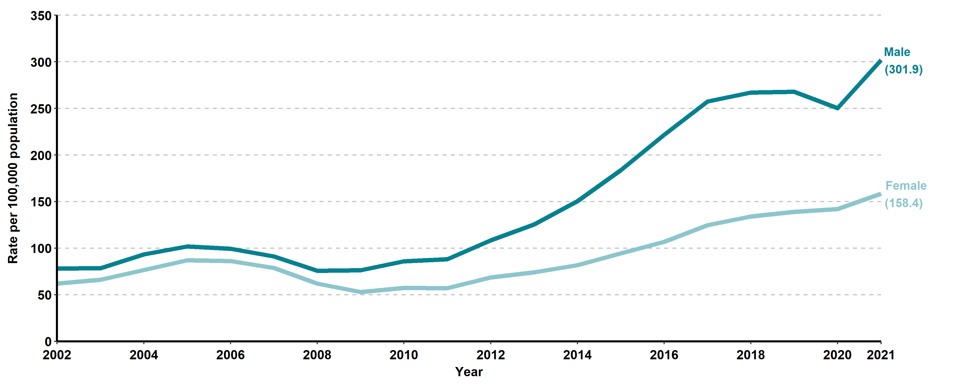
Gonorrhea, Incidence Rates by Gender, California, 2002–2021

Slide 11
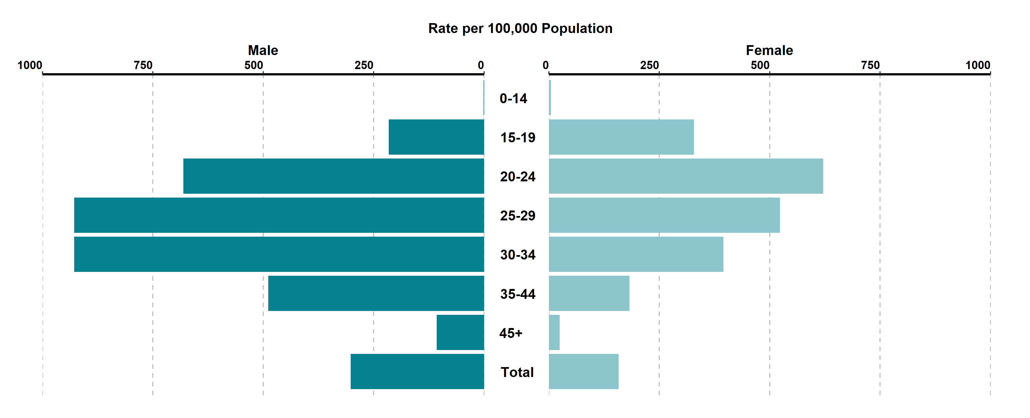
Gonorrhea, Incidence Rates by Age Group (in years) and Gender,
California, 2021
Age was “Not Specified” for 0.2% of female cases and 0.15% of male cases in 2021.

Slide 12
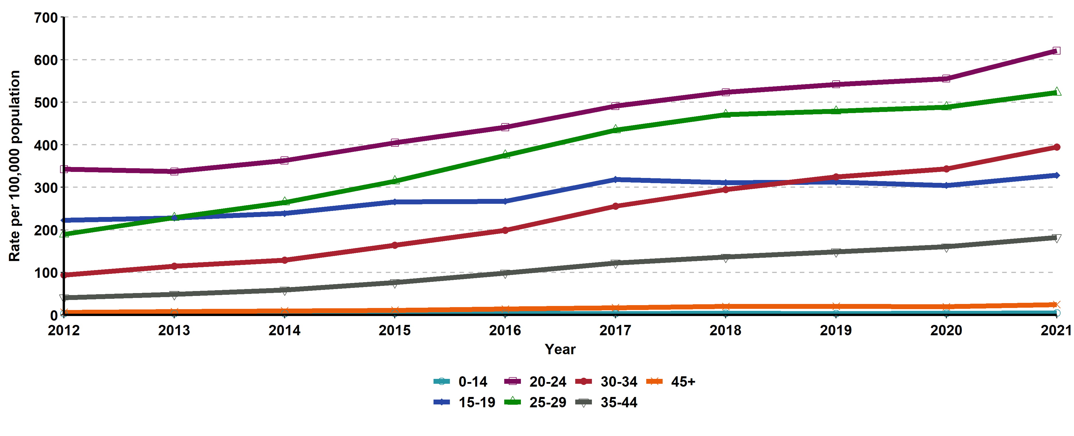
Gonorrhea, Incidence Rates for Females by Age Group (in years),
California, 2012–2021
Age “Not Specified” ranged from 0.14% to 0.45% of cases for females in any given year.

Slide 13
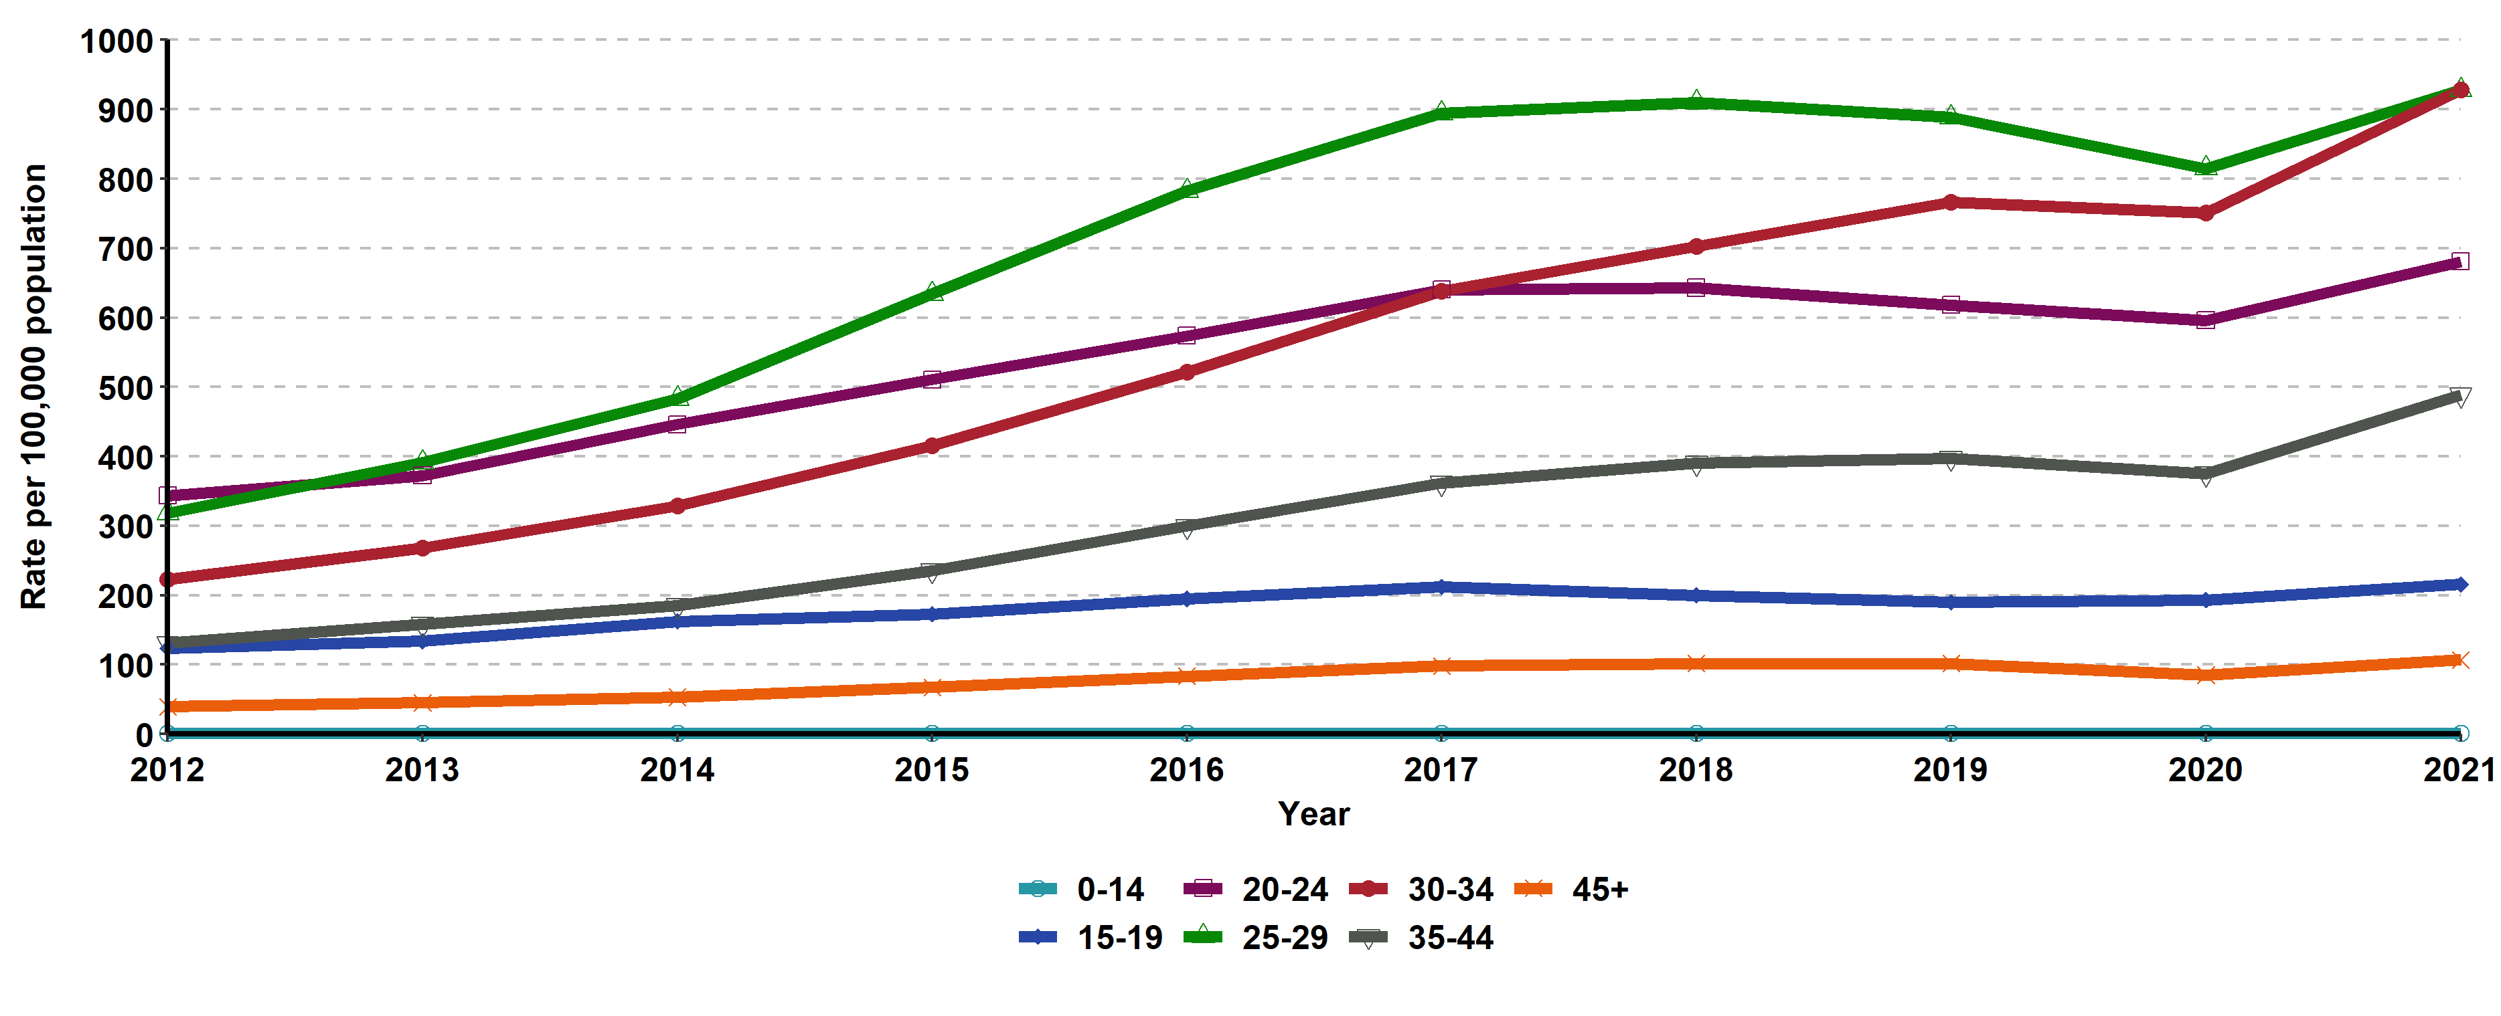
Gonorrhea, Incidence Rates for Males by Age Group (in years),
California, 2012–2021
Age “Not Specified” ranged from 0.1% to 0.57% of cases for males in any given year.

Slide 14
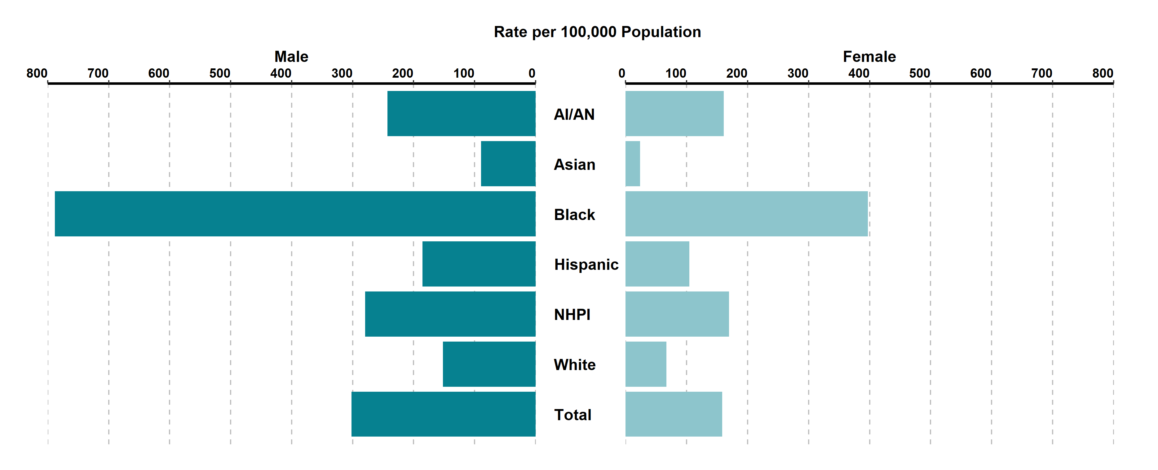
Gonorrhea, Incidence Rates by Race/Ethnicity and Gender,
California, 2021
AI/AN = American Indian/Alaska Native, NHPI = Native Hawaiian/Other Pacific Islander.
Race/Ethnicity was “Not Specified” for 35.24% of female cases and 30.51% of male cases in 2021.

Slide 15
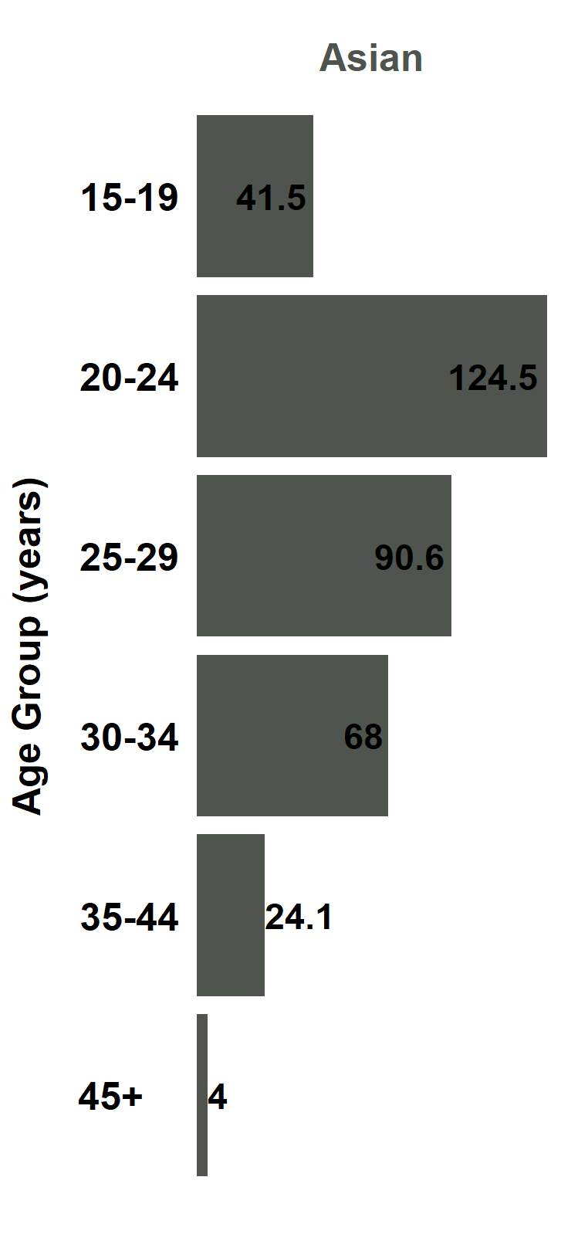
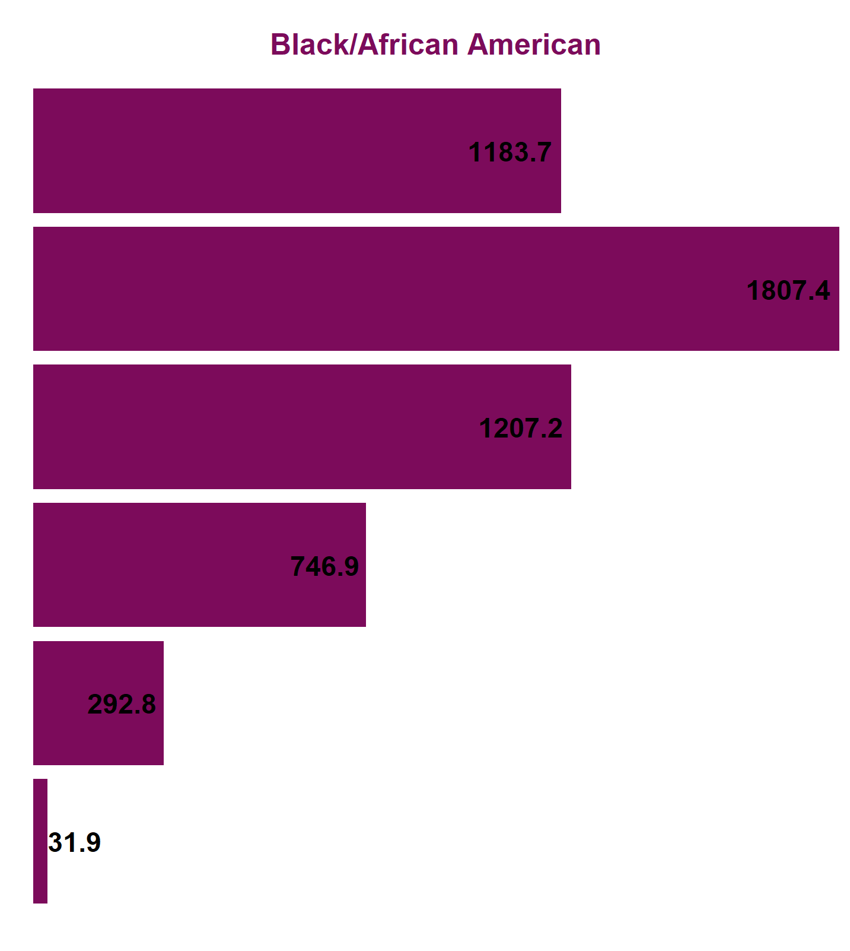
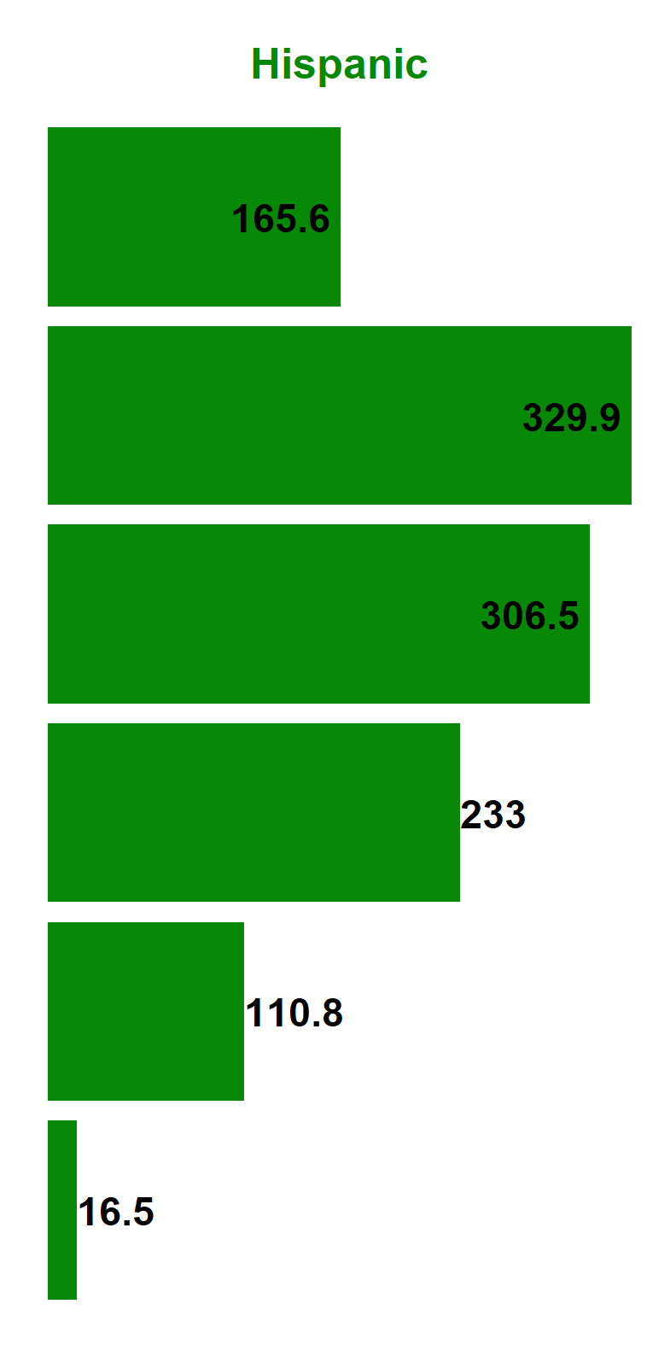
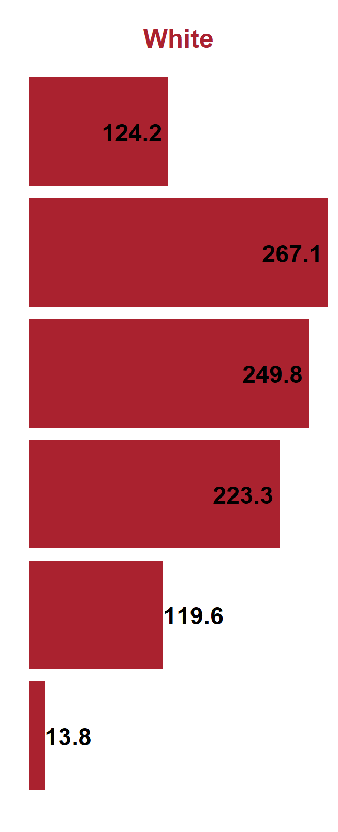
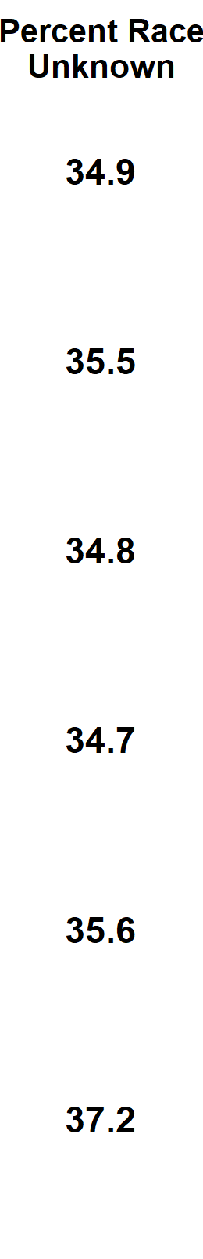
Gonorrhea, Female Incidence Rates by Race/Ethnicity and Age Group (in years), California, 2021
American Indian/Alaska Native and Native Hawaiian/ Other Pacific Islander and race-specific data for ages 0-14 were suppressed as per agency Data De-Identification Guidelines (DDG).

Slide 16
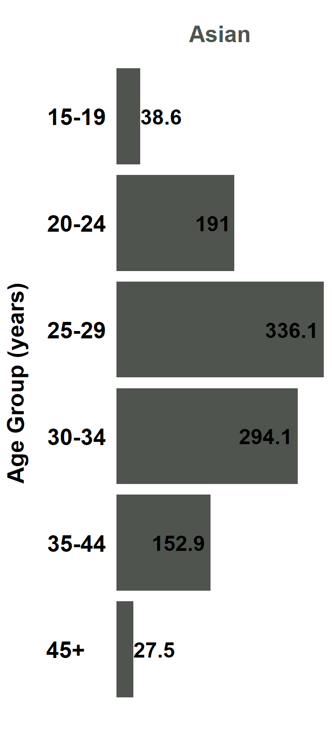
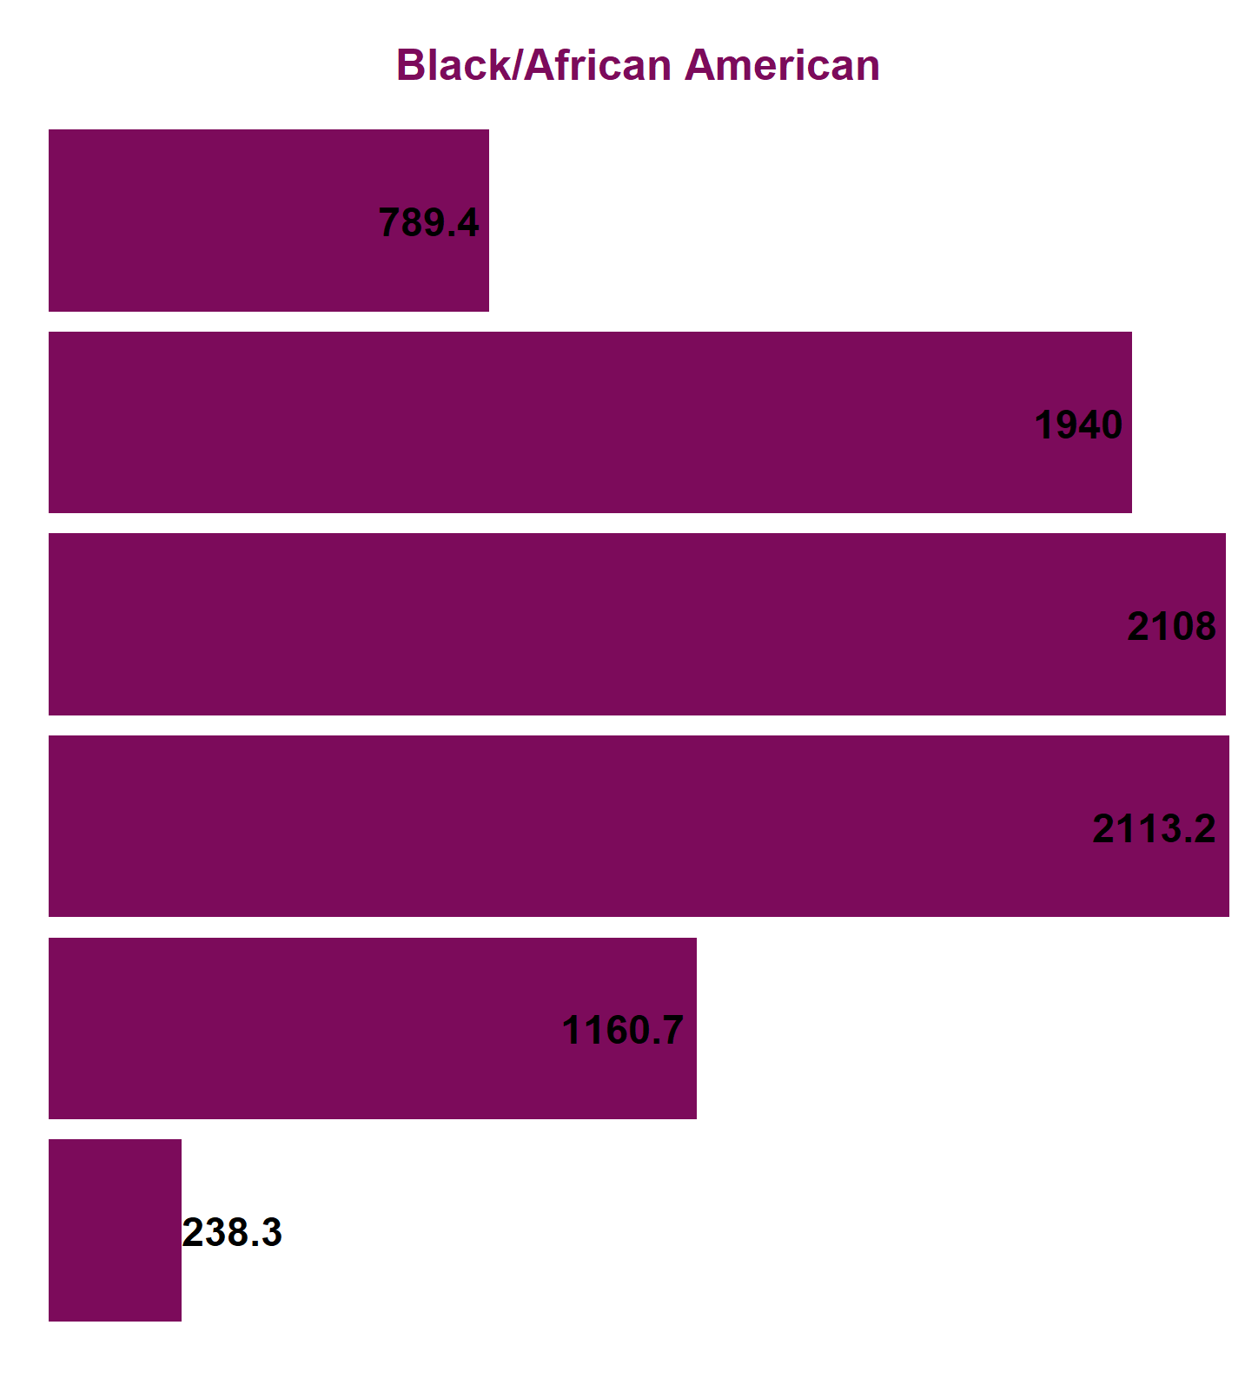
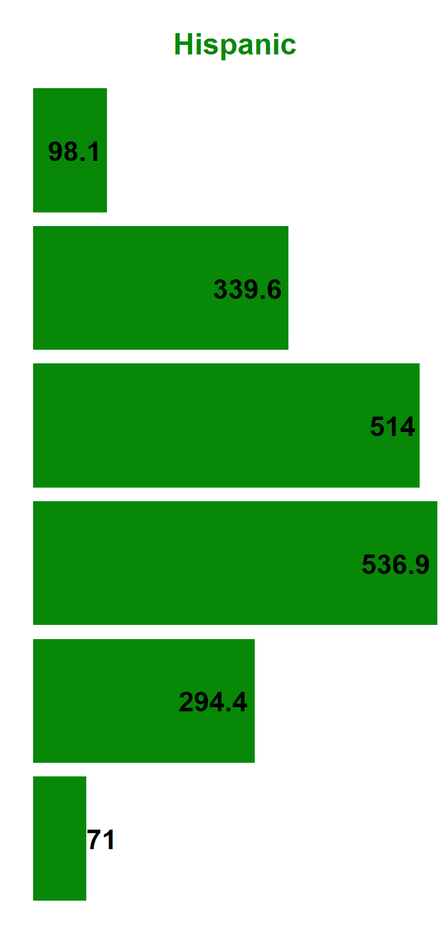
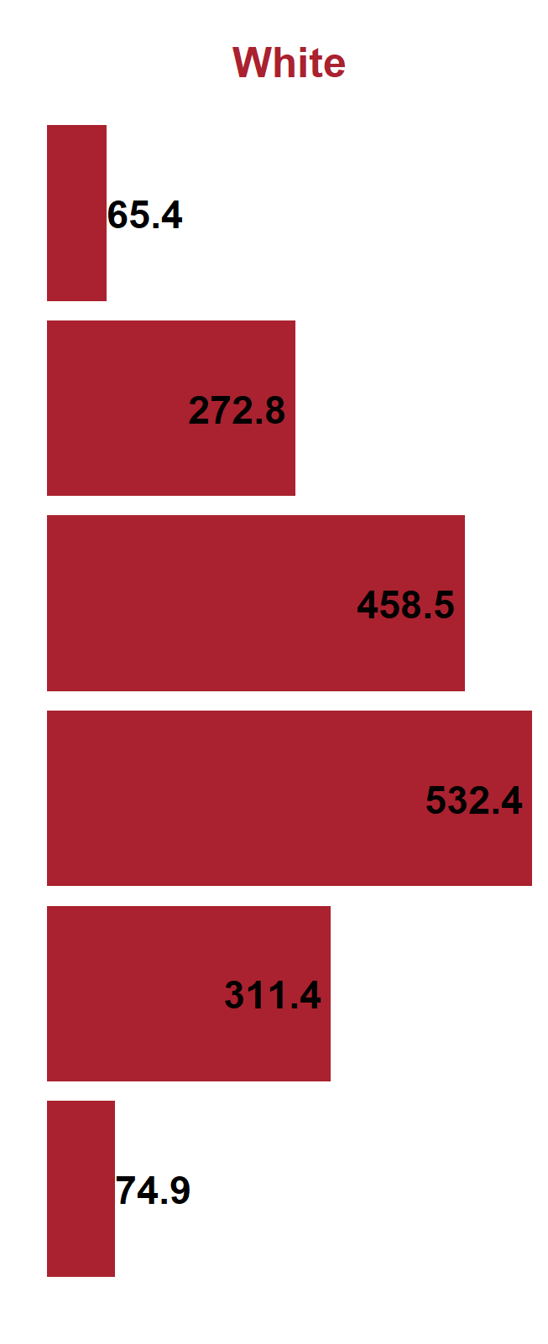
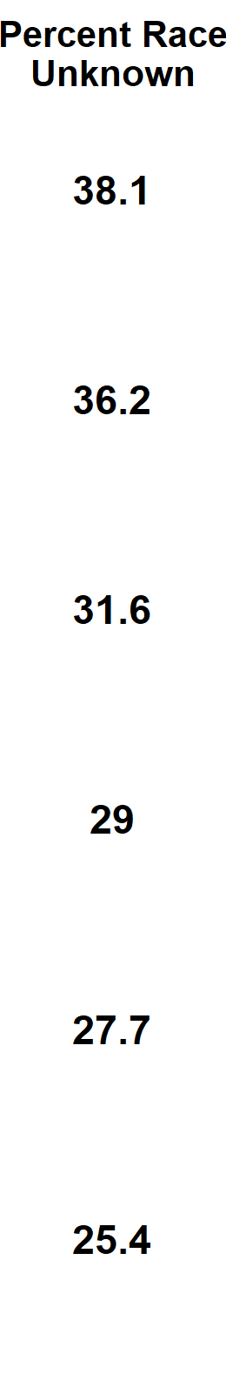
Gonorrhea, Male Incidence Rates by Race/Ethnicity and Age Group (in years), California, 2021
American Indian/Alaska Native and Native Hawaiian/ Other Pacific Islander and race-specific data for ages 0-14 were suppressed as per agency Data De-Identification Guidelines (DDG).

Slide 17
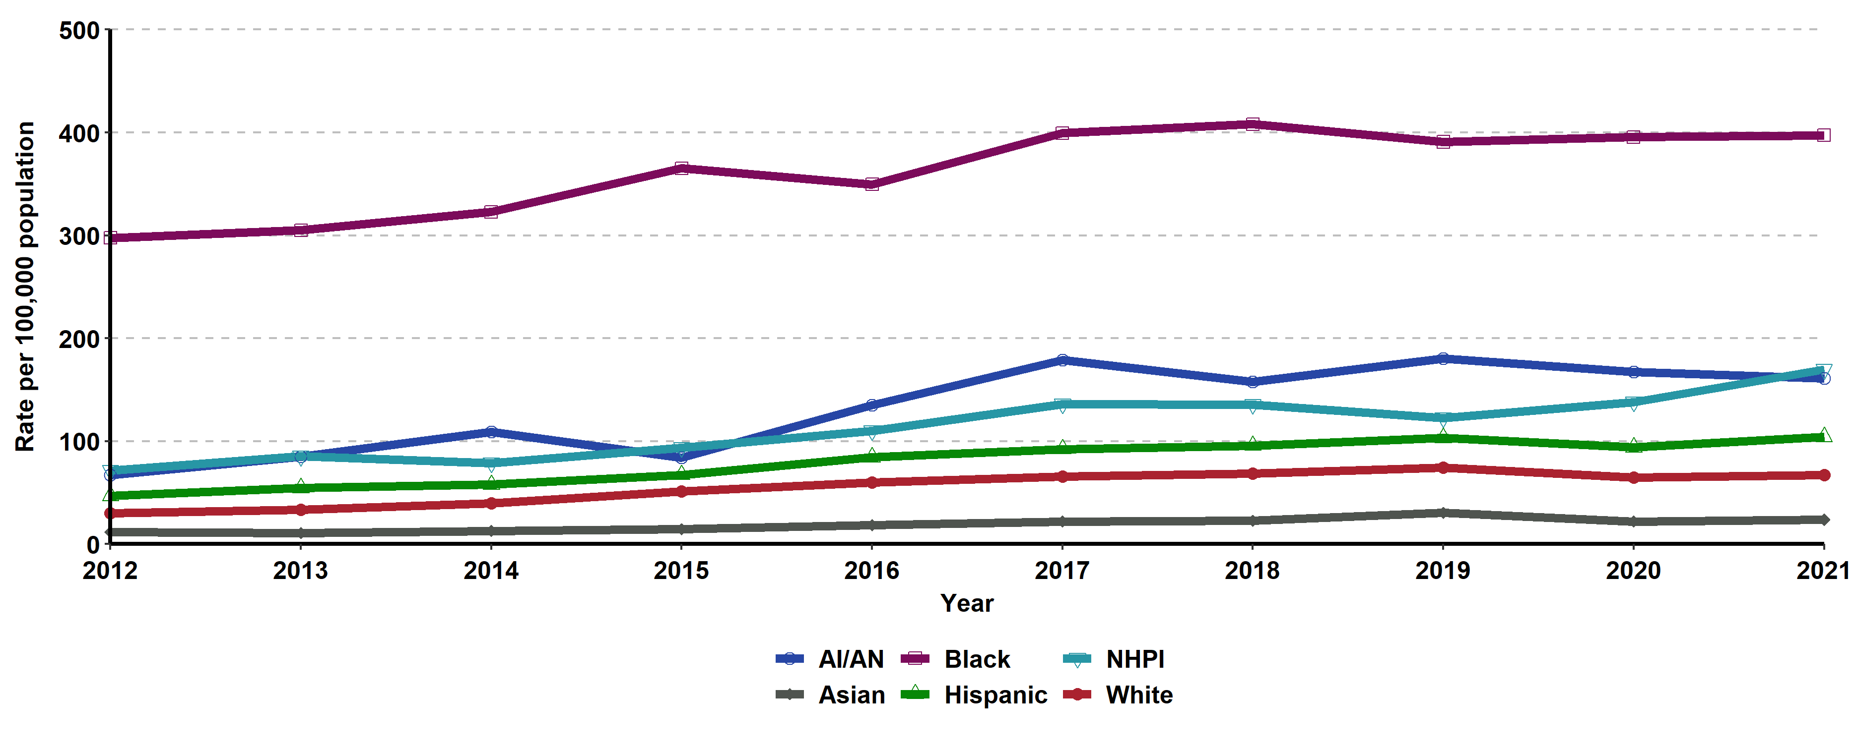
Gonorrhea, Incidence Rates for Females by Race/Ethnicity,
California, 2012–2021
AI/AN = American Indian/Alaska Native; NHPI = Native Hawaiian/Other Pacific Islander.
Race/ethnicity “Not Specified” ranged from 21.4% to 35.24% of cases for females in any given year.

Slide 18
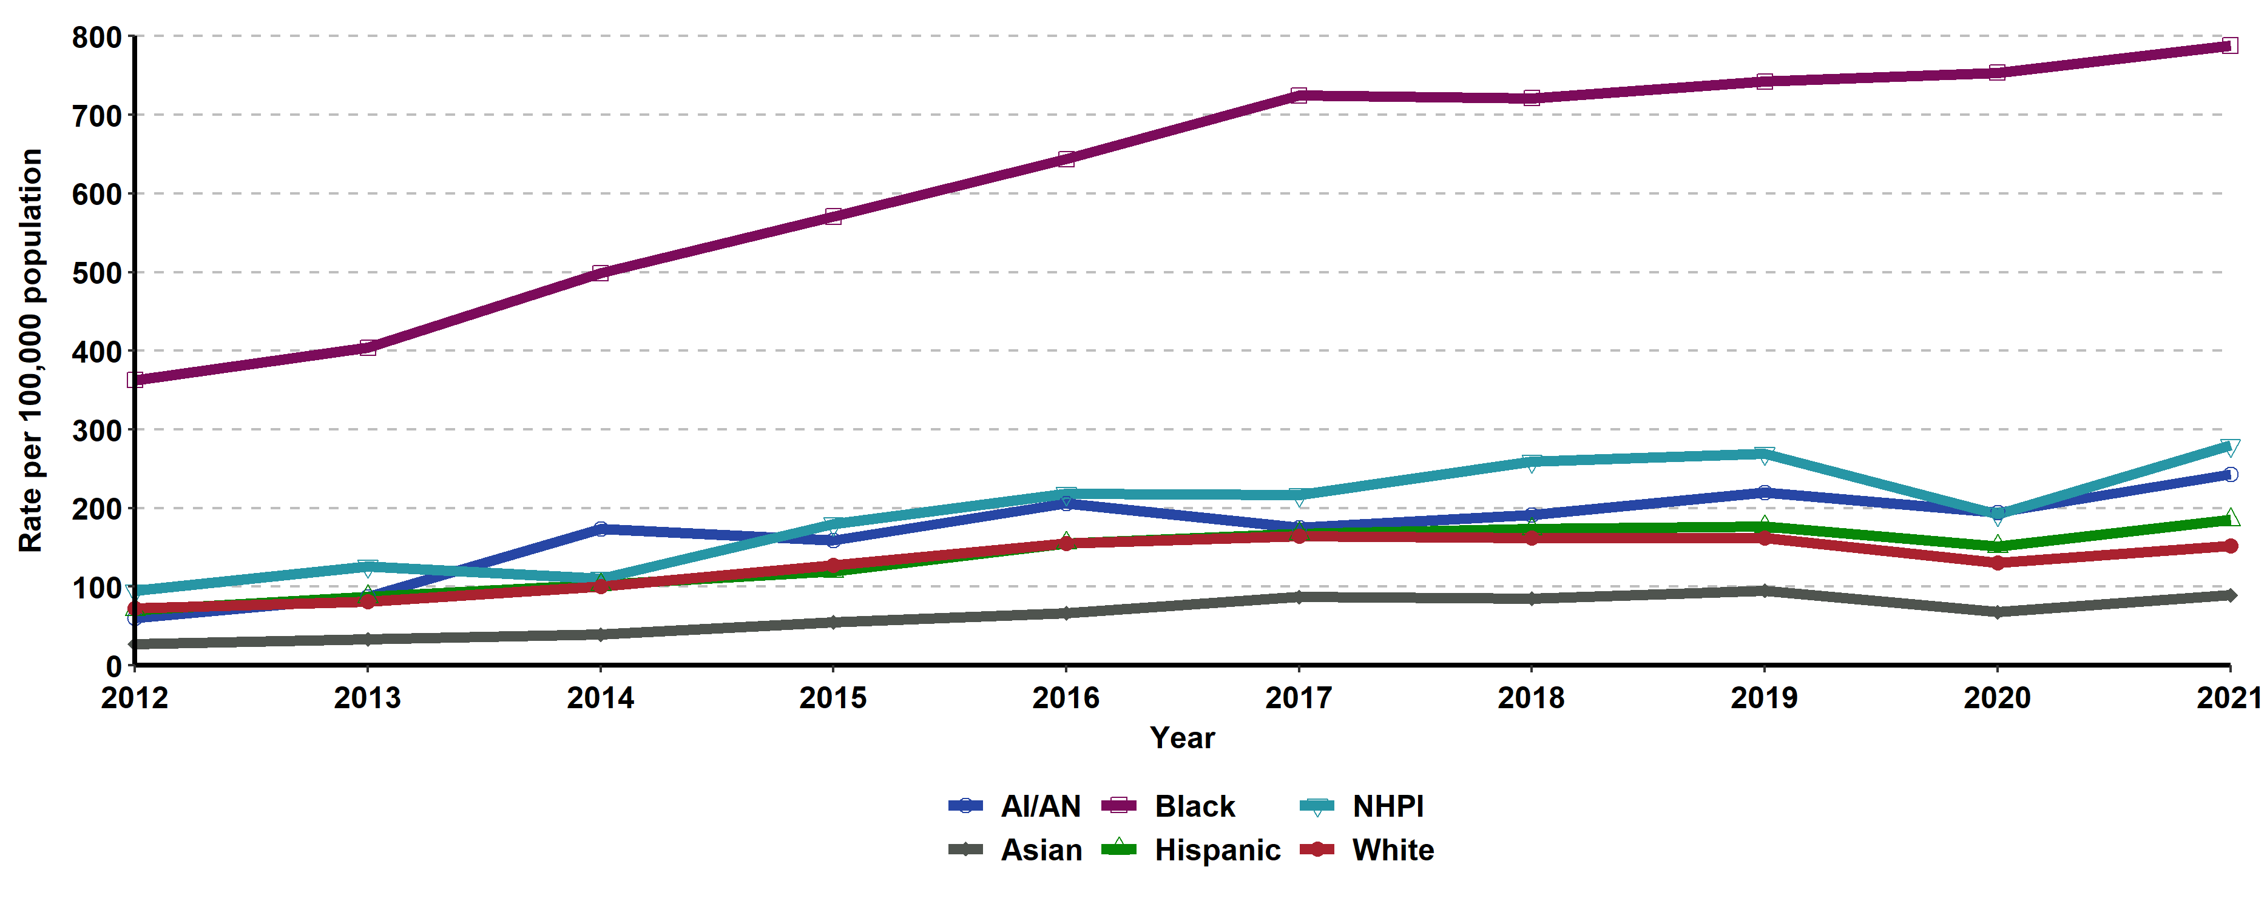
Gonorrhea, Incidence Rates for Males by Race/Ethnicity,
California, 2012–2021
AI/AN = American Indian/Alaska Native; NHPI = Native Hawaiian/Other Pacific Islander.
Race/ethnicity “Not Specified” ranged from 19.65% to 30.51% of cases for males in any given year.

Slide 19
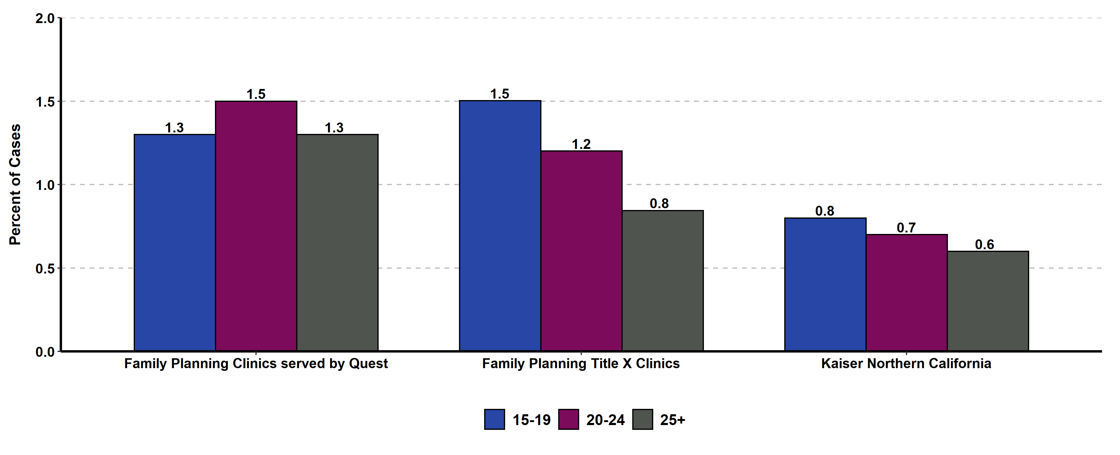
Gonorrhea Prevalence Monitoring, Percent Positive for Females of Selected Age Groups, by Health Care Setting, California, 2021
Sources: Kaiser Permanente Northern California, Essential Access Health, Quest Diagnostics)

Slide 20
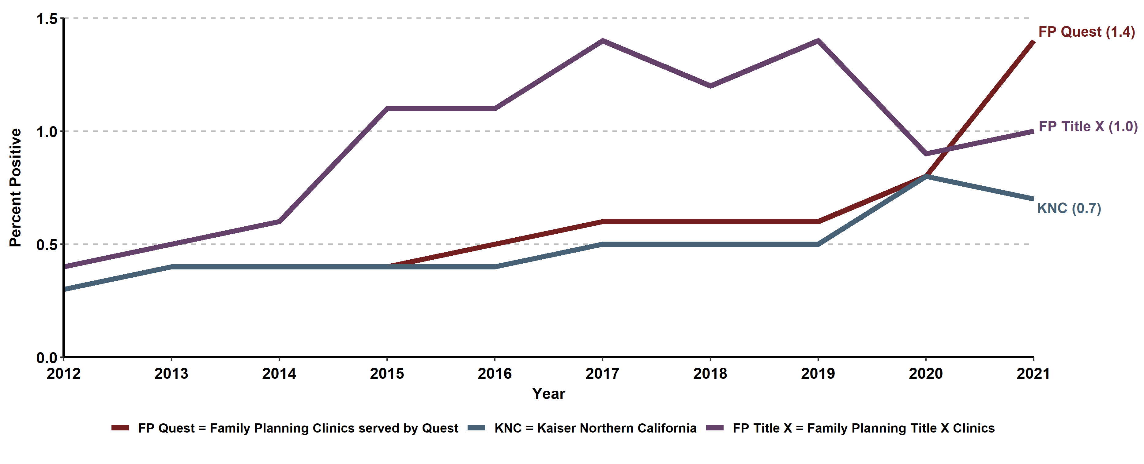
Gonorrhea Prevalence Monitoring, Percent Positive for Females, by
Health Care Setting, California, 2012-2021
FP Quest=Family Planning Clinics served by Quest, FP Title X = Family Planning Title X Clinics, KNC = Kaiser Northern California
Source: Kaiser Permanente Northern California, Essential Access Health, Quest Diagnostics

Slide 21
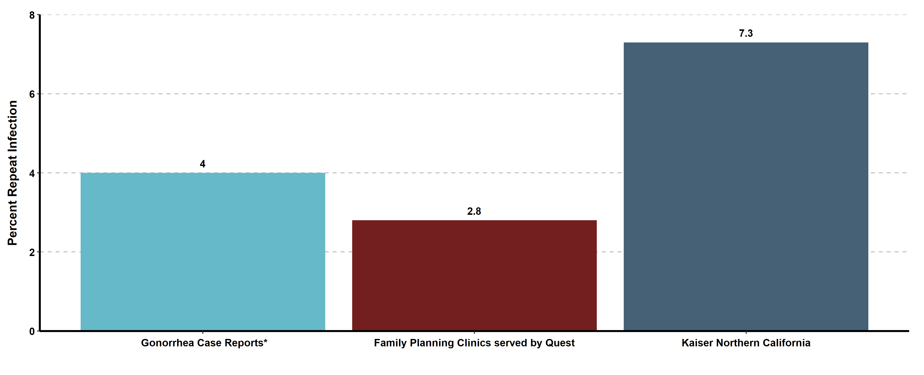
Gonorrhea Repeat Infection among Females 1-6 Months after Infection, by Data Source, California, 2021
* Excludes Los Angeles and San Francisco local health jurisdictions

Slide 22
California Gonococcal
Surveillance System (CGSS)
(Revised 02/2023)

Slide 23
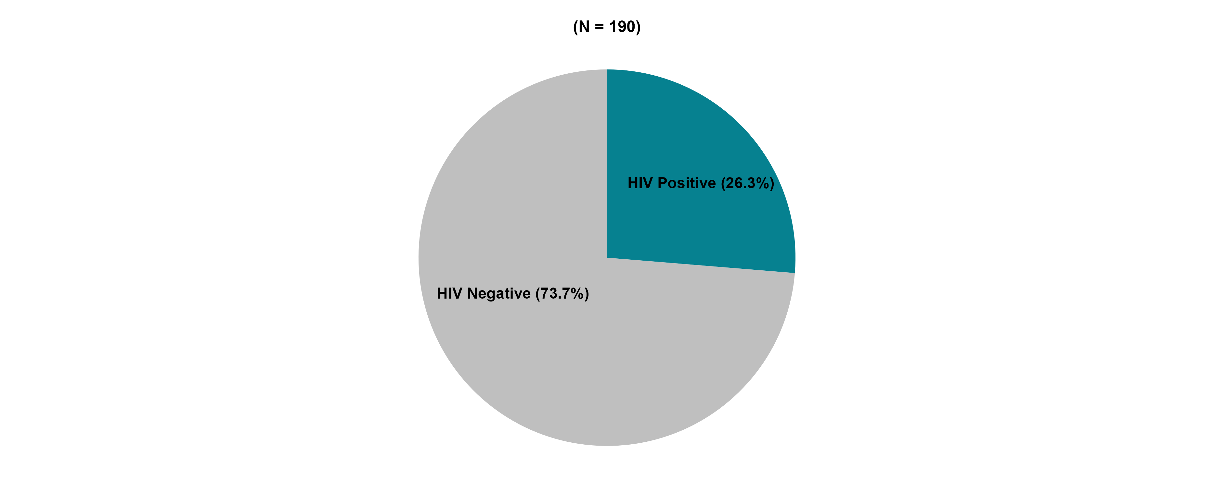
California Gonococcal Surveillance System (CGSS), HIV Status among Sampled and Interviewed Men Who Had Sex with Men* Cases, California, 2021
* Includes men who had sex with men only and men who had sex with men and women
N does not include HIV status unknown or refused to state: 23 cases in 2021

Slide 24
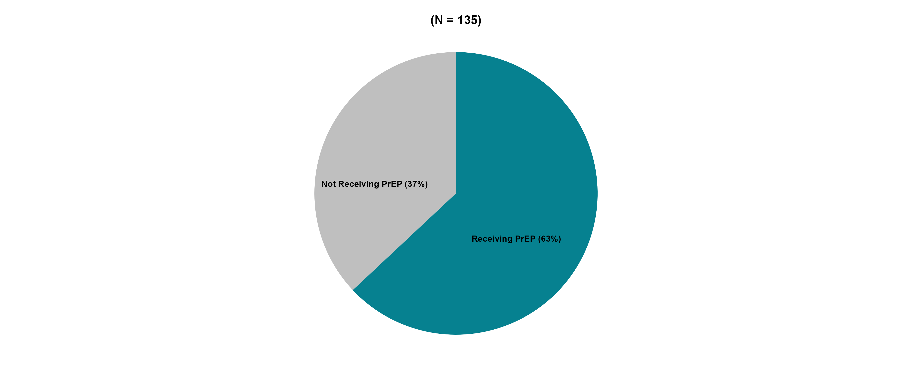
California Gonococcal Surveillance System (CGSS), HIV PrEP Use among Sampled and Interviewed HIV Negative Men Who Had Sex with Men* Cases, California, 2021
* Includes men who had sex with men only and men who had sex with men and women
N does not include PrEP status unknown or refused to state: 5 cases in 2021

Slide 25
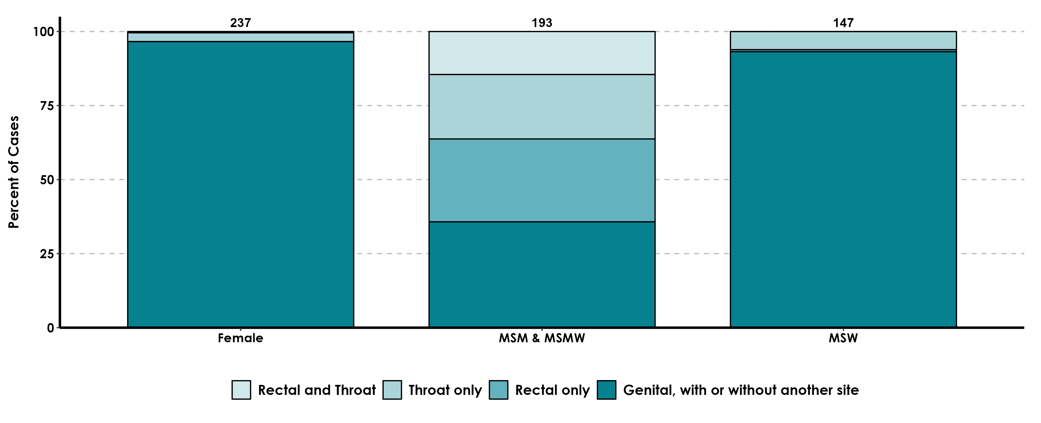
California Gonococcal Surveillance System (CGSS), Anatomic Site of Infection among Sampled and Interviewed Cases, by Gender and Gender of Sex Partners, California, 2021
Genital includes urine, urethral, and other unspecified “genital” sites.
MSM includes Men who had sex with Men only. MSMW includes Men who had sex with both Men and Women.
MSW includes Men who had sex with Women only.

Slide 26
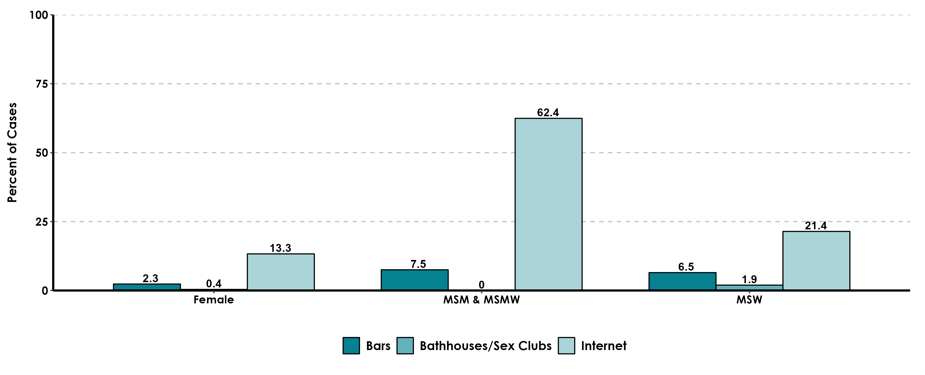
California Gonococcal Surveillance System (CGSS), Percent of Sampled and Interviewed Cases Who Reported Meeting Sex Partners at Specified Venues, by Gender and Gender of Sex Partners, California, 2021
MSM includes Men who had sex with Men only. MSMW includes Men who had sex with both Men and Women.
MSW includes Men who had sex with Women only. MSU includes Men whose sex partners’ gender(s) was/were unknown.

Slide 27
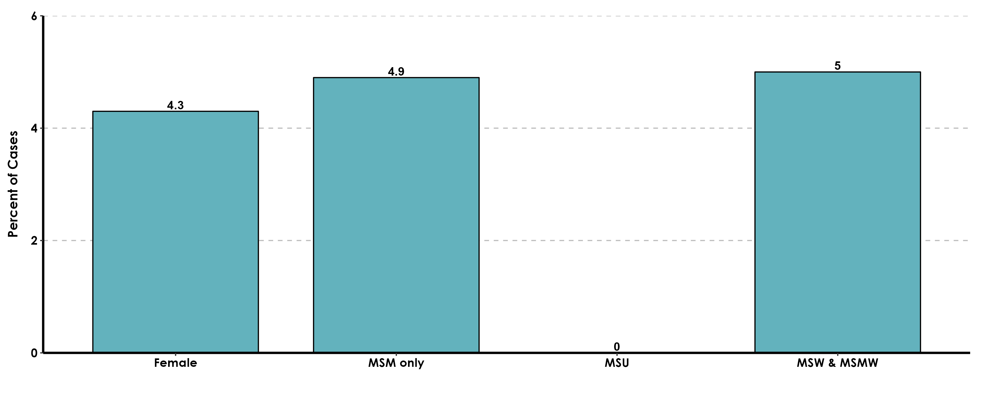
California Gonococcal Surveillance System (CGSS), Percent of Sampled and Interviewed Cases Who Reported Methamphetamine Use, by Gender and Gender of Sex Partners, California, 2021
MSM includes Men who had sex with Men only.
MSMW includes Men who had sex with both Men and Women. MSW includes Men who had sex with Women only.
MSU includes Men with unknown gender of sex partners.

Slide 28
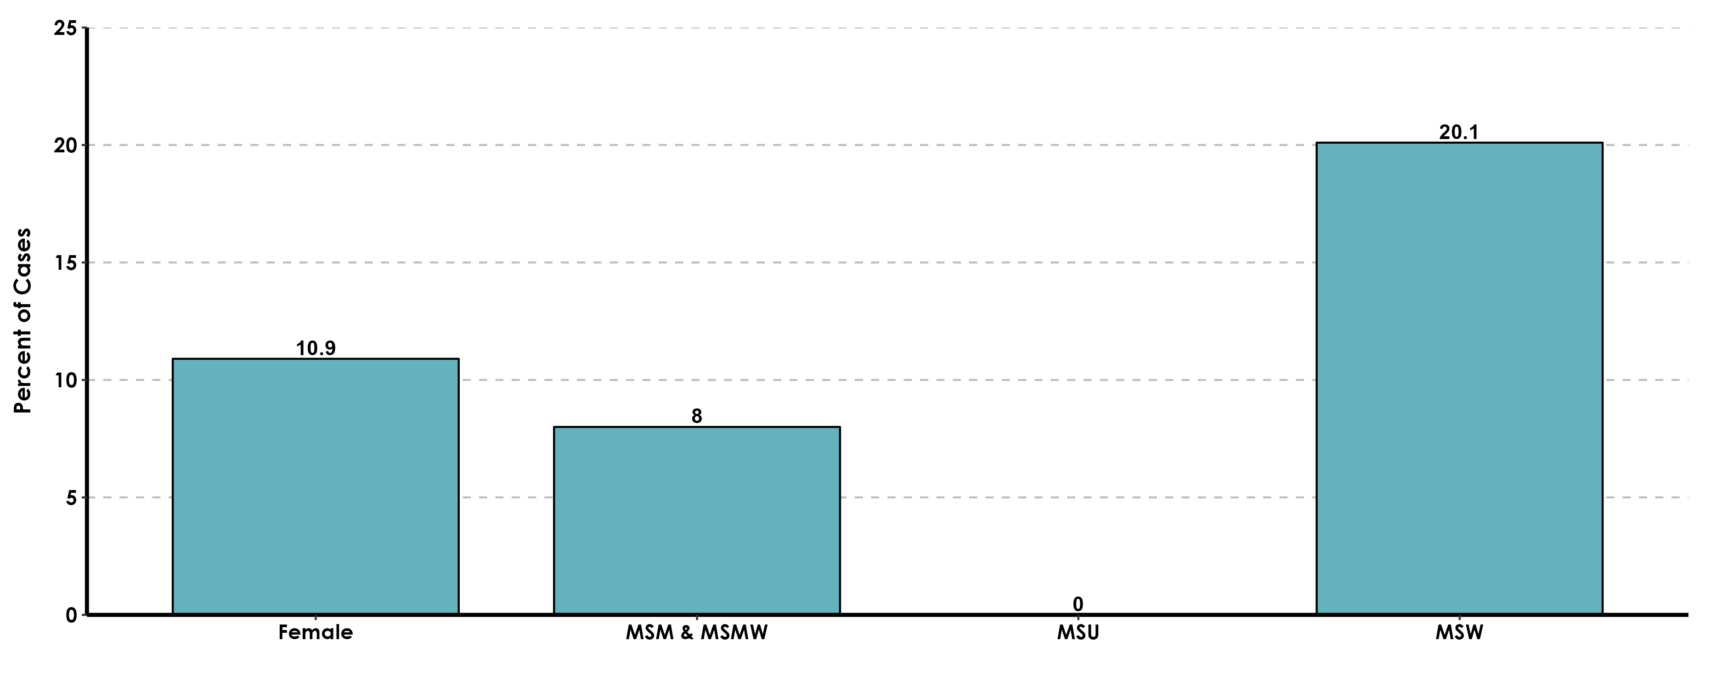
California Gonococcal Surveillance System (CGSS), Percent of Sampled and Interviewed Cases Who Reported Correctional History*, by Gender and Gender of Sex Partners, California, 2021
* Responded “Yes” to being in jail, juvenile hall, prison, incarcerated, on probation, or had an incarcerated partner in the 12 months prior to diagnosis.
MSM includes Men who had sex with Men only. MSMW includes Men who had sex with both Men and Women.
MSW includes Men who had sex with Women only. MSU includes Men with unknown gender of sex partners.

