Slide 1
Gonococcal Isolate Surveillance
Project (GISP)
(Revised 02/2023)

Slide 2
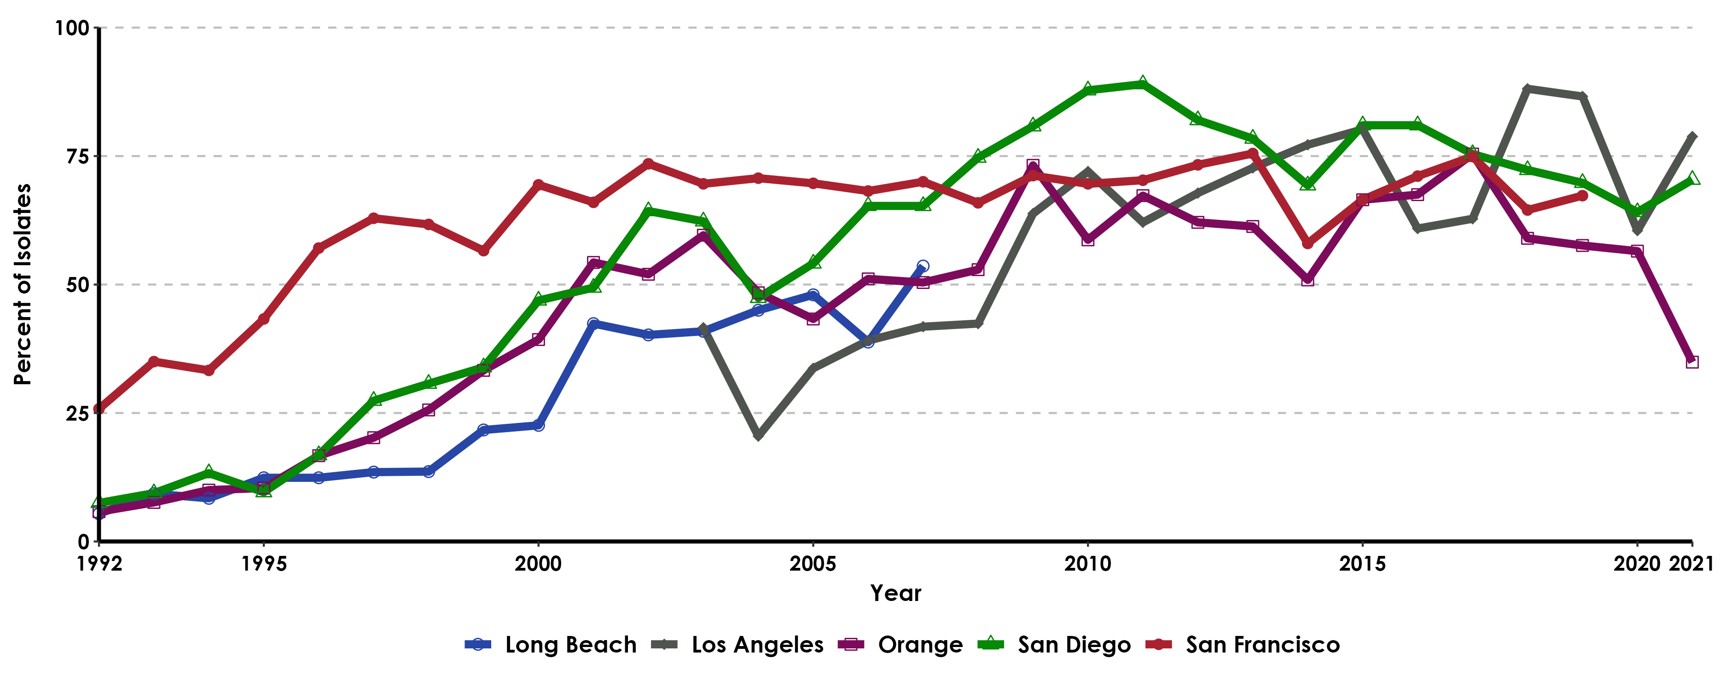
Gonococcal Isolate Surveillance Project (GISP), Percent of Neisseria Gonorrhoeae Isolates Obtained from Men Who Had Sex with Men in California GISP STD Clinic Sites, 1992-2021
MSM includes Men who had sex with Men only.
STD Clinic Sites: Long Beach (discontinued in 2007), Los Angeles (added in 2003), Orange, San Diego, San Francisco (discontinued mid-2019)

Slide 3
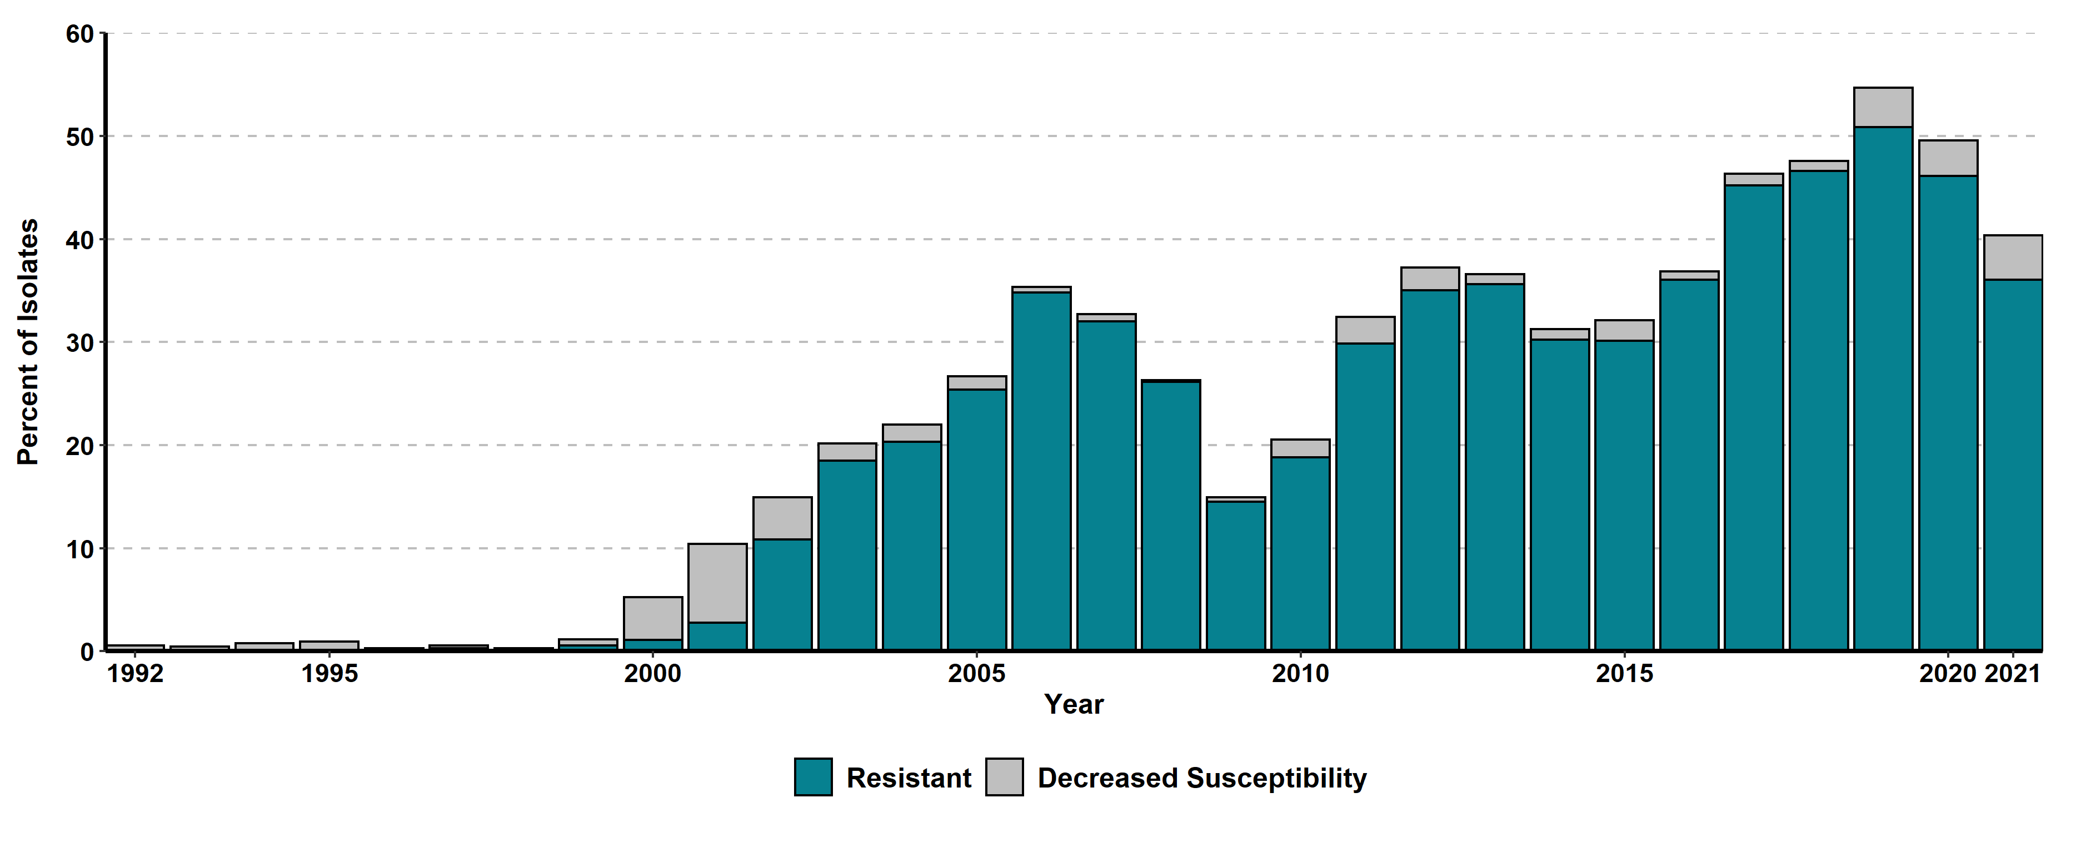
Gonococcal Isolate Surveillance Project (GISP), Percent of Neisseria Gonorrhoeae Isolates with Decreased Susceptibility or Resistance to Ciprofloxacin in California GISP STD Clinic Sites, 1992-2021
Resistant isolates had minimum inhibitory concentrations (MICs) ≥ 1 μg ciprofloxacin/mL. Isolates with decreased susceptibility had MICs of 0.125 – 0.5 μg ciprofloxacin/mL.
STD Clinic Sites: Long Beach (discontinued in 2007), Los Angeles (added in 2003), Orange, San Diego, San Francisco (discontinued mid-2019)

Slide 4
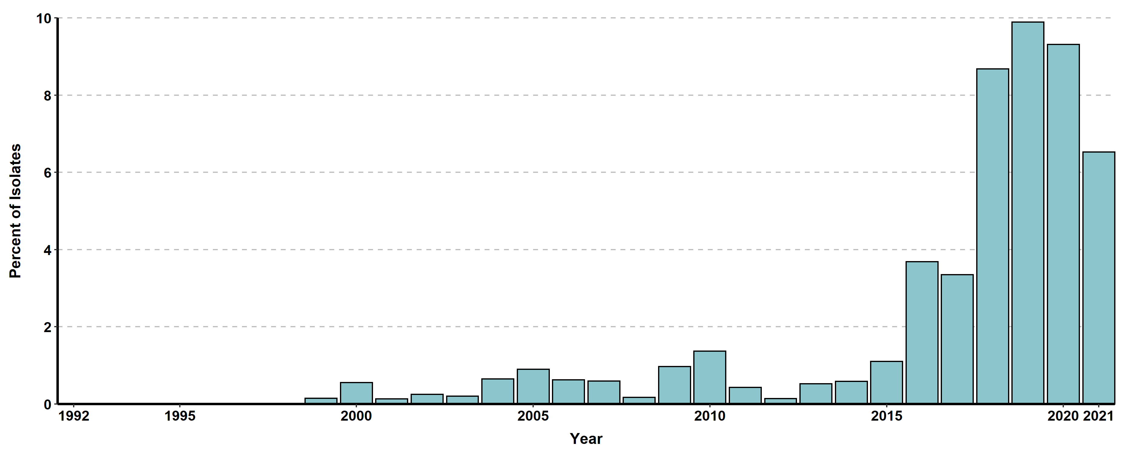
Gonococcal Isolate Surveillance Project (GISP), Percent of Neisseria Gonorrhoeae Isolates with CDC "Alert" Values for Azithromycin in California GISP STD Clinic Sites, 1992-2021
"Alert" values were set by CDC as markers to look at possible decreased susceptibility. Azithromycin alerts had minimum inhibitory concentrations (MICs) ≥ 2.0 μg/mL.
STD Clinic Sites: Long Beach (discontinued in 2007), Los Angeles (added in 2003), Orange, San Diego, San Francisco (discontinued mid-2019)

Slide 5
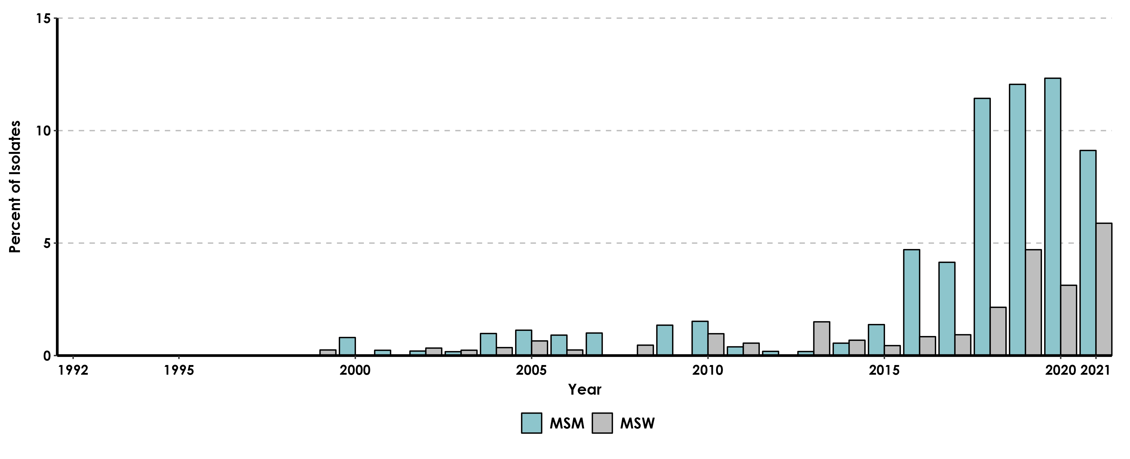
Gonococcal Isolate Surveillance Project (GISP), Percent of Neisseria Gonorrhoeae Isolates with CDC "Alert" Values for Azithromycin, by Gender and Gender of Sex Partners, in California GISP STD Clinic Sites, 1992-2021
MSM includes Men who had sex with Men only. MSW includes Men who had sex with Women only.
"Alert" values were set by CDC as markers to look at possible decreased susceptibility. Azithromycin alerts had minimum inhibitory concentrations (MICs) ≥ 2.0 μg/mL.
STD Clinic Sites: Long Beach (discontinued in 2007), Los Angeles (added in 2003), Orange, San Diego, San Francisco (discontinued mid-2019)

Slide 6
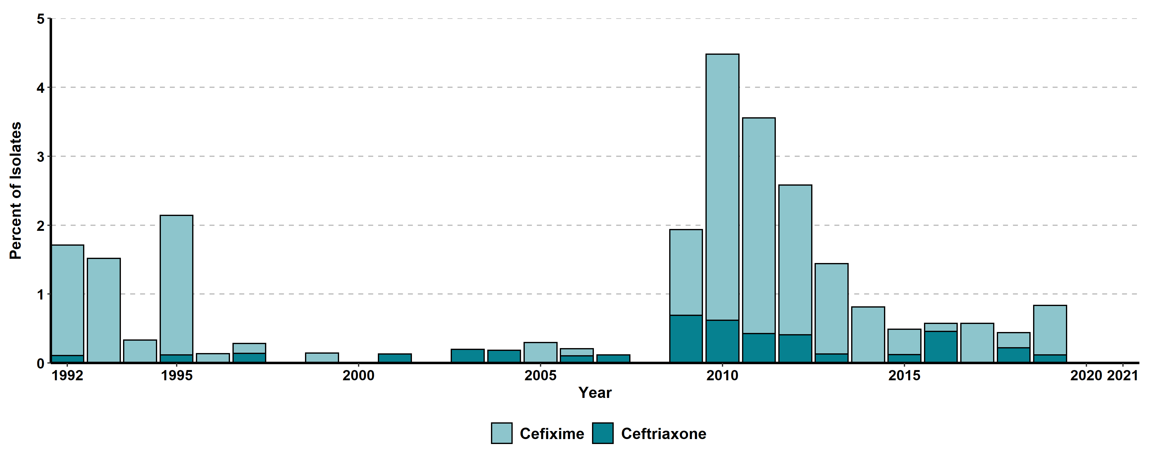
Gonococcal Isolate Surveillance Project (GISP), Percent of Neisseria Gonorrhoeae Isolates with CDC "Alert" Values for Selected Cephalosporins in California GISP STD Clinic Sites, 1992-2021
Cefixime susceptibility testing was not performed in 2007-2008.
“Alert” values were set by CDC as markers to look at possible decreased susceptibility. Cefixime alerts had minimum inhibitory concentrations (MICs) ≥ 0.25 μg/mL. Ceftriaxone alerts have MICs ≥ 0.125 μg/mL.
STD Clinic Sites: Long Beach (discontinued in 2007), Los Angeles (added in 2003), Orange, San Diego, San Francisco (discontinued mid-2019)

Slide 7
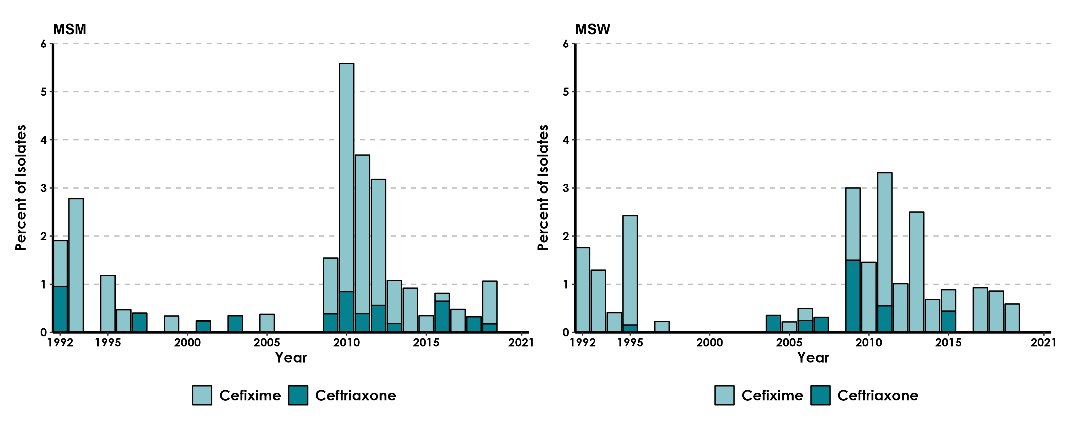
Gonococcal Isolate Surveillance Project (GISP), Percent of Neisseria Gonorrhoeae Isolates with CDC "Alert" Values for Selected Cephalosporins, by Gender and Gender of Sex Partners, in California GISP STD Clinic Sites, 1992-2021
Cefixime susceptibility testing was not performed in 2007-2008.
MSM includes Men who had sex with Men only. MSW includes Men who had sex with Women only.
STD Clinic Sites: Long Beach (discontinued in 2007), Los Angeles (added in 2003), Orange, San Diego, San Francisco (discontinued mid-2019)

