Slide 1
Congenital Syphilis
(Revised 02/2023)

Slide 2
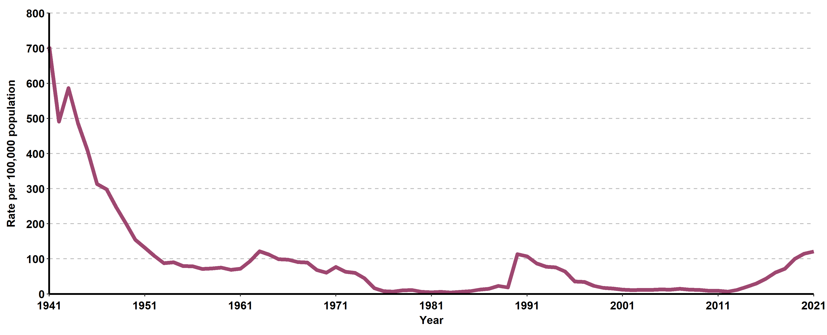
Congenital Syphilis (all stages), California Incidence Rates, 1941–2021

Slide 3
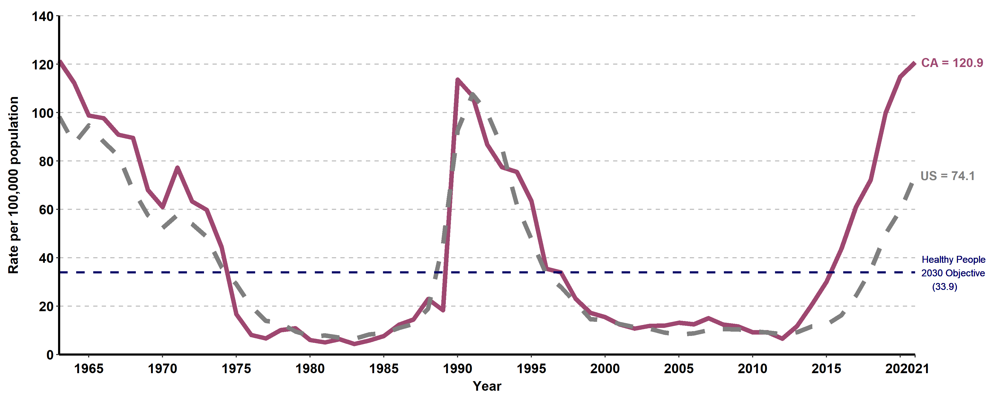
Congenital Syphilis, California versus United States
Incidence Rates, 1963–2021
The Modified Kaufman Criteria were used through 1989. The CDC Case Definition (MMWR 1989; 48: 828) was used effective January 1, 1990. California data prior to 1985 include all cases of congenital syphilis, regardless of age.

Slide 4
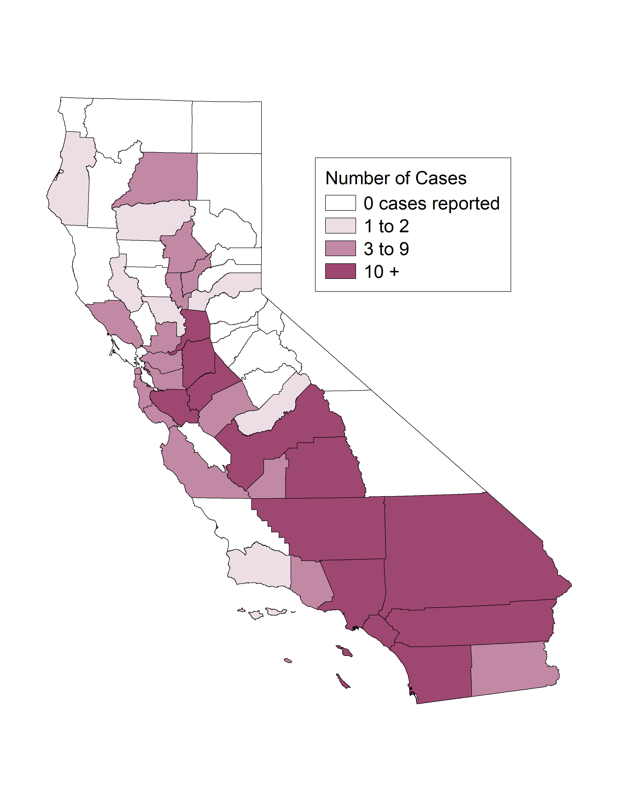
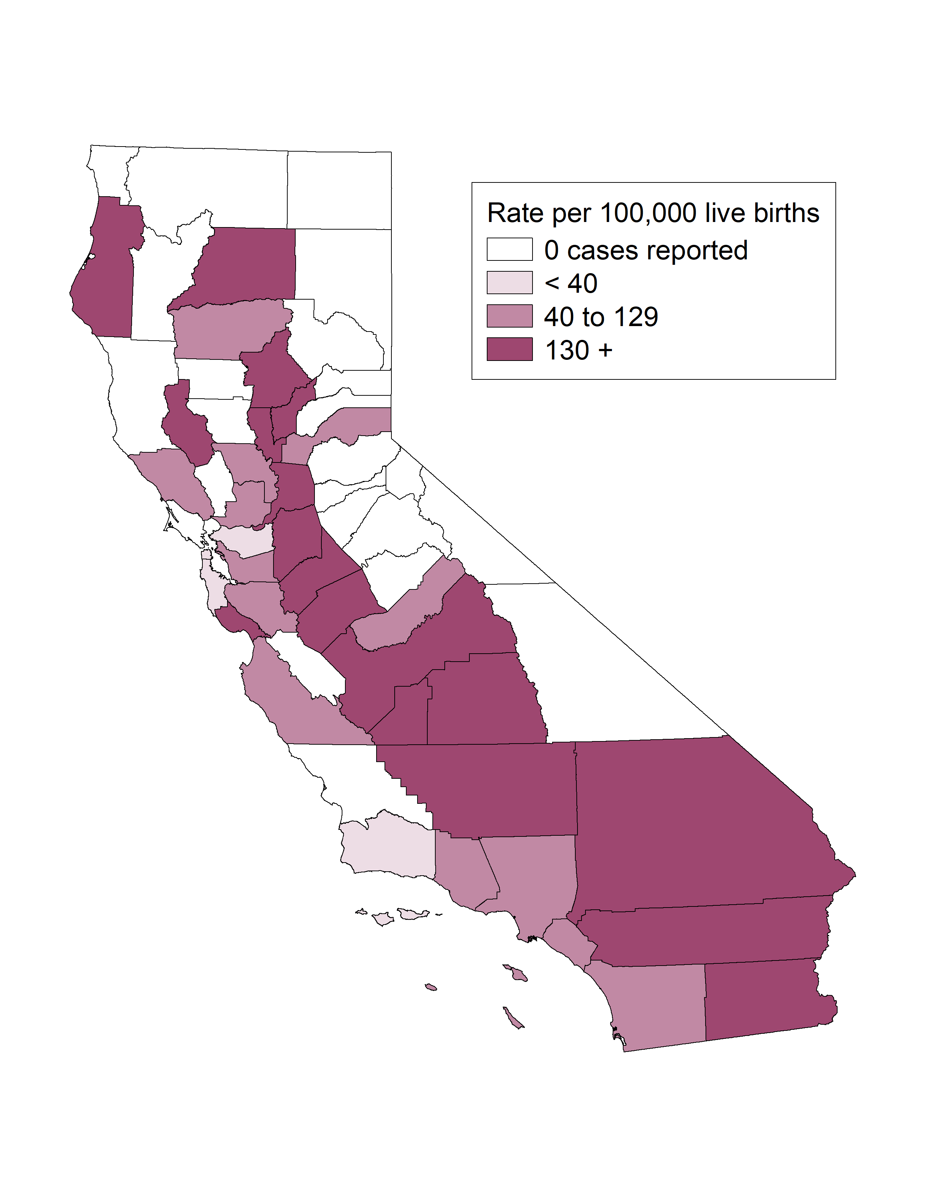
Congenital Syphilis, Case Counts and Incidence Rates by County,
California, 2021
Congenital Syphilis Cases
Congenital Syphilis Rates

Slide 5
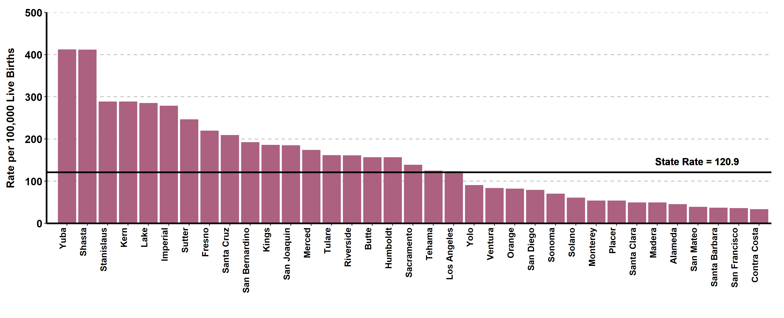
Congenital Syphilis, Ranked Incidence Rates by County,
California, 2021
This figure excludes counties with zero cases (24 counties had zero cases in 2021)

Slide 6
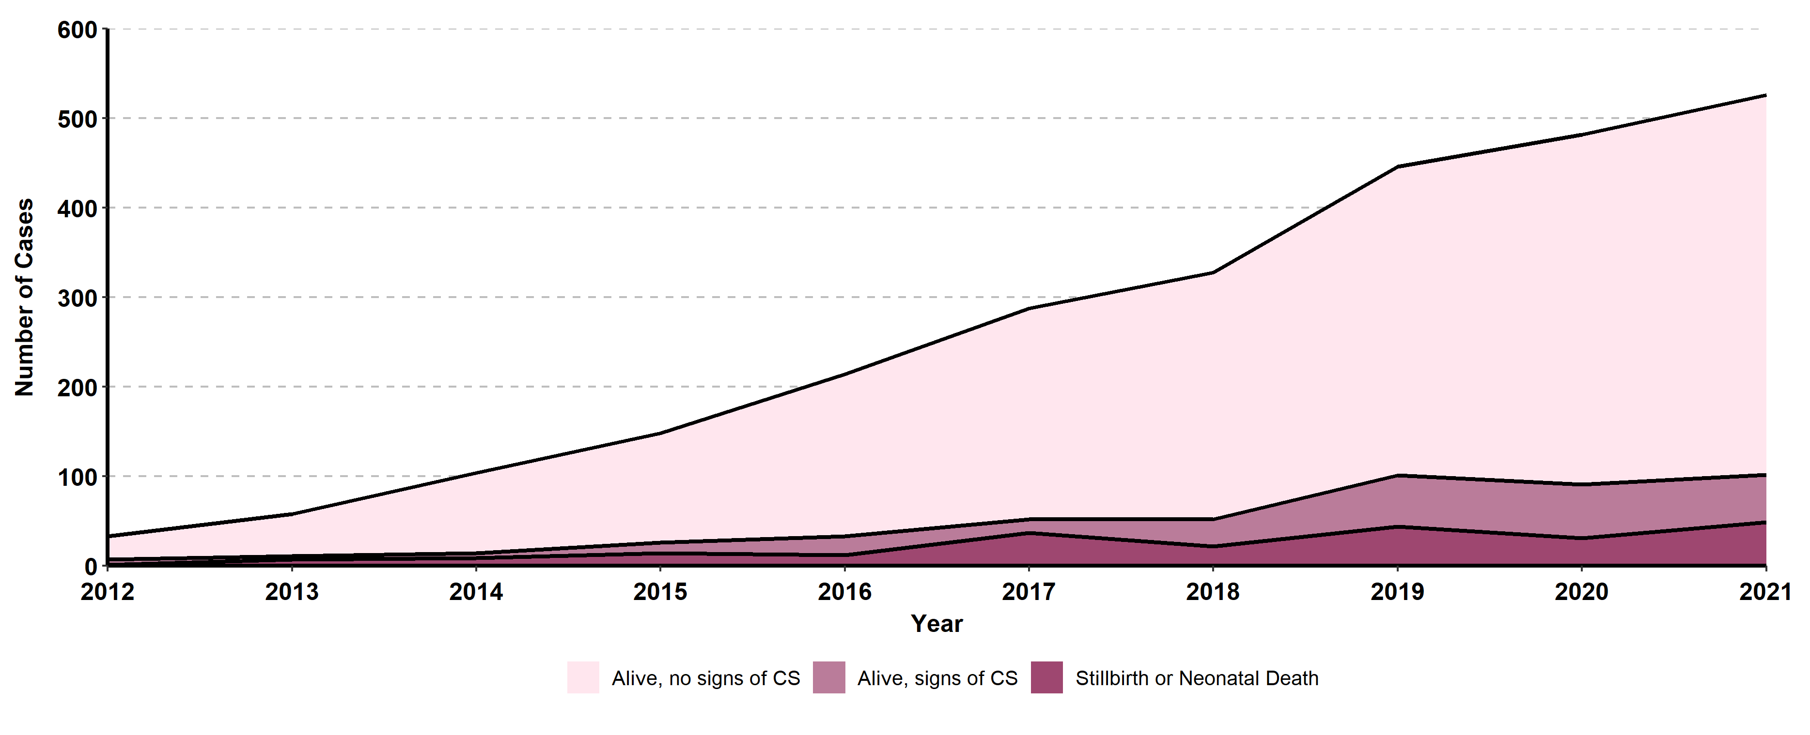
Congenital Syphilis, Cases by Vital Status and Presence of
Signs/Symptoms, California, 2012-2021
Alive, no signs of CS includes cases that were alive but were missing documentation of signs/symptoms.
Of the 528 total CS cases in 2021, 424 were alive with no signs, 53 were alive with signs of CS, 49 were stillbirths or neonatal deaths.

Slide 7
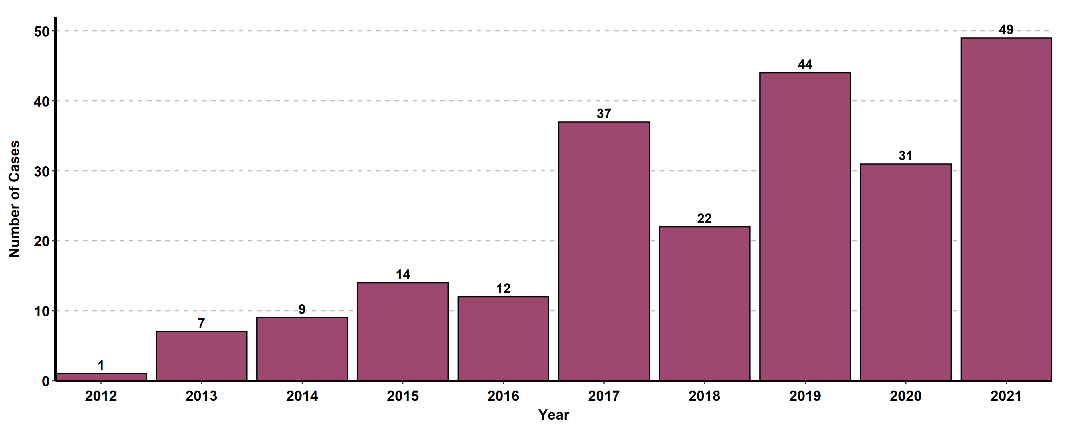
Congenital Syphilis Stillbirths or Neonatal Deaths, California, 2012-2021

Slide 8
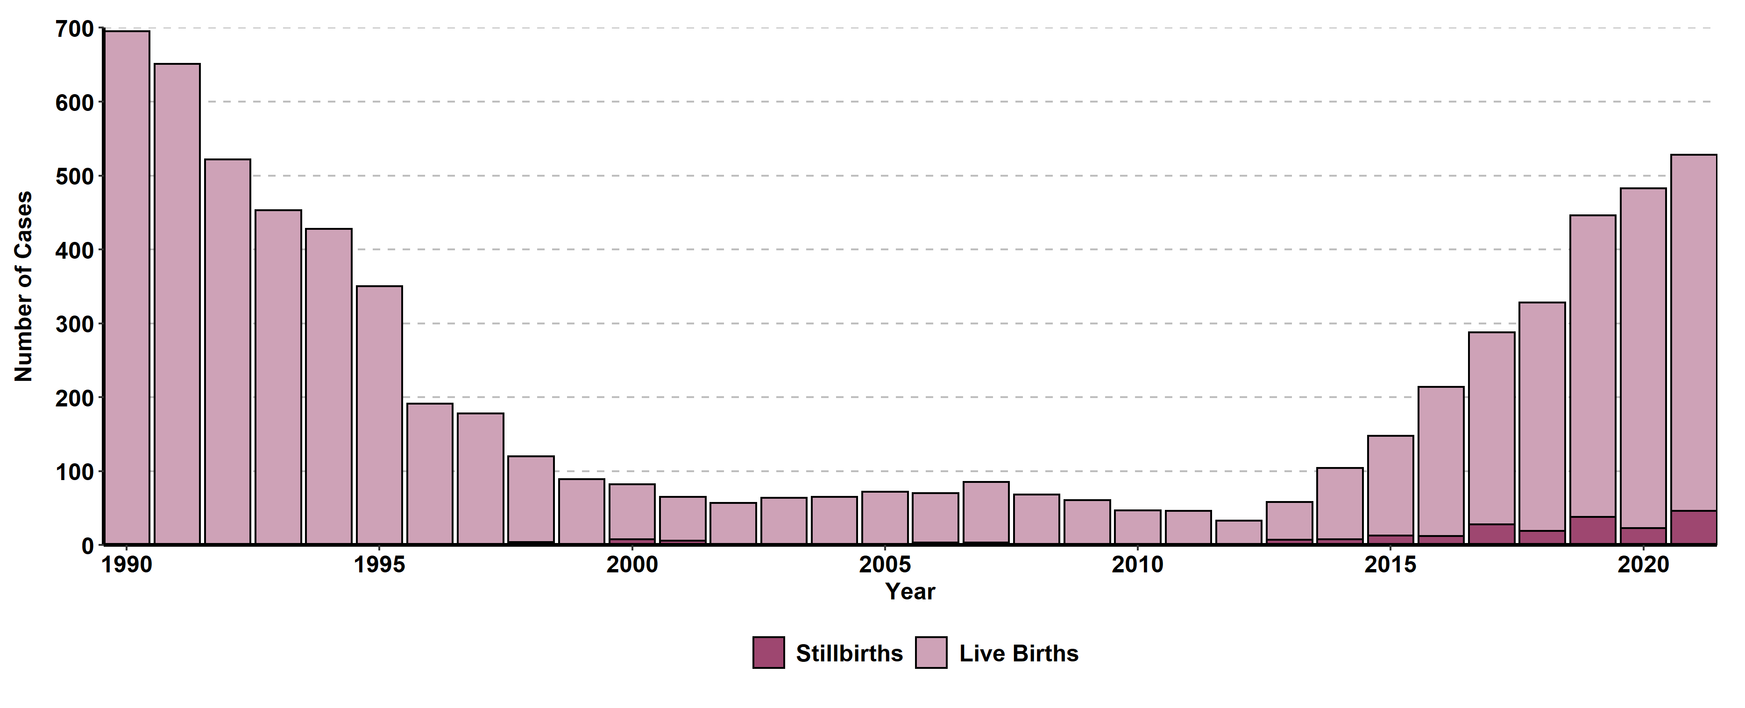
Congenital Syphilis, Stillbirth versus Live Birth Case Counts, California, 1990-2021

Slide 9
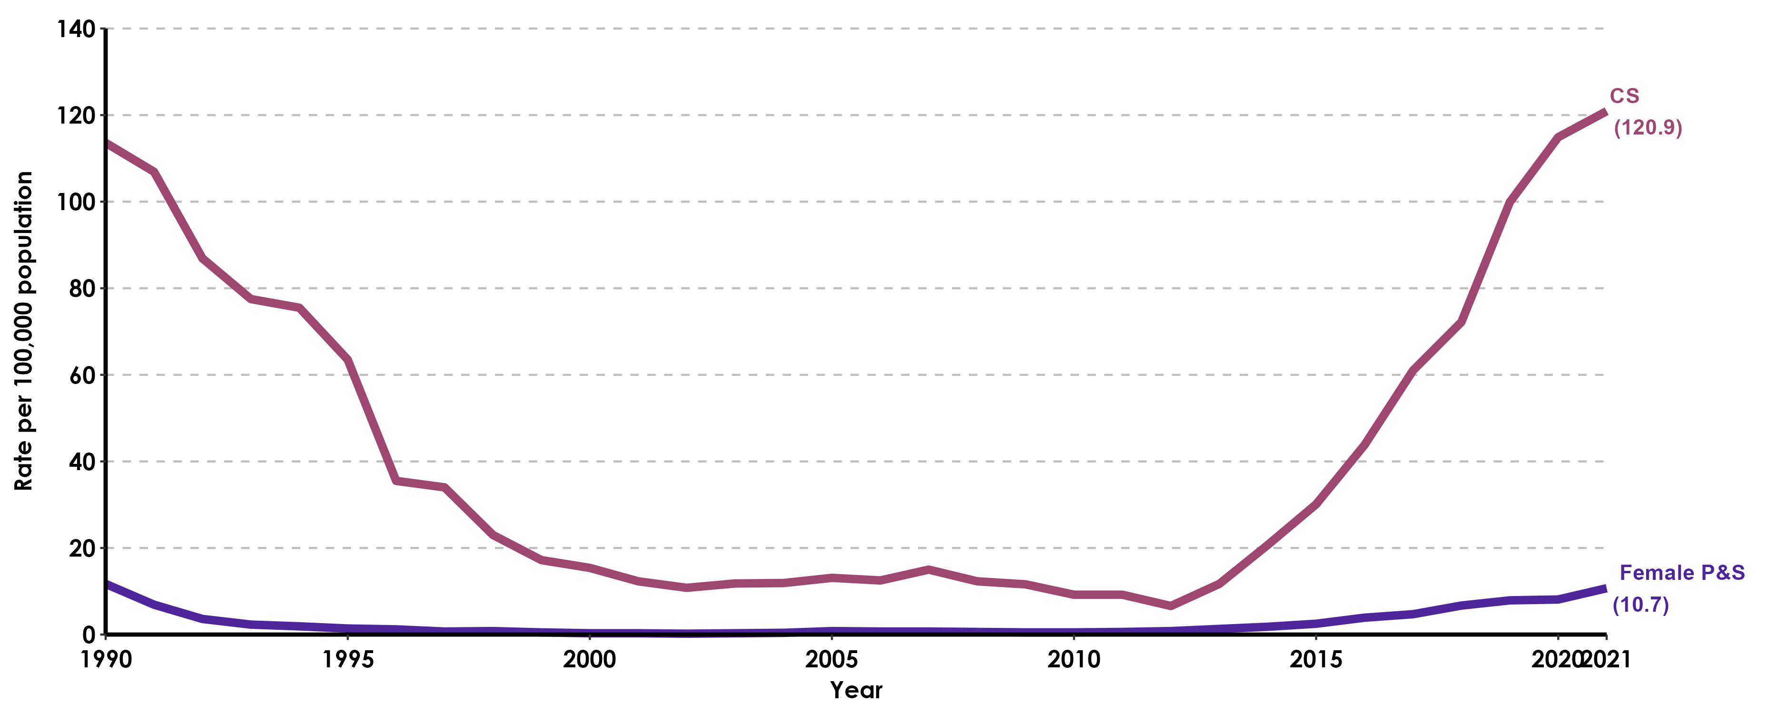
Congenital Syphilis versus Female Primary & Secondary Syphilis Incidence Rates, California, 1990-2021
P&S rates include Primary and Secondary Syphilis Rates

Slide 10
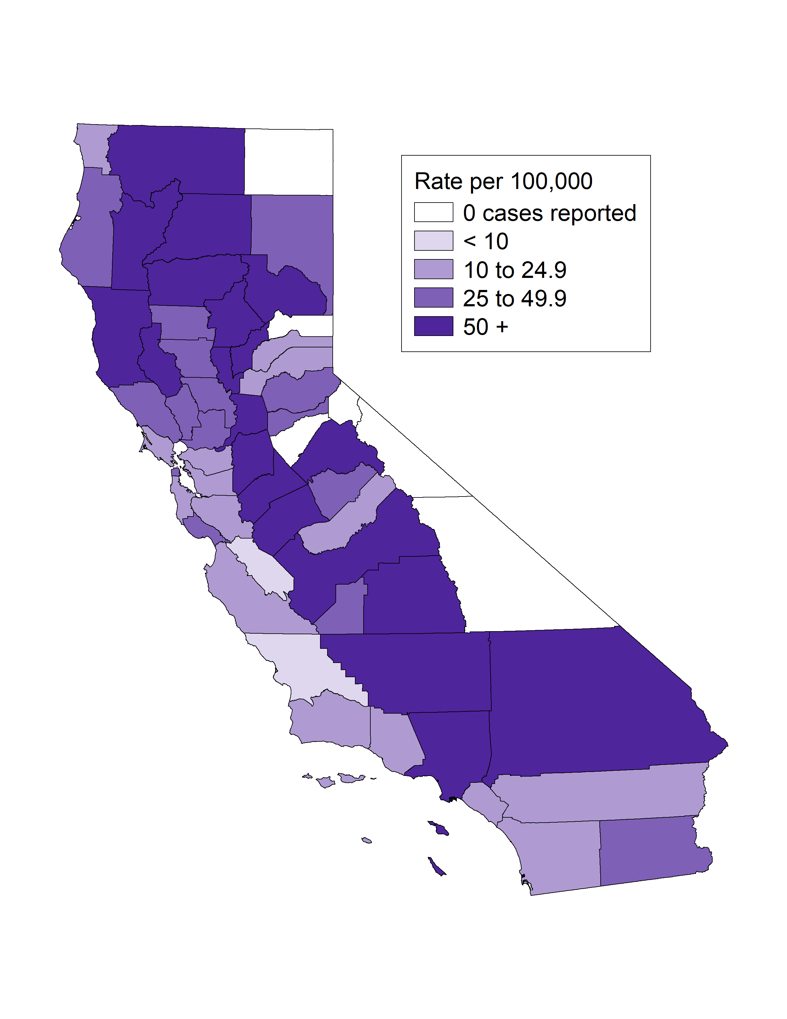
Early Syphilis* Incidence Rates among Women Age (15-44) & Congenital Syphilis Incidence Rates, by County, California, 2021
Early Syphilis Female Ages 15-44 Rates
Congenital Syphilis Rates
* Early syphilis includes primary, secondary, and early non-primary non-secondary syphilis.

Slide 11
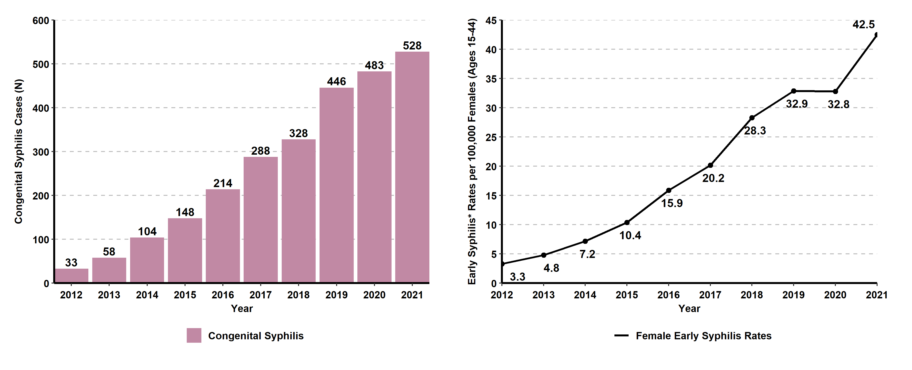
Congenital Syphilis Cases and Early Syphilis* Incidence Rates among Females Ages 15-44, California, 2012-2021
* Early syphilis includes primary, secondary, and early non-primary non-secondary syphilis.

Slide 12
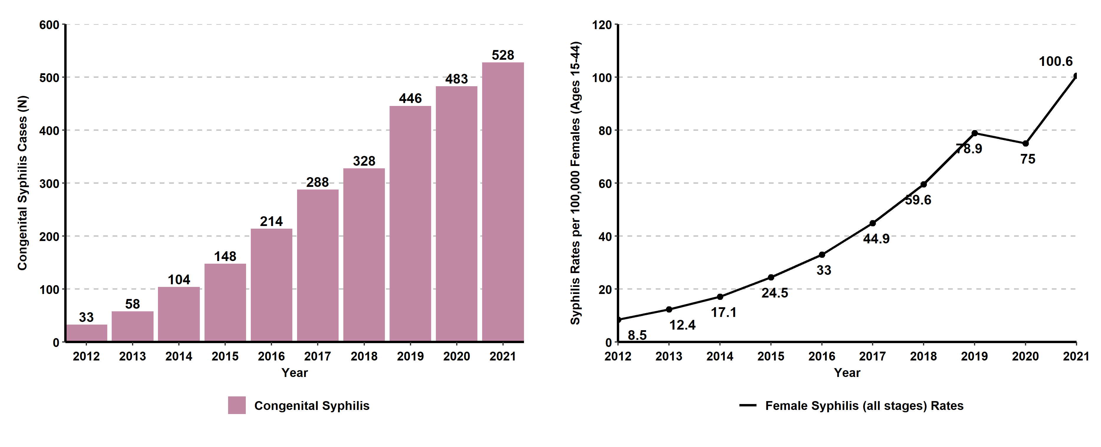
Congenital Syphilis Cases and Syphilis (all stages*) Incidence Rates among Females Ages 15-44, California, 2012-2021
* Includes primary, secondary, early non-primary non-secondary, and unknown duration or late syphilis.

Slide 13
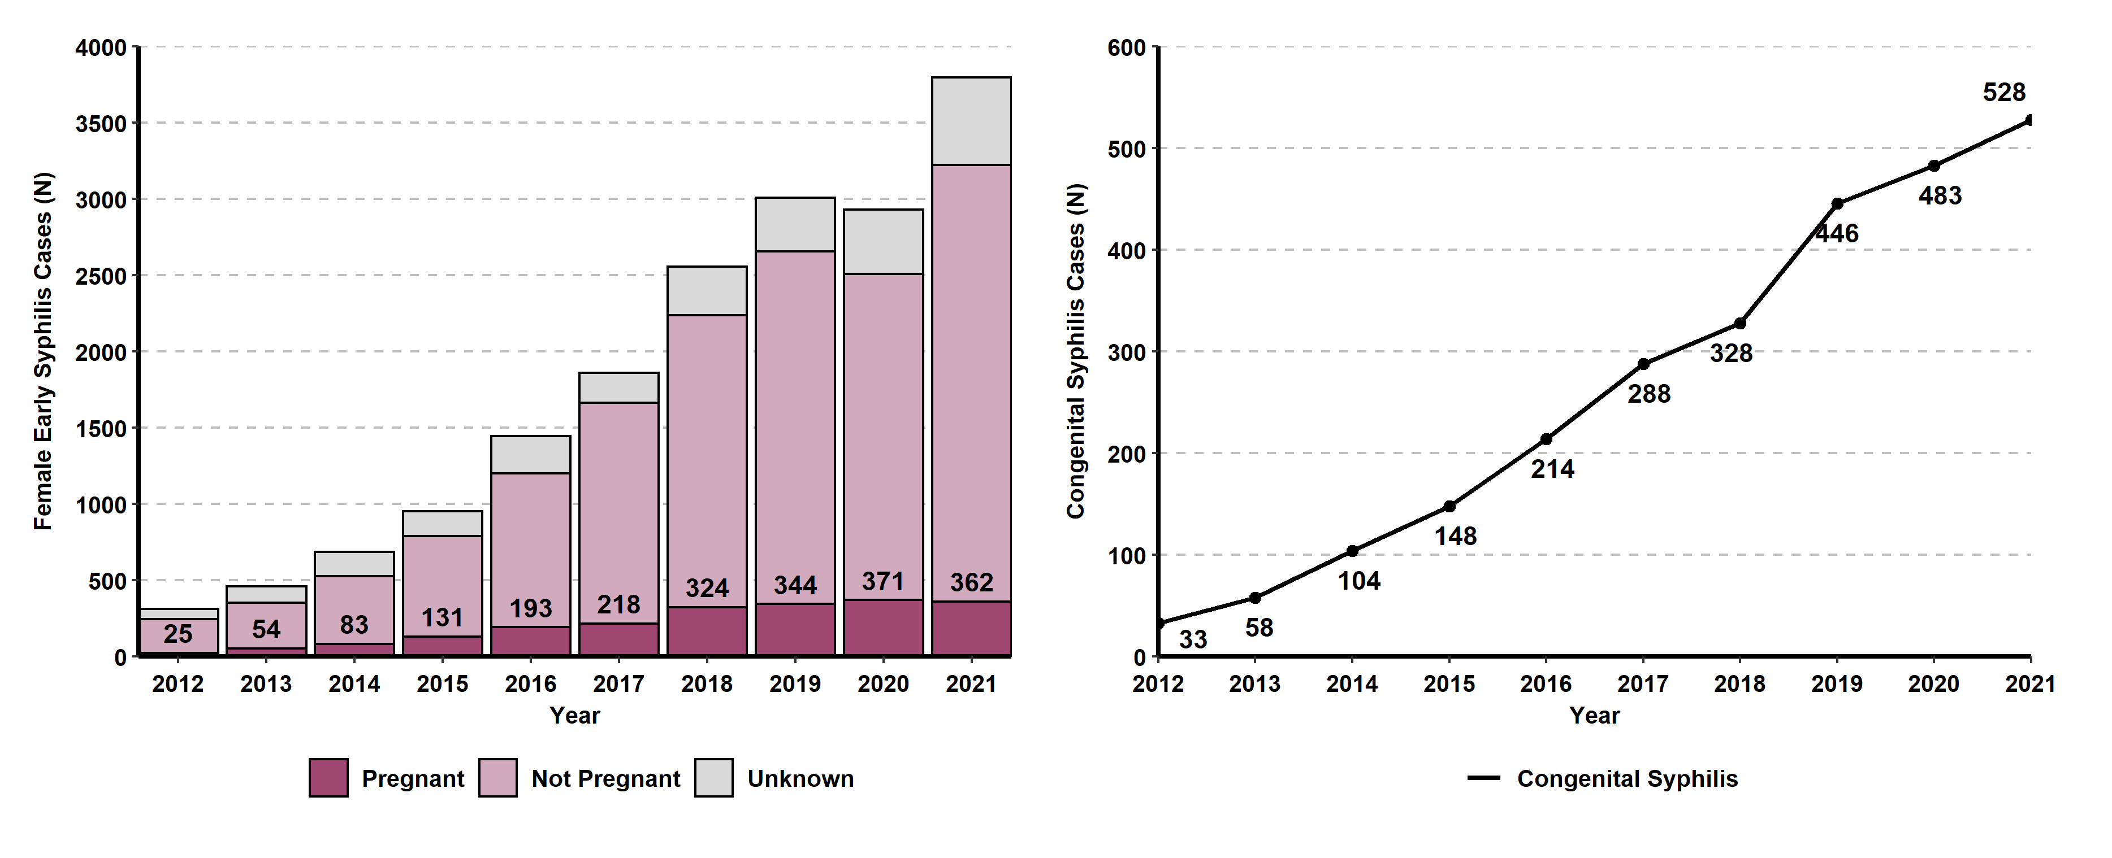
Congenital Syphilis Cases and Female Early Syphilis* Cases by Pregnancy Status, California, 2012-2021
* Early syphilis includes primary, secondary, and early non-primary non-secondary syphilis.

Slide 14
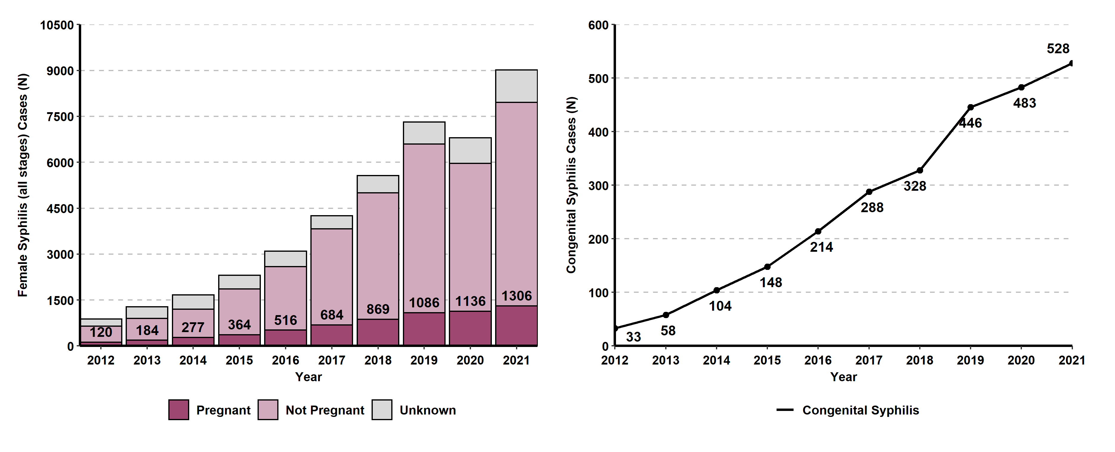
Congenital Syphilis Cases and Female Syphilis (all stages*) Cases by Pregnancy Status, California, 2012-2021
* Includes primary, secondary, early non-primary non-secondary, and unknown duration or late syphilis.

Slide 15
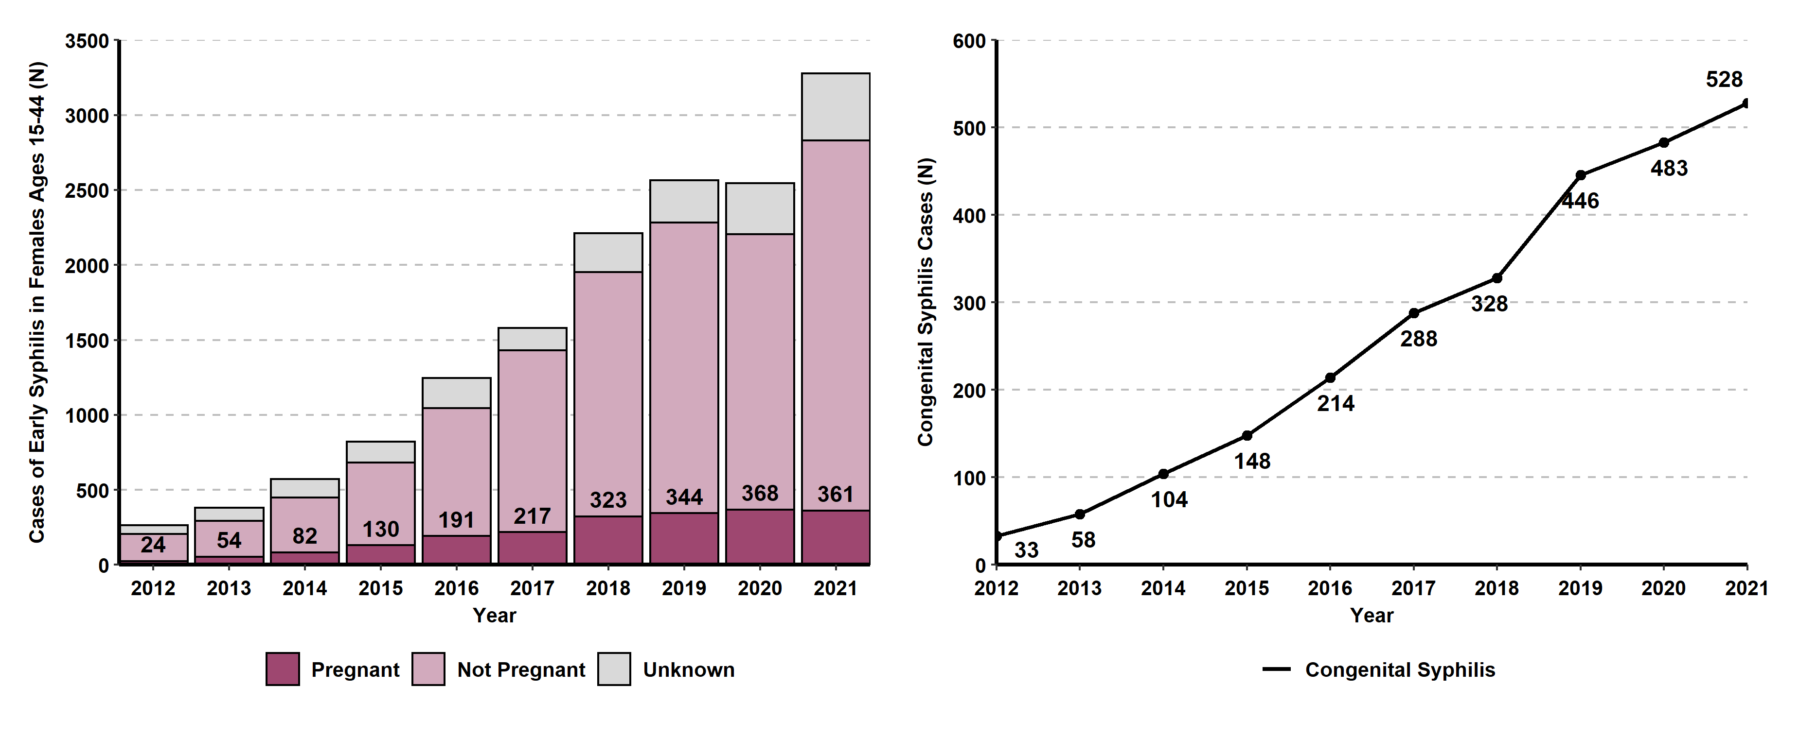
Congenital Syphilis Cases and Females Ages 15-44 Early Syphilis* Cases by Pregnancy Status, California, 2012-2021
* Early syphilis includes primary, secondary, and early non-primary non-secondary syphilis.

Slide 16
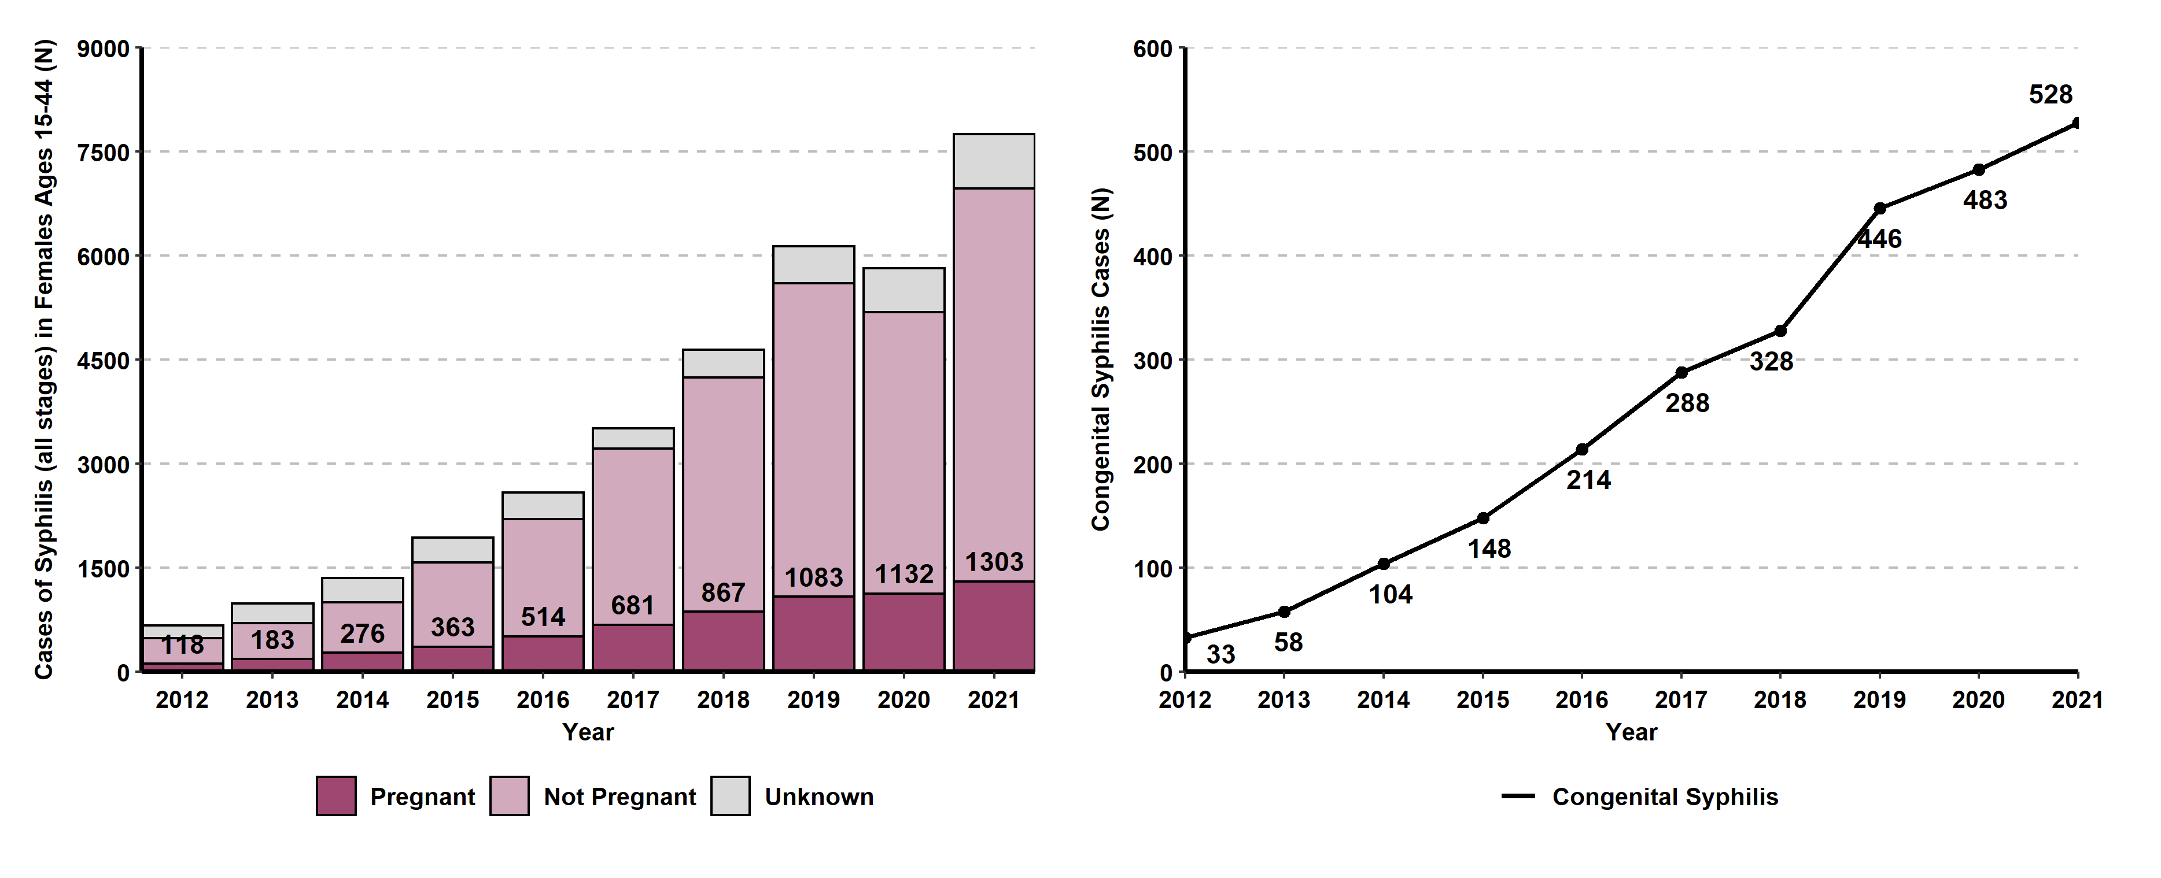
Congenital Syphilis Cases and Females Ages 15-44 Syphilis (all stages*) Cases by Pregnancy Status, California, 2012-2021
* Includes primary, secondary, early non-primary non-secondary, and unknown duration or late syphilis.

Slide 17
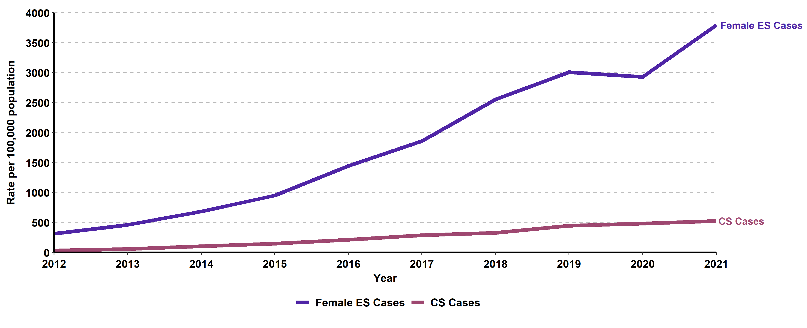
Female Early Syphilis* and Congenital Syphilis Cases, California, 2012–2021
* Early syphilis includes primary, secondary, and early non-primary non-secondary syphilis.

Slide 18
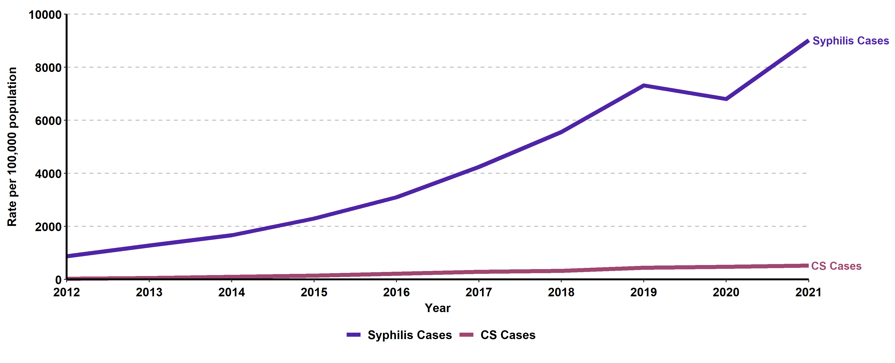
Female Syphilis (all stages*) and Congenital Syphilis Cases, California, 2012–2021
* Includes primary, secondary, early non-primary non-secondary, and unknown duration or late syphilis.

Slide 19
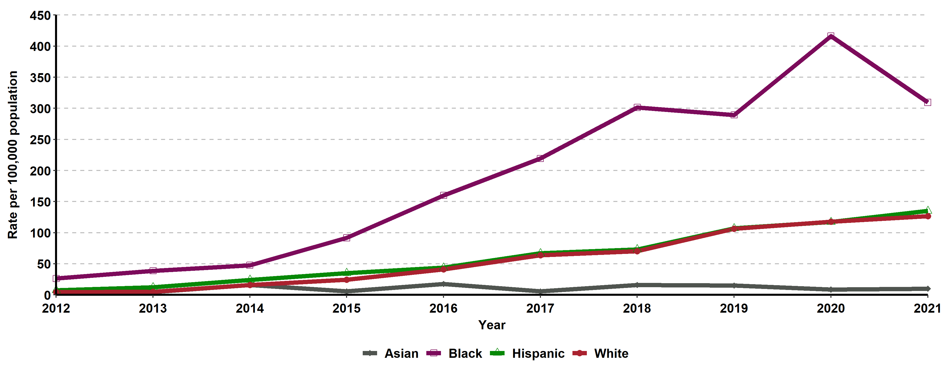
Congenital Syphilis, Incidence Rates for Females by Race/Ethnicity,
California, 2012–2021
Data were excluded for American Indian/Alaska Native and Native Hawaiian/Other Pacific Islander due to small number of cases causing unstable rates.

Slide 20
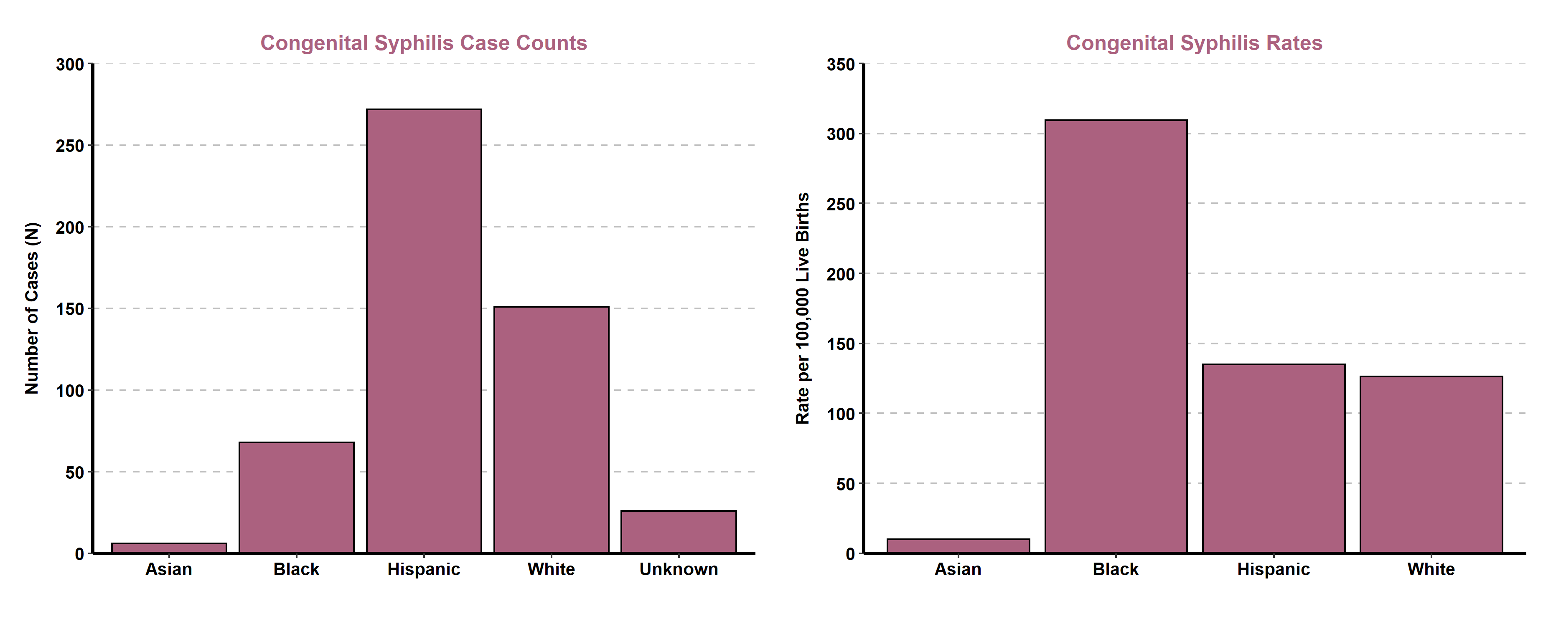
Congenital Syphilis, Incidence Rates by Race/Ethnicity, California, 2021
Data were excluded for American Indian/Alaska Native and Native Hawaiian/Other Pacific Islander due to small number of cases causing unstable rates.

Slide 21
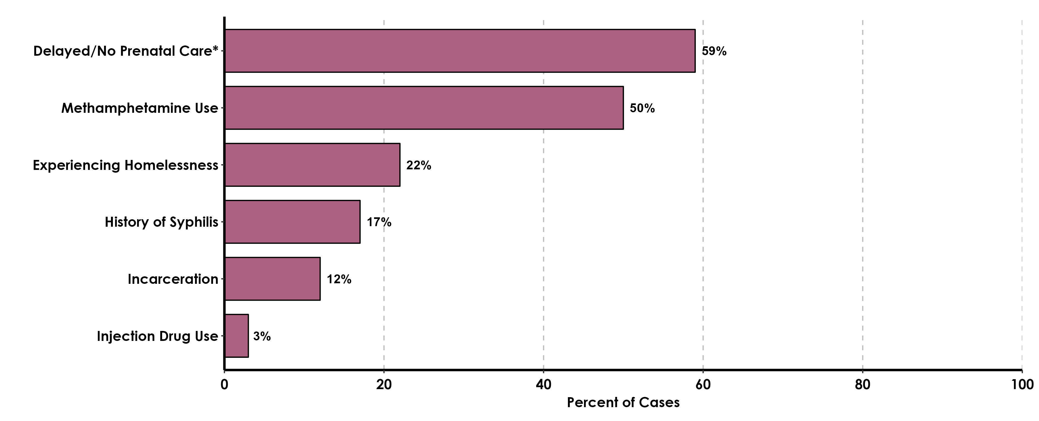
Risk Factors Reported by Mothers of CS Infants, California Project Area (CPA), 2021
These data do not include Los Angeles or San Francisco local health jurisdictions.
*Prenatal care information was collected from CS cases in the CPA (N=405).
Additional risk information were collected through CS quality assurance review of case interview records (N=175 interviewed/405 (43.2) total CS cases in CPA).

