Slide 1
Chronic Hepatitis C Infections in California
Cases Newly Reported through 2018
March 2020
Office of Viral Hepatitis Prevention
California Department of Public Health (CDPH), STD Control Branch
Notes:
Updated: date

Slide 2
Chronic Hepatitis C, California, 2018 Slide Set Notes
Data presented in these slides describe cumulative cases of chronic hepatitis C newly reported to CDPH from 1994-2018. Findings for the most recent five-year period (2014-2018) are highlighted to minimize the chance that an increase in case reports is due to the initiation of statewide electronic laboratory reporting (ELR) and auto processing of ELR hepatitis C data of data in October and December, 2013, respectively.
Data presented in these slides do not measure prevalence or incidence of chronic hepatitis C virus infections in California due to the asymptomatic nature of these infections, varied levels of completeness of surveillance reporting, and because it remains unknown how many of the cases described are currently living.

Slide 3
Chronic Hepatitis C, California, 2018 Slide Set Notes (continued)
These data reflect a change in the Council of State and Territorial Epidemiologist (CTSE)/Centers for Disease Control and Prevention (CDC) case definition for chronic hepatitis C in 2016. This change resulted in fewer cases with criteria to be classified as confirmed in 2016 compared to previous reporting years. Cases reported in 2012-2015 could be classified as confirmed with only a positive antibody result value above a certain threshold. In 2016, such cases were considered probable and ribonucleic acid (RNA) detection was necessary for confirmation. Cases in this report were classified based on the case definition current at the time of the case report.

Slide 4
Chronic Hepatitis C, California, 2018 Slide Set Notes (continued)
Percentages, rather than rates, were used to describe newly reported cases for which race/ethnicity is known, since race/ethnicity information was not reported for more than two-thirds of chronic hepatitis C cases (71 percent) during 2014-2018. Race/ethnicity data should be interpreted with caution.
Race/ethnicity was categorized as: American Indian/Alaska Native, Asian/Pacific Islander, African American/Black, Hispanic/Latino, and White. For the purposes of this slide set, Hispanic/Latino encompasses patients of Hispanic or Latino ethnicity, regardless of reported race; all other race categories presented do not include persons of Hispanic or Latino ethnicity.

Slide 5
Chronic Hepatitis C, California, 2018 Slide Set Notes (continued)
Individuals with chronic hepatitis C infection who were incarcerated in state prisons at the time of their first confirmed hepatitis case report are not attributed to the local health jurisdiction in which they were incarcerated. This is because people are often incarcerated in a different county than the one in which they would reside were they not incarcerated. In order to avoid overestimating the burden of disease in (often rural) counties with state prisons, chronic hepatitis C cases reported from state prisons were attributed to the state prison system at large. Accordingly, HCV data are presented in two sections—the first for the entire state (which includes cases in state prisons), and the second for hepatitis C cases in state prisons only.

Slide 6
Epidemiology of Chronic Hepatitis C in California

Slide 7
Chronic Hepatitis C – Rates of Newly Reported Cases (including State Prisons), California, 1994-2018

Slide 8
Chronic Hepatitis C – Number of Newly Reported Cases (including State Prisons) by Resolution Status, California, 2007-2018
Case definition changed.*
*As of January 2016, a positive hepatitis C virus antibody result with a high signal-to-cut-off ratio was considered probable; ribonucleic acid (RNA) was required for a confirmed case.

Slide 9
Chronic Hepatitis C – Age Distribution of Newly Reported Cases, California, 2014 and 2018
2014
2018

Slide 10
Chronic Hepatitis C – Rates of Newly Reported Cases by Age Group, California, 2014-2018

Slide 11
Chronic Hepatitis C – Cases and Proportions of Newly Reported Cases for Which Race/Ethnicity is Known, by Race/Ethnicity, California, 2018

Slide 12
Chronic Hepatitis C – Rates of Newly Reported Cases in Ranked Order by Local Health Jurisdiction, Excluding Cases in State Prisons, California, 2018

Slide 13
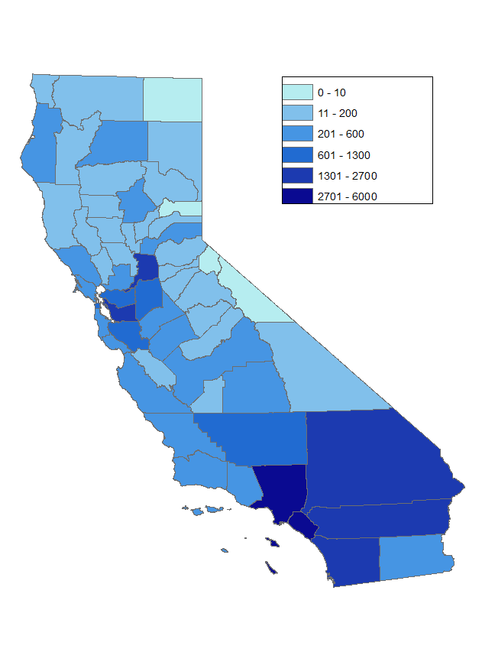
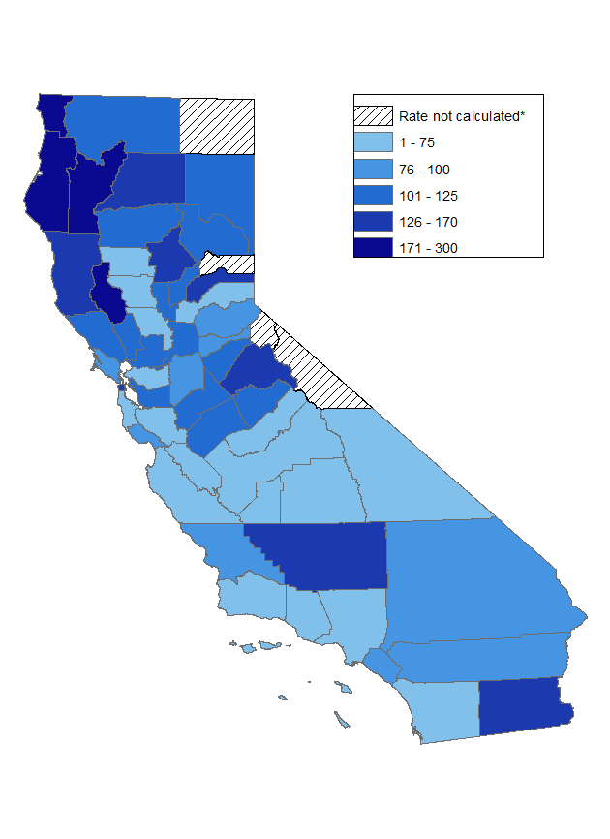
Chronic Hepatitis C – Case Counts and Rates of Newly Reported Cases by County, Excluding Cases in State Prisons, California, 2018
Case Counts
Rates
Notes:
* Rates were not calculated for local health jurisdictions that reported ten or fewer cases.
• State prisons cases were removed from local health jurisdiction totals and attributed to the state prison system as a whole.
Source: California Department of Public Health, Sexually Transmitted Disease (STD) Control Branch, Office of Viral Hepatitis Prevention

Slide 14
Epidemiology of Chronic Hepatitis C in State Prisons in California

Slide 15
Chronic Hepatitis C – Rates of Newly Reported Cases in State Prisons, 1994-2018

Slide 16
Chronic Hepatitis C – Number of Newly Reported Cases in State Prisons, by Resolution Status, California, 2009-2018
Universal screening at intake.
Case definition changed.*
*As of January 2016, a positive hepatitis C virus antibody result with a high signal-to-cut-off ratio was considered probable; RNA was required for a confirmed case.

Slide 17
Chronic Hepatitis C – Rates of Newly Reported Cases by Age Group, California State Prisons, 2014-2018

Slide 18
Chronic Hepatitis C – Cases and Proportions of Newly Reported Cases in State Prisons for Which Race/Ethnicity is Known, by Race/Ethnicity, 2018

