Slide 1

Module 4: Cleaning and Disinfection of Resident Rooms Infection Prevention and Control Training for Environmental Services Staff
Notes:
Instructor notes:
This course reviews the cleaning and disinfection process, walking through a standard cleaning process, a daily versus terminal clean, and how to use workplace reminders like an environmental cleaning checklist to make the job easier to navigate.
(Instructor prompts are noted in bold throughout the presentation.)
[Click]

Slide 2
Objectives
Describe the critical role of cleaning and disinfection
Discuss daily and terminal cleaning processes
Use an environmental cleaning checklist
Notes:
Today we will review the how and why of cleaning and disinfecting resident rooms. After this presentation you will be able to describe why and how cleaning and disinfection play a key role in keeping the care environment safe. You will be able to discuss the elements of a daily versus a terminal cleaning process, and know how to obtain and use an environmental cleaning checklist.
[Click]

Slide 3

Why Do Cleaning and Disinfection Matter?
Germs are present everywhere including objects and surfaces in the resident’s room
Germs are a source of infection
Improper cleaning and disinfection allows germs to spread leading to more infections
Notes:
Why do cleaning and disinfection matter?
Germs are present everywhere including objects and surfaces in the resident’s room – we cannot identify which surfaces need cleaning by just looking with our eyes.
Germs are a source of infection - What you can’t see can spread to your residents and you!
Improper cleaning and disinfection allow germs to spread which can lead to more infections - By only cleaning what you see, you may overlook a contaminated surface and increase the load of germs in the environment which can be transmitted to someone else.
[Click]

Slide 4
Clean Before You Disinfect a Surface
Cleaning is the physical removal of foreign material (e.g., dust, soil) and organic material (e.g., blood, germs)
Disinfection is the chemical process of killing germs on surfaces
Notes:
We must clean before we can disinfect a surface. Let’s talk about why.
Cleaning is the physical removal of foreign material like dust or soil and organic material like blood or germs. Cleaning removes large numbers of germs from a surface that would otherwise interfere with the disinfection process.
Disinfection is the chemical process that kills germs present on surfaces that can cause an infection or disease.
[Click]

Slide 5
Disinfectants Won’t Work if a Thorough Cleaning Doesn’t Happen First
1. Thoroughly clean a surface to remove most germs
2. Disinfect the surface to kill remaining germs
Notes:
Disinfectants won’t work if a thorough cleaning doesn’t happen first.
This can be illustrated by thinking about your dog’s water dish. As the water dish is used, a biofilm or a slimy substance starts to build up on the water bowl. You need to clean off the slimy substance before you can get to the dish to disinfect the dish itself.
So, to recap - always remember to thoroughly clean a surface or object with a microfiber cleaning cloth to remove any foreign material. Then your surface will be ready for the next step – disinfection. If we try to disinfect something that isn’t clean, the disinfectant won’t work as it should.
[Click]

Slide 6
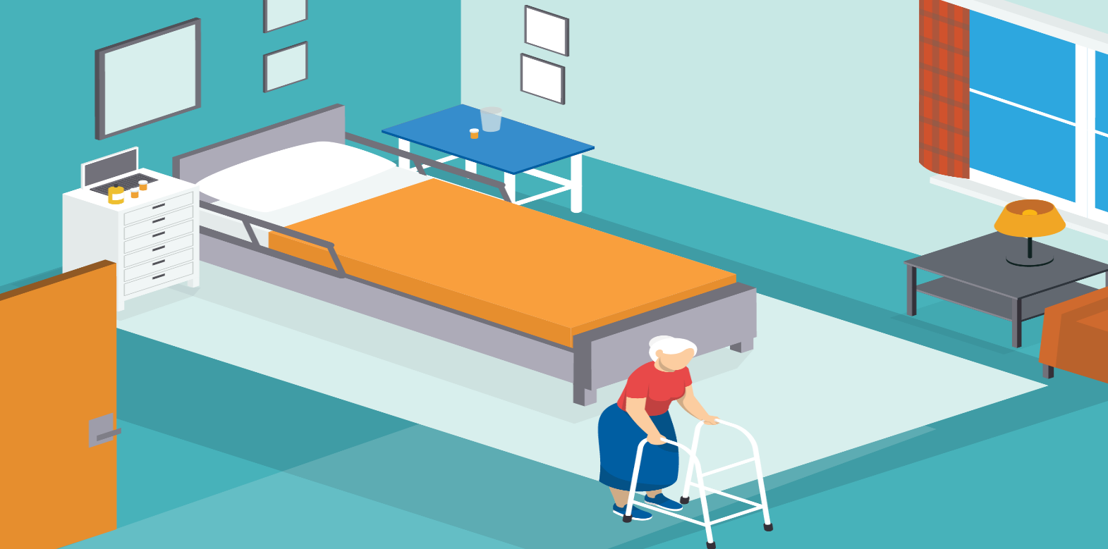




Where Can You Find the Highest Concentration of Germs in a Resident Room?
Notes:
(Instructor notes: This is an animated slide.)
Let’s get some engagement – Take a look at this picture. Where do you think the most germs are in this resident room?
(Instructor notes: Pause for 10 seconds, let people answer ideas).
Great answers.
(Click to display germs) The highest amount of germs in a resident room would be on or around the bed. You will also find germs on door handles, light switches, walkers, and many other places. These are referred to as high-touch surfaces.
[Click]

Slide 7
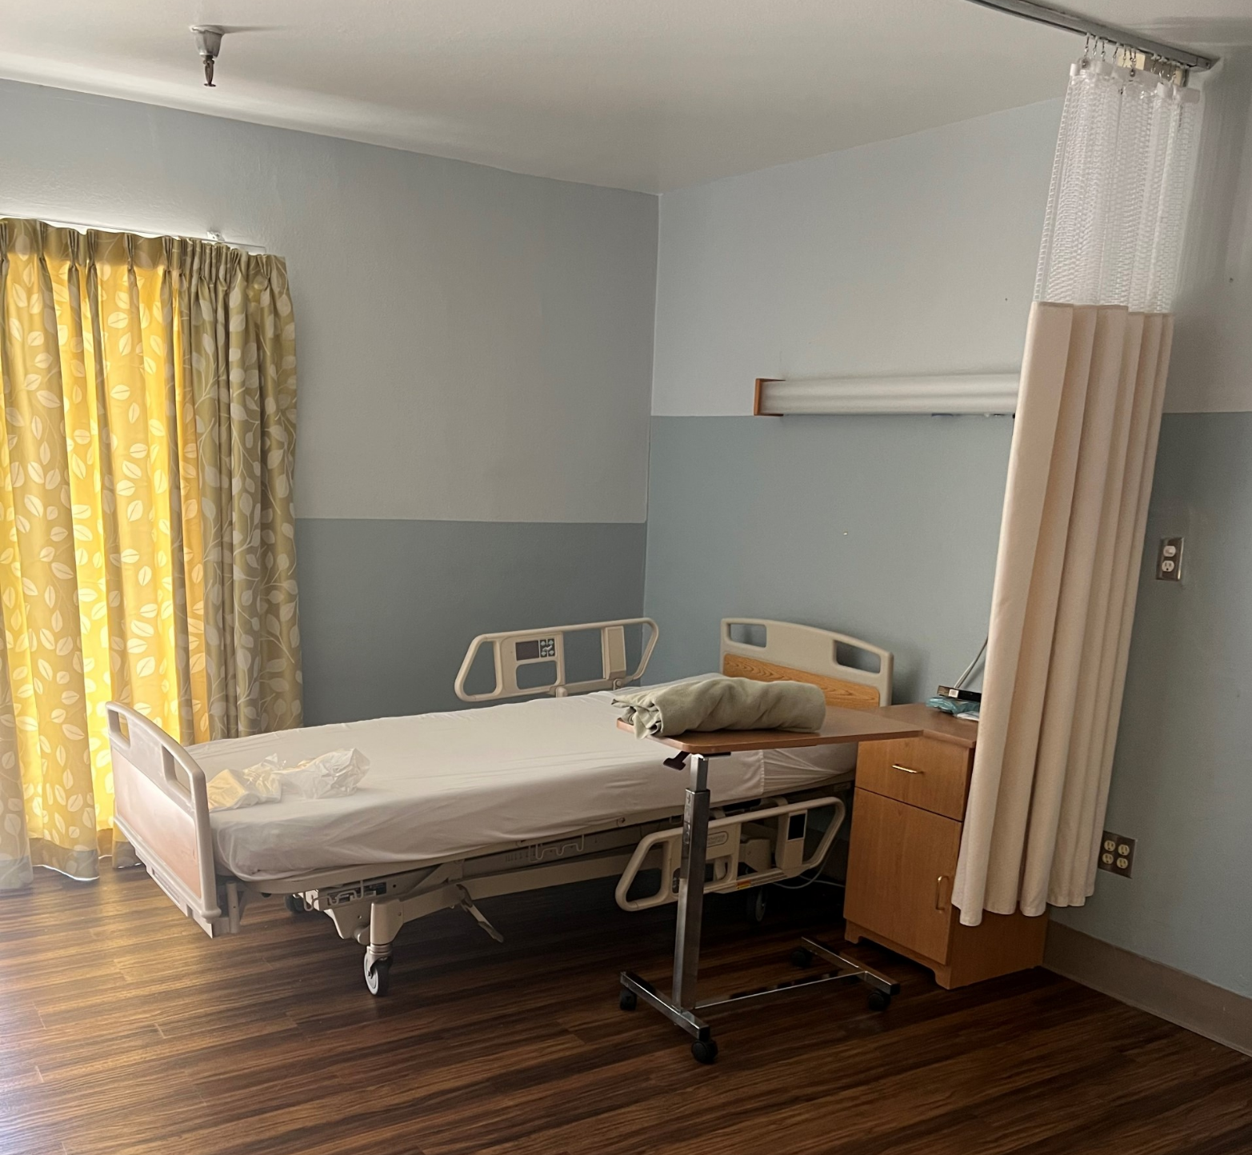
High-Touch Surfaces: An Overview
Surfaces and equipment that are most likely to be contaminated by germs
Surfaces that healthcare workers and residents touch more often
Prioritize cleaning high-touch surfaces at least once a day to reduce likelihood of germ spread
Notes:
High-touch surfaces are surfaces and equipment that are most likely to be contaminated by germs. These are surfaces that healthcare workers and residents touch more often, and therefore must be properly cleaned and disinfected regularly to prevent spreading germs. Generally, the more people who touch a surface, the higher the risk of spreading germs.
Prioritize cleaning high-touch surfaces at least once a day to reduce the likelihood of germ spread. You should consider more frequently cleaning the areas or rooms with high-risk conditions such as rooms with immunocompromised residents, during an outbreak, or if there are residents in isolation.
[Click]
(Instructor notes: High-touch surfaces can differ from facility to facility. Ensure you review any nuances in your policy with staff.)

Slide 8
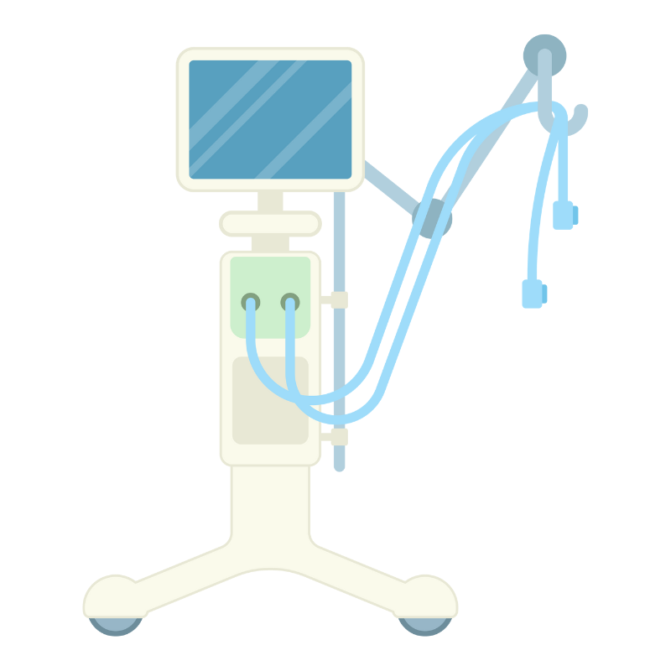
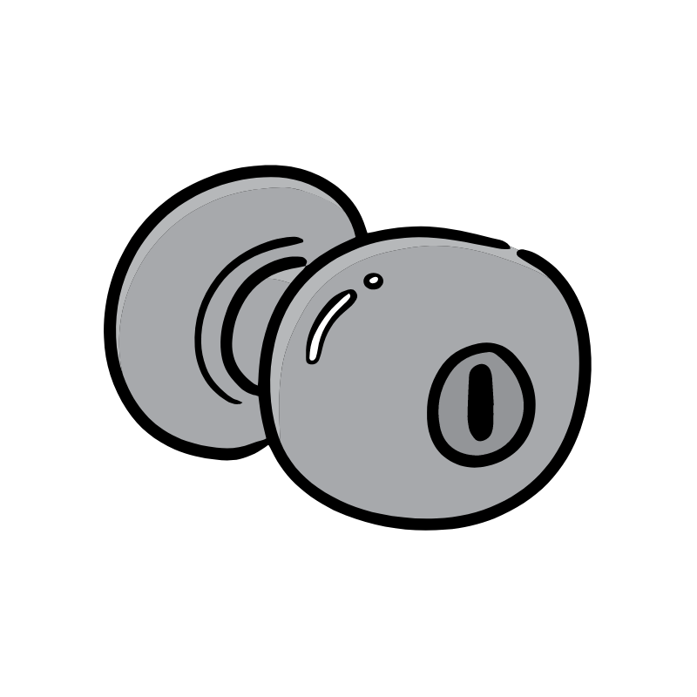
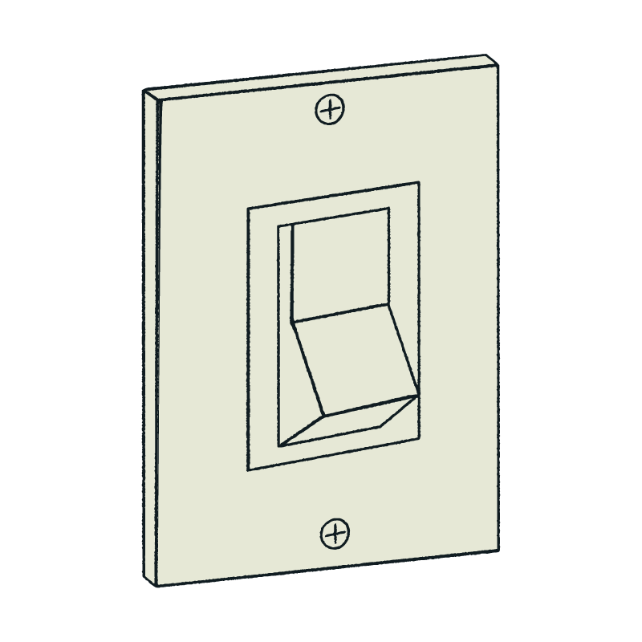
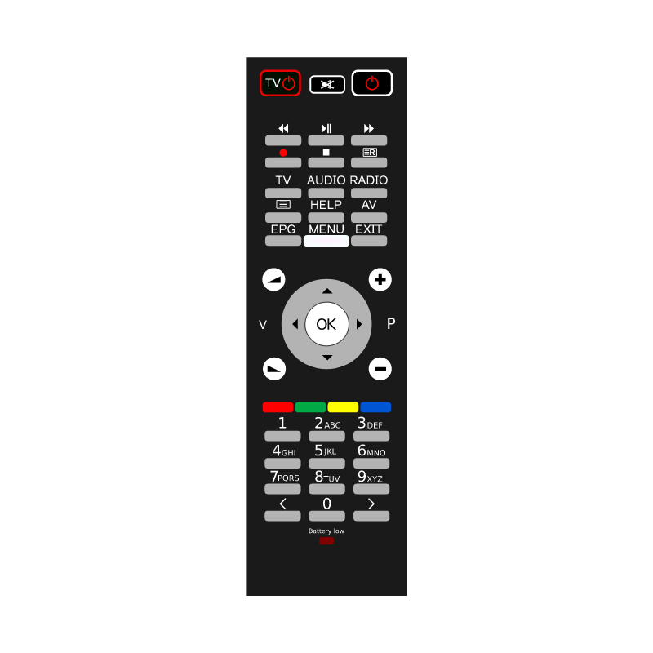
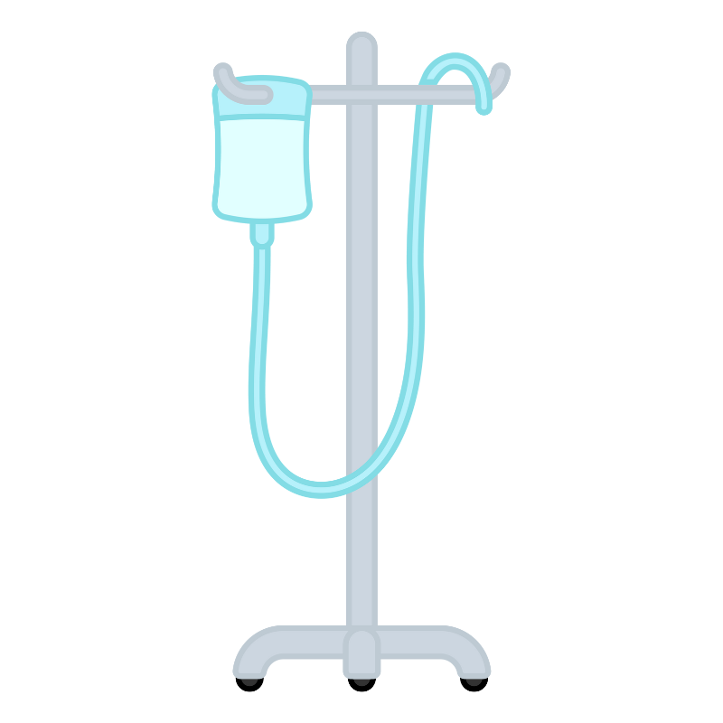

Examples of High-Touch Surfaces
Include:
Doorknobs
Light switch
Bedpans
Toilet handle
Bedrail
Call button
Remote
IV pump and pole
Bedside table
Commode chair
Computer keyboard
Tray table
Telephone
Respiratory equipment
Chairs
Tip: Post a list of high-touch surfaces on the EVS cart for reference.
Notes:
Here are some examples of high-touch surfaces you may find in a resident’s room. This is not a comprehensive list.
All of these surfaces mentioned may not all be the sole responsibility of EVS staff to clean. In some facilities, nursing staff are responsible for cleaning some surfaces as well. Environmental cleaning is a collaborative effort among ALL healthcare staff. It takes ALL to prevent the spread of infection.
Here's a tip – You can keep a list of high-touch surfaces on your EVS cart and refer to it as needed. Keep it sealed in a laminated and cleanable surface.
How can you, the EVS staff member, perform cleaning? (Note: next slide has answer)
[Click]
Instructor notes: It is a best practice to not tape anything to the EVS cart to avoid leaving sticky residue behind for germs to stick to. You can place laminated documents on a ring for staff to easily keep on the cart and reference, or place documents in a binder.

Slide 9
Knowledge Check
What are some examples of high-touch surfaces? Select all that apply.
Light switch
Bedrail
Doorknob
Toilet flusher
All of the above
Notes:
Let's test your knowledge,
What are some examples of high touch surfaces? Select all that apply.
Light switch
Bedrail
Doorknob
Toilet flusher
All of the above
(Instructor notes: Pause for 10 seconds for response.)
[Click]

Slide 10
Knowledge Check
What are some examples of high-touch surfaces? Select all that apply.
Light switch
Bedrail
Doorknob
Toilet flusher
All of the above
Notes:
If you chose E. All of the above you are correct!
(Instructor notes: Pause for 10 seconds for response.)
[Click]

Slide 11
Standard CLEANING Process
Notes:
A standard cleaning process ensures that every resident room is cleaned the same way and creates a safe care environment for each resident.
[Click]

Slide 12
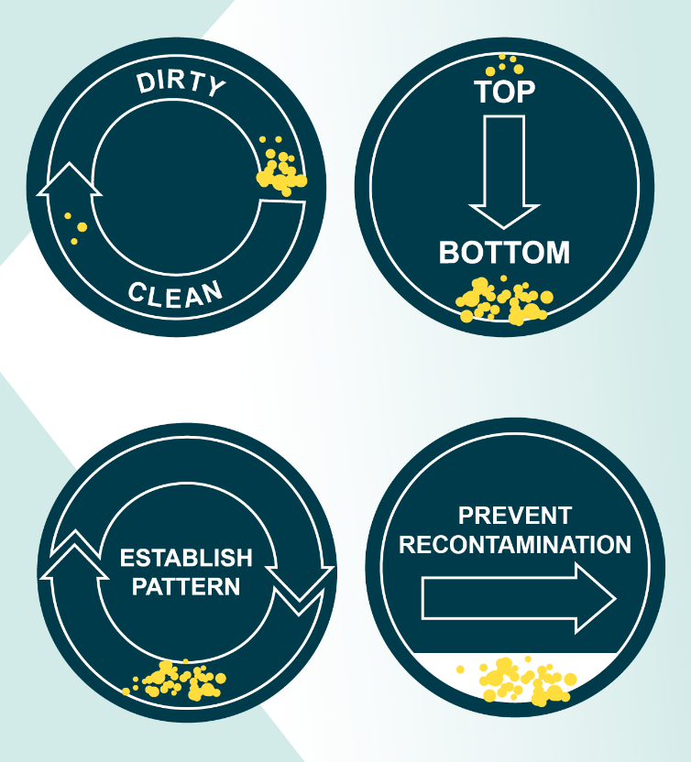
Standard Cleaning Process
Clean from dirty to clean
Clean from top to bottom
Establish a pattern
Prevent contamination
Examples:
Begin with common surfaces (e.g., doorknobs) before moving to the resident area
Restrooms should be cleaned last
Clean bed rails before bed legs
Notes:
A standard way of cleaning is necessary to maintain a basic standard of cleanliness. Procedures must be effective, consistent, and thorough.
These are examples of a standard cleaning process.
We should always move from clean areas to dirty areas – for example, begin with common surfaces like a doorknobs before moving to the resident area, and restrooms should always be cleaned last.
It’s also best to work around the room in the same direction every time. Clean from high to low surfaces, top to bottom – for example clean bed rails before bed legs, or high-touch surfaces before floors.
When using a wipe to clean from top to bottom, make sure to discard the wipe if it had contact with the floor before continuing the cleaning process.
Establish a pattern and follow a standard cleaning process to ensure consistency in cleaning and to prevent cross-contamination.
[Click]

Slide 13
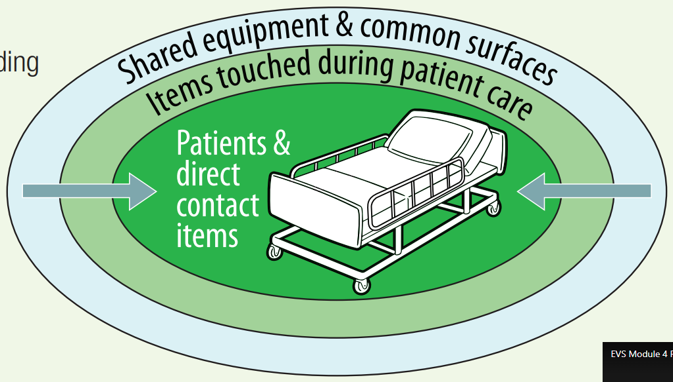
Standard Cleaning Process in a Resident Room
Notes:
Here’s a visual representation of cleaning a resident room. The arrows show you the general direction of cleaning.
Cleaning should be standardized. Objects distant from the resident's bed are least contaminated; they should be cleaned first.
Then move to items touched during resident care like bedrails or tray tables. And lastly, we’ll clean around the direct resident area – the bed itself or IV poles – which are the most contaminated.
By following this pattern we prevent spreading germs from a more dirty area to a less dirty or clean area.
Instructor notes: Shared equipment should be cleaned after every use and is generally not included in room cleaning. Complex medical equipment is usually cleaned by the department that uses it (e.g., respiratory therapy equipment).
[Click]

Slide 14
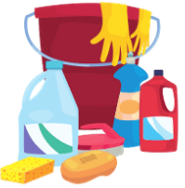
Prepare to Clean!
Coordinate with nursing staff (or follow the facility schedule) on which rooms need to be cleaned and when they need to be cleaned
Check isolation signage for required PPE and supplies
Clean your hands before handling cleaning supplies
Stock supplies in the EVS cart (e.g., prepare the needed number of microfiber cleaning cloths)
Clean your hands and put on PPE based on the isolation signage
Notes:
Now that we’ve performed an assessment of the residents’ rooms, let’s prepare to clean.
Coordinate with nursing staff, follow the facility schedule, or consult with the EVS manager on which rooms need to be cleaned and when they need to be cleaned. In some facilities, nursing staff helps with clearing the tray tables and any other personal belongings before EVS cleans the room. (Instructor notes: This process varies from facility to facility. Consider discussing your facility's policy here.)
Check for any isolation sign or if PPE is required before entering the room.
Perform hand hygiene before handling cleaning supplies.
As mentioned, assess the room to determine what supplies are needed to clean the room including number of microfiber cleaning cloths required to clean the room. Prepare these items all at once to limit the risk of cross-contamination by going back and forth to the cart.
Perform hand hygiene once more using ABHR or soap and water and don the required PPE if there are isolation precautions for that resident.
[Click]

Slide 15
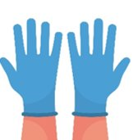
Hand Hygiene and Glove Use
Gloves are not a substitute for hand cleaning
Change gloves and clean your hands when moving from dirty to clean tasks (e.g., after cleaning the toilet, before getting the mop from the cart)
Clean in-between every glove change
Never reuse gloves
Notes:
As we learned in the hand hygiene module,
Gloves are not a substitute for hand cleaning.
Change gloves and clean your hands when moving from dirty to clean tasks (e.g., after cleaning the toilet, before getting the mop from the cart).
Clean your hands with ABHR or soap and water before putting on and immediately after removing gloves. When you remove your dirty gloves after cleaning an area, you contaminate your hands while removing the gloves. There might also be small tears in the gloves you may not see that can allow germs to contaminate your hands. If you put clean gloves on contaminated hands, you’ve now spread germs to your new gloves.
Never reuse gloves.
[Click]

Slide 16
Daily Room Cleaning Steps
Follow facility’s standard cleaning process
Remove trash and other items
Remove gloves and clean your hands when going from a dirty to a clean task
Change cleaning cloths between cleaning resident care areas, and when moving from a dirty to clean task
Follow facility floor cleaning policy
Clean and disinfect supplies before placing them back on the cart
Notes:
Let's review daily room cleaning steps.
Always follow the standard cleaning process at our facility
Remove trash and clutter to prepare the room for proper cleaning.
Remove gloves and clean your hands when going from a dirty task to a clean one.
Change microfiber cleaning cloths between cleaning resident care areas, and when moving from a dirty to clean task. Treat each resident care area as a separate room.
Follow facility floor cleaning policy
Lastly, clean and disinfect supplies used to clean the resident room before placing them back on the cleaning cart.
[Click]

Slide 17
Terminal Room Cleaning
In addition to all steps in a daily room cleaning:
Work with CNA to remove the resident’s belongings before cleaning the room
Remove any paper and tape on walls or equipment
Discard disposable items if used (e.g., paper-based bedpans)
Send any reusable items to be reprocessed
Clean the walls, blinds, or window curtains
For isolation room: Discard any open supplies and replace the privacy curtain
Notes:
Terminal room cleaning includes additional steps on top of those required for daily room cleaning. These include:
Working with CNA to remove the resident’s belongings before cleaning the room. Items like medical equipment used during resident care should be removed. Follow our facility’s equipment cleaning policy to ensure that shared medical equipment are cleaned and disinfected appropriately.
Remove any paper and tape on walls or equipment
Discard disposable items if used, for example, paper-based bedpans
Send any reusable items to be reprocessed
Clean the walls, blinds, or window curtains
For isolation rooms, discard any open supplies and replace the privacy curtain
[Click]

Slide 18
Cleaning Considerations for All!
Everyone plays a role in cleaning and disinfection
Clinical staff can remove resident's personal items so EVS can better focus on cleaning
Cleaning decreases germ bioburden in the room: The cleaner the room, the lower the chances of spreading germs.
Notes:
Everyone can play a role in cleaning.
Clinical staff can remove resident's personal items so EVS can better focus on cleaning.
If you consistently see piles of equipment or resident's personal belongings in rooms you are scheduled to clean, let your supervisor know – advocate for your role! We should work together as a team to provide a safe environment of care. The better we can communicate with each other and identify roles and responsibilities, the more efficient and successful we can be in our jobs.
Remember: Cleaning decreases germ bioburden in the room. The cleaner the room, the lower the chances of transferring germs.
[Click]

Slide 19
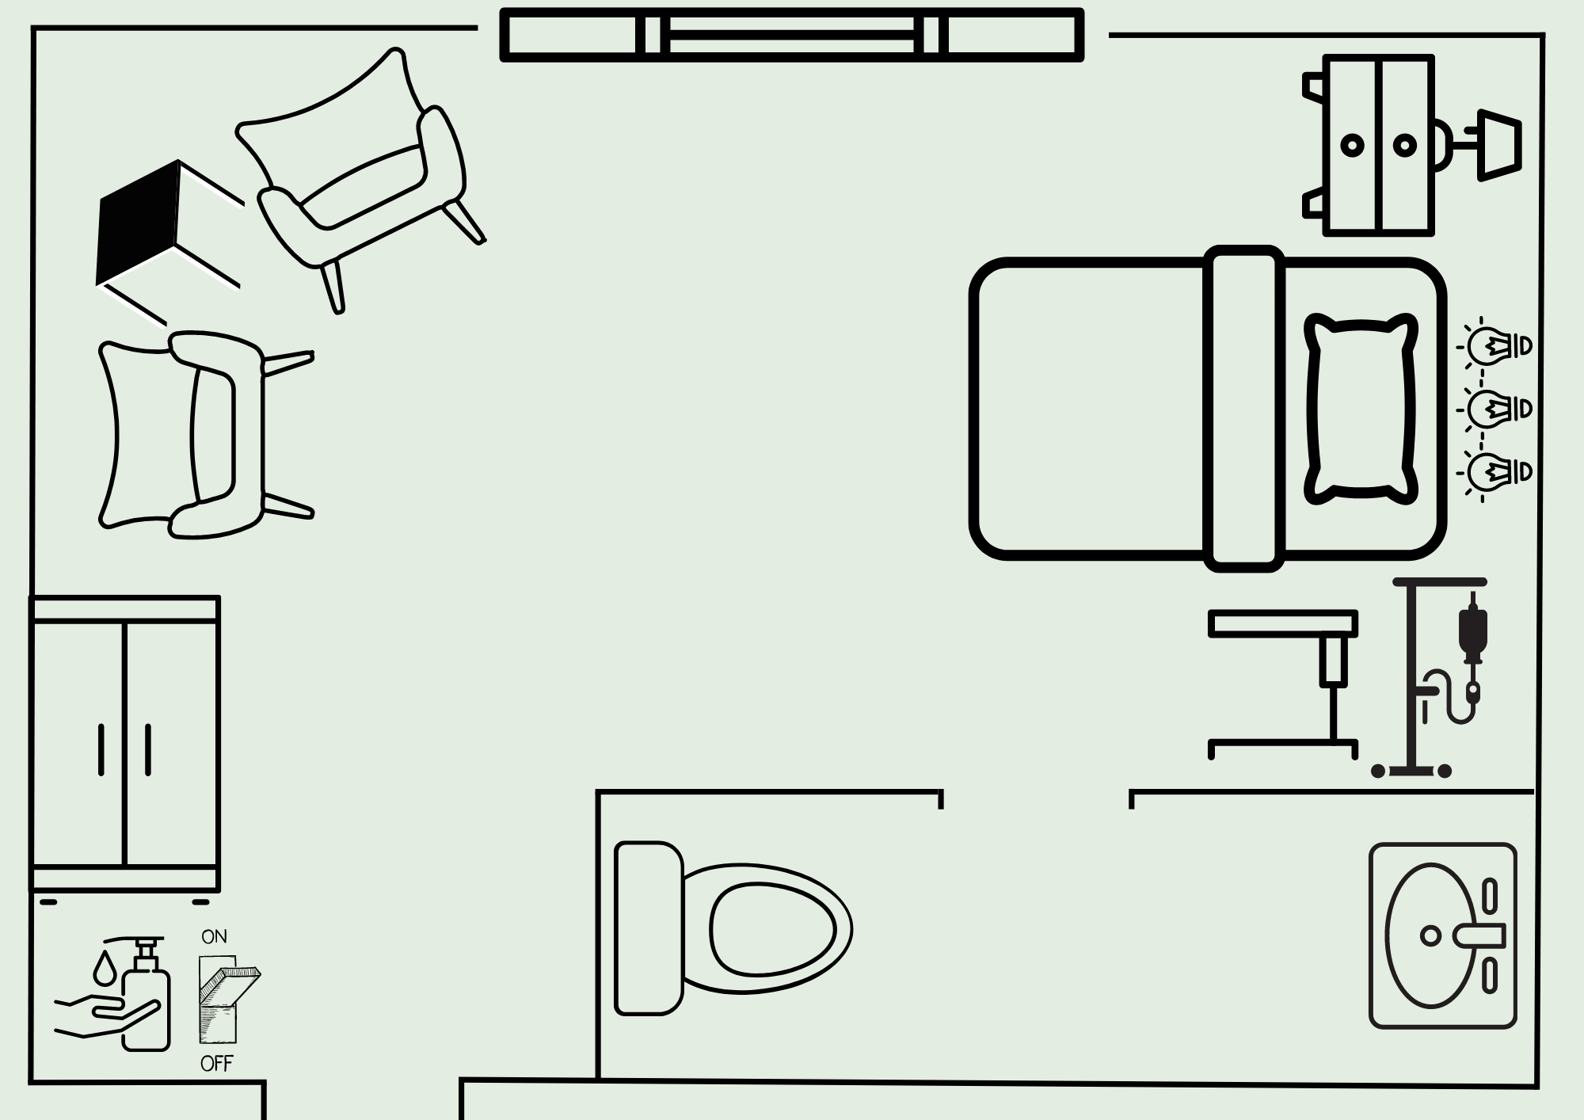
Cleaning a Single-Bed Room
Notes:
Let's look at a single-bed room. What would you do first to prepare for cleaning this room? (Pause for response)
Ensure you have all the supplies you will need to clean the room. Make sure you have your wet floor sign, too. Note if there are any challenges to safe cleaning, such as a resident currently present in the room, a resident on isolation precautions, or if there is a need for additional supplies or PPE due to spills or other obstacles. Any damaged or broken furniture should be reported to management, too. If you notice there are some items that may get in the way of cleaning, you can do your best to move things around and organize them, but note that this is usually done by nursing staff. Communicate with your supervisor if you regularly come across items that get in the way of cleaning, and work with your nursing staff to move certain items.
Let's perform hand hygiene, put on our gloves, and enter the room. Decide if you should go clockwise or counterclockwise. Remember, we generally want to move from clean to dirty. In this room we’ll go clockwise so that we move from the cleanest to the dirtiest parts of the room.
[Click]

Slide 20
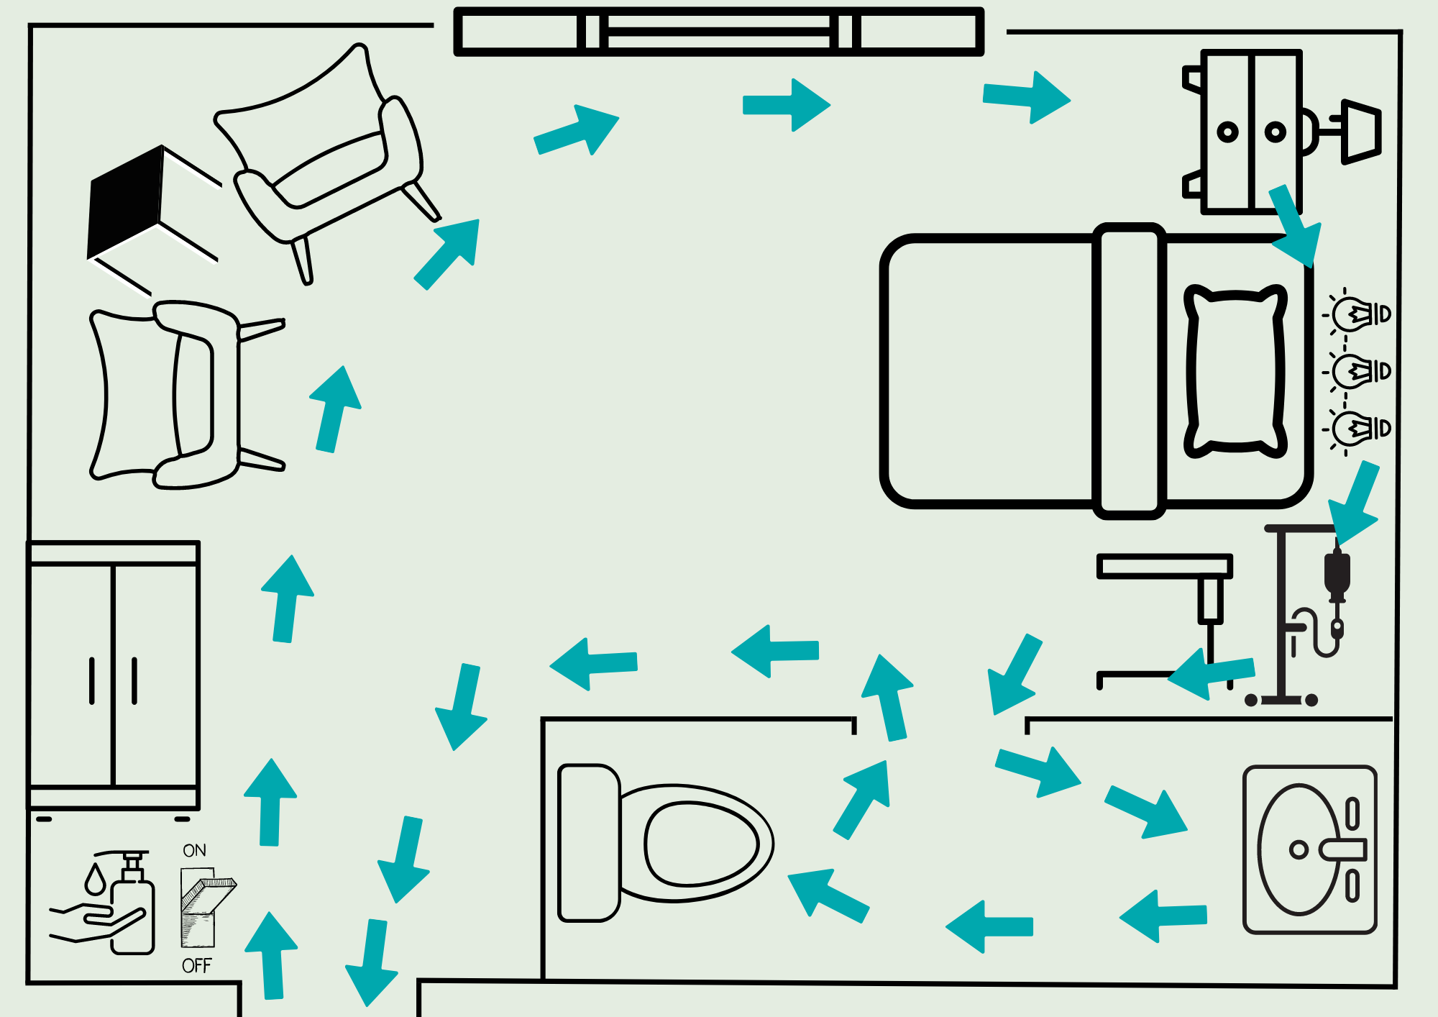
Notes:
We’ll start with the light switch, AHBR dispenser, closet, chairs, and the wall - on the left. There might be a TV or white boards here, too. Remember to go from top to bottom. Then clean the window sill. This can generally be done with one cleaning cloth.
[Click]

Slide 21
Notes:
Then you would remove your gloves, perform hand hygiene, put on a clean pair of gloves, and change your cleaning cloth, before moving to the bed area. Here, start with items like the overhead lights, night stand, and overbed table. Remember, we want to move from top to bottom. Then move to the IV pole, call button, TV remote, and bedframe which are in direct contact with the resident.
[Click]

Slide 22
Notes:
Lastly, you’ll move to the bathroom. Even though this is a single-resident room, you would remove your gloves, perform hand hygiene, and put on a clean pair of gloves before moving to the bathroom because you will likely go back to your cart to get cleaning supplies. Start with the sink area – clean the mirror, paper towel dispenser, soap dispenser, faucet and handles, the lip of the sink, and the bowl of the sink last. Then move to the toilet – clean the hand rail or grab bar, toilet roll holder, toilet flusher, toilet seat, and toilet bowl.
[Click]
Instructor notes: If the toilet and bathroom is very dirty, EVS staff may use a disinfectant (sometime bleach) first. Then remove their gloves, perform, hand hygiene, put on a clean pair of gloves and proceed with the cleaning process.

Slide 23
Notes:
Then, you'll leave the resident room and remove your gloves outside of the room, and perform hand hygiene.
[Click]

Slide 24
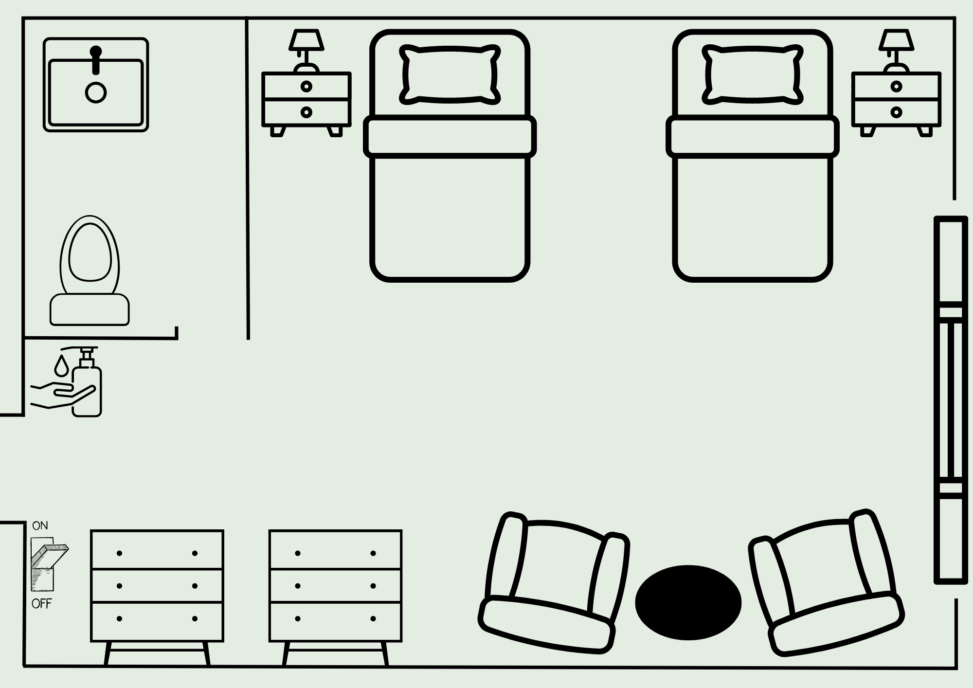
Cleaning a Two-Bed Room
Notes:
(Instructor notes: You may use this as an opportunity to engage staff. Ask which direction they would move in this example, what items they would clean throughout the process, and when they would perform hand hygiene and change into a new pair of gloves.)
Now let's look at a two-bed room. We'll perform hand hygiene, put on our gloves, and enter the room. In this room we’ll go counterclockwise so that we move from the cleanest to the dirtiest parts of the room.
[Click]

Slide 25
Notes:
Similar to the previous example, we’ll start with the light switch, the AHBR dispenser, the closets, chairs, and the wall. Then clean the window sill. Again, this can generally be done with one cleaning cloth.
Then you would remove your gloves, perform hand hygiene, put on a clean pair of gloves, and change your cleaning cloth, before moving to the first resident care area on the top right.
[Click]

Slide 26
Notes:
Clean items like the overhead lights, night stand, and overbed table. Remember, we want to move from top to bottom. Then move to the IV pole, call button, TV remote, and bedframe which are in direct contact with the resident.
In a multioccupancy room like this one each resident area is considered a new room. Between moving from the first resident's bedspace to the second resident's bedspace, you'll first remove your gloves, perform hand hygiene, put on a clean pair of gloves, and change your cleaning cloth.
[Click]

Slide 27
Notes:
In the second resident's bedspace, again, clean items like the overhead lights, night stand, and overbed table first, moving from top to bottom. Then move to the IV pole, call button, TV remote, and bedframe.
[Click]

Slide 28
Notes:
Lastly, you’ll move to the bathroom. Remove your gloves, perform hand hygiene, and put on a clean pair of gloves before starting in the bathroom. Start with the sink area – clean the mirror, paper towel dispenser, soap dispenser, faucet and handles, the lip of the sink, and the bowl of the sink last. Then move to the toilet – clean the hand rail or grab bar, toilet roll holder, toilet flusher, toilet seat, and toilet bowl.
Then, you'll leave the resident room and remove your gloves outside of the room, and perform hand hygiene.
[Click]

Slide 29
Notes:
One way some facilities might think about cleaning a room is by breaking up the room into zones: resident zones and healthcare zones.
[Click]

Slide 30
Notes:
The resident zone includes the resident and their immediate surroundings. Many high-touch surfaces are within the resident zone – the bed, for example.
Each resident zone can have their own set of germs. If each resident zone is not properly cleaned, the germ-filled surfaces can be a reservoir of those germs.
[Click]

Slide 31
Notes:
Similarly, germs in the healthcare zones – or those areas outside the resident zone like the seating area or closets, may have other germs that we don't want to spread to other parts of the room. By cleaning our hands, putting on clean gloves, and changing out our cleaning cloths, between moving to each zone, we can help prevent moving germs from one zone to another.
Always remember to move from cleanest to dirtiest, and to perform hand hygiene and change your gloves at key moments in the cleaning process.
[Click]

Slide 32
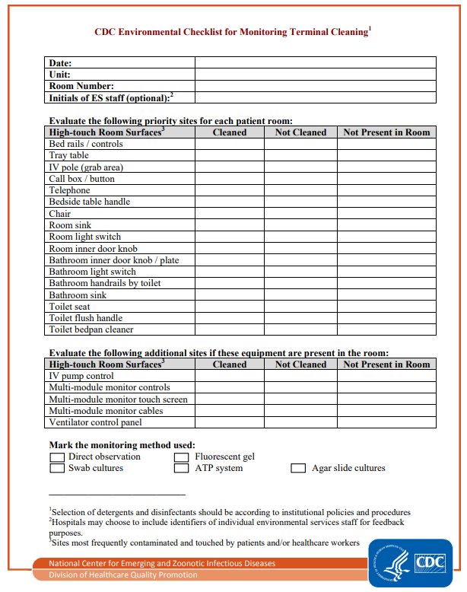
Use an Environmental Cleaning Checklist to Ensure all Surfaces are Cleaned
CDC Environmental Checklist for Monitoring Terminal Cleaning (www.cdc.gov/hai/pdfs/toolkits/environmental-cleaning-checklist-10-6-2010.pdf)
Notes:
(Instructor notes: Use this tool or one you already use in your facility to discuss a way of keeping track of cleaning high-touch surfaces.)
Checklists are useful tools to ensure that all staff EVS and nursing included, know their cleaning responsibilities. Checklists can help us standardize daily and terminal room cleaning processes. They help ensure all surfaces are cleaned.
Here is an example of terminal cleaning checklist from the Centers for Disease Control and Prevention or CDC.
How many of you use a daily or terminal cleaning checklists or assignment sheets? Are you familiar with your facility’s cleaning checklist? If you are unsure, ask your EVS manager to review the checklist with you.
[Click]

Slide 33
Best Practices for Cleaning and Disinfection
Ensure surfaces are clean before disinfecting
Organize supplies in the EVS cart
Identify high-touch surfaces to clean / Focus on high-touch surfaces
Notes:
Let's review best practices for cleaning and disinfection.
Ensure surfaces are clean before disinfecting
Organize supplies in the EVS cart
Identify high-touch surfaces to clean / Focus on high-touch surfaces
[Click]

Slide 34
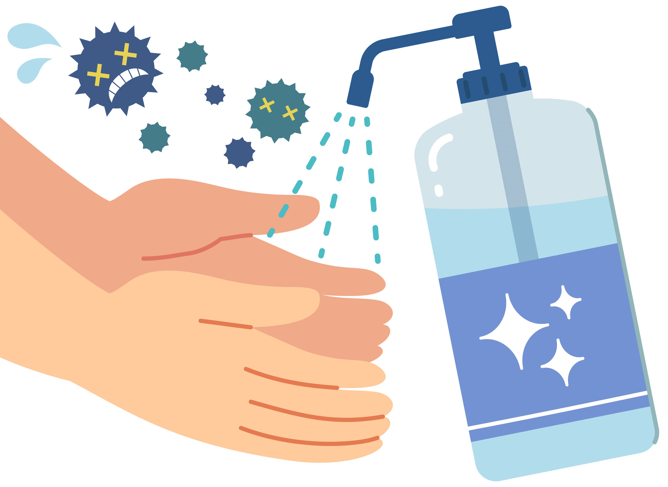
Best Practices for Cleaning and Disinfection
Clean from clean to dirty areas
Clean from top to bottom
Don appropriate PPE
Clean hands before and after cleaning tasks
Notes:
Clean from clean to dirty areas
Clean from top to bottom
Don appropriate PPE
Clean hands before and after cleaning tasks
[Click]

Slide 35
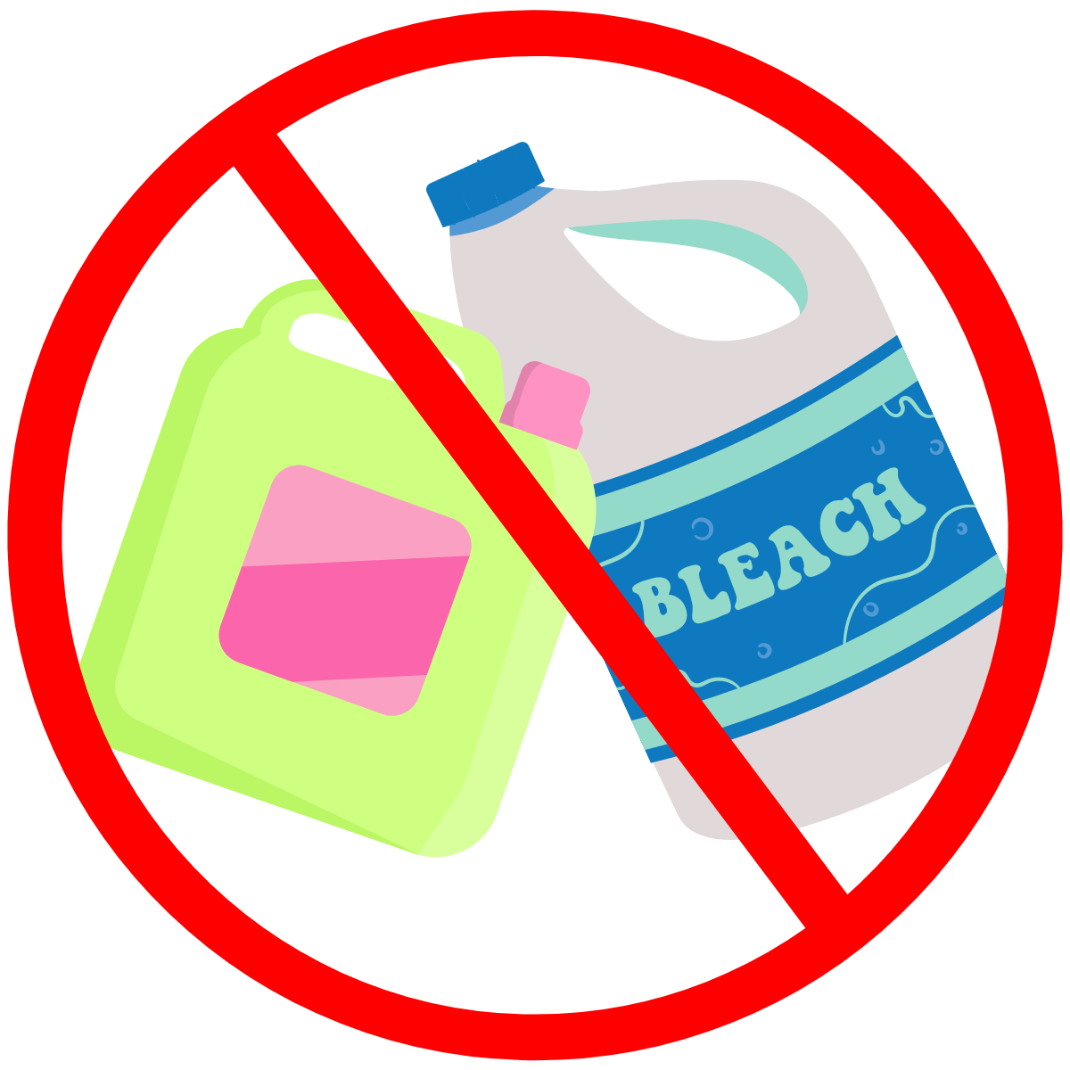
Best Practices for Cleaning and Disinfection
Don’t touch clean supplies with dirty hands
Never mix bleach and quaternary ammonium products (quats)
Notes:
Don’t touch clean supplies with dirty hands
And, never mix bleach and quaternary disinfectants
[Click]

Slide 36
References
CDC Environmental Checklist for Monitoring Terminal Cleaning, Centers for Disease Control and Prevention (CDC) (PDF) (www.cdc.gov/hai/pdfs/toolkits/environmental-cleaning-checklist-10-6-2010.pdf)
Cleaning, Disinfection and Reprocessing Reusable Equipment| California Department of Public Health (CDPH) Healthcare-Associated Infections (HAI) Program (PDF) (www.cdph.ca.gov/Programs/CHCQ/HAI/CDPH%20Document%20Library/SNF_OnlineIPCourse_Gs_Cleaning%20Disinfection%20Reprocessing_012521_ADA.pdf)
Cleaning and Disinfection Strategies for Non-Critical Surfaces and Equipment, CDC
(www.cdc.gov/infectioncontrol/pdf/strive/EC102-508.pdf)
Environmental Cleaning and Disinfection, CDC
(www.train.org/cdctrain/course/1081815/) Note: must make account to access
Reprocessing Reusable Resident Care Equipment, CDC
(www.train.org/cdctrain/course/1081814/) Note: must make account to access
Notes:
Instructor notes: Review any of the listed references for more information.
[Click]

Slide 37
Project Firstline Resources
Visit the Project Firstline Website www.cdph.ca.gov/Programs/CHCQ/HAI/Pages/ProjectFirstline.aspx
Email the Project Firstline AskBox
ProjectFirstline@cdph.ca.gov
Project Firstline is a national collaborative led by the U.S. Centers for Disease Control and Prevention (CDC) to provide infection control training and education to frontline healthcare workers and public health personnel. The California Department of Public Health Healthcare-Associated Infections (HAI) Program is proud to partner with Project Firstline, as supported through Strengthening HAI/AR Program Capacity (SHARP) funding. CDC is an agency within the Department of Health and Human Services (HHS). The contents of this presentation do not necessarily represent the policies of CDC or HHS and should not be considered an endorsement by the Federal Government.
Notes:
Instructor notes: For additional Project Firstline resources, you may direct EVS staff to access materials on the Project Firstline website or email our Project Firstline AskBox.

Slide 38
ACTIVITY TEACHING AIDES / WORKSHEETS
Notes:
Instructor notes: Use the following slides as alternatives to printing copies of worksheets. See the Activity Cards file for additional information.

Slide 39
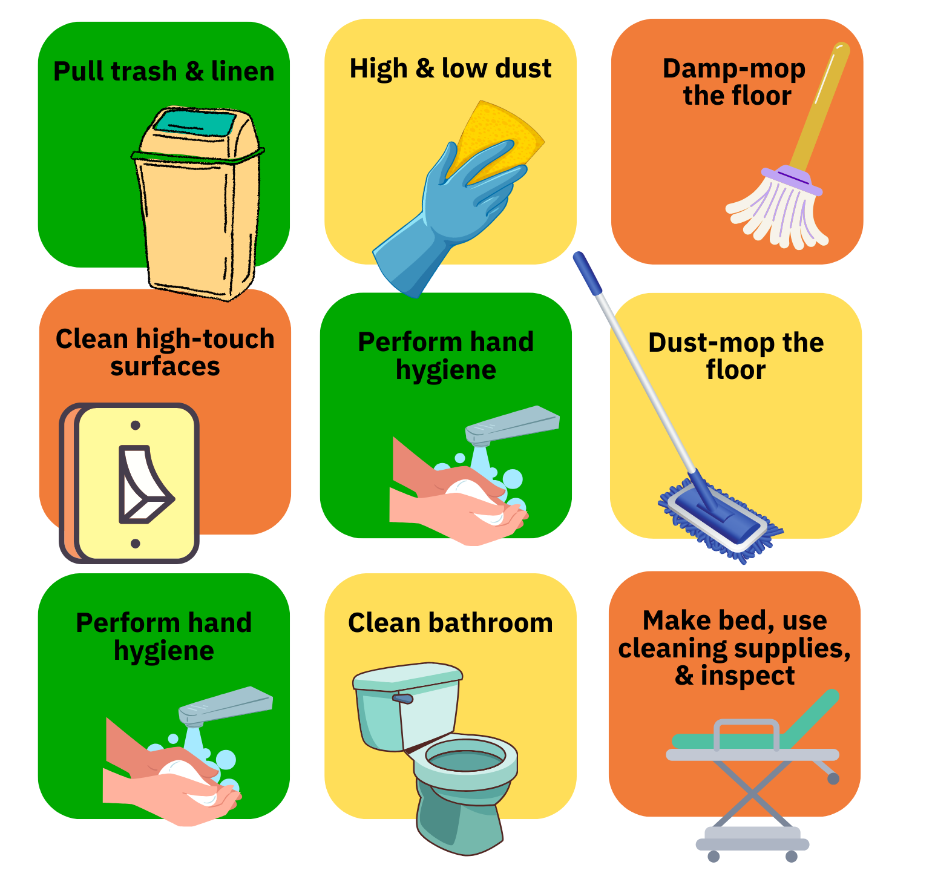
(apic.org/resources/topic-specific-infection-prevention/environmental-services/) are downloadable. May be adapted for facility use, except for the pre-recorded audio versions of module presentations.
Proper Cleaning and Disinfection Order
Place the cleaning and disinfection steps in order.
Notes:
Instructor notes: Use this slide as an alternative to printing copies for the "Proper Cleaning and Disinfection Order" activity. See the Activity Cards file for additional information.
Ask staff How can you help stop the spread of germs when you are cleaning a resident room?

Slide 40

(apic.org/resources/topic-specific-infection-prevention/environmental-services/) are downloadable. May be adapted for facility use, except for the pre-recorded audio versions of module presentations.
Notes:
Instructor notes: Use this slide for the "Proper Cleaning and Disinfection Order" activity to show the correct cleaning and disinfection order. See the Activity Cards file for additional information.

Slide 41
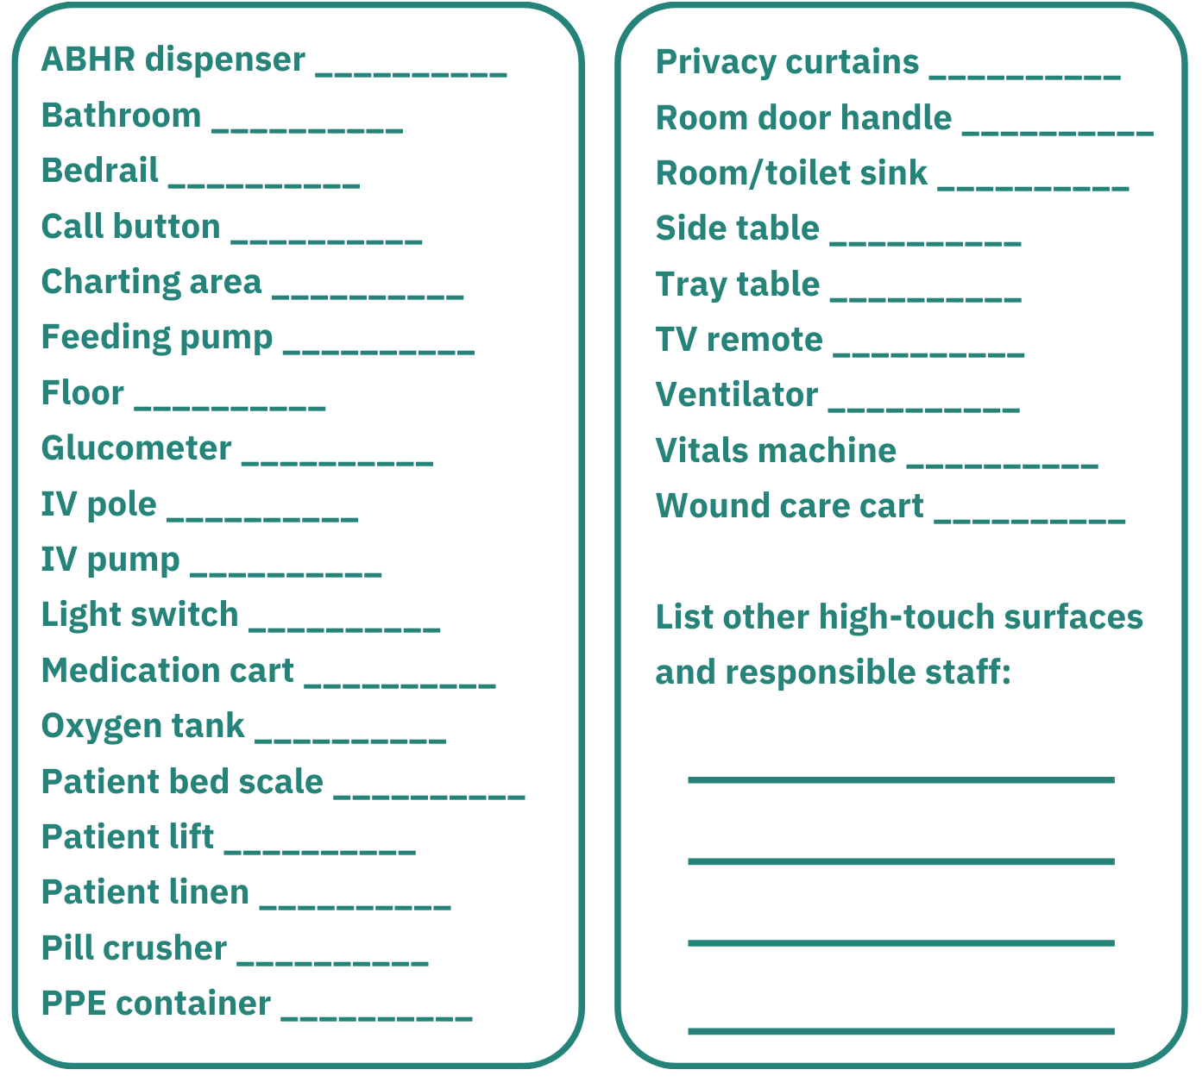

Identify Who Cleans What What are the high-touch surfaces in your facility? Who cleans each surface?
Notes:
Instructor notes: Use this slide as an alternative to printing copies for the "High-Touch Surfaces: Identifying Who Cleans What" activity. See the Activity Cards file for additional information.

Slide 42
What Would You Do? Understanding Proper IPC Practices Instructions
Read the cleaning and disinfecting example statement
Think about if you would or would not do the practice based on the training
Raise your hand as quickly as possible to answer the question and race others
Provide answer and rationale
Notes:
Instructor notes: Use the following slides for the "What Would You Do? Understanding Proper IPC Practices" activity. See the Activity Cards file for additional information.

Slide 43

Would you clean from clean areas to dirty?
Question 1

Slide 44

Question 1: Answer
Yes!
We should always move from clean areas to dirty areas. For example, begin with common surfaces before moving to the resident area, and restrooms should always be cleaned last. ​

Slide 45

Would you clean from high surfaces to low and top to bottom?
Question 2

Slide 46

Question 2: Answer
Yes!
Clean from high to low surfaces, top to bottom. For example, clean bed rails before bed legs, or high-touch surfaces before floors.

Slide 47

Would you change the curtains in a resident's room daily?
Question 3

Slide 48

Question 3: Answer
No!
Consider changing curtains when visibly soiled and per a set schedule. Refer to facility policy.

Slide 49

Would you store soiled equipment on the inside of the EVS cart?
Question 4

Slide 50

Question 4: Answer
No!
Items like medical equipment used during resident care should be removed. Follow facility’s equipment cleaning policy to ensure that shared medical equipment are cleaned and disinfected appropriately.​

Slide 51
Would you say that all facilities have the same high-touch surfaces?
Question 5

Slide 52

Question 5: Answer
No!
Facilities may differ in what surfaces are considered high-touch. High-touch surfaces are surfaces and equipment that are most likely to be contaminated by germs. These are surfaces that healthcare workers and residents touch more often, and therefore must be properly cleaned and disinfected regularly to prevent spreading germs.​
​

Slide 53
Would you place a used toilet brush in the shower?
Question 6

Slide 54
Question 6: Answer
No!
Placing a used toilet brush in the shower can lead to germs on the toilet brush spreading to the shower and putting residents at risk.

Slide 55
When cleaning each resident care area, would you start by cleaning the direct resident area or objects distant from the resident care area?
Question 7

Slide 56
Question 7: Answer
No!
We start by cleaning objects distant from the resident care area such as the common surfaces like doorknobs or light switches, then move to items touched during resident care like bedrails or tray tables.

Slide 57
When cleaning each bed space, would you start from the headboard and then move on to the footboard?
Question 8

Slide 58
Question 8: Answer
Yes!
When cleaning each bed space, start from the headboard and then move on to the footboard.

Slide 59
Thank you for your participation!

