Slide 1

Module 3: Setting Up a Cleaning Cart Infection Prevention and Control Training for Environmental Services Staff
Notes:
Instructor notes:
In this module we will review steps for setting up a cleaning cart including how to properly identify products and materials used for cleaning and disinfection
(Instructor prompts are noted in bold throughout the presentation.)
[Click]

Slide 2
Objectives
List high-touch surfaces at your facility
Identify the cleaning supplies and equipment used at your facility
Discuss how to set up a cleaning cart
Demonstrate how to clean and disinfect equipment after use
Notes:
By the end of this session, you will be able to
List high-touch surfaces present at your facility
Identify the cleaning supplies and equipment used at your facility
Discuss how to organize and set up a cleaning cart, and
Demonstrate how to clean and disinfect equipment after use before returning to the cleaning cart
[Click]

Slide 3
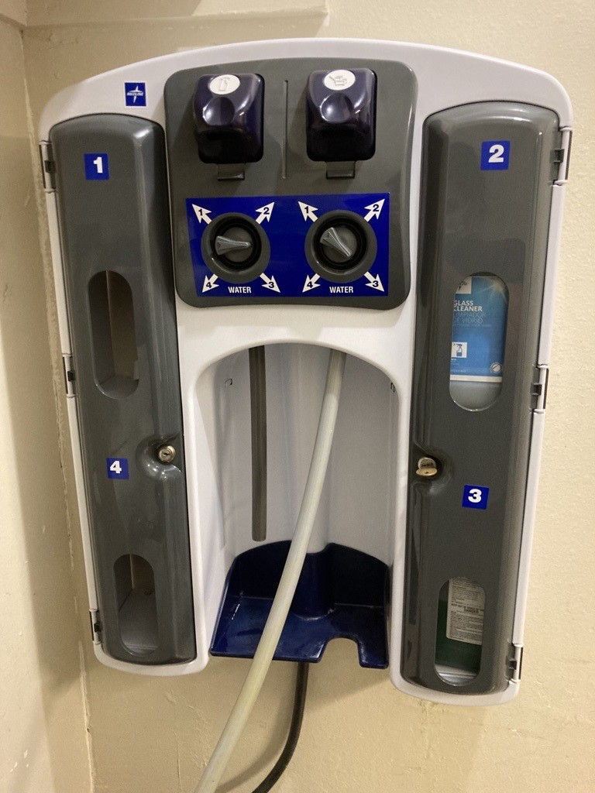
Preparing Environmental Cleaning Products: Types of Solutions
Premixed
Mixed in an automatic mixing station
Prepared manually
Notes:
There are different types of cleaning solutions. Cleaning products may be premixed, mixed automatic mixing station, or prepared manually.
[Click]

Slide 4
Preparing Environmental Cleaning Products: Manual Preparation
Always prepare solutions:
In a designated area
According to manufacturer’s instructions
Using accurate measuring tools (i.e., use a measuring cup). Never eyeball or guesstimate the measurement of disinfectant solution to water.
Discard solutions according to facility policy and label instructions.
Notes:
For manual preparation, solutions should always be prepared -
In a designated area. Daily preparation of supplies and equipment for cleaning staff will often depend on local factors such as the size of the resident care area.
Solutions should always be prepared according to manufacturer’s instructions – This is key to ensuring the product works effectively and as it’s supposed to.
And lastly, prepare solutions using accurate measure tools. Using a standard way of measuring, for example by using measuring tools like a measuring cup will help ensure proper preparation. Never eyeball or guesstimate the measurement of disinfectant solution to water.
When the disinfectant solution is not prepared per manufacturer’s instructions, it can be too strong, or weak and will not be able to disinfect appropriately. You should never add more water to dilute the smell of a cleaning solution, either. The disinfectant will not work as it is intended.
At the end of the day, discard any solutions according to facility policy and label instructions. This applies to all disinfectants, not just bleach.
[Click]

Slide 5




Preparing Environmental Cleaning Products: Personal Protective Equipment (PPE) and Safety
Wear appropriate PPE when prepping solutions
Gown/Apron
Facemask
Gloves
Face shield/Goggles
Notes:
When preparing cleaning products, we need to select personal protective equipment or PPE based on the type of infection prevention precautions assigned to the resident who’s room you will clean, as well as the chemicals to be used to clean the room.
That could include a gown or apron, a face mask, gloves, and a face shield or goggles.
[Click]

Slide 6
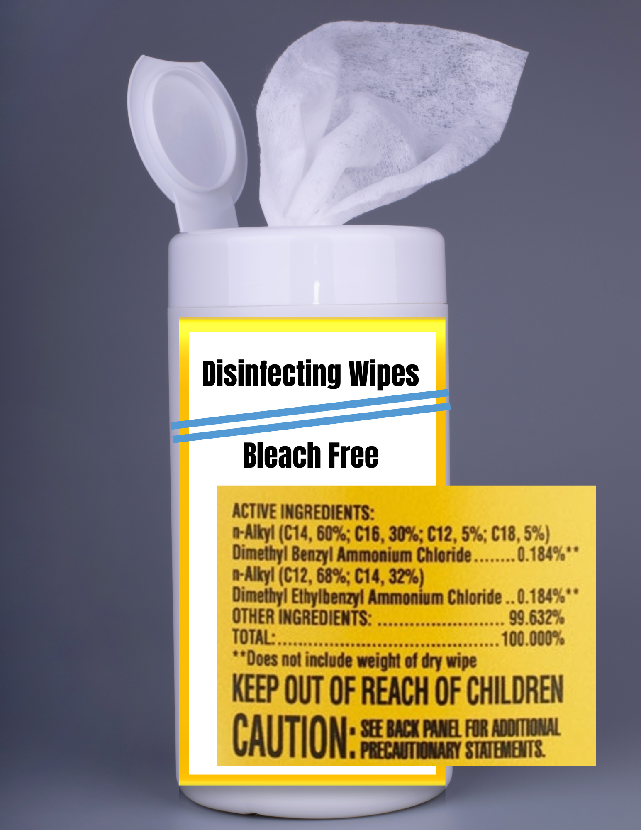
Products Must Be Used According to Label Instructions
Use containers approved or provided by the disinfectant manufacturer
Make sure the chemical and the label match
Never refill used containers with different chemicals
Never refill dispensers intended for single use
Check expiration date
Notes:
Products must be used according to label instructions.
Be sure to use standardized containers that are clearly labeled with the date the product was mixed.
Chemicals should only be mixed in dispensing containers that are appropriately labeled. Use containers approved or provided by the disinfectant manufacturer.
Make sure the chemical and the label match
Never refill used containers with different chemicals
Never refill dispensers intended for single use
Check expiration date
If you’re using an automatic dispenser at your facility, these should be regularly calibrated. Check with your EVS manager if it is unclear whether or not your dispenser is properly calibrated.
[Click]

Slide 7
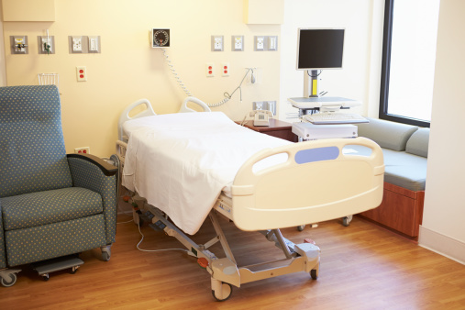

Consider Safety, Efficiency, and Convenience When Setting Up Your Cart
Be familiar with products and tools used
Identify supply needs
Save time; be efficient
Support safety through appropriate use of products
Note: Clean your hands and put on clean gloves before touch clean items on your cart.
Notes:
When setting up a cart consider safety, efficiency, and convenience.
By knowing how to set up your cart you will
Be familiar with the products and tools used for cleaning a resident room, and you’ll be able to find what you need when you need it.
You’ll easily see what items, including resident room supplies, need to be restocked on your cart. For example you might consider dedicating a toilet brush for each resident room and bathroom especially a resident on contact isolation with enteric disease.
Staying organized means you save time and you are more efficient with your cleaning process. You won’t need to spend time looking for particular products or tools to use.
Knowing how to safely use the products on your cart means that you will clean to the best of your ability and follow manufacturer’s guidelines. Note that you should never touch your carts and equipment with contaminated gloves. Always clean your hands and change your gloves before touching clean items on your cart.
All of these efforts will help limit opportunities for cross-contamination.
[Click]

Slide 8
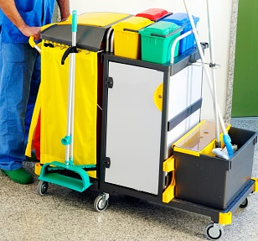
Gathering Supplies and Cart Setup: Top of Cart
Alcohol-based hand rub (ABHR) and soap refills
Required PPE
Resident room supplies
When setting up your cart, consider: safety, convenience, and efficiency.
Notes:
Now that we know about preparing solutions and how to identify correct PPE to use, let’s set up cart! Here is an example of how you can set up a cart. Appropriately setting up your cart for the needs of the rooms you will clean will better prepare you for the cleaning session and hopefully will eliminate having to return to a supply room for more supplies in the middle of a cleaning session.
You can set these items up anywhere in your cart but make sure you have them available.
For the top of the cart –
Stock this section of your cart with
Alcohol-based hand rub and soap refills as needed
Any required PPE
And resident room supplies like paper products, which might include toilet paper, paper towels, or tissues.
Again, when you are setting up your cart, think about safety, convenience, and efficiency.
Having your hand rub accessible at the top of your cart will make it easy to perform hand hygiene at all the appropriate moments like between glove changes.
Your cart should never store any personal items like water bottles or food. Avoid eating or snacking during cleaning for your own safety.
What other items do you store at the top of your cart? (Instructor notes: Pause for 10 seconds for their response.)
[Click]

Slide 9
Gathering Supplies and Cart Setup: Front Deck
Mops with removeable mopheads/floor mops
Broom/dry mop
Duster
Buckets
Wet floor caution signs
Soiled linen bag
Trash bag
Notes:
For the front deck or outside of the cart:
This area should include mops with removable mopheads or floor mops. Note that these should be switched out between each room or when grossly soiled, like after cleaning the bathroom.
Buckets, wet floor caution signs, and bags for soiled linen and trash can all be placed here.
Set yourself up so that you are able to follow a standard cleaning process that lowers the chance of spreading germs.
[Click]

Slide 10
Gathering Supplies and Cart Setup: Inside Cart
Microfiber cleaning cloths
Cleaning solutions and disinfectants
Solution containers
Bags or bins for soiled materials
Note:
Do not mix chemicals (this can create toxic gases)
Do not use spray bottles for cleaning
Do not keep items on cart you won’t use or need
No food or drinks on cart!
Lock your cart or store in a secure place
Notes:
The inside of your cart:
Should be stocked with
Microfiber cleaning cloths
Cleaning solutions and disinfectants
Portable solution containers
Use solution containers to allow for full saturation of your microfiber cleaning cloths. Try not to overload the solution containers with cleaning cloths. Only fill the solution containers with just enough microfiber cleaning cloths to finish the first cleaning schedule. For example, use separate microfiber cleaning cloths for each bedspace in a multi-bed room and use separate cloths for the bathroom. This helps to have a well-saturated cleaning cloth which in turn helps to maintain the correct contact/wet time.
Portable containers for environmental cleaning products or disinfectant solutions should be clean, dry, appropriately-sized, labelled, and dated.
Inside the cart you’ll also store bags or bins to separate clean from soiled microfiber cleaning cloths.
Some things to keep in mind:
Do not mix chemicals. This can create toxic gases.
Do not use spray bottles for cleaning. Pour bottles are preferred over spray bottles. Spray bottles can cause aerosolization of the product which can get into people's eyes or lead to breathing issues.
Do not keep items on your cart that you won’t use or need for your cleaning session
Absolutely no food or drinks on your cart! It is not acceptable to have food or drinks next to your toilet brush or any other items on your cart.
And, carts should be equipped with a lockable compartment to store cleaning and disinfectant solutions. You should never leave your cart unattended when in use. If your cart does not have a lock, secure your cart in a locked space. Locking away cleaning and disinfectant solutions is especially a concern, for example, on memory care unit. We want to avoid use of cleaning and disinfectant solutions by individuals who are not trained to handle the products.
[Click]

Slide 11
Let’s Get Ready to Clean a Room
Ask yourself the following:
What is the type of room? (single-occupancy, multiple-occupancy)
Are there special cleaning needs? (isolation room, ventilated resident, room obstacles)
What resident room supplies need to be replenished?
Notes:
Now we’re going to clean a room.
First conduct a visual inspection to determine if there are any challenges to safe cleaning.
Ask yourself the following:
What is the room set up? Is it an isolation room? Is it a room with a resident on a ventilator? A memory care unit room?
What is the situation of the room? What type of cleaning and disinfectant products do you need? Is there any need for additional supplies or PPE due to spills? Or is the resident on isolation precautions? Are there any obstacles, or is there damaged/broken furniture that should be reported to management?
What resident room supplies need to be replenished? Are any supplies kept in the resident room? Know where clean items are stored and dirty items are reprocessed
[Click]

Slide 12
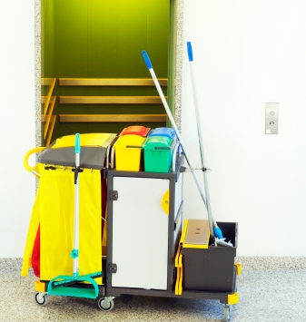
Daily Cleaning of Reusable Equipment and Cart Storge
Clean and disinfect reusable cleaning equipment (e.g., mop) after each use
Reduces bioburden
To avoid germ transmission
Should be done in a designated area
EVS manager should have access to assess EVS cart before use
Notes:
Environmental cleaning supplies and equipment quickly become contaminated during their use. Regularly clean and disinfect all reusable items after use reusable supplies and equipment like mops and toilet brushes in a designated area that is not used for other purposes
This helps reduce bioburden, or germ build up, and helps to avoid germ transmission.
Thoroughly clean, disinfect, and rinse equipment such as buckets and solution containers and store them upside down to allow for complete drying. This helps to prevent germ growth. Ensure that mop heads, and microfiber cloths are clean and dry before use. Clean and disinfect all the reusable supplies and equipment in a designated area that is not used for other purposes.
The EVS manager should have access to the reusable equipment and cart so they can assess equipment before use.
[Click]

Slide 13
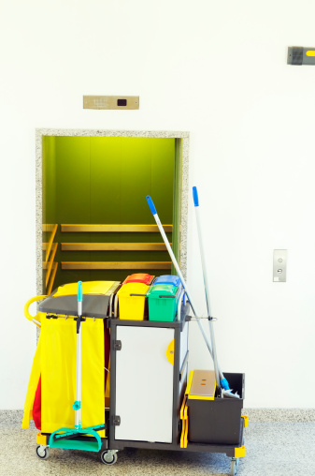
Cleaning of Reusable Equipment and Cart Storage at the End of the Shift
Remove dirty mop heads and soiled microfiber cleaning cloths
Ensure cleaning follows manufacturer’s instructions
Follow your facility’s policy for cleaning EVS cart and closet
Notes:
Cleaning reusable equipment should occur at the end of each shift.
This includes
Removing dirty mop heads and soiled microfiber cleaning cloths – depending on your facility policy, these may go to be laundered.
Making sure that you clean all items according to the manufacturer’s instructions, and
Following your facility’s policy for cleaning the EVS cart and closet.
[Click]

Slide 14
Knowledge Check
Why do we clean and disinfect reusable cleaning equipment after each use? Select all that apply.
Reduces bioburden
To prevent spreading germs
To keep a safe working environment
To prevent germ growth
All of the above
Notes:
Let's test your knowledge,
Why do we clean and disinfect reusable cleaning equipment after each use? Select all that apply.
Reduces bioburden
To avoid germ transmission
Should be done in a designated area
To prevent germ growth
All of the above
(Instructor notes: Pause for 10 seconds for response.)
[Click]

Slide 15
Knowledge Check
Why do we clean and disinfect reusable cleaning equipment after each use? Select all that apply.
Reduces bioburden
To prevent spreading germs
To keep a safe working environment
To prevent germ growth
All of the above
Notes:
If you chose E. All of the above you are correct!
[Click]

Slide 16
Recommendations for Cleaning Carts
Stock enough resident room supplies
Have access to ABHR
Stock enough microfiber cleaning cloths so they can be changed when soiled
Use buckets or bins for disinfectant solution
Use microfiber mops
Separate clean and soiled items
Clean and disinfect reusable equipment
Clean high-touch surfaces at least once per shift
Keep a reference list of high-touch surfaces on your cart
Know the required contact/wet times for all disinfectants used
Have a lockable compartment
Store in a designated EVS area
Notes:
Let’s review some best practices for setting up cleaning carts
Stock your cart with enough resident room supplies – make sure to assess the resident area you’ll be cleaning before gathering supplies to avoid having to return for more supplies in the middle of cleaning process.
Consider having alcohol-based hand rub on your cart to perform hand hygiene when necessary. Note that on certain care units you may not want this on your cart, a memory care unit for example.
Stock microfiber cloths for cleaning resident areas. Ensure you have enough to change when necessary.
Keep buckets or bins for disinfectant solution on your cart to saturate cloths with the disinfectant solution. Cloths, when removed from the bin, should not be placed back in – no double dipping!
Have at least one microfiber mop available per room, and additional microfiber mop heads available to change when soiled. With larger rooms, i.e., with 3 or more residents, you may need to change the microfiber mophead more frequently.
Be sure to separate clean and soiled items.
Always clean and disinfect any reusable equipment after each use.
Clean high-touch surfaces at least once each shift, and keep a list of high-touch surfaces on your cart for reference. We recommend using a plastic-covered copy that is cleanable.
Know the required contact/wet times for all disinfectants used.
Make sure your cart has a lockable compartment or you are able to store your cart in a locked area
And be sure to store your cart in a designated EVS storage area after use.
[Click]

Slide 17
Practices to Avoid with Cleaning Carts
Never mix different chemicals
Do not refill containers
Do not mix clean and soiled materials
Do not use the same cloth for two different resident bedspaces
Do not use a dirty cloth on a clean area
Never store personal items, food, or beverages on cart or in EVS closet
Do not use spray bottles
Never leave cart unattended
Notes:
These are practices to avoid with cleaning carts -
Never mix different chemicals or disinfectants together
Do not refill or top off cleaning or disinfectant containers. For example, if you have a little bit of a disinfectant and a little bit of the same disinfectant in another bottle, don't refill one bottle with the other to make one full bottle.
Do not mix clean and soiled materials
Do not use the same cloth for two different resident bedspaces.
Do not use a dirty cloth on a clean area.
Never store personal items, food, or beverages on your cart or in the EVS closet
Do not use spray bottles
And lastly, never leave your cart unattended when in use.
[Click]

Slide 18
Summary
It is essential for EVS staff to have training on and demonstrate competency in using products on a cleaning cart to ensure safety and success of use
A standardized cart set up can streamline cleaning and disinfection processes and reduce cross-contamination
High-touch surfaces and cleaning equipment should be cleaned regularly (e.g., daily)
Notes:
In summary,
It is essential for EVS staff to have training on and demonstrate competency in using products on a cleaning cart to ensure safety and success of use
Set up the cart in a standardized manner that streamlines the cleaning and disinfection process and lower chances for cross-contamination
And, high-touch surfaces and cleaning equipment should be cleaned regularly.
[Click]

Slide 19
References
Cleaning and Disinfection Strategies for Non-Critical Surfaces and Equipment, CDC (PDF) (www.cdc.gov/infectioncontrol/pdf/strive/EC102-508.pdf)
Disinfection and Sterilization, Centers for Disease Control (CDC) (www.cdc.gov/infectioncontrol/guidelines/disinfection/index.html)
Environmental Cleaning, Healthcare-Associated Infections Program, California Department of Public Health (CDPH) (www.cdph.ca.gov/Programs/CHCQ/HAI/Pages/EnvironmentalCleaning.aspx)
Environmental Cleaning in Healthcare Part 1: Set up the Cleaning Cart, Nebraska Infection Control Assessment and Promotion Program (ICAP) and Nebraska Antimicrobial Stewardship Assessment and Promotion Program (ASAP) (Video) (www.youtube.com/watch?v=_O4B0Nmfr40)
Notes:
Instructor notes:
Reference any of the listed references for more information.
[Click]

Slide 20
References
EVS and the Battle Against Infection: a Graphic Novel, CDC (www.cdc.gov/infectioncontrol/training/evs-battle-infection.html)
Healthcare Environmental Infection Prevention and Control (www.cdc.gov/hai/prevent/environment/index.html)
Notes:
Instructor notes:
Reference any of the listed references for more information.
[Click]

Slide 21
Project Firstline Resources
Visit the Project Firstline Website (www.cdph.ca.gov/Programs/CHCQ/HAI/Pages/ProjectFirstline.aspx)
Email the Project Firstline AskBox
ProjectFirstline@cdph.ca.gov
Project Firstline is a national collaborative led by the U.S. Centers for Disease Control and Prevention (CDC) to provide infection control training and education to frontline healthcare workers and public health personnel. The California Department of Public Health Healthcare-Associated Infections (HAI) Program is proud to partner with Project Firstline, as supported through Strengthening HAI/AR Program Capacity (SHARP) funding. CDC is an agency within the Department of Health and Human Services (HHS). The contents of this presentation do not necessarily represent the policies of CDC or HHS and should not be considered an endorsement by the Federal Government.
Notes:
Instructor notes:
For additional Project Firstline resources, you may direct EVS staff to access materials on the Project Firstline website or email our Project Firstline AskBox.

Slide 22
ACTIVITY TEACHING AIDES / WORKSHEETS​
Notes:
Instructor notes: Use the following slides as alternatives to printing copies of worksheets. See the Activity Cards file for additional information.

Slide 23
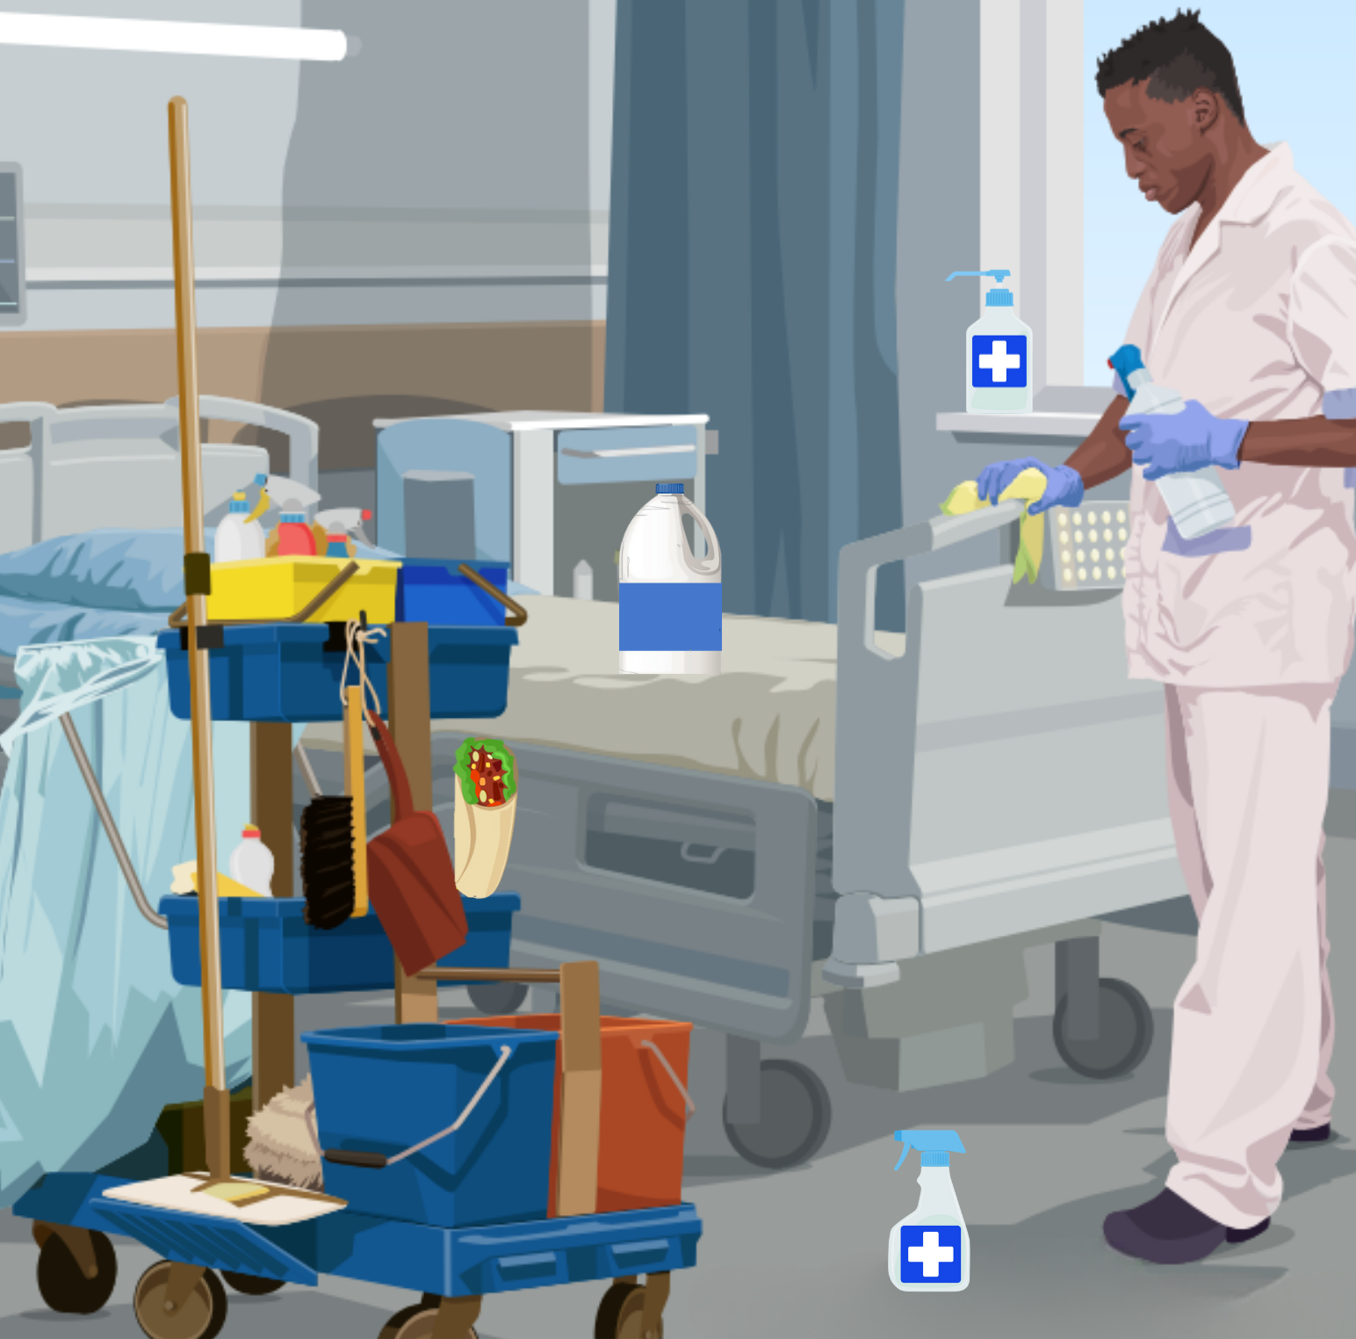
Spot it!
Identify five incorrect Environmental Services (EVS) cart practices.
Notes:
Instructor notes: Use this slide as an alternative to printing copies for the "Spot It! Identify Incorrect EVS Cart Practices" activity. See the Activity Cards file for additional information.

Slide 24
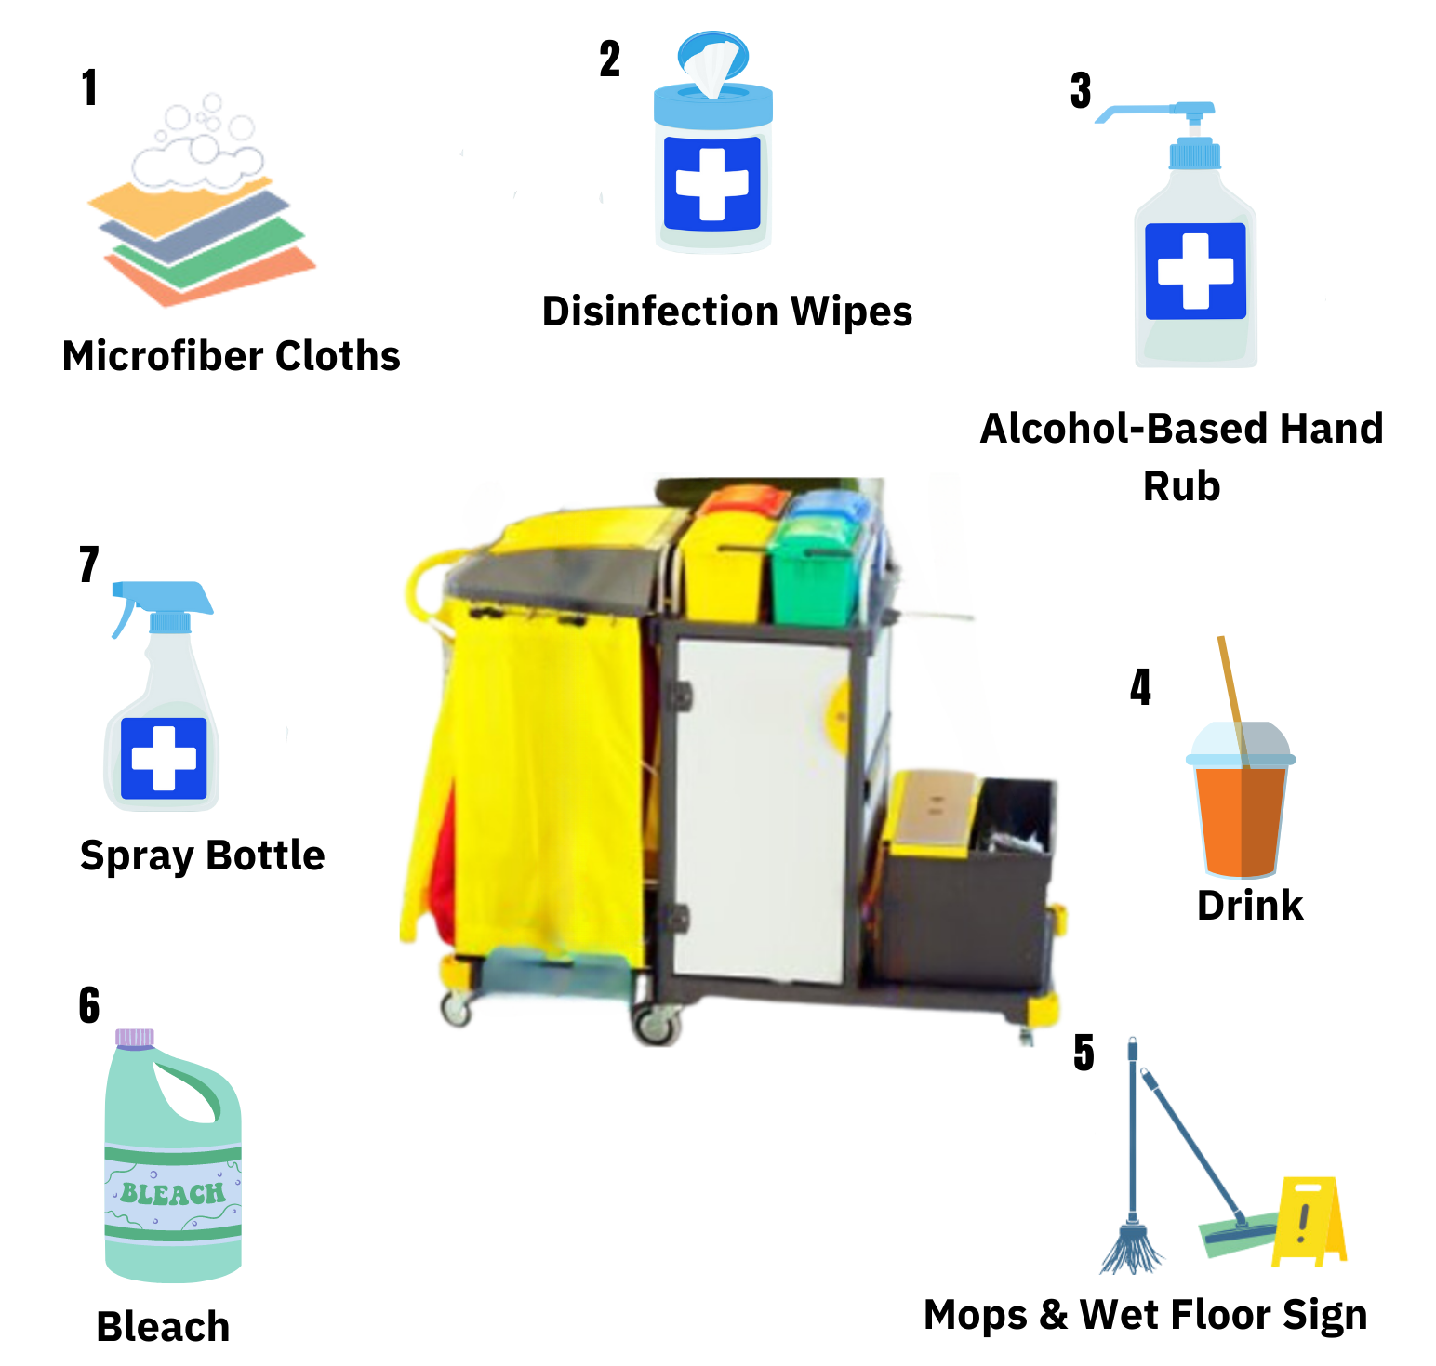
Pin it!
Pin the equipment to the Environmental Services (EVS) Cart.
Where would you place each item? Which items do not belong?
Notes:
Instructor notes: Use this slide as an alternative to printing copies for the "Pin It! Place the Supplies on the EVS Cart" activity. See the Activity Cards file for additional information.

