Slide 1

Module 2: Understanding Disinfectants
Infection Prevention and Control Training for Environmental Services Staff
Notes:
Instructor notes:
In this module we will review disinfectants.
(Instructor prompts are noted in bold throughout the presentation.)
[Click]

Slide 2
Objectives
Review the difference between cleaning and disinfection
Examine types of disinfectants
Demonstrate how to select a disinfectant
Identify key components of reading a disinfectant label
Discuss on the importance of proper disinfectant dilution
Notes:
By the end of today’s discussion, you will be able to specify the difference between cleaning and disinfection, describe disinfectant types, demonstrate how to select a disinfectant, and discuss the importance of proper disinfectant dilution.
[Click]

Slide 3
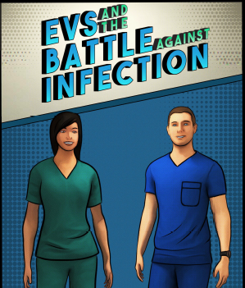
You Can Make a Difference!
Improper cleaning and disinfection of environmental surfaces allow germs to spread and lead to infections
The Environmental Services (EVS) team can be the first line of defense against germs!
Notes:
As we know, germs spread by pathways. Both germs in the environment and improperly disinfected surfaces play a role in spreading germs. When all healthcare workers, including environmental services staff, work together to help create a safe environment for residents, we can all prevent the spread of germs. By following appropriate infection prevention and control practices and correct selection and use of disinfectants, EVS staff play an important role by reducing the amount of germs in the environment.
[Click]

Slide 4
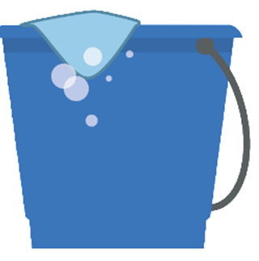
Cleaning Versus Disinfection
Cleaning
Removing dust, dirt, and bodily fluids using water and detergent
Disinfection
Killing germs on hard, non-porous surfaces with a chemical called a disinfectant
Notes:
Let’s review the difference between cleaning and disinfection.
Cleaning is the process of removing dust, dirt, and bodily fluids using water and detergent
Disinfection is the process for killing germs on hard, non-porous surfaces with a chemical called a disinfectant. The process of disinfection is achieved using disinfectants, which will be the focus of today’s presentation.
[Click]

Slide 5
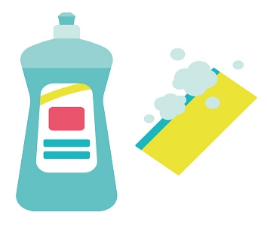
Detergents
Use a detergent (Note: soap is a detergent)
Detergent is mixed with water to lift the dirt off surface
Removes but does not kill germs
Germs can live in cleaning solution, change often
Less toxic, less odor, and cheaper than disinfectants
Notes:
Before we move ahead, let’s discuss soaps, detergents, and the cleaning process.
For cleaning, you would use a detergent. Note that soap is a type of detergent.
To use a detergent, you first need to wet the surface to be cleaned. Water is necessary to lift the dirt off of the surface.
Detergents do not kill germs. When you apply friction when using a detergent, the friction removes the germs from the surface and the detergent latches onto the germs, and they can be washed down the drain.
Once detergent has latched onto enough germs, dirt, and oil, it no longer works and you need to change your cleaning solution. Think about your kitchen sink - when you’re cleaning greasy dishes and you notice the soap is no longer foamy or the water is oily, it’s time to change the solution.
Some advantages of using a detergent are that they are less toxic, they have less odor, and they are cheaper than disinfectants. Disadvantages include that you need to change the solution frequently and they do not kill germs.
[Click]

Slide 6
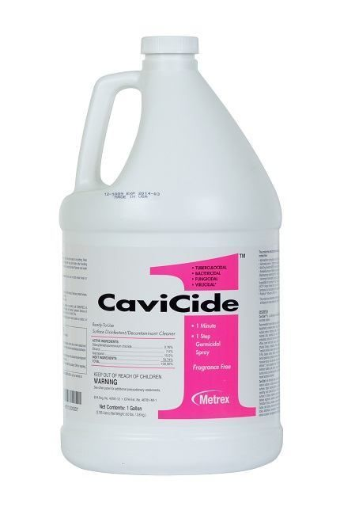
Disinfection and Disinfectants
Chemicals that kill germs (e.g., quats, bleach, hydrogen peroxide)
Used on hard, non-porous surfaces such as bedrails and bedside tables
A one-step detergent-disinfectant product cleans and disinfects at the same time
Notes:
Now, let’s discuss disinfection and disinfectants.
Disinfectants are chemical compounds that kill germs. Some examples include quats, bleach, and hydrogen peroxide. Your choice of disinfectant depends on the germ you are trying to kill and the area or room you are disinfecting.
Disinfectants are applied to objects such as bedrails, chairs, or other high-touch surfaces.
All organic material and soil must be removed first by a cleaning product before applying disinfectant, unless you are using a combined detergent-disinfectant product which can be used to both clean and disinfect. A one-step product includes both detergents and disinfectants so that germs are removed and killed at the same time.
[Click]

Slide 7

Disinfectant Type | Properties
Quaternary Ammonium Products (Quats) | Widely-used Generally, doesn’t kill spores Can cause health problems; ensure proper personal protective equipment (PPE) use
Chlorine-based (Bleach) | Kills a wide range of germs including spores Fast-acting Can cause health problems; ensure proper PPE use Can damage metals and fabrics
Hydrogen peroxide, accelerated H₂O₂ (Oxides) | Kills a wide range of germs including spores Can be shorter contact/wet time
Do not mix quats and bleach, as this can form a toxic gas.
Notes:
These are some examples of the types of disinfectants used in skilled nursing facilities. This table highlights some of their properties.
There is no perfect disinfectant. Many facilities choose to use multiple products. Be especially careful when using bleach with other types of disinfectants; it is good practice to prepare or use bleach disinfectants in well-ventilated areas.
Note that you should never mix quats and bleach as this can form a toxic gas.
EVS staff should review and know how to access your facility’s Materials Data Sheet or MDS. Ask your supervisor if you are unclear of how to use your disinfectants.
[Click]
7

Slide 8
Cleaning Versus Disinfection
Cleaning
Scrubbing surfaces with water and detergent to physically removing dust, dirt, and body fluids
Disinfection
Killing germs on surfaces with chemicals
Disinfectants can’t work if cleaning doesn’t happen first. Always remember to clean before disinfecting.
Notes:
Disinfectants can’t work if cleaning doesn’t happen first! If proper cleaning does not occur first, the dirt will act like an umbrella to protect the germs from being killed by the disinfectant. Always remember to thoroughly clean a surface or object before disinfecting it to kill germs.
[Click]

Slide 9
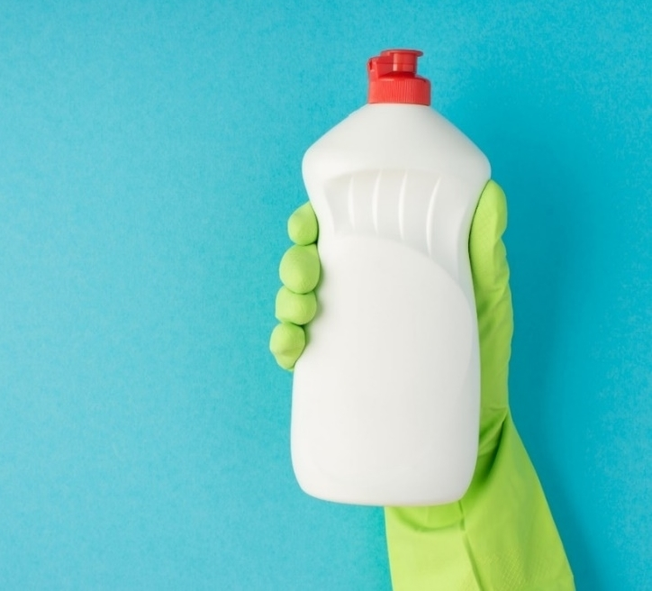
Is the Disinfectant Appropriate for the Task?
Always check if the disinfectant you are using is appropriate for the task. Ask your EVS manager if unsure.
Environmental Protection Agency (EPA)-registered, and labeled as “hospital-grade disinfectant”
Kill claims: Type of germs the disinfectant kills
Contact/wet time: Time required for the disinfectant to work
Safety: Know the toxicity, PPE requirements, and appropriate use of disinfectant
Notes:
(Instructor notes: This is an animated slide.)
Disinfectant selection is made by environmental services and facility leadership, but it is your responsibility to know if the disinfectant is appropriate for the task. You should be aware of the disinfectants that are available. Speak with your EVS manager if you are not sure what to use, how to use them, or if you have concerns about the disinfectants being used.
(Click to display 1st bullet)
Facilities select disinfectants that are Environmental Protection Agency or EPA-registered and labeled for use in healthcare settings. The EPA regulates the use of chemicals to protect people and the environment from health risks. EPA-registered disinfectants will typically have “hospital-grade disinfectant” written on the label.
Let’s look into some other considerations when selecting a disinfectant:
(Click to display 2nd bullet)
Kill claims ​provide information about the types of germs a disinfectant kills. You can find this on the label. Always follow the manufacturer’s instructions on the disinfectant label.
(Click to display 3rd bullet)
Contact or wet time is the time required for a wet disinfectant to be in direct contact with a surface to ensure that the germs are killed. You may need to apply disinfectant more than once to ensure that you meet the contact or wet time.
(Click to display 4th bullet)
Safety. Always read the disinfectant label carefully to find information on toxicity, PPE requirements, and if the disinfectant is appropriate for the surface you will be cleaning and disinfecting. If your facility uses multiple disinfectants, you should know which disinfectants should be used on which surfaces and under what circumstances.
Other questions you should consider before using a disinfectant include -
Does the disinfectant clean and disinfect in a single step?
Does the disinfectant come concentrated meaning it requires mixing or is it pre-mixed?
Does the disinfectant have a strong odor that interferes with breathing?
[Click]

Slide 10

Contact/Wet Time
Contact/wet time is the amount of time required for a disinfectant to kill germs on a pre-cleaned surface
A surface must remain wet long enough to achieve surface disinfection
  You may have to re-apply to achieve the contact/wet time
Follow label instructions for the appropriate contact/wet time
Notes:
Disinfectants are a lot like us! If you don’t give it enough time to complete it’s job, it won’t be able to kill the germs. The good news is – the amount of time each disinfectant takes to kill germs is written in the label instructions for use. This is called contact or wet time.
You have likely heard this term used in your facility.
Contact or wet time is the amount of time required for a disinfectant to kill germs on a pre-cleaned surface. Note that if using a one-step cleaning and disinfectant as recommended by CDC the surface does not need to be precleaned, and the contact/wet time on the label will both clean and disinfect the surface.
After applying disinfectant to the surface, the surface must remain wet long enough to kill the germs So, if a disinfectant label lists a 10-minute contact time, the surface must stay wet for the entire 10 minutes to work. That could mean going back and re-wetting the surface to keep it wet for 10 minutes.
Always follow the manufacturer’s instructions for achieving the appropriate contact time. The label is the law.
If you’re finding it difficult to keep the surface wet for the entire contact time, for example, if you have to rewet a surface more than once, please let your EVS manager know. They may not be aware of how long this process is taking or should be aware of any issues.
[Click]

Slide 11

Knowledge Check
In order for a disinfectant to be effective, what must occur?
Select all that apply.
Surface must be cleaned
Surface must remain wet for the disinfectant contact/wet time
EVS staff must know and use the disinfectant contact/wet time
All the above
Notes:
Let’s test your knowledge.
In order for contact/wet time to be effective using a two-step cleaning an disinfecting agent, what must occur?
Select all that apply
Surface must be cleaned
Surface must remain wet for the disinfectant contact/wet time
EVS staff must know and use the disinfectant contact/wet time
All the above
(Instructor notes: Pause for 10 seconds for response.)
[Click]

Slide 12
Knowledge Check
In order for a disinfectant to be effective, what must occur?
Select all that apply.
Surface must be cleaned
Surface must remain wet for the disinfectant contact/wet time
EVS staff must know and use the disinfectant contact/wet time
All the above
Notes:
If you chose D, all the above, you are correct!
[Click]

Slide 13
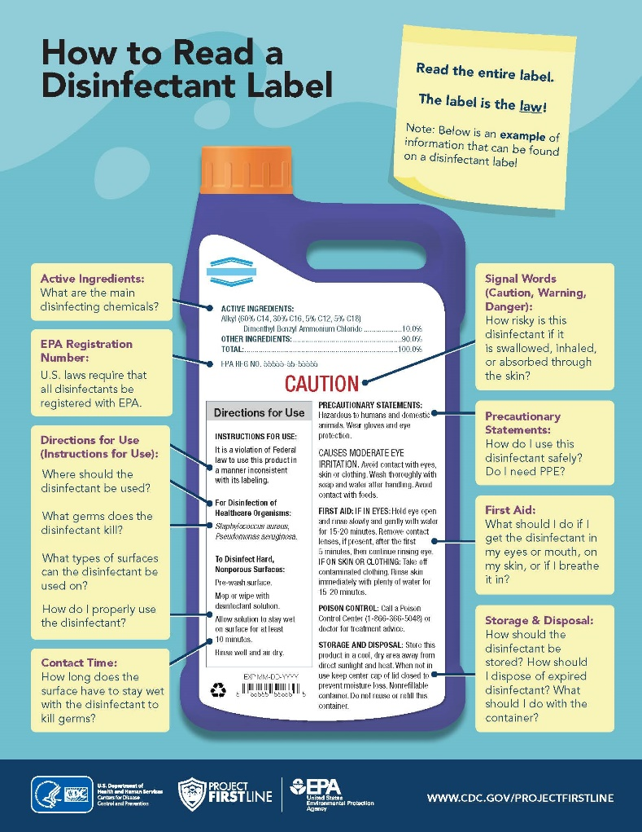
How to Read a Disinfectant Label
How to Read a Disinfectant Label (PDF)
(www.cdc.gov/hai/pdfs/HowToReadALabel-Infographic-508.pdf)
Notes:
What information can you find on a disinfectant label?
There are a number of items you can find on the label. Let’s take a closer look together -
[Click]

Slide 14
How to Read a Disinfectant Label
  Active Ingredients
  What are the main disinfecting chemicals?
How to Read a Disinfectant Label (PDF)
(www.cdc.gov/hai/pdfs/HowToReadALabel-Infographic-508.pdf)
Notes:
The label always states the active ingredients, such as ammonium chloride or bleach.
[Click]

Slide 15
How to Read a Disinfectant Label
  Directions for Use
  Identify (e.g., bacteria, viruses, fungi) the germs it kills
  Follow directions for use (e.g., how to mix product, how to disinfect)
  Use recommended amount for the correct duration (contact/wet time)
How to Read a Disinfectant Label (PDF)
(www.cdc.gov/hai/pdfs/HowToReadALabel-Infographic-508.pdf)
Notes:
You’ll also find what the disinfectant kills for example bacteria, viruses, or fungi. When working with spore-forming germs such as C. difficile or Norovirus, check the label to confirm if the disinfectant is sporicidal. Spores are difficult to kill and require specific types of disinfectants.
[Click]

Slide 16
How to Read a Disinfectant Label
  Directions for Use
  Identify (e.g., bacteria, viruses, fungi) the germs it kills
  Follow directions for use (e.g., how to mix product, how to disinfect)
  Use recommended amount for the correct duration (contact/wet time)
How to Read a Disinfectant Label (PDF)
(www.cdc.gov/hai/pdfs/HowToReadALabel-Infographic-508.pdf)
Notes:
Follow label instructions for use-label is the law. If a product needs to be diluted with water, follow the instructions exactly. Estimating is not acceptable and can create a disinfectant that is too strong or too weak and doesn’t do it’s job.
[Click]

Slide 17
How to Read a Disinfectant Label
  Directions for Use
  Identify (e.g., bacteria, viruses, fungi) the germs it kills
  Follow directions for use (e.g., how to mix product, how to disinfect)
  Use recommended amount for the correct duration (contact/wet time)
How to Read a Disinfectant Label (PDF)
(www.cdc.gov/hai/pdfs/HowToReadALabel-Infographic-508.pdf)
Notes:
Always use the recommended amount of the disinfectant for the correct duration. Look for the contact/wet time on the label. If a label has different contact/wet times for different germs, always go with the longest contact time on the label. Depending upon the germ, the contact time can vary.
[Click]

Slide 18
How to Read a Disinfectant Label
  Precautionary Statements
  Confirm required PPE
  Review precautions
How to Read a Disinfectant Label (PDF)
(www.cdc.gov/hai/pdfs/HowToReadALabel-Infographic-508.pdf)
Notes:
Check the disinfectant label to confirm the type of PPE required. For example do you need to use gloves or goggles? Different PPE will be required based on potential hazards.
[Click]

Slide 19
How to Read a Disinfectant Label
  Storage and Disposal
  Identify storage and disposal recommendations
How to Read a Disinfectant Label (PDF)
(www.cdc.gov/hai/pdfs/HowToReadALabel-Infographic-508.pdf)
Notes:
…and be familiar with the storage and disposal recommendations.
[Click]

Slide 20
How to Read a Disinfectant Label
  Precautionary Statements
  Confirm required PPE
  Review precautions
How to Read a Disinfectant Label (PDF)
(www.cdc.gov/hai/pdfs/HowToReadALabel-Infographic-508.pdf)
Notes:
Review the disinfectant precautions including the first aid protocol…
[Click]

Slide 21
How to Read a Disinfectant Label
  Check Expiration Date
  Manufacturer’s expiration date
  Open date/discard date
  Mix date/discard date
How to Read a Disinfectant Label (PDF)
(www.cdc.gov/hai/pdfs/HowToReadALabel-Infographic-508.pdf)
Notes:
Lastly, note the disinfectant expiration date. On this sample the expiration date is on the bottom left; you might also find it written on the cap. There may be different types of expiration dates on the container. You should be familiar with which of these apply in your facility so you know when to discard product; ask your EVS Manager if you are unsure.
[Click]

Slide 22
How to Read a Disinfectant Label
  Check Expiration Date
  Manufacturer’s expiration date
  Open date/discard date
  Mix date/discard date
How to Read a Disinfectant Label (PDF)
(www.cdc.gov/hai/pdfs/HowToReadALabel-Infographic-508.pdf)
Notes:
The manufacturer’s expiration date is the date the manufacturer says the product is good until. This should be stamped or written on the bottle.
[Click]

Slide 23
How to Read a Disinfectant Label
  Check Expiration Date
  Manufacturer’s expiration date
  Open date/discard date
  Mix date/discard date
How to Read a Disinfectant Label (PDF)
(www.cdc.gov/hai/pdfs/HowToReadALabel-Infographic-508.pdf)
Notes:
What we sometimes see is an open date which is the initial date the container was opened.
Check to see if the manufacturer’s instructions state that the product will expire before the manufacturer’s expiration date once it is opened. If yes, you’ll either write down the open date or the discard date on the container. Your facility policy should note which date to record and how to record it. You might use stickers or permanent marker.
For example, the manufacturer might say the product is ‘good until January 2025’, but the manufacturer’s instructions might also say ‘good for 30 days upon opening.’ If your policy says to write the discard date, you would write the date 30 days from now on the container with a permanent marker.
[Click]

Slide 24
How to Read a Disinfectant Label
  Check Expiration Date
  Manufacturer’s expiration date
  Open date/discard date
  Mix date/discard date
How to Read a Disinfectant Label (PDF)
(www.cdc.gov/hai/pdfs/HowToReadALabel-Infographic-508.pdf)
Notes:
A mix date is the date a product is first mixed. Mixed products may only be stable for a certain amount of time and may expire before the manufacturer’s expiration date. For example, if the product you’re mixing is only good for 24 hours after mixing, make sure to write what time it was mixed or the discard date on the container. Which date you use will again be in your facility’s policy.
Make sure to know your products.
[Click]

Slide 25
Dilute Disinfectant Per Label Instructions
Always use disinfectant in correct dilution
Never mix different disinfectants together
Automated dispenser: Automatically dispenses disinfectant mixed with water
Manual dispenser: Requires careful measuring to manually mix concentrated disinfectant with water
Notes:
Some disinfectants come premixed and others need to be diluted.
Disinfectants must be mixed according to the manufacturer’s guidelines in order to work properly. Disinfectants should always be used in correct concentration and are not interchangeable. Incorrect concentrations and inappropriate use of disinfectants can result in ineffective usage. Over-diluted disinfectants may not kill germs and over concentrated disinfectants can be harmful and can cause occupational diseases among EVS staff.
There are two methods to prepare a disinfectant for use by mixing water with a concentrated disinfectant.
An automated dispenser, as the name suggests, automatically dispenses concentrated disinfectant that is mixed with water in a desired concentration. It is a convenient way to dispense disinfectant as it does not require manual dilution. But you should still check to make sure the dilution is accurate as per manufacturer's instructions. A test strip can be used to confirm the dilution. Follow your facilities policy as to how often a test should be conducted to confirm dilution. Automated dispensers must be calibrated at intervals determined by the manufacturer.
A manual dispenser requires EVS staff to manually mix the concentrated disinfectant with water to a desired concentration. EVS staff should be properly trained on how to mix concentrated disinfectants.
We will describe manual mixing in the next few slides. ((remove - For example, manufacturer's instructions will direct you to use specific type of bottle that may be marked up to a certain point or may say to fill up the bottle up to the rim. If you use a bottle of your choice with or without correct marking or with the rim being at the different level, it may lead to incorrect dilution or mixing of the disinfectant.))
[Click]

Slide 26
Preparing Environmental Cleaning Products:
Manual Preparation
Prepare solutions in a designated area (i.e., housekeeping closet)
Follow label instructions
Use accurate measuring tools (i.e., use a measuring cup). Never eyeball or guesstimate the measurement of disinfectant solution to water.
Use PPE to prevent splashes or sprays
Notes:
For manual preparation, solutions should always be prepared -
In a designated area. Daily preparation of supplies and equipment for cleaning staff will often depend on local factors such as the size of the resident care area.
Solutions should always be prepared according to label instructions. This is key to ensuring the product works effectively and as it’s supposed to.
Prepare solutions using accurate measure tools. Using a standard way of measuring, for example by using a measuring cup will help ensure proper preparation. Never eyeball or guesstimate the measurement of disinfectant solution to water.
And lastly, use personal protective equipment (PPE) to prevent splashes or sprays.
When the disinfectant solution is not prepared per label instructions, it can be too strong, or weak and will not be able to disinfect appropriately. You should never add more water to dilute the smell of a cleaning solution, either. The disinfectant will not work as it is intended.
If you or your residents don’t like the smell or other properties of the disinfectant, don’t try to fix it on your own. Contact your EVS Manager to let them know.
[Click]

Slide 27
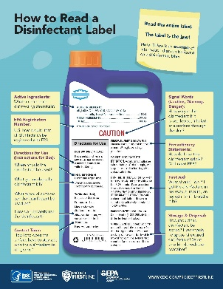
Best Practices For Disinfectant Use
Follow label instructions
Use the appropriate disinfectant for the surface
Notes:
Let's recap some dos and don’ts of disinfectant use:
Always follow label instructions for safe and effective use of a disinfectant.
Use appropriate disinfectant for the surface to protect the surface from damage.
[Click]

Slide 28

Best Practices For Disinfectant Use
Follow contact/wet time
Ensure the disinfectant dilution is accurate
Ensure the right PPE for the job
Notes:
Follow contact or wet time to kill the claimed type of germs. A disinfectant needs to remain wet on the surface long enough to kill the germs completely.
Ensure the disinfectant dilution is correct. Be familiar with the cleaning solutions you are using and ensure you change the solutions when recommended by the label instructions or when soiled.
Ensure proper PPE use to protect yourself from exposure to chemicals. For example, use gloves when handling disinfectant saturated cloths, and use eye protection when splashing might occur during mixing.
[Click]

Slide 29
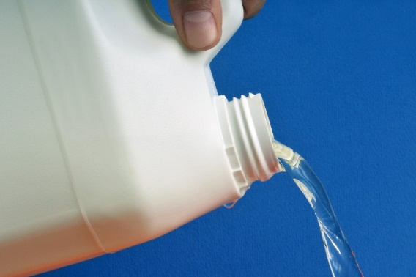
Practices to Avoid For Disinfectant Use
Don’t mix or dilute unless specified on the label
Don’t “top off” or add new solution to containers
Don’t mix different disinfectants!
Notes:
Don’t mix or dilute the disinfectant unless specified on the label. Additionally, follow label instructions regarding expiration date and how frequently fresh solution should be prepared. Solutions of detergents or disinfectants can be a reservoir for pathogens, particularly if the solution is prepared in a dirty container, stored for long periods of time, or prepared incorrectly.
Don’t “top off" or add new solution to containers containing old solution.
Don’t mix different disinfectants! For example, don’t mix bleach with quats or any other disinfectants. It can create a hazardous situation.
[Click]

Slide 30
Summary
Only clean surfaces can be disinfected
Disinfectant choice depends on the surface being cleaned
Follow the label instructions for use including contact/wet time
Don’t mix different disinfectants
Notes:
In summary
Only clean surfaces can be disinfected
Disinfectant choice depends on the surface being cleaned
Follow the label instructions for use, including the contact/wet time
Don’t mix different disinfectants
[Click]

Slide 31
References
Cleaning, Disinfection and Reprocessing Reusable Equipment, California Department of Public Health Healthcare-Associated Infections Program (CDPH) (PDF) (www.cdph.ca.gov/Programs/CHCQ/HAI/CDPH%20Document%20Library/SNF_OnlineIPCourse_Gs_Cleaning%20Disinfection%20Reprocessing_012521_ADA.pdf)
Environmental Cleaning and Disinfection Course, Centers for Disease Control and Prevention (CDC) (courses.cdc.train.org/Module11B_EnvironmentalCleaningandDisinfection_LTC/index.html)
EPA’s Registered Antimicrobial Products Effective Against Clostridium difficile Spores, Environmental Protection Agency (EPA) (PDF)(www.epa.gov/pesticide-registration/list-k-antimicrobial-products-registered-epa-claims-against-clostridium)
EVS and the Battle Against Infection: a Graphic Novel, CDC (www.cdc.gov/infectioncontrol/training/evs-battle-infection.html)
Factors Affecting the Efficacy of Disinfection and Sterilization, CDC (www.cdc.gov/infectioncontrol/guidelines/disinfection/efficacy.html#anchor_1554391167)
FAQs, Cleaning & Disinfecting Environmental Surfaces, CDC (www.cdc.gov/oralhealth/infectioncontrol/faqs/cleaning-disinfecting-environmental-surfaces.html)
Notes:
Instructor notes:
Reference any of the listed references for more information.
[Click]

Slide 32
References
Methods of Disinfection, Disinfection, CDC (www.cdc.gov/infectioncontrol/guidelines/disinfection/disinfectionmethods/index.html#anchor_1554328072)
Recommendations for Disinfection and Sterilization in Healthcare Facilities, CDC (www.cdc.gov/infectioncontrol/guidelines/disinfection/recommendations.html)
Reduce Risk from Surfaces, CDC (www.cdc.gov/hai/prevent/environment/surfaces.html)
Steps for Safe & Effective Disinfectant Use, EPA (PDF) (www.epa.gov/sites/default/files/202004/documents/disinfectants/onepager.pdf)
Notes:
Instructor notes:
Reference any of the listed references for more information.
[Click]

Slide 33
Project Firstline Resources
Visit the Project Firstline Website www.cdph.ca.gov/Programs/CHCQ/HAI/Pages/ProjectFirstline.aspx
Email the Project Firstline AskBox
ProjectFirstline@cdph.ca.gov
Project Firstline is a national collaborative led by the U.S. Centers for Disease Control and Prevention (CDC) to provide infection control training and education to frontline healthcare workers and public health personnel. The California Department of Public Health Healthcare-Associated Infections (HAI) Program is proud to partner with Project Firstline, as supported through Strengthening HAI/AR Program Capacity (SHARP) funding. CDC is an agency within the Department of Health and Human Services (HHS). The contents of this presentation do not necessarily represent the policies of CDC or HHS and should not be considered an endorsement by the Federal Government.
Notes:
Instructor notes:
For additional Project Firstline resources, you may direct EVS staff to access materials on the Project Firstline website or email our Project Firstline AskBox.

Slide 34
ACTIVITY TEACHING AIDES / WORKSHEETS
Notes:
Instructor notes: Use the following slides as alternatives to printing copies of worksheets. See the Activity Cards file for additional information.

Slide 35
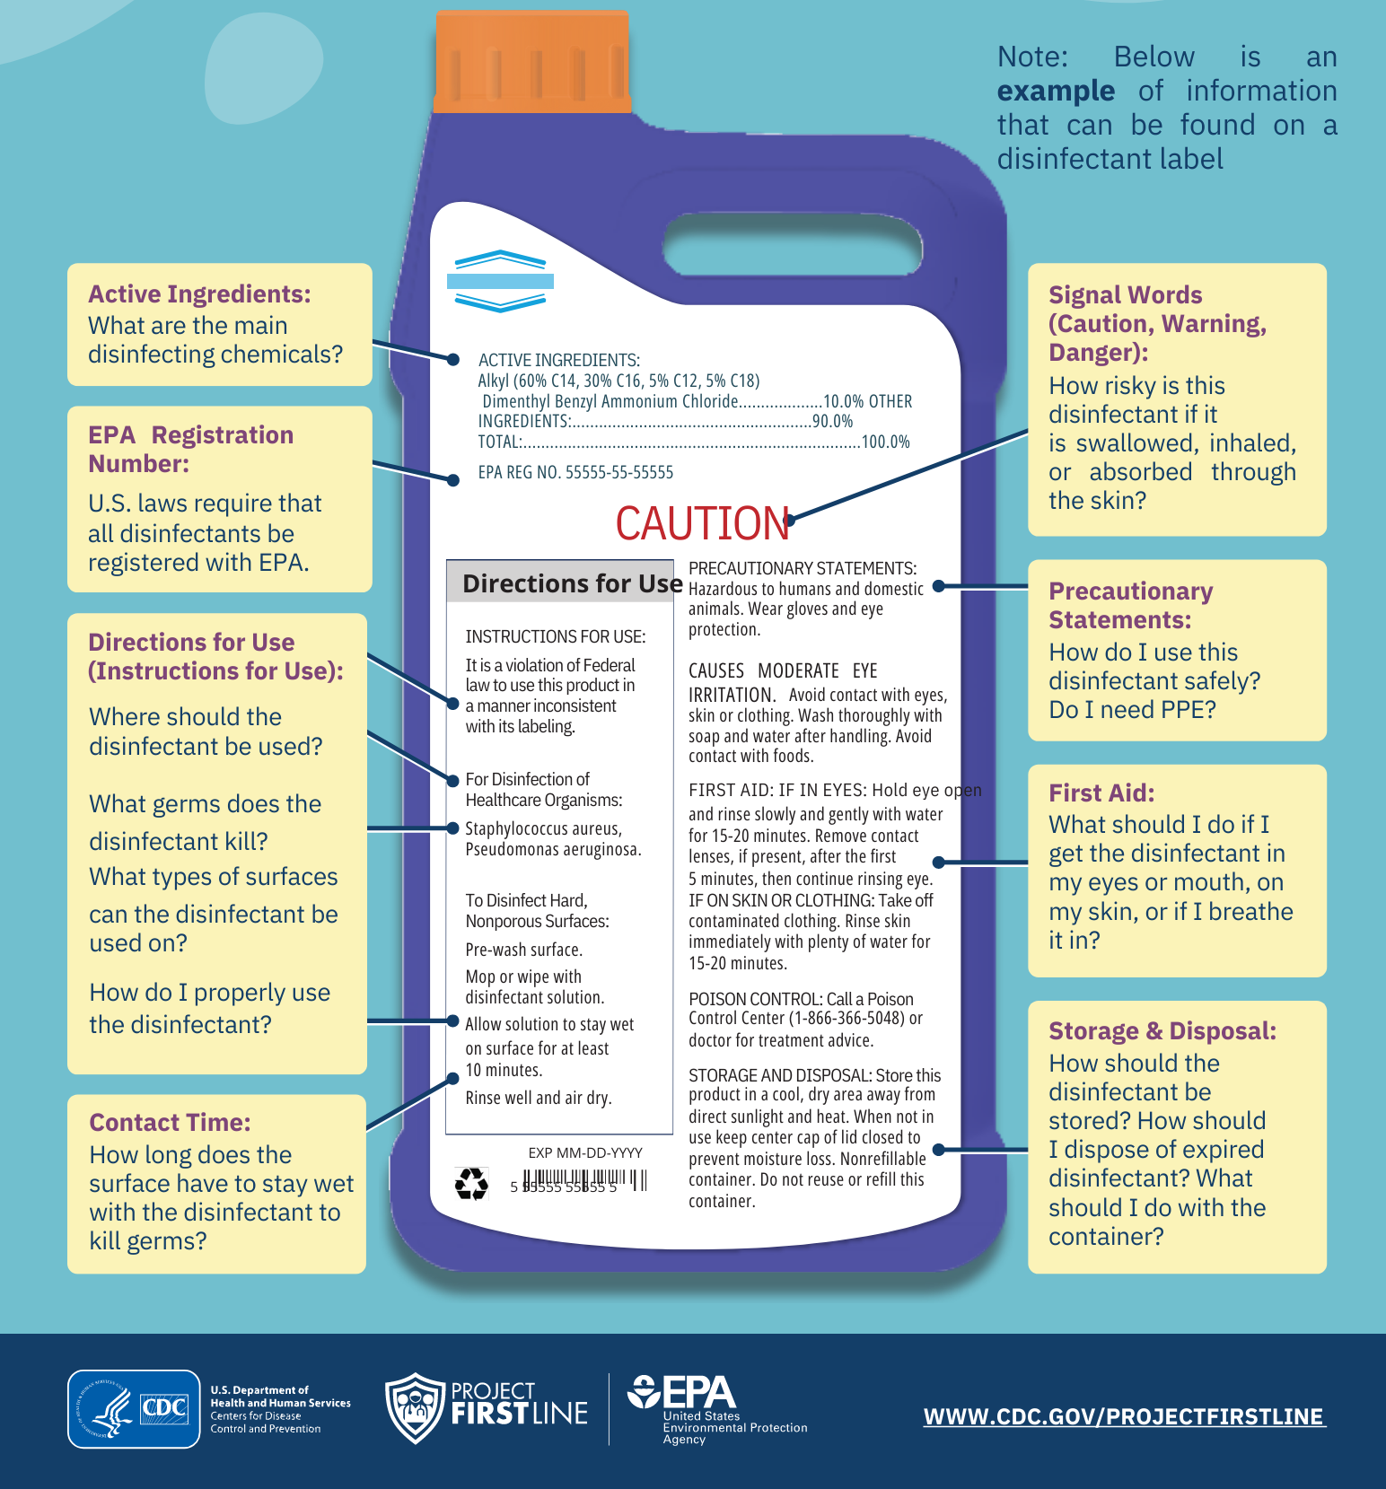
How to Read a Disinfectant Label
Notes:
Instructor notes: Use this slide as an alternative to printing copies for the "Read a Disinfectant Label" activity. See the Activity Cards file for additional information.

Slide 36

Case Scenario #1
You have a new resident coming in. The nursing staff is putting pressure on EVS staff to clean the room faster and to have it ready soon. The contact/wet time for the product you use is 5 minutes, but nursing staff is asking you to ‘speed it up’.
How do you proceed with cleaning and disinfecting? Select all that apply.
  Let it dry quickly
  Wait the 5 minutes and allow it to dry
  Wipe it off so it dries faster
  Ignore the nursing staff
  Other (Share your response)
Notes:
Instructor notes: Use this slide as an alternative to printing copies for the "What Would You Do?: Contact/Wet Time" activity. See the Activity Cards file for additional information.
Case Scenario 1
You have a new resident coming in. The nursing staff is putting pressure on EVS staff to clean the room faster and to have it ready soon. The contact/wet time for the product you use is 5 minutes, but nursing staff is asking you to ‘speed it up’.
How do you proceed with cleaning and disinfecting? Select all that apply.
Let it dry quickly
B. Wait the 5 minutes and allow it to dry
C. Wipe it off so it dries faster
D. Ignore the nursing staff
E. Other (Share your response)
(Instructor notes: Pause for 10 seconds then move to next slide.)
(Click)

Slide 37
Case Scenario #1
You have a new resident coming in. The nursing staff is putting pressure on EVS staff to clean the room faster and to have it ready soon. The contact/wet time for the product you use is 5 minutes, but nursing staff is asking you to ‘speed it up’.
How do you proceed with cleaning and disinfecting? Select all that apply.
  Let it dry quickly
  Wait the 5 minutes and allow it to dry
  Wipe it off so it dries faster
  Ignore the nursing staff
  Other (Share your response)*
  *E may be a correct response depending on facility policy and procedure.
Notes:
If you answer B, you are correct. Note that if you answer E, may be a correct response depending on facility policy and procedure.
Instructor notes: For each case scenario, review correct answers (highlighted in yellow) with the group and provide any additional comment or rationale per facility policy and procedures.
How do you proceed with cleaning and disinfecting? Select all that apply.
Let it dry quickly
Wait the 5 minutes and allow it to dry
Wipe it off so it dries faster
Ignore the nursing staff
Other (Share your response)*
*E may be a correct response depending on facility policy and procedure
(Click)

Slide 38
Case Scenario #1 Continued
How would you respond to the situation? What could you do if you’re being pressured to clean a room faster than you are able to?
  Contact EVS supervisor, let them know what’s going on
  Inform the nursing staff of the products contact/wet time to make the room/surface safe for the next resident
  Ask EVS supervisor for assistance (maybe they can get extra EVS staff to help)
  Open lines of communication between nursing staff and EVS to ensure each other’s deadlines and limitations
  Involve facility’s infection preventionist and let them know this is an (ongoing) situation
  All of the above
Notes:
For the same case scenario, How would you respond to the situation? What could you do if you’re being pressured to clean a room faster than you are able to?
Contact EVS supervisor, let them know what’s going on
Inform the nursing staff of the products contact/wet time to make the room/surface safe for the next resident
Ask EVS supervisor for assistance (maybe they can get extra EVS staff to help)
Open lines of communication between nursing staff and EVS to ensure each other’s deadlines and limitations
Involve facility’s Infection Preventionist and let them know this is an (ongoing) situation
All of the above
(Instructor notes: Pause for 10 seconds for response then move to next slide.)
(Click)

Slide 39
Case Scenario #1 Continued Answer
How would you respond to the situation? What could you do if you’re being pressured to clean a room faster than you are able to?
  Contact EVS supervisor, let them know what’s going on
  Inform the nursing staff of the products contact/wet time to make the room/surface safe for the next resident
  Ask EVS supervisor for assistance (maybe they can get extra EVS staff to help)
  Open lines of communication between nursing staff and EVS to ensure each other’s deadlines and limitations
  Involve facility’s infection preventionist and let them know this is an (ongoing) situation
  All of the above
Notes:
If you answered F, All of the above, you are correct.
Instructor notes: For each case scenario, review correct answers (highlighted in yellow) with the group and provide any additional comment or rationale per facility policy and procedures.
2) How would you respond to the situation? What could you do if you’re being pressured to clean a room faster than you are able to?
Contact EVS supervisor, let them know what’s going on
Inform the nursing staff of the products contact/wet time to make the room/surface safe for the next resident
Ask EVS supervisor for assistance (maybe they can get extra EVS staff to help)
Open lines of communication between nursing staff and EVS to ensure each other’s deadlines and limitations
Involve facility’s Infection Preventionist and let them know this is an (ongoing) situation
All of the above
(Instructor notes: Pause for 10 seconds for response then move to next slide.)
(Click)

Slide 40
Case Scenario #2
A product has a 10-minute contact/wet time, but it dries in 5 minutes. What do you do? Select all that apply.
Reapply the product to ensure it stays wet for the entire 10 minutes
Add water to the surface so it stays wet longer
Let the EVS manager know that you are having to rewet the surface to achieve the contact/wet time
Use another product from home
Nothing
Notes:
Instructor notes: Use this slide as an alternative to printing copies for the "What Would You Do?: Contact/Wet Time" activity. See the Activity Cards file for additional information.
Case Scenario 2
A product has a 10-minute contact/wet time, but it dries in 5 minutes. What do you do? Select all that apply.
Reapply the product to ensure it stays wet for the entire 10 minutes
Add water to the surface so it stays wet longer
Let the EVS manager know that you are having to rewet the surface to achieve the contact/wet time
Use another product from home
Nothing
(Instructor notes: Pause for 10 seconds for response then move to next slide.)
(Click)

Slide 41
Case Scenario #2 Answer
A product has a 10-minute contact/wet time, but it dries in 5 minutes. What do you do? Select all that apply.
Reapply the product to ensure it stays wet for the entire 10 minutes
Add water to the surface so it stays wet longer
Let the EVS manager know that you are having to rewet the surface to achieve the contact/wet time
Use another product from home
Nothing
Notes:
If you selected A and C, you are correct.
Instructor notes: For each case scenario, review correct answers (highlighted in yellow) with the group and provide any additional comment or rationale per facility policy and procedures.
(Click)

Slide 42
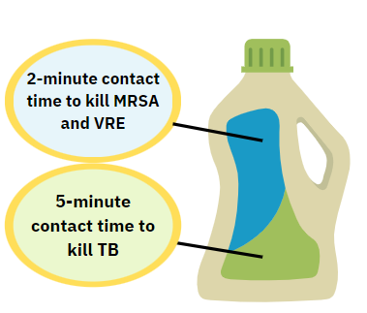
Case Scenario #3
You are using a disinfectant product that has different contact/wet times. This disinfectant product has, a 2-minute contact time to kill MRSA & VRE and a 5-minute contact time to kill TB.
Which contact/wet time would you use?
The shortest time
The longest time
The average time
The expiry date
At midnight
Notes:
Instructor notes: Use this slide as an alternative to printing copies for the "What Would You Do?: Contact/Wet Time" activity. See the Activity Cards file for additional information.
Case Scenario #3
You are using a disinfectant product that has different contact/wet times. This disinfectant product has, a 2-minute contact time to kill MRSA & VRE and a 5-minute contact time to kill TB.
Which contact/wet time would you use?
The shortest time
The longest time
The average time
The expiry date
At midnight
(Instructor notes: Pause for 10 seconds for response then move to next slide.)
(Click)

Slide 43
Case Scenario #3
You are using a disinfectant product that has different contact/wet times. This disinfectant product has, a 2-minute contact time to kill MRSA & VRE and a 5-minute contact time to kill TB.
Which contact/wet time would you use?
The shortest time
The longest time
The average time
The expiry date
At midnight
Notes:
If you chose B, you are correct.
Instructor notes: For each case scenario, review correct answers (highlighted in yellow) with the group and provide any additional comment or rationale per facility policy and procedures.
(Click)

Slide 44
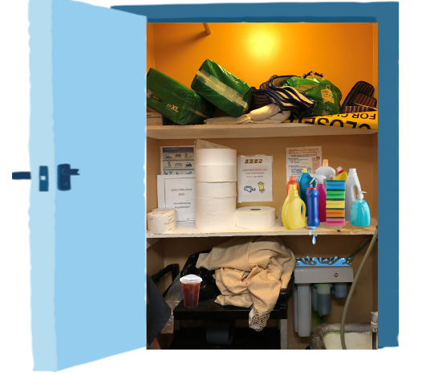
Picture This: What to Look for in an EVS Closet
Identify 6 areas for improvement.
Notes:
Instructor notes: Use this slide as an alternative to printing copies for the "Picture This: What to Look for in an EVS Closet" activity. See the Activity Cards file for additional information.

