Slide 1

Notes:
Instructor notes:
Set the stage for training as an opportunity for collaboration where everyone is able to learn. As the instructor, it is essential to create a supportive teaching environment. Use this time to improve processes and offer support to staff so that they will feel comfortable coming to leadership when needed. Before you begin your training, consider showing your appreciation for your EVS staff's participation in the training and for their continued efforts in keeping your facility clean and safe for all residents.
Suggested script:
We know that housekeeping staff (you) are hard-working and really care about keeping your building clean and safe for residents, visitors and staff. In the past several years many things have changed in health care including new problems with new kinds of germs sometimes called superbugs. Some of these superbugs can last a long time on things like beds and handrails. We know you are already experts at cleaning and now this training will help you become experts at the “infection control” way of cleaning. Today we are talking about the most important thing you can do to stop superbugs from spreading in your building: all the best ways to do hand hygiene.
[Click]

Slide 2
Module 1: Hand Hygiene for EVS Staff
Infection Prevention and Control Training for Environmental Services Staff
Notes:
Instructor notes:
In this module we will review hand hygiene as it relates to your role as a member of the environmental services team.
Optional set up: Distribute alcohol-based hand rub (ABHR) for activity on slide 15.
(Instructor prompts are noted in bold throughout the presentation.)
[Click]

Slide 3
Objectives
Describe how hand hygiene helps stop the spread of germs
Demonstrate proper hand hygiene practices
Adopt proper hand hygiene practices during environmental cleaning and disinfection
Notes:
By the end of today’s discussion, you will be able to describe how hand hygiene helps stop the spread of germs, demonstrate proper hand hygiene practices for environmental services staff, and adopt proper hand hygiene practices during environmental cleaning and disinfection tasks.
[Click]

Slide 4
How Germs May Spread
Notes:
Our bodies are very good at protecting against many germs, but when residents in healthcare are weak or ill, their defenses may not work as well. Also, some germs can still cause infection in someone who’s healthy.
Lets talk about how germs make someone sick.
[Click]

Slide 5


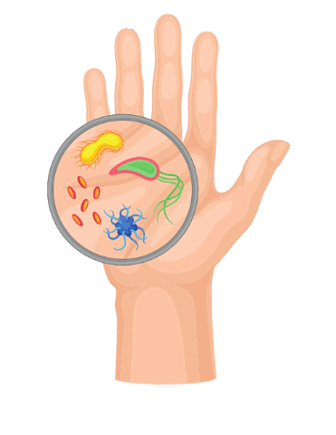

Reservoirs: Where Germs Live
Body Reservoirs
Environmental Reservoirs
Examples: Skin, gastrointestinal system ("the gut"), respiratory system, blood
Examples: Sinks/faucets, medical devices, bed rails, door handles, curtains
Notes:
Germs need a place to live – we call these places ‘reservoirs.’ Essentially, they’re like habitats. Reservoirs can be in the human body – the skin; the digestive system or ‘gut’; the lungs and airway; and the blood. Reservoirs can also be in the environment like on sinks, medical devices or bedrails.
Germs frequently spread between and among these reservoirs. Understanding where germs live helps us recognize where there is risk for them to be spread, and why infection control actions work to stop them from spreading and making people sick.
[Click]

Slide 6
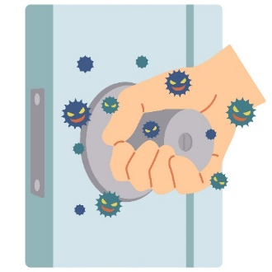
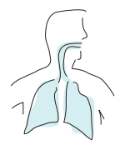


Pathways: How Germs Spread
Touch
Breathed In
Splashes or sprays
Notes:
Germs need a pathway – Because they typically can’t move on their own, at least not very far, germs need a way to get from where they live to another place or a person.
There are a few common pathways for germs to be spread from reservoirs in healthcare –
One is by touch. This usually involves the skin – especially the hands – but it also happens with devices, which touch different people and surfaces.
Another is when they’re breathed in.
And another is through splashes and sprays of blood, body fluid, or water from a sink or other source. Germs in those splashes or sprays can get into your eyes, nose, or mouth, or into a cut or a break in your skin and cause infection.
Anything that we do that involves touch – whether it’s touching a person or things in the environment, like door knobs and curtains – can be a risk for germs to spread.
[Click]

Slide 7

How Germs Make People Sick
New Person
Germs need to get around the person’s natural defenses (e.g., skin, immune system)
Germs need to survive in the environment
Implement infection prevention and control practices to help keep germs from spreading
Can be a resident, visitor, or healthcare personnel
Notes:
Germs also need to arrive at a new person. That person could be a resident, or you or one of your colleagues! And in order to infect them, the germs need to get around the person’s natural defenses – if the person is already sick, then their immune system could be weak and not able to fight germs as well as a healthy person’s can. If their skin is broken – from having an IV inserted, for instance – germs can enter their body through that break in the skin defense.
Throughout all of these elements, the germs need to survive in the environment if they’re going to make someone sick – that’s called being ‘infectious.’
The infection prevention and control actions that you take at any of these points help keep germs from spreading and causing infection.
Now we’re going to use what we know about reservoirs, pathways, and how germs make people sick to discuss a scenario.
[Click]

Slide 8
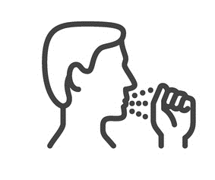


How Germs May Spread: Example
Reservoir
Pathway
Reservoir
Bedrails contaminated with germs
Staff’s unwashed hands transmit germs to roommate
Roommate gets sick from germs
Notes:
(Instructor notes: This is an animated slide.)
Let’s walk through one example to better understand how germs may spread.
As an EVS staff member, you come in to clean the areas of a resident's room. You can’t see them, but you know that there are germs on surfaces throughout the room. You’re really busy today, and you forget to clean your hands after you clean the first resident’s area.
(Click slide once to display ‘Pathway’ column)
You then move to clean the second bedspace in the room. You’ve now transmitted germs from the first bedspace to the second bedspace.
(Click slide once to display ‘Reservoir’ column)
And then the roommate gets sick.
The germ moved from an environmental reservoir through a pathway to a body reservoir.
[Click]

Slide 9
Knowledge Check
What is a simple action EVS staff can take to prevent germs from spreading? Select the best answer.
Perform hand hygiene
Remove all sources of infection
Use only private rooms
All of the above
Notes:
Let’s take a poll!
How can EVS staff prevent germs from spreading?
Select all that apply.
Perform hand hygiene
Eliminate all sources of infection
Use only private rooms or
All of the above
(Instructor notes: Pause for 10 seconds then move to next slide.)
[Click]

Slide 10
Knowledge Check
What is a simple action EVS staff can take to prevent germs from spreading? Select the best answer.
Perform hand hygiene
Remove all sources of infection
Use only private rooms
All of the above
Notes:
If you selected A, you are correct. EVS staff can prevent germs from spreading by performing hand hygiene.
Removing all sources of infection would be impossible. And private rooms may not be available.
[Click]

Slide 11
Hand Hygiene
Notes:
Let's now look at the hand hygiene
[Click]

Slide 12
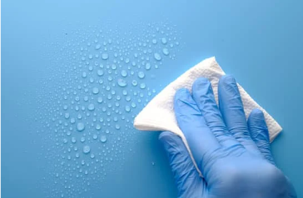
EVS Staff Clean Many Surfaces
Bedrails
Bed side tables
Chairs
Door handles
Floors
Light switches
Showers
Sinks
Toilets
…
Notes:
As an EVS staff while you are cleaning the room you touch multiple surfaces, such as bedrails, chairs, and cleaning supplies.
During that time, if you do not perform hand hygiene when needed, you are potentially passing the germs to other residents or environmental surfaces.
[Click]

Slide 13

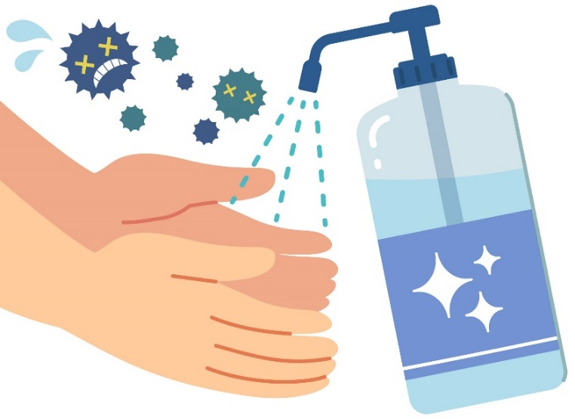
Hand Hygiene Prevents Germ Spread
Hands are the most common mode for transmission of germs.
Perform hand hygiene for at least 20 seconds to keep your hands clean and stop the spread of infections. Clean hands save lives.
Soap and Water
Alcohol-Based Hand Rub (ABHR)
Notes:
(Instructor notes: This is an animated slide.)
Hand hygiene is the key element in preventing the spread of infections.
Your hands are the most common mode of germ transmission.
Performing proper hand hygiene can prevent spreading infection from you to your resident and back to others.
But what exactly is proper hand hygiene?
Can you name the two methods to properly clean your hands? (Instructor notes: Pause for 10 seconds to allow time for response.)
Great answers everyone, you’re right!
(Click to display answer/images)
Soap and water and alcohol-based hand rub or ABHR – you might also use the term hand sanitizer - are two methods you can use to properly perform hand hygiene.
[Click]

Slide 14
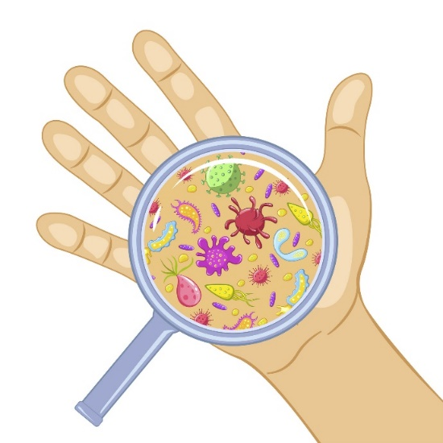
Why Do We Need To Clean Our Hands for at Least 20 Seconds?
Scrubbing hands for 20 seconds is necessary because some germs can be difficult to remove.
ABHR destroys the proteins in germs. Cover all hand surfaces with ABHR until hands feel dry. It should take around 20 seconds.
Remember: 20 seconds can save a life!
Notes:
Scrubbing hands for 20 seconds is necessary because some germs can be difficult to remove. Friction is required to scrub the germs off.
ABHR destroys the proteins in germs. Cover all hand surfaces with ABHR until hands feel dry. It should take around 20 seconds. Washing hands with soap and water will remove germs; using ABHR will kill germs – both methods prevent the spread of infection.
It is recommended to perform hand hygiene for at least 20 seconds.
Remember: 20 seconds can save a life!
[Click]
Instructor notes: The amount of time spent cleaning hands is debated. Some guidelines say 15 seconds; others say 20 seconds. The goal is to clean all surfaces of the hands. We say "at least 20 seconds“ and encourage staff to make sure they scrub all surfaces of the hands.

Slide 15

Notes:
(Instructor notes: This slide has an embedded video. Right click and select ‘Save Media as…’ to save the video for future use outside of the slides. Video script is below if sound does not work. See slide 33 for an alternative diagram to show instead of the video.)
Let’s see how to properly perform hand hygiene with soap and water. (Click slide once to play video.)
See how quick and easy it can be to use soap and water? As we saw in the video, it is important to follow all steps to achieve proper hand hygiene.
[Click]
Video script:
Turn on the water and rinse your hands. Apply soap. Scrub your hands palm to back, between your fingers, fingernails, your thumbs, and don't forget your wrists. Rinse your hands thoroughly to make sure no soap is left behind. Dry with a single use towel and use that towel to turn off the faucet.

Slide 16
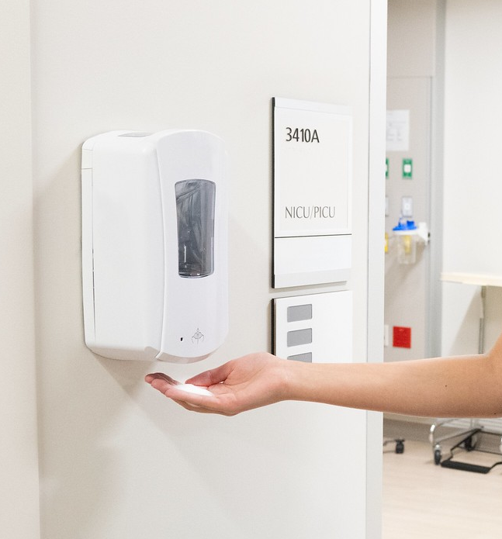
Hand Hygiene with ABHR
Step 1. Apply ABHR to the palms of hands. Use enough product to cover all hand surfaces.
Step 2. Rub hands together until dry. Spread between fingers, fingernails, on the front and back of hands, thumbs and wrists.
Notes:
Technique is key in performing proper hand hygiene.
Now that we have seen how to perform hand hygiene with soap and water, let’s practice hand hygiene together by using ABHR. If you have ABHR with you, now is the time to get it out.
(Instructor notes: Give participants a moment to get ABHR. Demonstrate the process as participants follow along.)
Let’s all follow the proper hand hygiene steps listed on the slide.
Ready. Let’s start.
First, apply ABHR to the palms of your hands. Use enough product to cover all hand surfaces. If you’re unsure how much ABHR to use, ask your EVS manager – it might differ depending on the product you’re using.
Step 2. Rub your hands together until dry. Go palm to palm, palm to back, between fingers, under your fingernails, thumbs, and again don’t forget your wrists. Never shake off excess ABHR or wipe off with a towel.
Great now the ABHR has been rubbed dry and your hands are clean!
[Click]

Slide 17
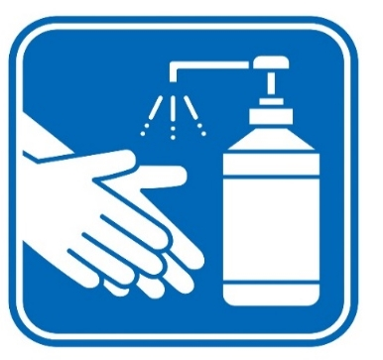
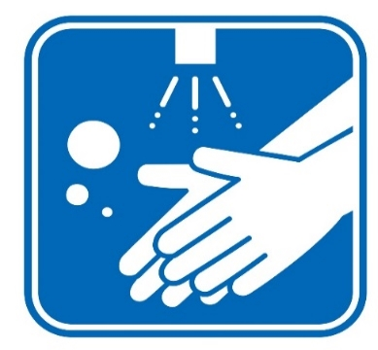
Which Hand Hygiene Method To Use?
ABHR
Soap and Water
Hands are not visibly dirty
Touching cleaning supplies from the cart
Upon entry and exit of every resident room or bedspace
Before donning (putting on) and after doffing (taking off) gloves
Hands are visibly dirty
After contact with bodily fluids
Resident has C. difficile infection
Before and after meal
After using restroom
Notes:
(Instructor notes: This is an animated slide.)
Sometimes you’re going to have to choose the best hand hygiene option in different situations.
Let’s talk about how to choose the hand hygiene method you would use in different situations.
(Click slide once to display ‘ABHR’ column)
ABHR is the preferred method of hand hygiene as it kills germs, and it is convenient. ABHR helps maintain healthy hand skin and nails because it is less irritating to skin than handwashing and use of gloves.
It is appropriate to use ABHR when:
Yours hands are not visibly dirty.
When touching cleaning supplies from the cart.
Upon entry and exit of every resident room or bedspace.
And, before donning or putting on, and after doffing or taking off gloves.
(Click slide once more to display ‘Soap and Water’ column)
There are situations when ABHR should not be used, and soap and water is required.
Examples include when:
Your hands are visibly soiled,
When you come in contact with blood or body fluids,
If the resident has C. difficile infection,
Before and after meals,
And after using the restroom
[Click]

Slide 18
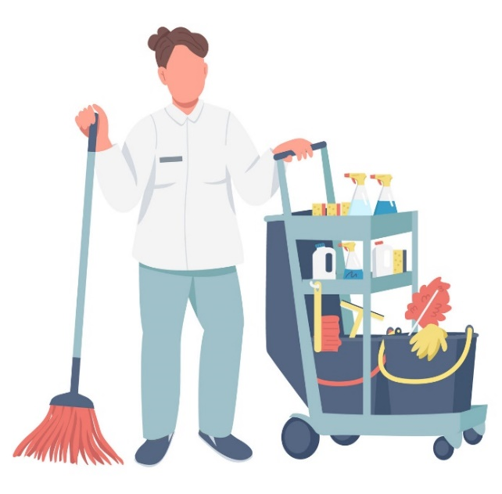

Every EVS Moment Matters!
EVS Hand Hygiene Moments
When entering a resident room and before putting on gloves
Upon leaving a resident room and after removing gloves
Between dirty and clean tasks
Before touching clean items on a cart
Between cleaning resident bedspaces
Adapted from WHO’s Your 5 Moments for Hand Hygiene
(cdn.who.int/media/docs/default-source/integrated-health-services-(ihs)/infection-prevention-and-control/your-5-moments-for-hand-hygiene-poster.pdf?sfvrsn=83e2fb0e_16)
Notes:
As an EVS staff, you play an integral part to prevent the spread of infection.
There are five key moments that will always require at least one method of hand hygiene. This is modeled after the World Health Organization’s 5 Moments for Hand Hygiene. Hand hygiene is required:
Upon entering a resident room and before putting on gloves
Between dirty and clean tasks. For example, before taking items from the cleaning cart.
Between cleaning resident bedspaces that share a room
Before touching clean items on an EVS cart. Note that when going back to your cart after any task, you are moving between dirty and clean tasks and this might be a signal that you need to clean your hands.
And lastly, upon leaving a resident room and after removing gloves
By performing hand hygiene during every one of these moments, you can reduce the spread of germs in your facility.
[Click]

Slide 19
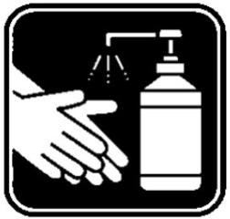

Hand Hygiene Scenario - What’s Missing?
1. Cleans hands and dons (put on) gloves
Notes:
Now that we know why hand hygiene is so important and when to perform it, lets look at this scenario and see where EVS staff could have prevented the spread of germs in a resident's room.
First, the EVS staff performs hand hygiene, enters the resident's room to clean, and then dons gloves.
[Click]

Slide 20

Hand Hygiene Scenario - What’s Missing?
1. Cleans hands and dons (put on) gloves
2. Cleans bedspace 1
Notes:
They clean bedspace 1.
[Click]

Slide 21

Hand Hygiene Scenario - What’s Missing?
1. Cleans hands and dons (put on) gloves
2. Cleans bedspace 1
3. Doffs (take off) and dons second pair of gloves
Notes:
After cleaning bedspace 1, the EVS staff doffs or removes their gloves, and dons a second pair of clean gloves.
[Click]

Slide 22
Hand Hygiene Scenario - What’s Missing?
1. Cleans hands and dons (put on) gloves
2. Cleans bedspace 1
3. Doffs (take off) and dons second pair of gloves
4. Cleans second bedspace
Notes:
They go to clean resident 2’s bedspace…
[Click]

Slide 23

Hand Hygiene Scenario - What’s Missing?
1. Cleans hands and dons (put on) gloves
2. Cleans bedspace 1
3. Doffs (take off) and dons second pair of gloves
5. Doffs gloves
4. Cleans second bedspace
Notes:
then doffs their gloves…
[Click]

Slide 24
Hand Hygiene Scenario - What’s Missing?
1. Cleans hands and dons (put on) gloves
2. Cleans bedspace 1
3. Doffs (take off) and dons second pair of gloves
6. Cleans hands and exits room
5. Doffs gloves
4. Cleans second bedspace
Notes:
…and then performs hand hygiene before leaving the residents’ room.
Think about this situation-where else should the EVS staff have performed hand hygiene?
(Instructor notes: Pause for 5-10 seconds to allow time for response.)
[Click]

Slide 25
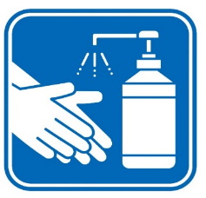
Hand Hygiene Scenario
1. Cleans hands and dons (put on) gloves
2. Cleans bedspace 1
3. Doffs (take off) and dons second pair of gloves
6. Cleans hands and exits room
5. Doffs gloves
4. Cleans second bedspace
Notes:
Great answers!
Right. After the EVS staff touched items in resident 1’s bedspace and moved to resident 2’s bedspace, they should have performed hand hygiene before donning clean gloves.
When you remove your dirty gloves after cleaning bedspace 1, you contaminate your hands while removing the gloves.
If you put clean gloves on contaminated hands, you’ve now spread germs to your new gloves.
You might be thinking “But what if I didn’t contaminate my hands while removing my gloves? Do I need to perform hand hygiene again?” The answer is yes. It is very likely that you do contaminate your hands while removing your gloves, and there might be small tears in the gloves you may not see that can allow germs to contaminate your hands. When you apply clean gloves over your contaminated hands, you contaminate your new gloves.
Always perform hand hygiene before donning new gloves.
[Click]

Slide 26
Additional Considerations
Skin health
  Caring for the healthcare environment can damage your hand skin
  Use facility-approved soap, ABHR, and hand creams.
  Tell your supervisor if your hands develop cracks or redness
Nail health
  Keep your nails short and natural
    Bacteria live in the space between the fingernail and the nail
    Chipped nail polish provides a reservoir for germs
  Familiarize yourself with facility hand hygiene policy
Notes:
We want to recognize how caring for the healthcare environment can affect the hands of EVS staff. Here are some things to keep in mind as you take care of the healthcare environment and make it a safer place for your residents.
You can help keep your hands healthy by using facility-approved hand cream when going on breaks, and by making sure you thoroughly rinse off any soap residue which can be very irritating to the skin.
Healthy skin and nails are vital in preventing infections. Any cracks in the skin can provide an opening for germs to enter the body. By checking to see if your skin is healthy with no cracks or redness, you can keep germs from getting under your skin. Let your supervisor or employee health know if you notice that your skin is not intact or if you are having a reaction to any products used for work.
EVS personnel are part of the healthcare team and should have short, natural nails just like other staff are required to have.
Broken, cracked, or chipped nails can also be a reservoir for germs. Bacteria live in the space between the fingernail and the nail. Cleaning the area under the nail is much more difficult as nail length increases. Because of this, long nails and artificial nails can make it hard to perform good hand hygiene and have even been associated with being the cause of outbreaks.
Familiarize yourself with your facility's hand hygiene policy to be prepared and keep both yourself and residents safe.
[Click]

Slide 27
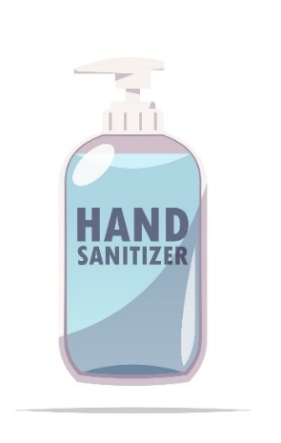
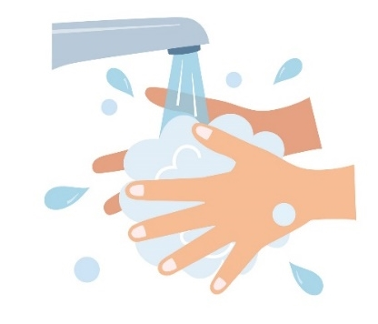
Best Practices to Keep Your Hands Clean
Clean hands for at least 20 seconds with ABHR or soap and water
Clean hands are vital during EVS tasks to prevent the spread of germs to our residents and ourselves.
Notes:
Let’s now recap some dos and don’ts of proper hand hygiene.
Clean your hands with of soap and water or alcohol-based hand rub for at least 20 seconds. Perform hand hygiene regularly and properly to stop the spread of germs.
[Click]

Slide 28
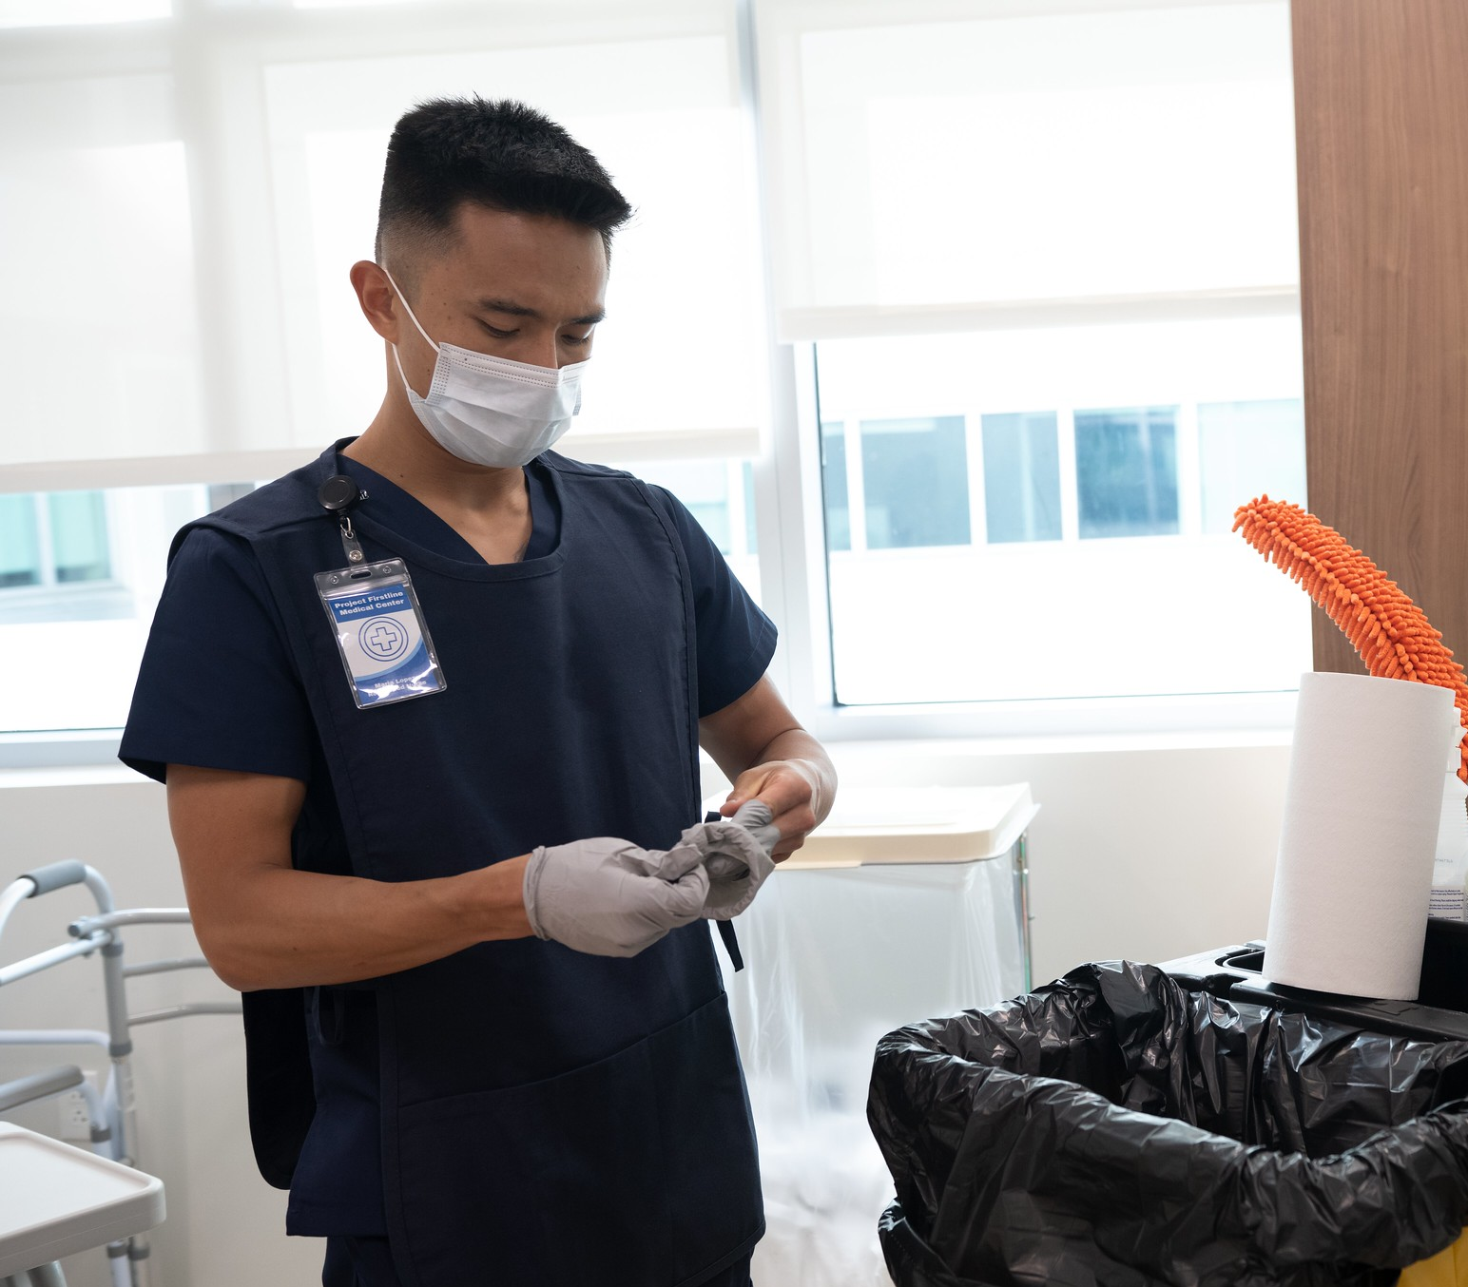
Best Practices to Keep Your Hands Clean
Gloves are not a substitute for hand cleaning. Clean your hands before putting on and immediately after removing gloves.
Clean hands are vital during EVS tasks to prevent the spread of germs to our residents and ourselves.
Notes:
Gloves are not a substitute for hand hygiene. As mentioned in the hand hygiene scenario, EVS staff should perform hand hygiene before putting on and immediately after removing gloves. When removing dirty gloves it very likely that you do contaminate your hands; there might be small tears in the gloves you may not see that can allow germs to contaminate your hands. Putting on clean gloves with contaminated hands can spread germs to your new gloves.
[Click]

Slide 29
Best Practices to Keep Your Hands Clean
Clean your hands
  Upon entering a resident room and before putting on gloves
  Before touching clean items on an EVS cart
  Between cleaning resident bedspaces that share a room
  Between dirty and clean tasks. For example, before placing items back on the cleaning cart
  Upon leaving a resident room and after removing gloves
Clean hands are vital during EVS tasks to prevent the spread of germs to our residents and ourselves.
Notes:
Remember to perform hand hygiene at every hand hygiene moment listed here.
Lastly, hand hygiene is vital during environmental cleaning and disinfection tasks to prevent the spread of germs to our residents and ourselves.
[Click]

Slide 30
Summary
Clean hands reduce the spread of germs
Clean your hands the right way
  Washing hands with soap and water for 20 seconds
  Using enough ABHR to cover all hand surfaces, rubbing until dry
All EVS staff should know which:
  Method of hand hygiene to use
  Situations that require hand washing
  Times when they should clean their hands
Notes:
In summary,
Hand hygiene prevents the transmission of germs
You can now demonstrate proper hand hygiene via
Washing hands with soap and water for 20 seconds, or
Using enough ABHR to cover all hand surfaces, rubbing until dry
We should all adopt proper hand hygiene practices
Know which method of hand hygiene to use
Know what situations to use each hand hygiene method, and
Know when you should clean your hands, for example, performing hand hygiene before donning and after doffing gloves.
[Click]

Slide 31
References
Clean Hands Video, Centers for Disease Control and Prevention (CDC)
(www.youtube.com/watch?v=xmYMUly7qiE)
Hand Hygiene, CDC
(www.cdc.gov/handhygiene/index.html)
Healthcare-Associated Infections Program, California Department of Public Health (CDPH) (www.cdph.ca.gov/Programs/CHCQ/HAI/Pages/HAIProgramHome.aspx)
Project Firstline, CDC (www.cdc.gov/infectioncontrol/projectfirstline/index.html)
Your 5 Moments for Hand Hygiene, World Health Organization (WHO)
  (cdn.who.int/media/docs/default-source/integrated-health-services-(ihs)/infection-prevention- and-control/your-5-moments-for-hand-hygiene-poster.pdf?sfvrsn=83e2fb0e_16)
Notes:
Instructor notes: Reference any of the listed references for more information.
[Click]

Slide 32
Project Firstline Resources
Visit the Project Firstline Website (www.cdph.ca.gov/Programs/CHCQ/HAI/Pages/ProjectFirstline.aspx)
Email the Project Firstline AskBox
ProjectFirstline@cdph.ca.gov
Project Firstline is a national collaborative led by the U.S. Centers for Disease Control and Prevention (CDC) to provide infection control training and education to frontline healthcare workers and public health personnel. The California Department of Public Health Healthcare-Associated Infections (HAI) Program is proud to partner with Project Firstline, as supported through Strengthening HAI/AR Program Capacity (SHARP) funding. CDC is an agency within the Department of Health and Human Services (HHS). The contents of this presentation do not necessarily represent the policies of CDC or HHS and should not be considered an endorsement by the Federal Government.
Notes:
Instructor notes: For additional Project Firstline resources, you may direct EVS staff to access materials on the Project Firstline website or email our Project Firstline AskBox.

Slide 33
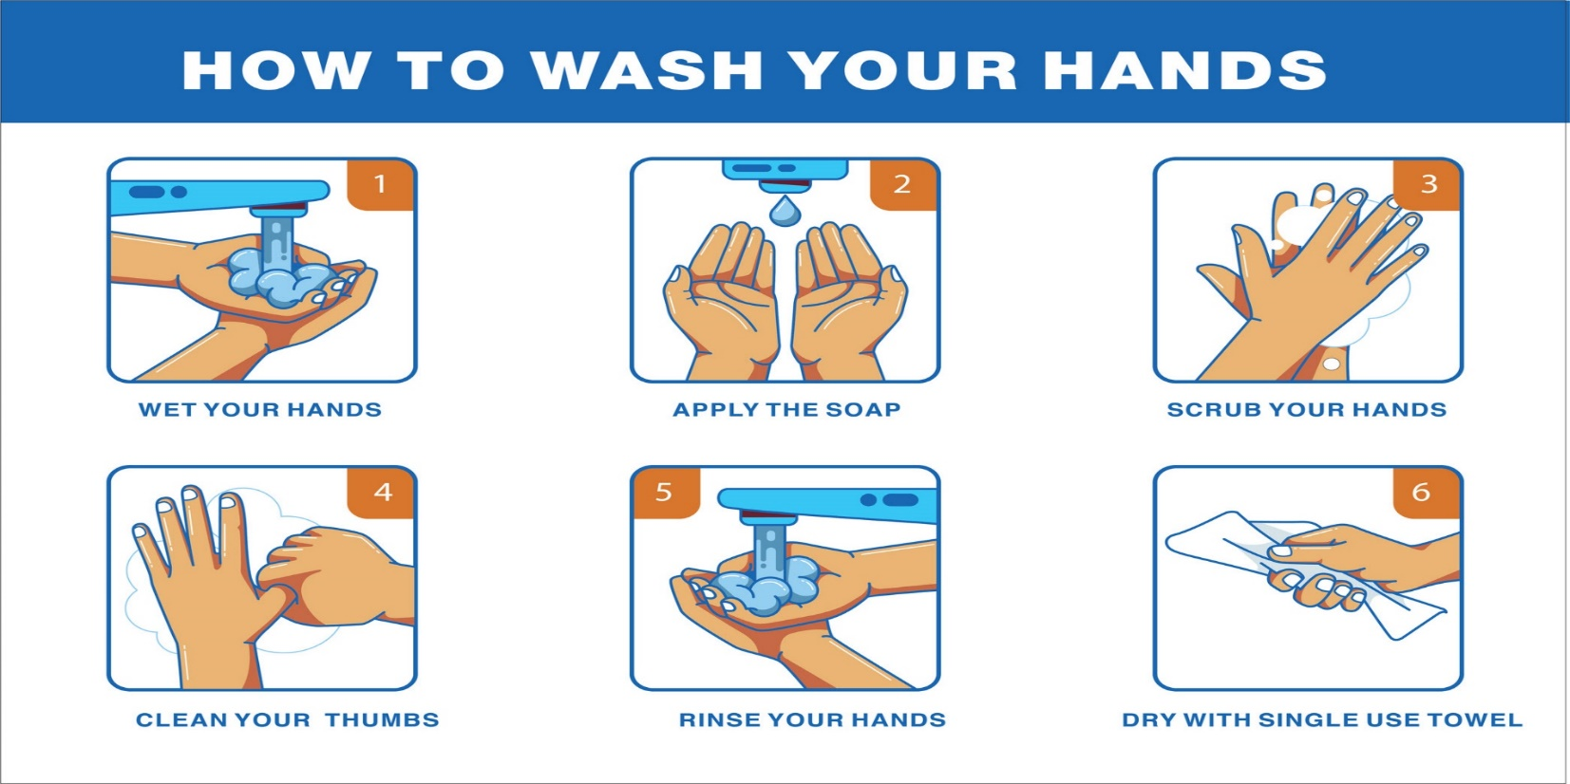
Notes:
Instructor notes: Use this slide as an alternative to the video embedded on slide 15, or as an additional teaching aide.
Wet your hands, apply soap, scrub your hands for 20 seconds including cleaning your thumbs, and always use the towel to turn off the water to avoid contaminating your clean hands.

