Slide 1
Fit Testing N95 Respirators in Health Care Facilities
Kate Durand, MHS
California Department of Public Health
Occupational Health Branch
Regional Trainings on Preparedness for Respirator Use in Health Care Facilities
Spring 2010
Notes:
Now that you have heard all about why health care workers may need to wear respirators during the course of their work and why they need to be fit tested, we will move on to going over how to properly fit test a respirator.

Slide 2
Respirator Standard Requirement
Fit test tight-fitting facepieces:
Make, model, and size that will be used
Prior to use
Annually
When change in make, model, or size
Change in physical characteristic affecting fit
Quantitative or Qualitative
Notes:
You learned earlier why respirators might be required in a health care facility.
You also learned that if an employee is required to wear a respirator that relies on a tight-fitting face-piece, the OSHA respiratory protection standard requires that they be fit tested
They must be fit tested prior to wearing the respirator on the job and on an annual basis.
They must also be re-fit tested whenever they change respirator make, model or size or whenever physical characteristics change significantly to affect fit. This might include a significant change in body weight, facial scarring, loss of teeth, use of dentures, etc. – anything that would change the shape of the face, or affect the seal.
And – in the case of N95s, the standard allows for either a quantitative or a qualitative test.

Slide 3
Quantitative Fit Testing
Measures the concentration of a contaminant in the air and inside the respirator face-piece.
Uses the measurements to calculate a fit factor
Objective but expensive.
Notes:
A quantitative fit test involves actually measuring the concentration of a contaminant in the air and the concentration of the same contaminant inside the respirator face-piece and comparing those two concentrations to come up with something called a fit factor (the amount that the concentration is reduced by wearing the respirator).
This method has the advantage of being completely objective, but it is also very expensive. The instrument we use for quantitative fit testing (called a PortaCount) costs over $10,000. If you have access to one, this is really the best way to go.
In reality, because of the cost, most health care facilities other than large hospitals choose to do qualitative fit testing.

Slide 4
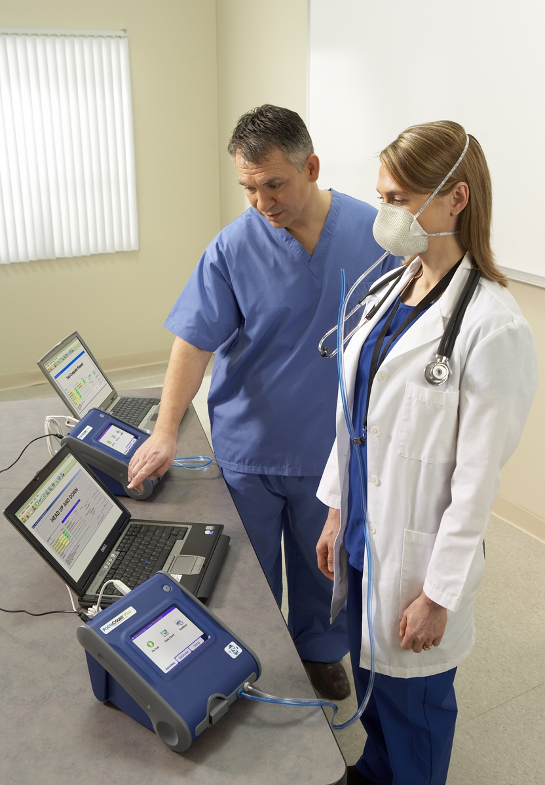
Quantitative Fit Testing in Action
Photo courtesy of TSI, Inc.

Slide 5
Approved Qualitative Fit Tests
Bitrex®
Saccharin
Stannic chloride (irritant smoke)
Isoamyl acetate (banana oil)
Not for use with N95
Notes:
Qualitative fit tests are pass/fail tests based on whether or not the test subject detects a contaminant that is sprayed around the face seal of the respirator inside an enclosure. This is what makes these tests subjective in nature, and therefore, somewhat less reliable than the quantitative test.
There are currently four different qualitative fit test protocols that are approved by OSHA.
The Bitrex® test is the one used most in healthcare facilities and this is the one we will teach you today. It uses an aerosol of Bitrex®, a bitter-tasting chemical, to determine whether or not there is leakage through the face seal of the respirator.
The saccharin protocol is essentially the same as the Bitrex® protocol, although it relies on the sweet taste of saccharin instead of the bitter taste of Bitrex®.
The stannic chloride (or irritant smoke test) is a slightly less subjective qualitative test because the irritant smoke elicits an involuntary cough in test subjects who are exposed to a low concentration of the smoke. However, the involuntary cough is also the reason many people choose not to use this protocol.
The isoamyl acetate protocol is a test that relies on odor, rather than taste. This protocol is designed for fit testing respirators fitted with organic vapor cartridges and cannot be used to fit test filtering face-piece respirators because the filtering face-piece will not remove the isoamyl acetate from the air.

Slide 6
No Facial Hair
Must make sure that there is nothing that interferes with the face to face-piece seal, such as facial hair or glasses.
If so, you must not fit test.
Notes:
Before you fit test anyone, you must be sure that they do not have any facial hair that might interfere with the face to face-piece seal.
Make sure your employer has a policy that deals with the issue of facial hair and workers who may need to wear respirators.

Slide 7
NO EATING, DRINKING, OR SMOKING FOR PRIOR 15 MINUTES
Eating, drinking, or smoking within 15 minutes of being fit tested can affect the test subject’s ability to taste the test chemical.
If they have just eaten lunch – WAIT!

Slide 8
Prepare Nebulizers
Pour about 2 cc of sensitivity solution and fit test solution into corresponding nebulizers.
Screw the tops on
Notes:
The first thing you need to do before you fit test anyone is set up your equipment.
Notice that you have two nebulizers and two different bottles of Bitrex solution on the table in front of you.
I want one of the people in each pair to take the nebulizer that says “Sensitivity Test Solution” in red and the bottle with the red label that says “Sensitivity Solution”
The other person in each pair should pick up the nebulizer that says “Fit Test Solution” in black and the bottle with the black label that says fit test solution.
Each of you should pour about 2 ccs of solution from your bottle into the corresponding nebulizer.
Screw the tops on to the nebulizers.

Slide 9
Bitrex® Protocol
Taste threshold screening
Properly don a respirator you think fits
Fit check (neg or pos pressure)
Don test enclosure (hood)
Expose to test aerosol
Notes:
These are the basic steps involved in the Bitrex® fit test protocol.
First you complete a taste threshold screening to determine the test subject’s sensitivity to Bitrex.
Then you help them to select and properly don a respirator with a good fit.
Then you show them how to do a user fit check, which they should do each time they don a respirator.
They then don the test enclosure and you expose them to the test aerosol.
We will discuss each of these steps in detail as we go through the process of fit testing each other.

Slide 10
Taste Threshold Screening
Don enclosure (hood) – no respirator
Breathe through slightly open mouth, tongue extended
Spray threshold check solution into hood
10 squeezes up to 3 times
If tasted, threshold is 10, 20, or 30
If not tasted, do not use this protocol.
Notes:
The purpose of the taste threshold screening is to determine how sensitive the test subject is to the taste of Bitrex®. Different people will have different taste thresholds and the amount of Bitrex® that you use in the test must be adjusted accordingly. Basically, we don’t want someone to pass the test simply because they cannot sense the taste of the test chemical at the test concentration.
First, ask the test subject to don the enclosure.
Then, instruct them to breathe through their mouth with their mouth slightly open and their tongue slightly extended.
Spray the check solution into the hood with 10 squeezes of the nebulizer labeled “Sensitivity Test Solution”.
If the subject does not taste the Bitrex® , squeeze the nebulizer 10 more times for a total of 20 squeezes.
If the subject does not taste the Bitrex® , squeeze the nebulizer 10 more times for a total of 30 squeezes.
If the subject still does not taste the Bitrex® , you must not use this test protocol for this person.
If the test subject does taste the Bitrex at any time during this test, stop squeezing and note the threshold as either 10, 20, or 30 squeezes.

Slide 11
Selecting a Respirator
There is no one-size-fits-all
Employee must be allowed to choose from several brands and sizes
Must be flexible about purchasing more than one model.

Slide 12
Test
Properly don respirator and adjust for best seal
Fit check
Spray fit test solution into hood (same number of times as taste threshold – 10, 20, or 30)
Perform test exercises
Replenish with half the number of initial sprays every 30 seconds.
Notes:
The next step is to choose a respirator that fits comfortably. Several different brands and sizes of respirators should be made available for this process. When the test subject is choosing the respirator, the fit tester should provide instruction on the proper donning and adjusting of the respirator. The tester should also instruct the user on how to perform positive and negative pressure fit checks to ensure that a good seal is achieved.
Once a respirator has been selected, the test subject dons the respirator and then the enclosure.
Now – everybody be patient. I am going to explain the next couple of steps before we start because once we start, you need to keep moving.
Using the nebulizer with the Fit Test Solution, we will spray into the enclosure the number of squeezes of Bitrex® that was required to elicit a taste response in the taste threshold test.
The test subject will then perform the list of test exercises required for all fit test protocols.
While they are doing this and while you are timing each exercise, you must also replenish the aerosol in the enclosure every 30 seconds by using one half the initial number of squeezes.
.

Slide 13
Test Exercises
Normal breathing – 1 min
Deep breathing – 1 min
Head side to side – 1 min
Head up and down – 1 min
Talking (rainbow passage) – 1 min
Bending over/Jogging – 1 min
Normal breathing – 1 min
Notes:
These are the test exercises that must be performed.
Each of the test exercise shall be performed for one minute, except for the grimace, which is only required for 15 seconds.
When you get to the talking exercise, you may have the test subject read from the rainbow passage that is on the laminated sheet in front of you. This is a standard piece of text that is often used by speech pathologists because it contains every sound in the English language. Alternatively, you may have the test subject recite a memorized poem or count backwards from 100. Just keep them talking for one minute.
If the test subject indicates at any time during the test that they taste Bitrex, stop the test.

Slide 14
Fit Test Exercise Chart

Slide 15
Doffing the Respirator
Think about where there is contamination
Minimize cross-contamination
Do not touch the outside of the filtering face-piece with hands

Slide 16
Test Results
If subject tastes the Bitrex®, test has failed - try another respirator.
Must complete entire protocol, including taste threshold again.
If subject does not taste Bitrex®, test is passed.
Notes:
If the test subject reports tasting Bitrex® any time during the test, the fit test has failed and the subject must choose another respirator and repeat the entire protocol, including the taste threshold test.
If the subject completes the fit test exercises without detecting Bitrex® , the test is passed and the brand and size of respirator should be recorded for that user.
If a user will have the possibility of wearing more than one brand of respirator because of shortages, etc., they must pass a fit test with each respirator that they will use.
If an employee is unable to pass a fit test with any of the available brands or sizes of respirator, they must not wear a respirator that relies on a tight-fitting face-piece.

Slide 17
Recordkeeping
Employer must keep a record of:
Name or ID of employee tested
Type of fit test performed
Specific make, model, size of respirator tested
Date of test
Pass/Fail result
Notes:
The respiratory protection standard also requires that employers keep records of fit tests for all employees wearing respirators.
You must record the name or ID number of the employee, the type of test performed, the respirator that was tested, the date of the test, and whether or not the subject passed or failed. If a quantitative test is performed, you must keep the strip chart recording or other record of the measured fit factor.
The record of the fit test must be kept until another fit test is performed.

Slide 18
Questions?
Is there any part of the protocol you do not understand?
Will you be able to go back and do this at your facility?

